Slide 1
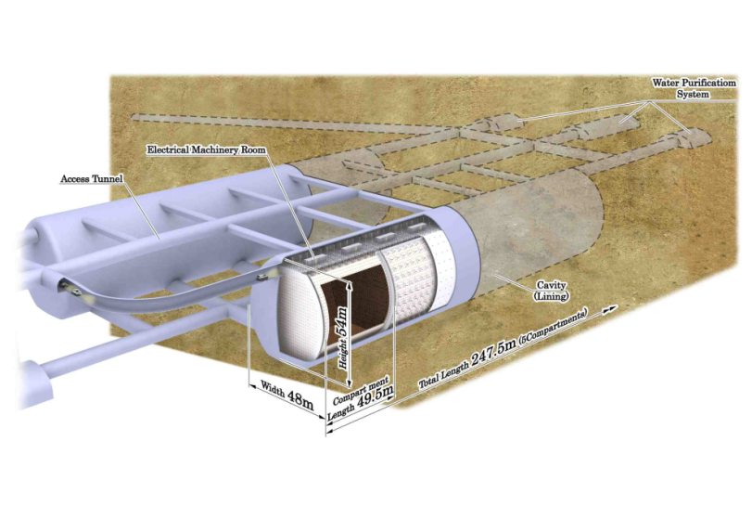
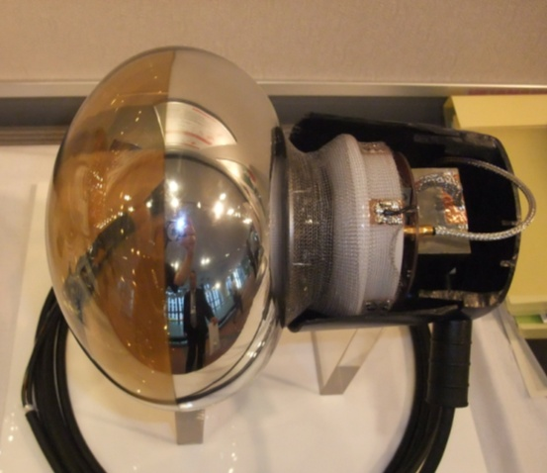
Development of hybrid photomultiplier for Hyper-Kamiokande
Akimichi TAKETA¹, Yasuhiro NISHIMURA²
for Hyper-K working group
¹ERI, The University of Tokyo
²ICRR, The University of Tokyo

Slide 2
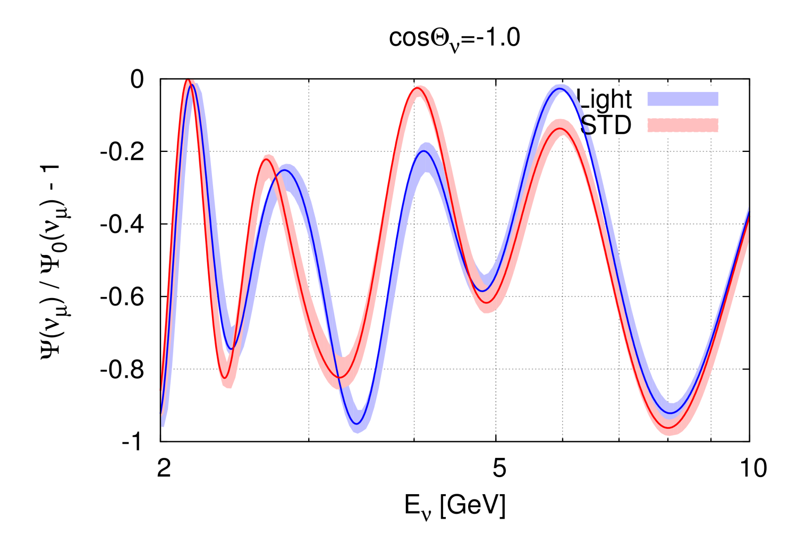
Purpose: Earth composition measurement
Hyper-K will measure atm-ν oscillation
Oscillation probability depends on electron density, not matter density
By using neutrino oscillation, we can measure the electron density of the medium
  If sterile neutrino does not exist
We have the precise matter density of the earth
  From seismic wave tomography and free oscillation
  They are not direct observation of matter density
Combining matter density and electron density, we can measure the average chemical composition of the deep earth !
  Ratio of atomic number to mass number (Z/A)
Energy and angular resolution is essential for this study
Notes:
ポンチ絵

Slide 3
HPD (Hybrid Photo Detector)
PMT
HPD
Typical values in 8-inch HPD prototype
Metal dynode
Avalanche Diode (AD)
Amp
ｅ
ｅ
ｅ
Amp gain
X ~200
Bombardment gain
ΔV
~ -260V
1-2kV
x ~ 5
~8kV
 | PMT (20”) | HPD (8”)
HV | 1-2kV | ~8kV
Gain | ~10⁷ | ~10⁴ - 10⁵
C.E. | ~70% | ~97%
Bombardment gain
x ~400
AD gain
x ~100
High voltage around 10kV is required
to collect electrons in small region of AD (~5-10mm)
to increase gain at electron-bombardment
Same photo cathode (Q.E.)
High performance and low cost : better PID and angular resolution
Difficulties to consider viability for practical use in Hyper-K
  Dark noise from AD + Amp., HV around 10kV, low gain,
  thermal dependence of AD gain, No prior experience using

Slide 4
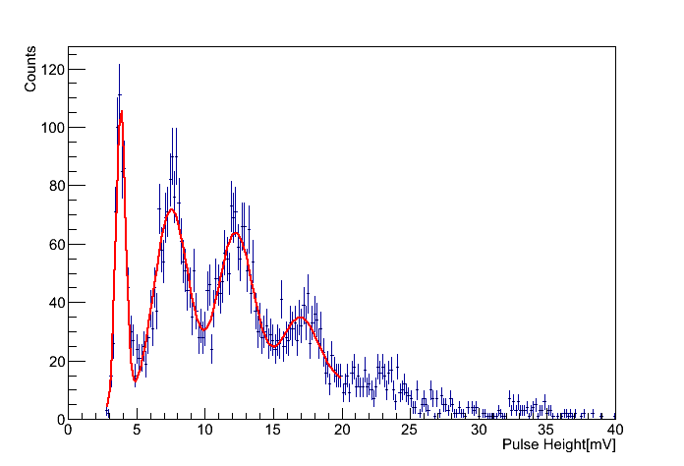
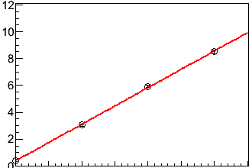
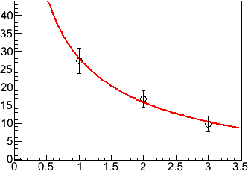
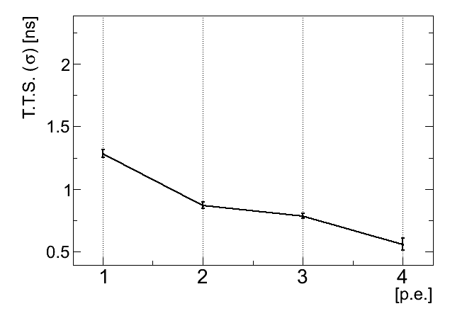
Basic performance of HPD prototype
Pulse height distribution
Amplitude [mV]
Linearity
Charge
[pC]
1 p.e.
2 p.e.
up to 3 p.e.
3 p.e.
σ[%]
σ [%]
Time Transition Spread (TTS) [ns]
photo electrons (p.e.)
Signal timing
of 1 - 4 photons
(With 70m cable)
Intrinsic resolution of only HPD
620 ps σ /p.e.
All results are preliminary by HPD prototype.

Slide 5
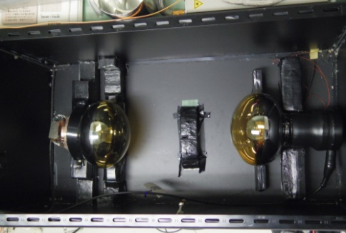
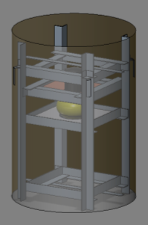
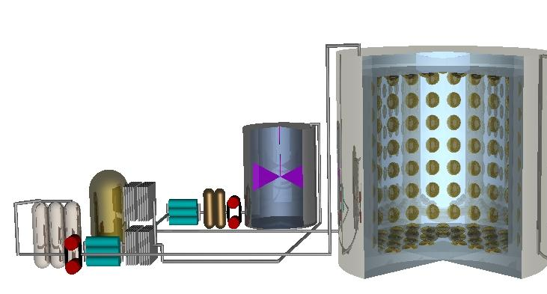
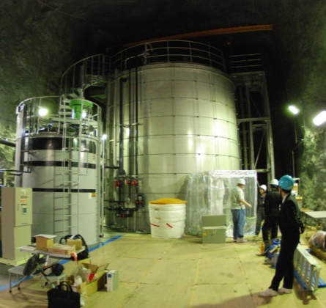
Overview of HPD study
Development of HPD
with Hamamatsu photonics
Safety test
in water
8” HPD
(8” PMT)
Proof test in EGADS tank (2013 - )
Calibration (March 2013)
Replaced to 8 of 8-inch HPDs
Gain adjustment
of 10 HPDs
200t tank
20” PMTs x 240
7 m
Pre-treatment system
Precise performance
evaluation
2 HPDs are
evaluated in detail.
0.2% Gd water
in 200 ton water tank
Evaluating Gadolinium’s Action on Detector Systems
→ Finally test 20” HPD in 200t tank based on 8”HPD R&D

Slide 6
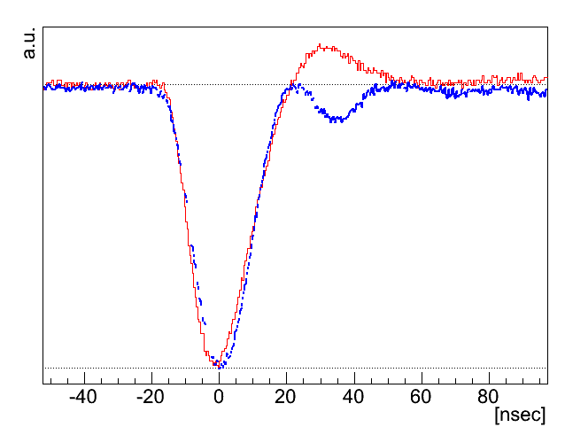
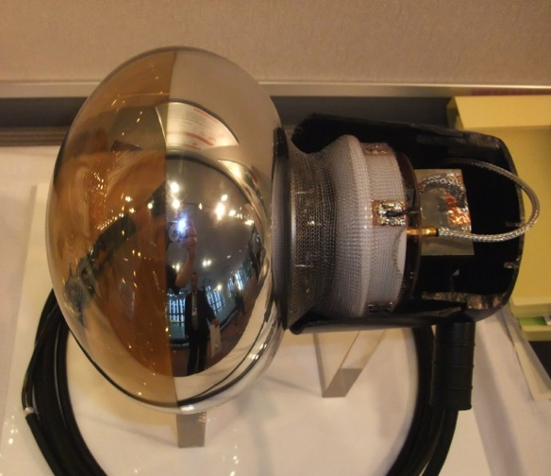
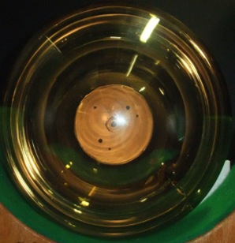
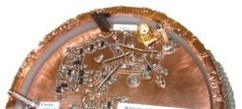
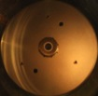
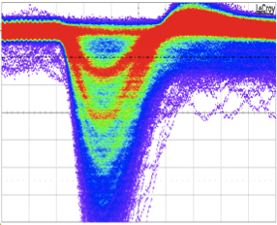

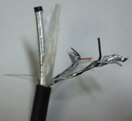
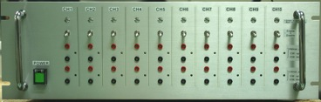
8-inch HPD
Signal
HPD(8-inch)
PMT(20-inch)
30cm
8-inch photocathode
Preamp
(under development)
High voltage module
(2ch 10kV/500V Max)
項目 | 値
感度波長範囲 | 300 ～ 650 nm
光電面 | バイアルカリ
面板材質 | 硼珪酸
２次電子増倍方式 | 半導体電子打ち込み式
ターゲット半導体 | 5mmφアバランシェダイオード
20cm
Amp out
AD out / Amp in
Signal from amplifier
Range of sensitive wavelengths |  | 300 - 650 nm
Typical voltage | Photocathode | 8 kV
 | AD bias | 260 V
Gain |  | 4ｘ10⁴
Single-photon resolution（σ） |  | 20 %
Transition time spread（σ） |  | 620 ps
5mm φ
avalanche diode (AD)
LV
10V
10 mV
Signal
Hamamatsu Photonics
Cable
1 p.e.
rise / fall
8 / 16 ns
Pulse width
: 18ns
I-V amp.
（+8kV - ΔV）
AD
20 ns
filter
Inst.
amp
100 ns
（+8kV）
filter
Coaxial
Control
10ch control power supply
No HV line in water!
LV PS
HPD
cable in water

Slide 7
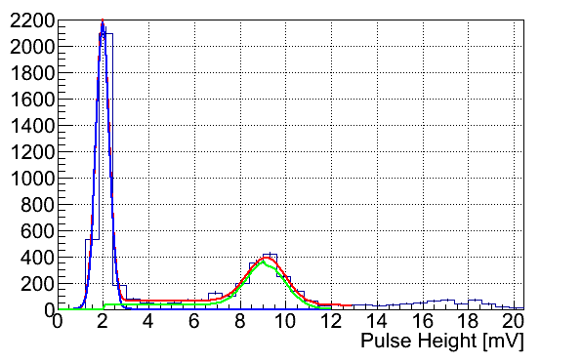
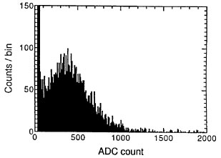
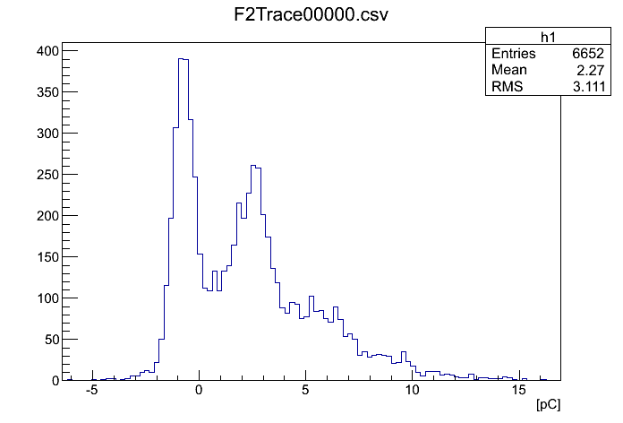
Hit threshold and efficiency
0.25 p.e. threshold is set for 1 hit at Super-K (20” PMT)
1 photon events
pedestal
8” HPD
← pedestal
20” PMT
Fitting function
and each component
1 p.e.
Ex trigger
1 p.e. signal
0.25p.e.→
1 p.e.→
0.25p.e.
Better trigger efficiency is expected thanks to narrow 1 p.e. peak at 8” HPD.
  Even if threshold is higher than 0.25 p.e.
Calibration setup and gain, threshold optimization in Feb 2013.
Purity[%]
= {Sig. /(Sig. + Ped.)}
(>threshold)
Trigger efficiency [%]
Signal efficiency[%]
= Sig.(>threshold)
/ Sig.(All)
Threshold [mV]

Slide 8
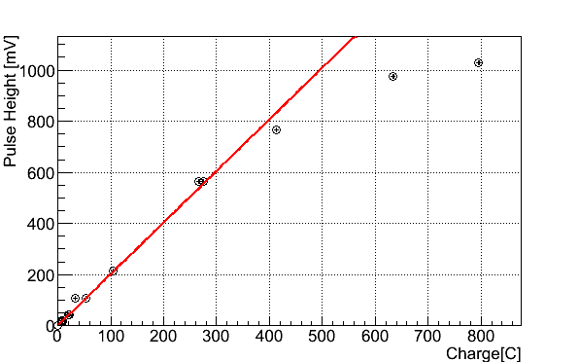
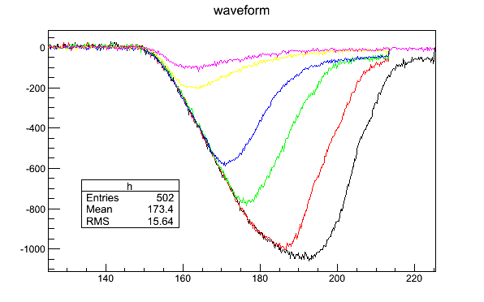
HPD performance
Dynamic range is wide by HPD itself, but limited by amplifier currently mounted on 8”HPD.
  3-60mV/p.e. from 8” HPD
  Linearity up to ~600mV
    < ~200p.e.
    Sufficient if amplitude gain
    is same as SK-PMT.
  Amplifier will be developed continuously.
P/V ratio and TTS σ is limited by Amplifier
  Intrinsic noise
  Trans impedance problem
Pulse height - charge
~600mV

Slide 9
Potential problem of 20-inch HPD
I-V amp.
（+8kV - ΔV）
AD
filter
Inst.
amp
（+8kV）
filter
Larger Parasitic capacitance of AD leads:
  worse frequency response
  depends on I-V gain (= amp impedance)
If we reduce impedance
  We will loose gain = P/V ratio, TTS σ
  Inst-amp cannot recover this loss because of current noise density. (It’s floating measurement)

Slide 10
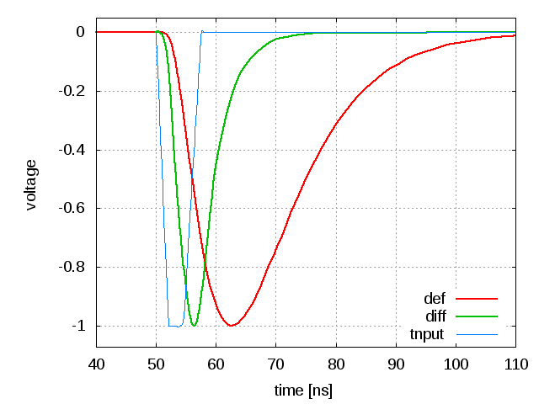
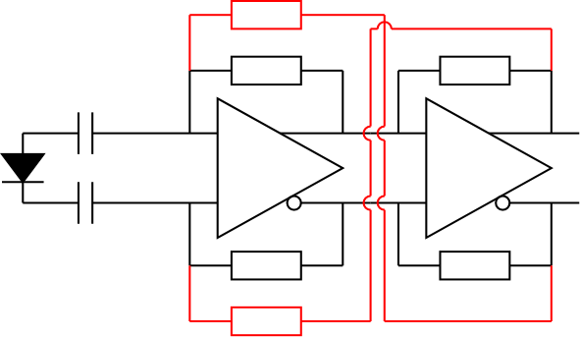
Possible solution
Low impedance of 1st full differential amp
  Parasitic capacitance is negligible
  Better frequency response
Multiplex return
  Reduce trans-impedance amplifier noise
Single power supply (+5V)

Slide 11
Current status (concludion)
Production of ten 8-inch HPDs has finished. for proof test in 200t tank.
  Long time running, durability of HV switching and safety operation in water were checked.
  Quality test was finished
  Proof test will start in this summer
1st 20-inch HPD will be produced in this year
Jan
Feb
Mar
Apr
2013
2015
2016
2014
20”HPD R&D
Durability test
Test
Installation
Relative to 20”PMT,
trigger performance,
durability, stability,..
8”HPD R&D
1
2
3
8
200 t
Proof test ( tank )
Calibration
2
Ten 8” HPD production
Performance evaluation
Uniformity,
band width, rate tolerance, thermal・B-field dependence, dark rate..

