Slide 1
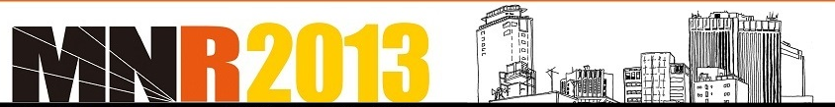
Scanning Microscope
for muon radiography
with nuclear emulsion
Cristiano Bozza¹, Lucia Consiglio², Nicola D'Ambrosio³,
Giovanni De Lellis⁴, Chiara De Sio⁵, Natalia Di Marco³,
Umut Kose⁶, Eduardo Medinaceli⁷, Seigo Miyamoto⁸,
Ryuichi Nishiyama⁸, Fabio Pupilli³, Simona Maria Stellacci¹,
Chiara Sirignano⁷, Paolo Strolin⁴, Hiroyuki Tanaka⁸, Valeri Tioukov²
University of Salerno and INFN¹, INFN Napoli², INFN / LNGS³,
University of Napoli and INFN⁴, University of Salerno⁵,
INFN Padova⁶, University of Padova and INFN⁷, University of Tokyo⁸

Slide 2
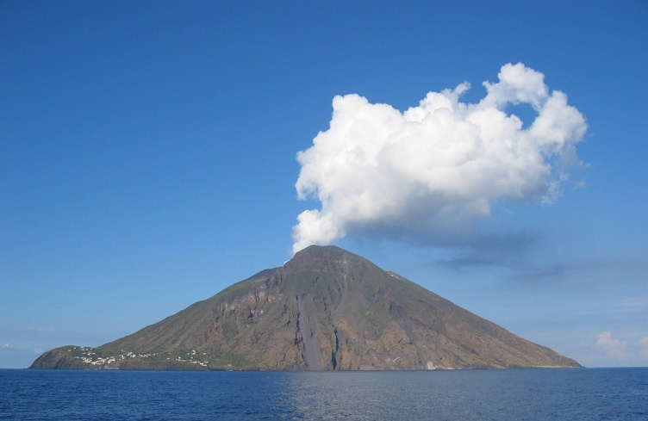
Scanning Microscope
for muon radiography with nuclear emulsion
Nuclear emulsion detectors for muon radiography
Detectors are made of stacked emulsion films
μ
μ
e⁺e⁻
e⁺e⁻
e⁺e⁻
Emulsion has no time resolution, no trigger: all tracks are recorded
Emulsion films record hard tracks as well as soft tracks
3D information available for each track: momentum discrimination and/or particle id. possible!

Slide 3

Scanning Microscope
for muon radiography with nuclear emulsion
Nuclear emulsion images
AgBr gel
Charged particles ionize Ag atoms (stochastic process), producing the latent image
Metallic Ag grows in filaments during development
1 μm
With green-white light the average λ is 600 nm: the filaments cannot be resolved because
of diffraction
“Grains” = clusters of filaments

Slide 4
Scanning Microscope
for muon radiography with nuclear emulsion
Looking at emulsion films: basic optical setup
CMOS sensor
Objective lens
(or lens system)
Illuminated spot
Emulsion film
Plastic base
Condenser lens
Lamp (optionally w/ filters)
White, green or blue

Slide 5
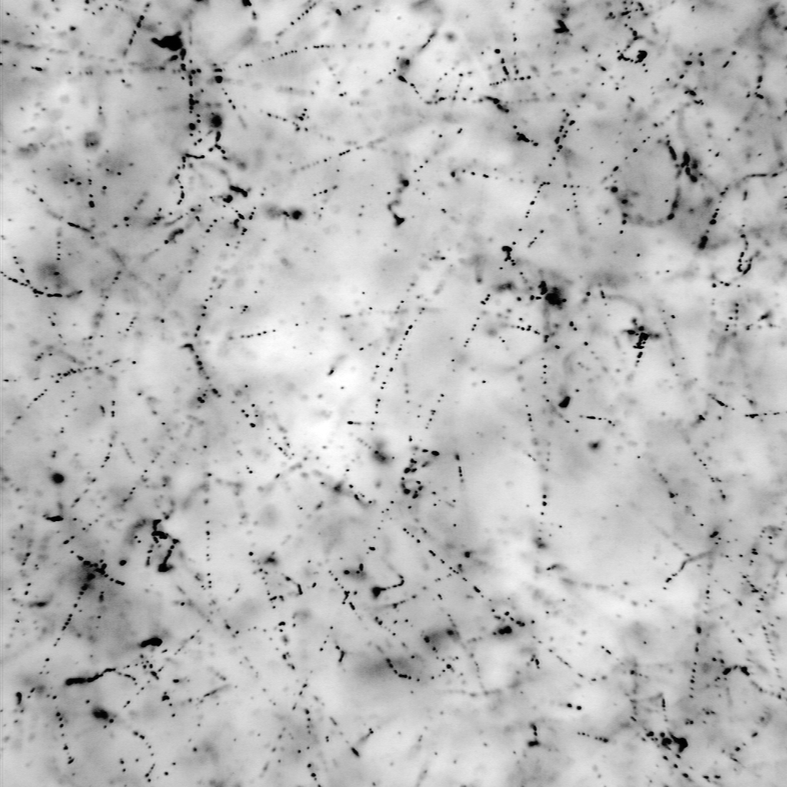
Scanning Microscope
for muon radiography with nuclear emulsion
Nuclear emulsion images
Imaging by objective + camera: the spatial density of metallic Ag is folded with the PSF
(point-spread function), characterizing the optical setup
Ψ(x,y,z)
Out of focus
Focal
plane
Out of focus
Depth of field: ~3 μm
Typical grain size after development: 0.2÷1 μm
(0.5 μm in the case shown in this talk)
50 μm
Grains in emulsion image: high-energy tracks, electrons, fog (randomly developed grains,
not touched by any ionizing particle)

Slide 6
Scanning Microscope
for muon radiography with nuclear emulsion
Nuclear emulsion images
Grain images are not uniform, and depend more on the neighborhoods than on the
features of grains themselves
Finite depth of field: grains out of focus can be seen
Shadow effect: grains stacked one on top of the other on the focal axis look darker (bigger)
Highly ionizing particles: grains may be so close they cannot be resolved
A “hole”: no doubt the charged particle passed there, but it just did not ionize!

Slide 7
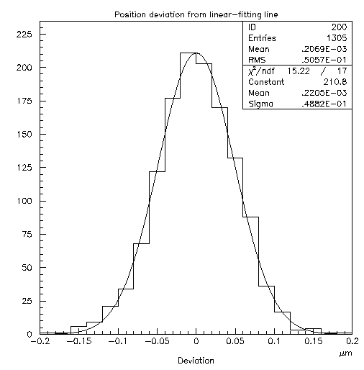
Scanning Microscope
for muon radiography with nuclear emulsion
Nuclear emulsion images
3D tomography:
change focal plane
Alignment residuals of track grains: 50 nm in optical microscopy!
Good precision helps rejecting random alignments and thus increasing signal/background ratio

Slide 8
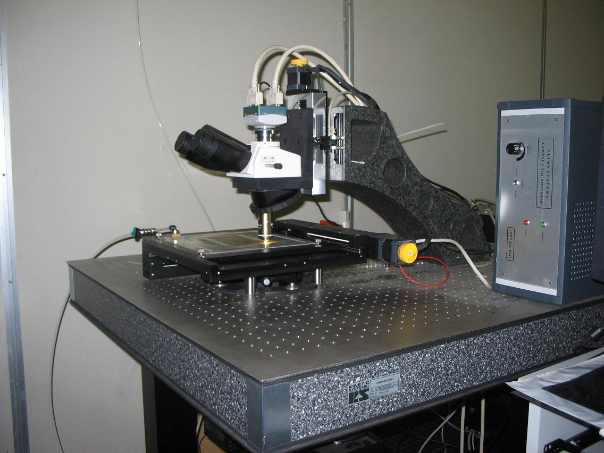
Scanning Microscope
for muon radiography with nuclear emulsion
The European Scanning System (ESS)
Developed for OPERA, used in all European laboratories
Also installed at Tokyo ERI
Scanning speed: 20 cm²/h/side
Z stage (Micos)
0.05 μm nominal
precision
CMOS camera
1280×1024 pixel
256 gray levels
376 frames/sec
(Mikrotron MC1310)
Emulsion Plate
XY stage (Micos)
0.1 μm nominal
precision
Illumination system, objective (Oil 50× NA 0.85)
and optical tube (Nikon)

Slide 9

Scanning Microscope
for muon radiography with nuclear emulsion
The ESS: working principles
Tomographic sequences
Z axis moving, 2D images
spanning emulsion thickness
280×365μm²
Next field of view,
Z at top, new cycle
DAQ cycle
(185 ms)
Process/save data
Move XYZ to next view
Camera
Vision Processor
(Matrox Odyssey)
Host PC
(Dual Pentium
Workstation)
Running
WinXP
2D Images
(peak 452 MB/s,
avg. 97 MB/s)
Binarized
2D Images
Motors
(VEXTA
Nanostep)
Motion Controller
(National Instruments
FlexMotion)
Grains
XYZ Motion
Commands
Power
Functional blocks

Slide 10

Scanning Microscope
for muon radiography with nuclear emulsion
The ESS:
Image processing
(SySal2000)
15 images
10 grains signal/image,
3000 grains background+
noise, shadows, scratches, spots
2D FIR Filter+
Equalization+
Threshold
Grain recognition
(Host PC, multithreaded
Assembler code)
3D microtrack reconstruction
(Host PC or tracking servers,
multithreaded C++ code)
300 ÷ 3000 microtracks / view

Slide 11
Scanning Microscope
for muon radiography with nuclear emulsion
The ESS: Tracking
(SySal2000)
Tracking: recognition of aligned sequences of grains in 2D images
(microtracks)
Highly optimized algorithm to
deal with big combinatorial
complexity
Parallel processing: can use up
to 8 processors/cores per machine

Slide 12
Scanning Microscope
for muon radiography with nuclear emulsion
The ESS: Tracking (SySal2000)
ScanGrid: use powerful machines dedicated to on-line tracking/computing and simplify the architecture of data-taking
Grains
Other info
(setup, monitoring)
tracks
Installation in Salerno: 70 tracking cores shared by 4 microscopes
Installation at LNGS: 80 tracking cores shared by 10 microscopes
Automatic load balancing (different quality of emulsion requires different processing power)

Slide 13
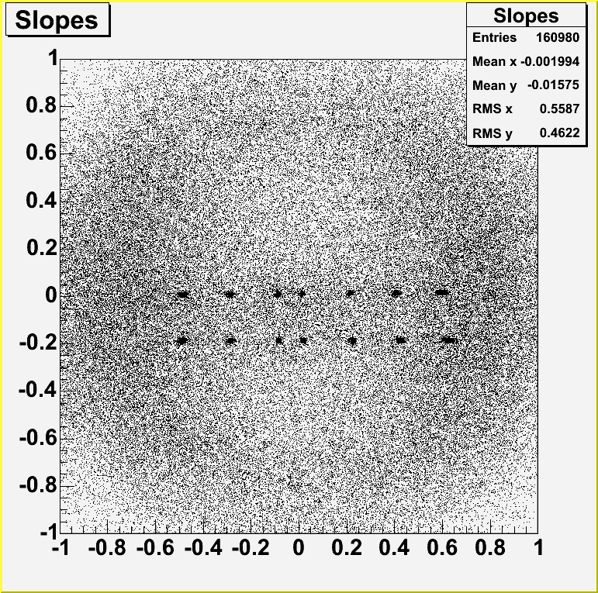
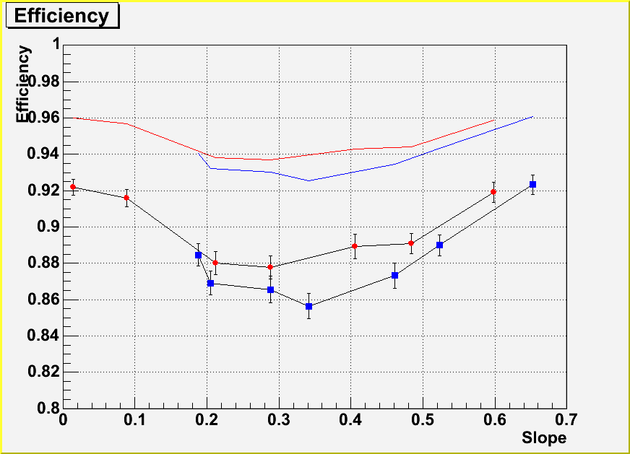
Scanning Microscope
for muon radiography with nuclear emulsion
The ESS: current performances
Tests on 8 GeV/c pion beams
Microtrack
Base-track
Sy = 0
Sy = -0.180
Notice: efficiency depends on emulsion quality!!!

Slide 14
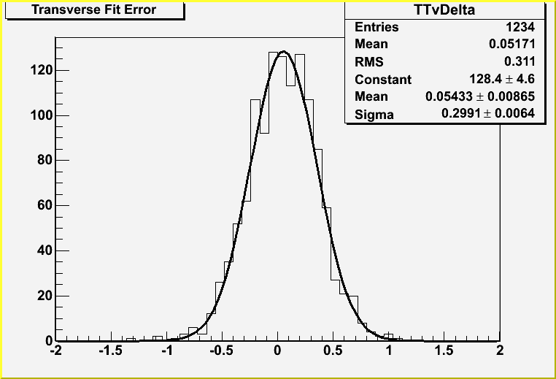
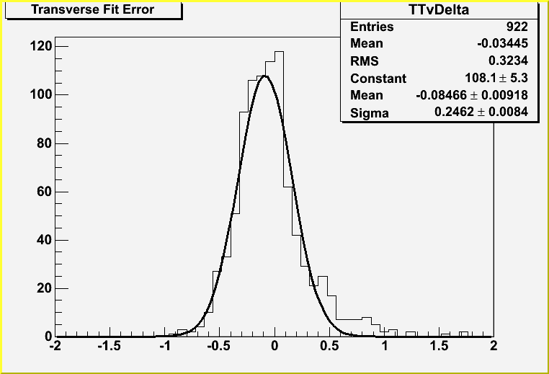
Scanning Microscope
for muon radiography with nuclear emulsion
The ESS: current performances
Precision of film-to-film track connection
Sx = 0.025
Sy = 0
Sx = 0.600
Sy = -0.180

Slide 15
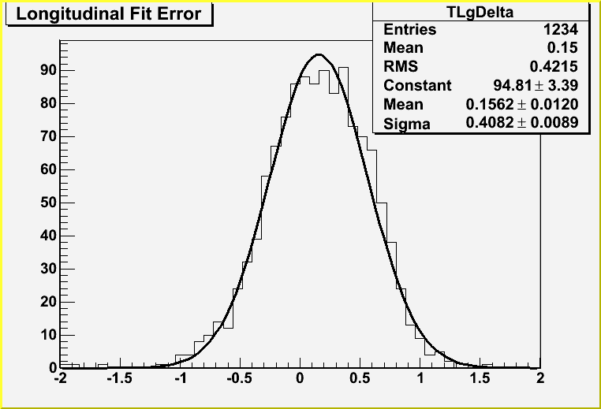
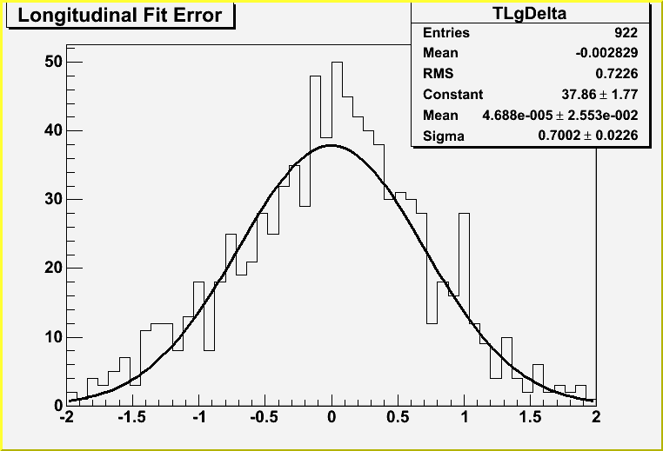
Scanning Microscope
for muon radiography with nuclear emulsion
The ESS: current performances
Precision of film-to-film track connection
Sx = 0.025
Sy = 0
Sx = 0.600
Sy = -0.180

Slide 16
Scanning Microscope
for muon radiography with nuclear emulsion
The Quick Scanning System (QSS): evolution of the ESS
Increase scanning speed: enable using larger areas
⇒ higher statistics
improve signal/background ratio
improve sensitivity to flux variations
improve sensitivity to density variations
Increase sensor size (area scanned at each tomographic sweep)
Increase grabbing speed
Increase processing speed
Reduce dead time due to motion
Keep data quality high:
low number of fake tracks ⇒ effectively discriminate electrons from muons
good precision ⇒ effectively discriminate electrons from muons
high efficiency ⇒ increase data rate/unit area
(with triplet or quadruplet stacks, microtracking efficiency suppresses statistics with at least the 6th power!)

Slide 17
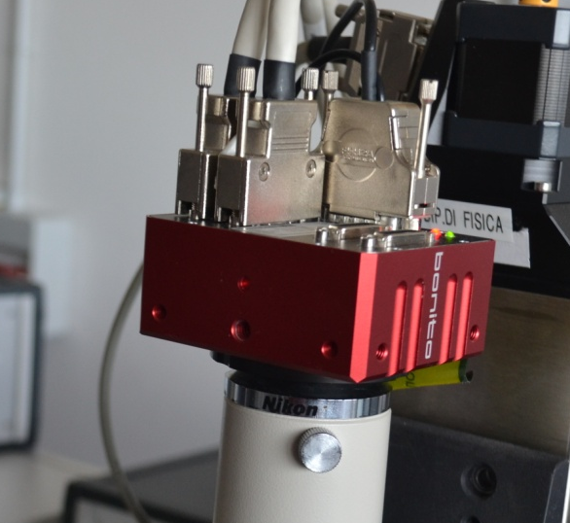
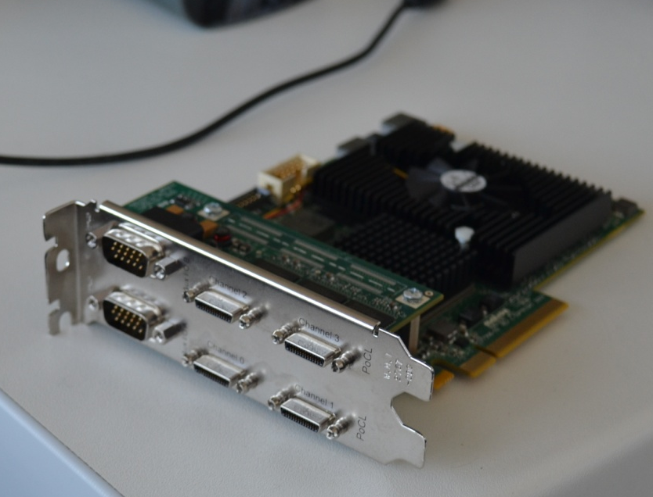
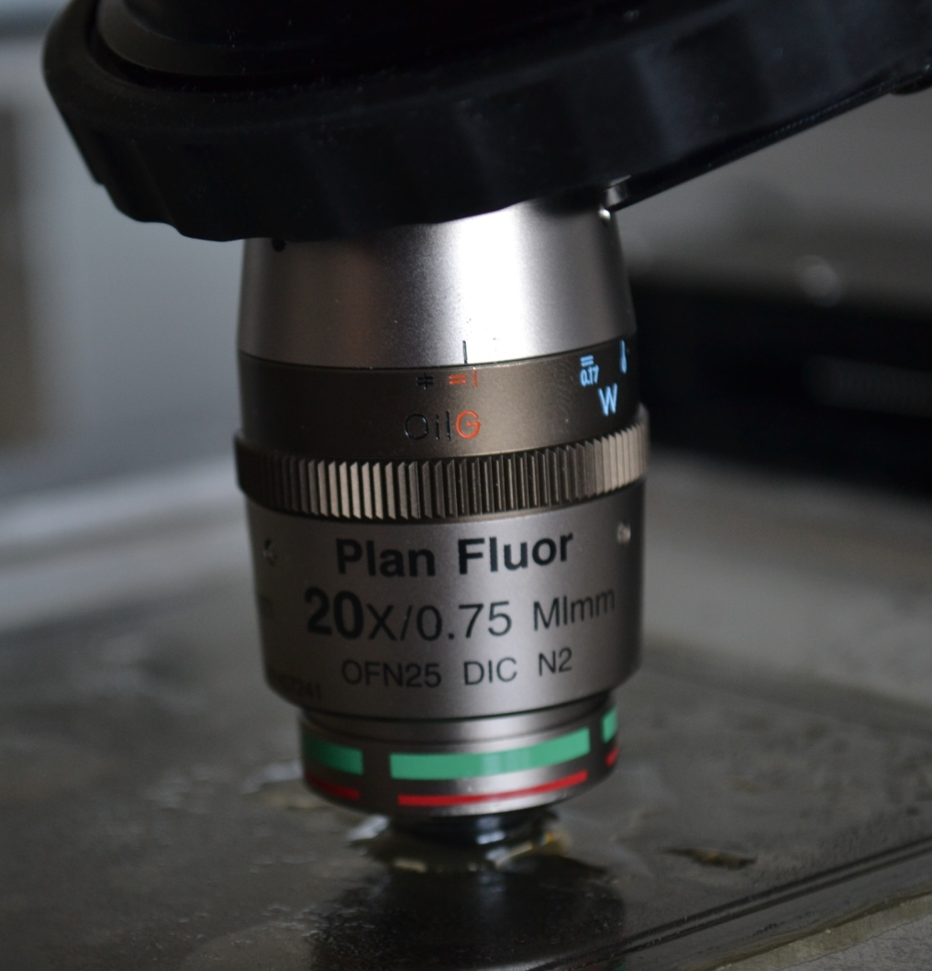
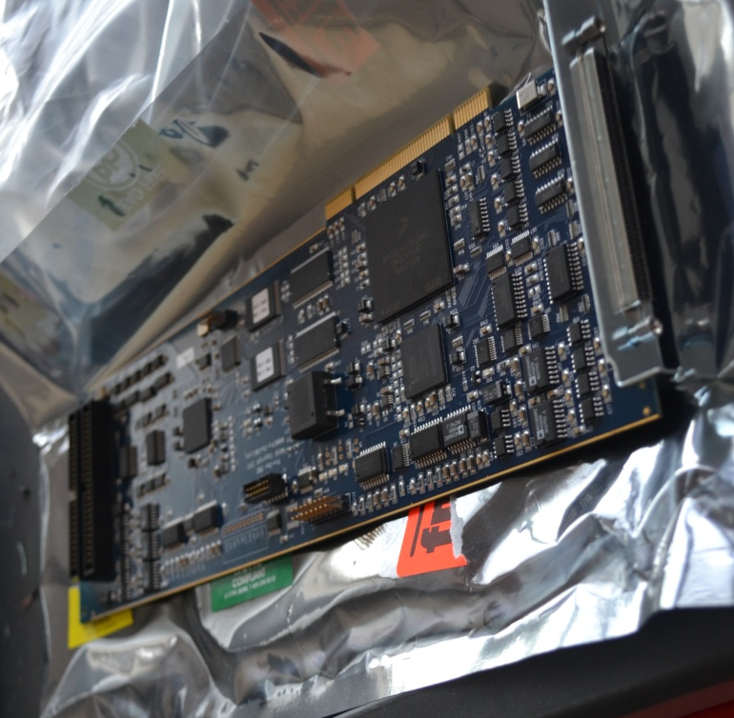
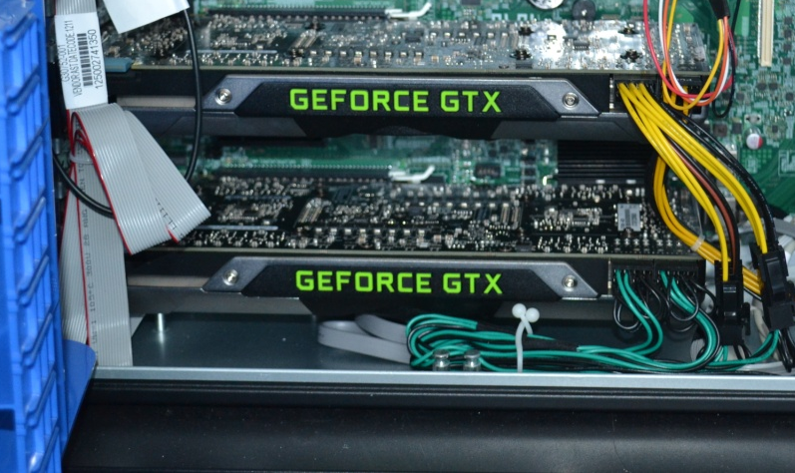
Scanning Microscope
for muon radiography with nuclear emulsion
The QSS
Same mechanics, new hardware
Double CL frame grabber (Matrox Radient)
New optics (20×)
4 Mpixel camera, 400 fps
Image processing and tracking by GPU
New motion control unit
Pro-Dex MAXk

Slide 18
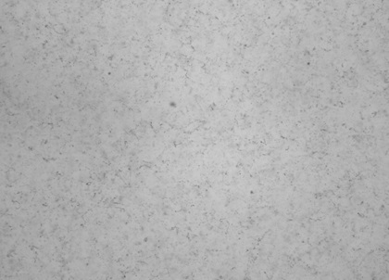
Scanning Microscope
for muon radiography with nuclear emulsion
The Quick Scanning System (QSS): evolution of the ESS
Z motion, 2D images
read and processed on-the-fly
(vision processor in host PC)
“Stop’n’go”
“Continuous motion”
X axis travels at constant speed
2D images read and processed on-the-fly (GPU in host PC)
Dead time due to motion is reduced

Slide 19
Scanning Microscope
for muon radiography with nuclear emulsion
The Quick Scanning System (QSS): evolution of the ESS
Steps for track reconstruction
Dark pixel clustering
GPU
View-to-view alignment by chain pattern matching
GPU
Image-to-image alignment (same view)
GPU
Microtrack recognition
GPU
Chains of clusters
(1 chain = 1 or more grains)
GPU
Base-track linking (uses standard SySal.NET linking)
CPU

Slide 20
Scanning Microscope
for muon radiography with nuclear emulsion
The Quick Scanning System (QSS): evolution of the ESS
Image-to-image alignment
1 ms stage sampling loop on XYZ (does not require piezodrive)
Image distortion corrections
XY curvature
Z curvature
Z axis slant
(X and Y)
XY Trapezium
Magnification vs. Z

Slide 21
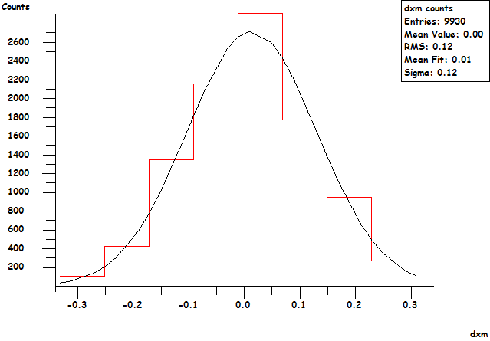
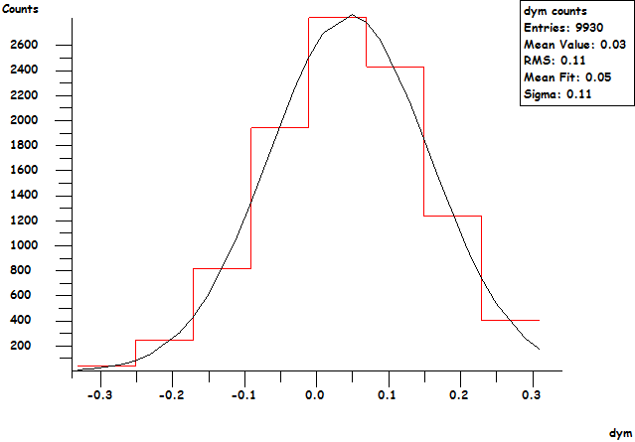
Scanning Microscope
for muon radiography with nuclear emulsion
The Quick Scanning System (QSS): evolution of the ESS
Image-to-image alignment results
μm
μm
XY precision: 0.12 μm

Slide 22
Scanning Microscope
for muon radiography with nuclear emulsion
The Quick Scanning System (QSS): evolution of the ESS
View-to-view mapping:
discard duplicated grains in overlap
region and correct misalignments
due to stage motion
3D track recognition:
Microtracks: sequences of aligned grains (230 nm tolerance on X/Y, 2 μm on Z)
recognized in the whole scanning volume
GPU-based tracking server (2× NVidia GTX690) – 3072 CUDA cores/microscope

Slide 23
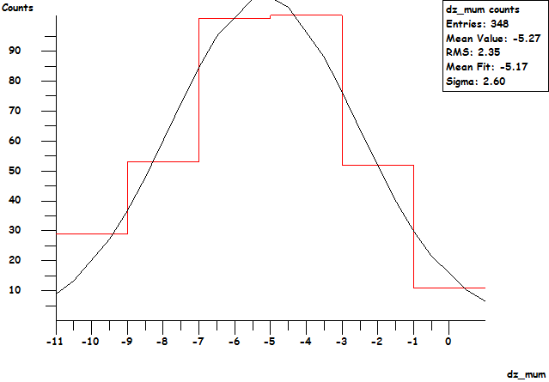
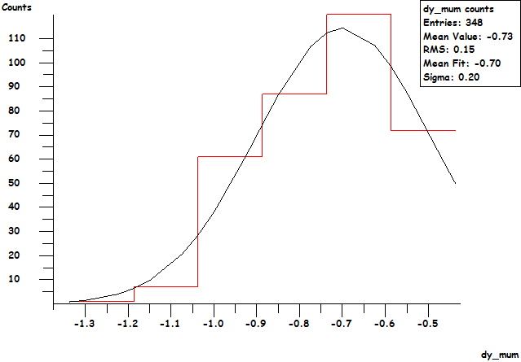
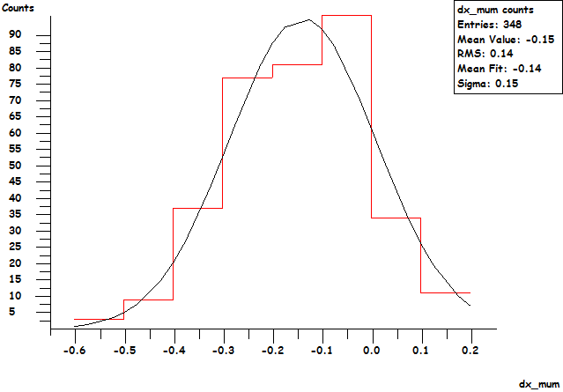
Scanning Microscope
for muon radiography with nuclear emulsion
The Quick Scanning System (QSS): evolution of the ESS
View-to-view 3D pattern matching
Recovers transverse vibrations and XYZ sampling errors (allows microtracking across views)
Merges chain duplicates in overlap volume (prevents excess microtracks)
μm
μm
Z precision: 2.6 μm
μm
XY precision: 0.2 μm

Slide 24
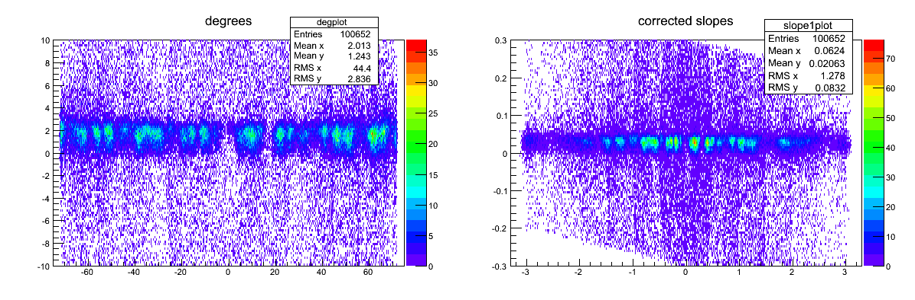
Scanning Microscope
for muon radiography with nuclear emulsion
The Quick Scanning System (QSS): evolution of the ESS
Tracking on test films exposed to large angle beams
Preliminary!

Slide 25
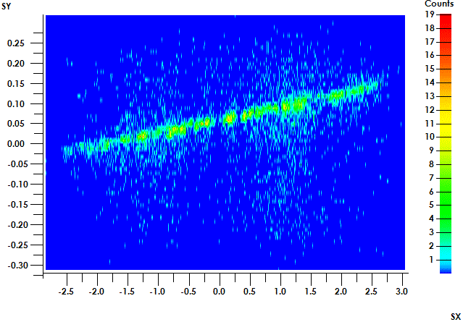
Scanning Microscope
for muon radiography with nuclear emulsion
The Quick Scanning System (QSS): evolution of the ESS
Tracking on test films exposed to large angle beams
Preliminary!

Slide 26
Scanning Microscope
for muon radiography with nuclear emulsion
The Quick Scanning System (QSS): evolution of the ESS
The scanning speed is 41 cm²/h with 31 layers, 58% view travel, 200 fps operation
This should ensure maximum signal/noise ratio
Depending on conditions, it is possible to speed up the system with minimal changes (tuning quantities in the parameter form)
31→21 layers (glued emulsions, low fog) ⇒ 64 cm²/h (tested)
+ 58%→75% view travel (8 core CPU) ⇒ 85 cm²/h (technically tested)
+ 200→400 fps ⇒ 120 cm²/h (estimated)
For future applications, having low fog emulsion will in general improve the performances (fewer layers needed for high efficiency, low combinatorial background)
Cost of the upgrade from ESS to QSS: about 20 k€!

Slide 27
Scanning Microscope
for muon radiography with nuclear emulsion
Conclusions
The ESS is an established technology that provides the performances needed for muon radiography
Film-to-film connection at micrometric level (slope accuracy of the order of 10 mrad is
easily achieved)
The ESS has been used for Unzen and Stromboli data readout
The QSS is the upgraded project that is approaching its first stage (2× speed) with cheap
hardware upgrades
Outlook: 6× speed increasing just the number of GPU’s (4 × 600 €)
Stay tuned for first applications of the QSS in muon radiography!

