Slide 1
Nuclear emulsion: the review of the recent observations and the development of technologies
Seigo Miyamoto
On the behalf of every emulsion users and developers
Notes:
I will talk about the recent observation and the development of technologies about nuclear emulsion

Slide 2
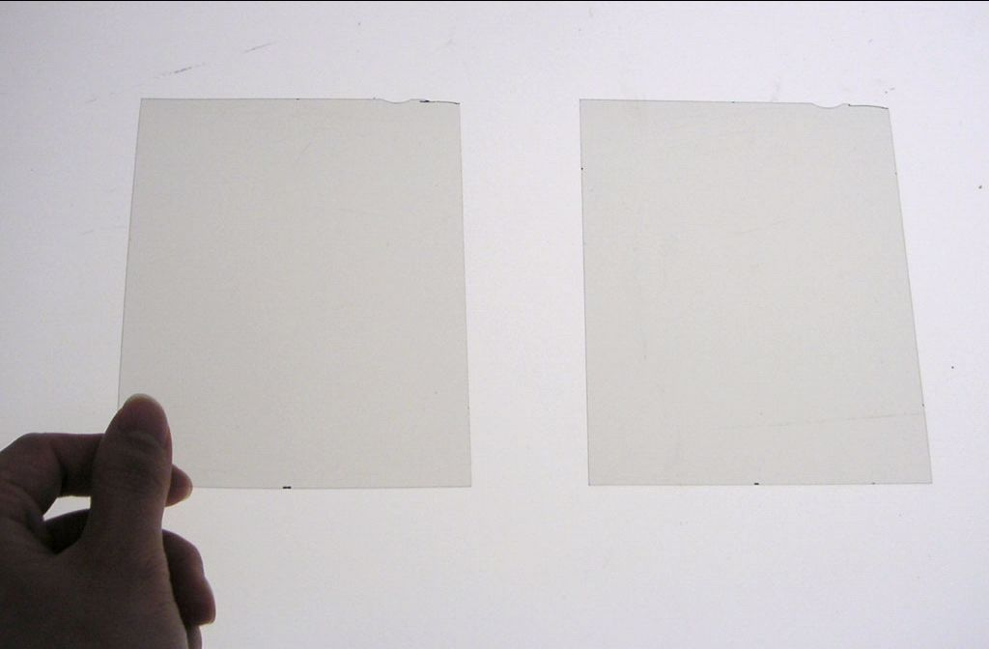
Detector : Nuclear emulsion film
Notes:
This is the picture of emulsion films after development. Let say Nega film.
It seems no image in this film.

Slide 3
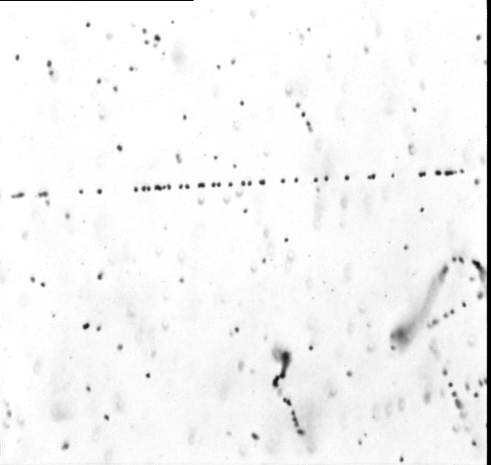
Detector : Nuclear emulsion film
150 micron
microscopic image
No power supply
Compact
Good stability for hard environment, except > 30 ℃
The real-time monitoring is not available
→Need development and scanning by automated readout system
Recorded as silver grains
along the line particle passed through
Notes:
This is the microscopic view of emulsion film.
The grains along this straight line is the trajectory of the muon
We can detect the muon track with the position resolution is less than 1 micron.

Slide 4
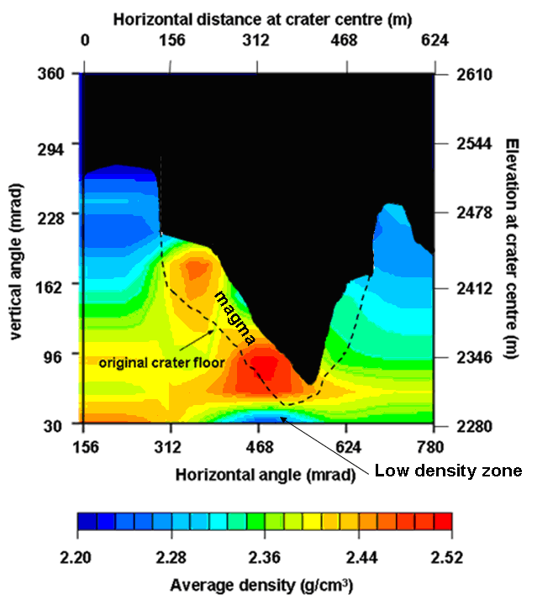
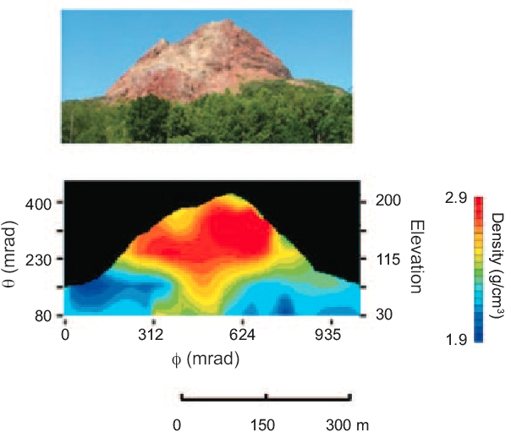
Break through in 2006
Tanaka and Nakano et al., 2007
Notes:
The image of density profile on Mt. Asama and Showa-shinzan in nuclear emulsion.
These works were done by Tanaka from University of Tokyo and Nakano from Nagoya university.

Slide 5
Recent observations and going-on projects by emulsion detectors
Notes:
Let me introduce the recent observations and going-on projects by emulsion detectors

Slide 6
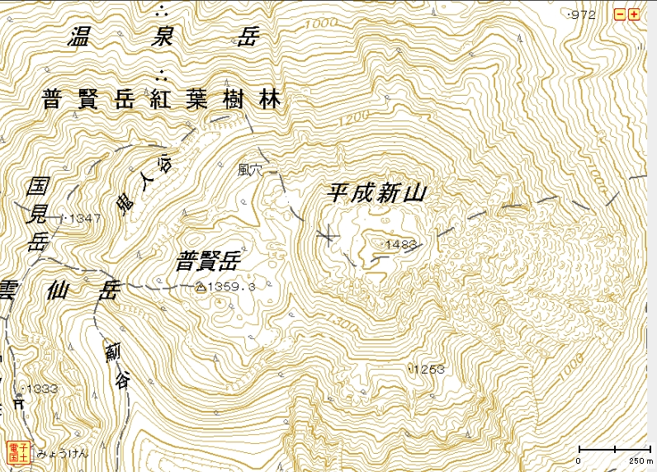
Unzen lava dome imaging by Miyamoto et al
Detector is here
Tan = -0.60 rad - 30 deg
Tan = +0.60 rad +30 deg
Notes:
The first one is imaging of lava dome in Unzen, which is located southern part of Japan.
They put the emulsion detectors in the natural cave of Unzen.

Slide 7
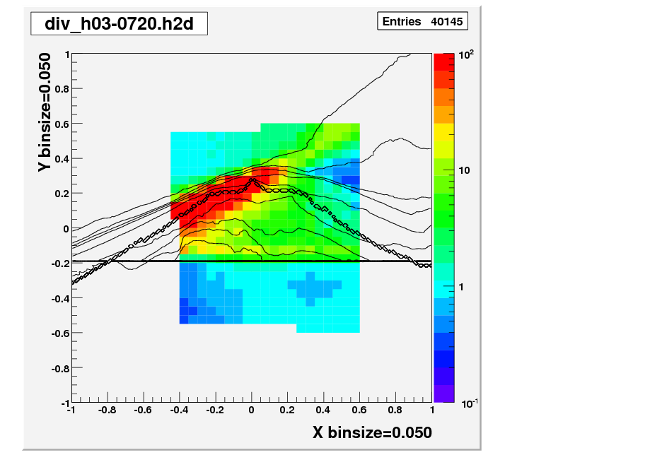
Observed muon/Expected ratio
100
Assuming the density of mountain is 2.5g/cc
Tan( elevation - 10.5 deg )
200
C
A
300
400
500
B
600
Zenith = 90.0 deg
Tan( azimuth - 127.5 deg )
The detector cannot discriminate GeV/c particle
A : Observed/Expected > 100 → BG dominant
B : Observed/Expected = several → BG dominant
C : Observed/Expected < 1.0→ It seems no BG ?
Tan( azimuth - 127.5 deg )
Tan( azimuth - 127.5 deg )
Notes:
The very preliminary plots of observed muon angular distribution vs expected muon by calculation.
Unfortunately it seems the image is full of back ground
Despite the site is covered 10m-thick rock at least.

Slide 8
Q. What is the BG source ?
A. Low momentum particles
The experimental study on background source of muon radiography using the detector which can discriminate GeV/c order momentum of the particles ( Emulsion Cloud Chamber ) was done around the Mt. Usu and showa-shinzan by Nishiyama et al.
This study confirms that the source of background noise is low-momenta(<1GeV) charged particles.
Notes:
The very basic and important experimental study of background for muon radiography was done by

Slide 9
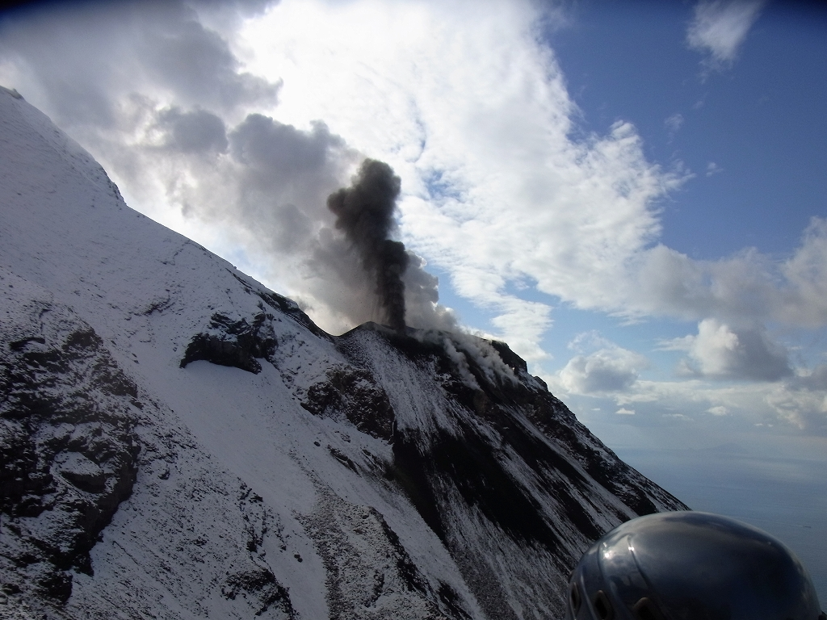
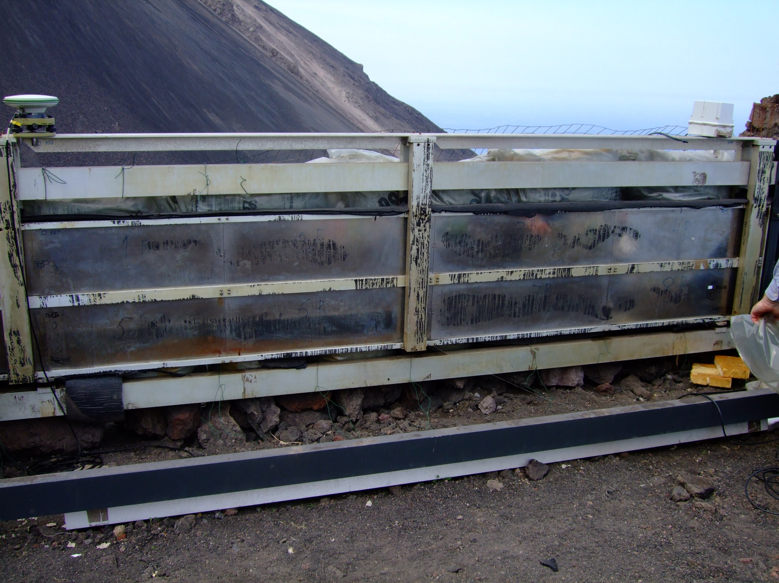
Stromboli Italy by Tioukov et al.
The imaging of conduit is critical for the eruption dynamics model
The preliminary image of Stromboli will be shown.

Slide 10
Stromboli Italy by Tioukov et al.
Difficult to get the power supply
Expected diameter of the conduit is 10m or less
10m/500m = 20mrad
→ Very high angular resolution is needed and emulsion detector is suitable for conduit imaging

Slide 11
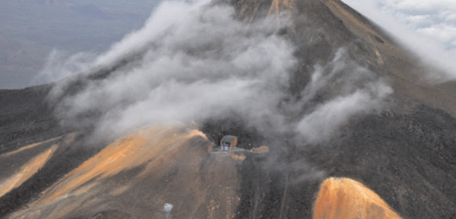
Mt. Teide @ Tenerife, Canary Island
Imaging the shallow part of summit cone by Hernandez, Padron et al

Slide 12
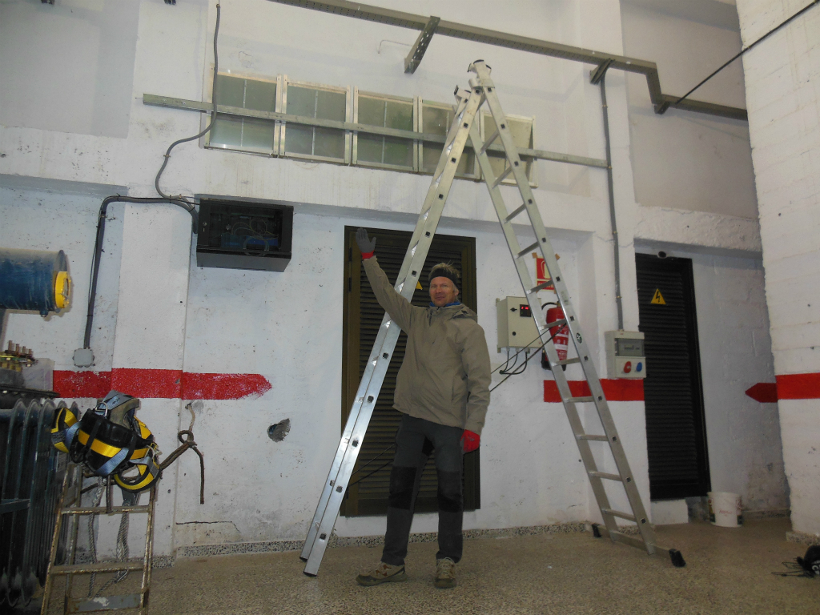
Beam of cable car building W 2.5m x D 0.3m x H 0.7m Emulsion Cloud Chambers 0.5 m² includes two 1mm-thick lead plates.

Slide 13
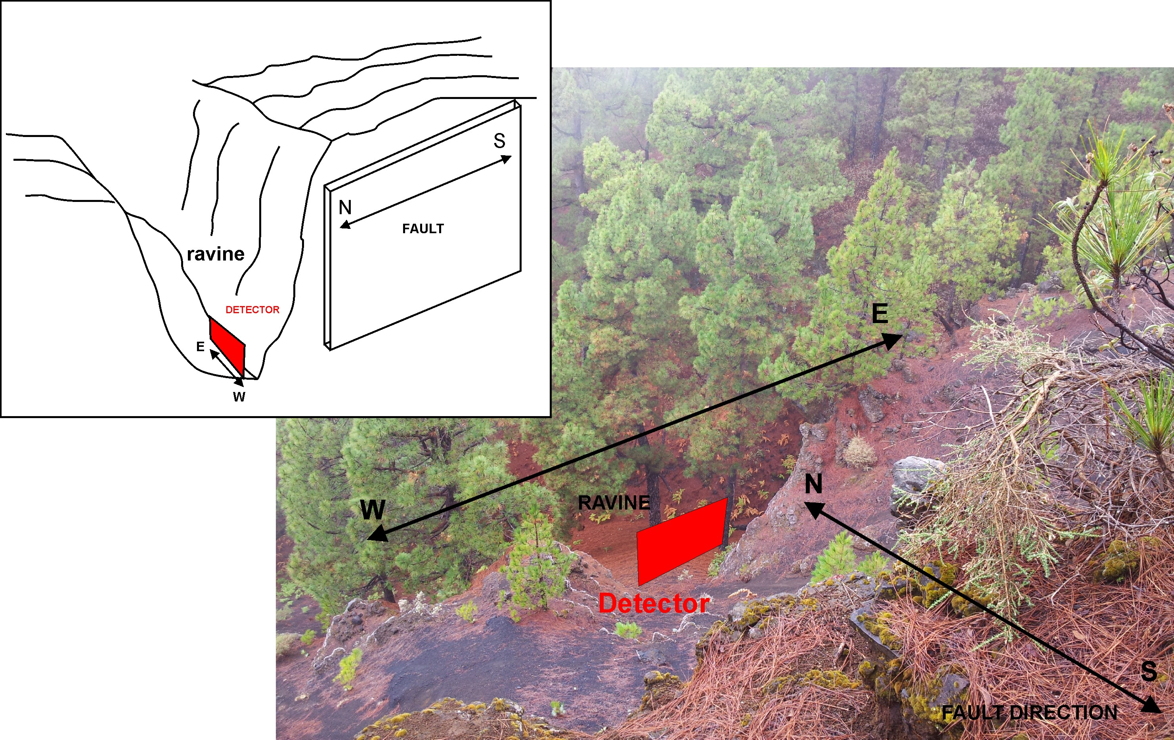
The imaging of La Palma Fault in 1949
Hernandez, Padron et al.
PROJECTS
The emulsion detector will be installed in this October.

Slide 14
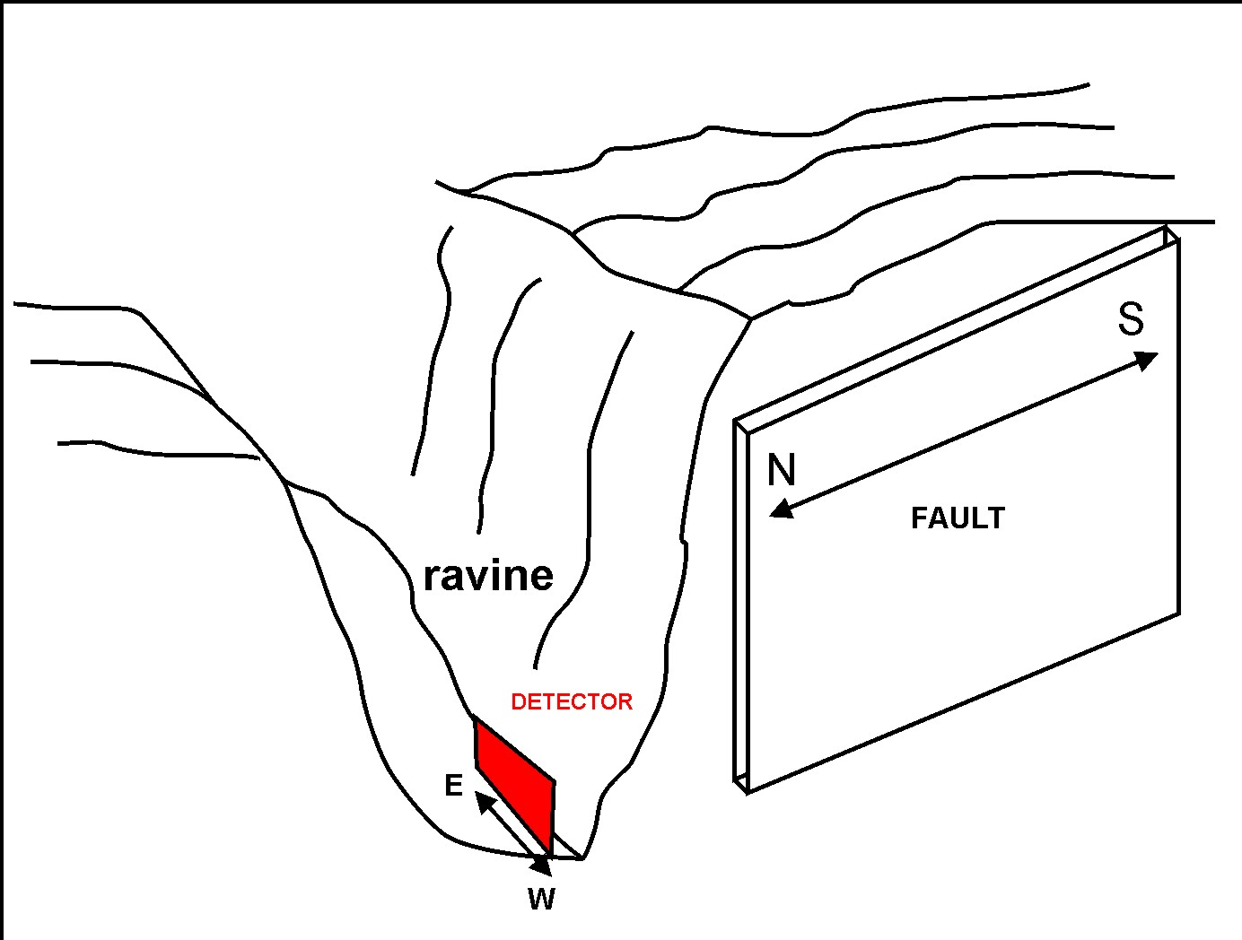
The imaging of La Palma Fault in 1949
Hernandez, Padron et al.
PROJECTS
No infrastructure around this site → No power supply
Expected width of the fault is 1m to 10m. → Need high resolution

Slide 15
The technical development

Slide 16
Large scale production of new emulsion films
We have been used the emulsion films which was made more than ten years ago.They accumulate all tracks of charged particles passed through → Too many background → Need to increase threshold to recognize the track in emulsion → Muon detection efficiency decrease.
Morishima et al are going to product the new emulsion film, which consists of very sensitive emulsion gel with the order of ~ 1 m²/day.

Slide 17
QSS “Quick Scanning System” next generation’s scanning system
QSS are under fine-tuning which consists of low magnification objective lens → large field of view.
4M pix high-speed camera
Continuous stage moving with constant velocity.
Track recognition by Multiple GPUs.
150 cm2/hour = 2.7m²/2plates/month/system
By Bozza et al.

Slide 18
The MONSTER readout system : “HTS”
Sixteen CMOS sensors mounted in the grid discontinuously
30cm-diameter objective lens
Very quick movement of XY stage with counter mass movement.
Track recognition of Multiple GPUs.
6000 cm2/hour = 108m²/2plates/month/system
By Yoshimoto, Nakano, et al.

Slide 19
Summary
Emulsion detectors have been used/will be used for muon radiography due to its advantage features
Recent technical development implies that the muon radiography with ~ 10m² effective area with BG-free (Emulsion Cloud Chamber) is promising.

