Slide 1
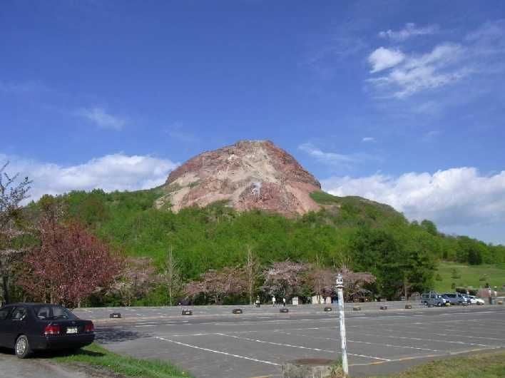
Muography in Showa-Shinzan Lava Dome
R. Nishiyama
Earthquake Research Institute, University of Tokyo
26 July 2013, MNR workshop 2013, Tokyo

Slide 2
Contents
Eruption History of Showa-Shinzan
Geophysical Surveys
  (a). Precedent studies
      (b). Muography in 2007
      (c). Joint analysis of muography and gravity measurements
Implication
      What we can say now
      What we want to see …

Slide 3
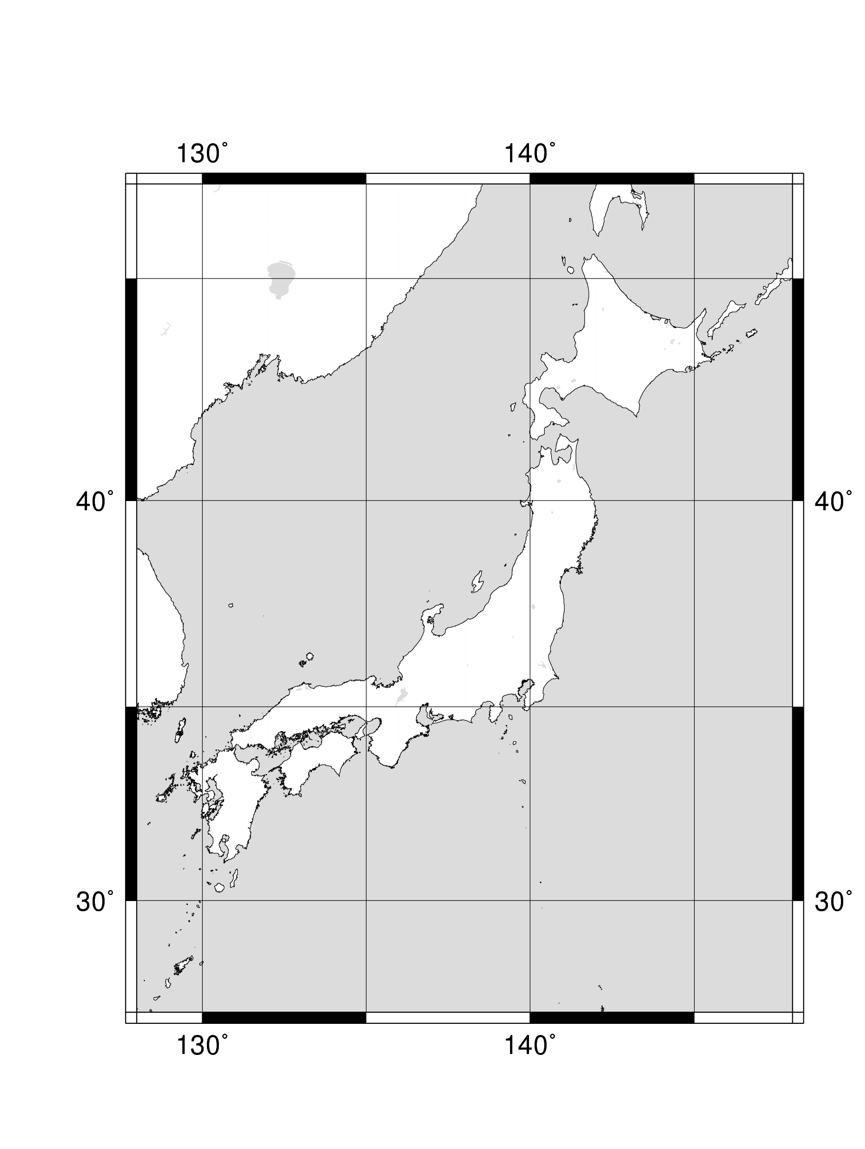
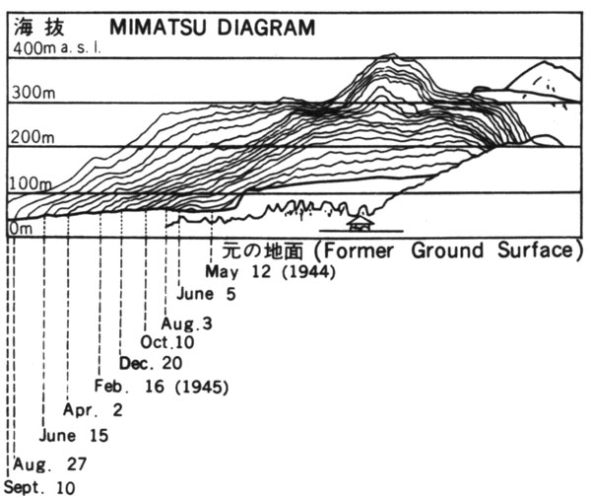

Showa-Shinzan Lava Dome
Eruption history (Dec. 1943 ~ Sep. 1945, Usu)
(0). wheat field
(1). volcanic earthquakes and significant ground uplift
(2). paroxysmal explosions at craters on the uplifted plateau
(3). dacite magma extruded from below the plateau
Minakami et al. [1951]
roof-mountain
(uplifted-plateau)
dacite lava dome
dacite lava dome
roof-mountain
(1). pre-volcanic stage
(2). paroxysmal eruption
size & shape of conduit ?
density (porosity) variation ?
(3). development of dome
Morphological development recorded by Mimatasu [1962].

Slide 4
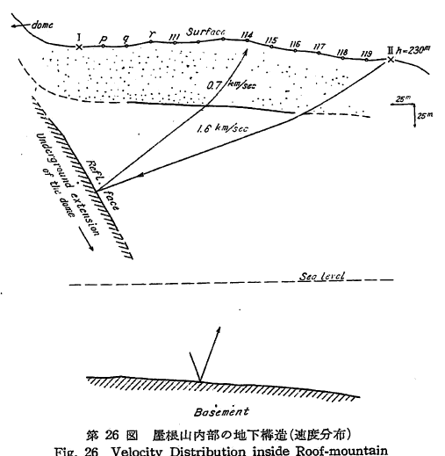
Precedent geophysical surveys
seismic survey (Nemoto et al., 1957)
Reflection of seismic wave at magma-soil boundary.
geomagnetic survey (Nishida and Miyajima., JVGR, 1984)
“The root of the lave dome of Mt. Showa-Shinzan has almost the same diameter as that of the dome exposed on the earth's surface.”
gravity survey (Nemoto et al., 1957)
1 mgal positive Bouguer anomaly on the top of the dome.
Shape of lava plugs have been studied by various studies.

Slide 5
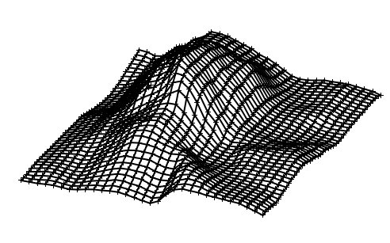
Muography in 2007
Average density profile
Tanaka et al., GRL, 2007

Slide 6
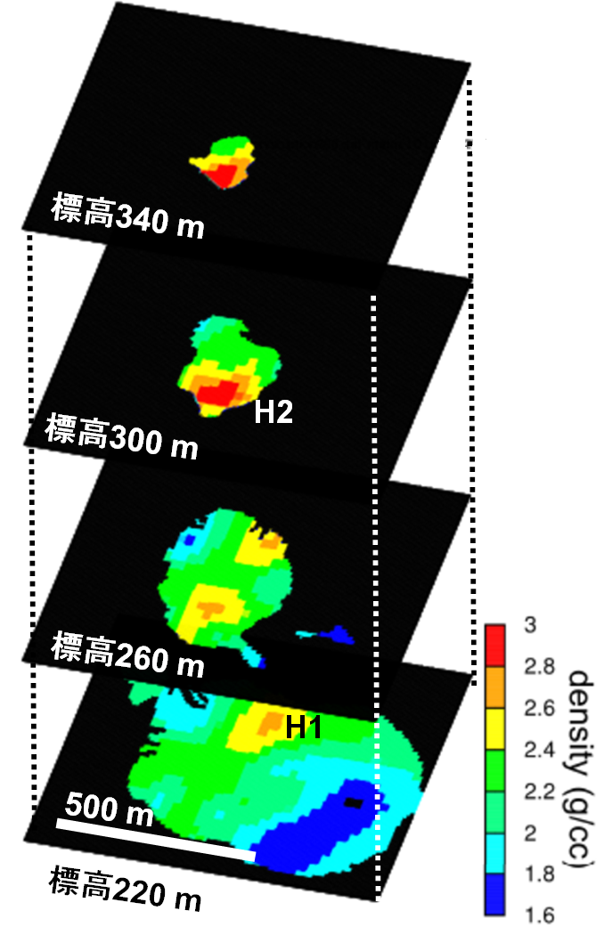
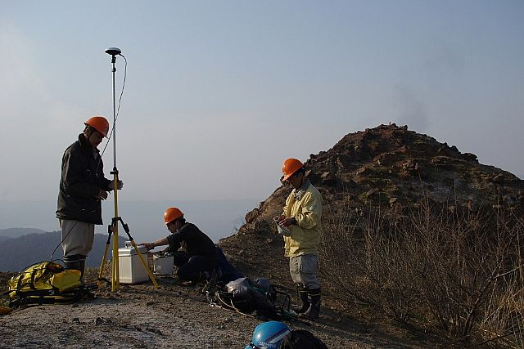
Joint analysis: muography + gravity → 3D
You can see details in my afternoon talk.
muography data
Gravity data
Nishiyama et al. submitting.

Slide 7
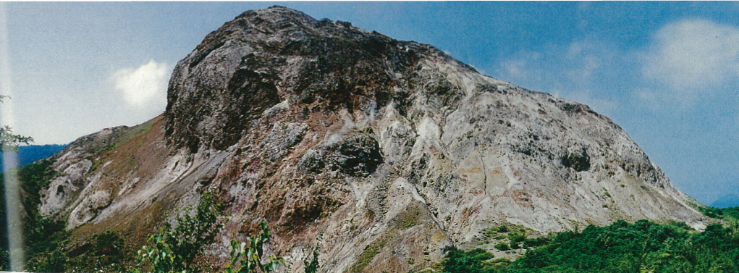
Implications
Uplifted plateau (east, low density)
Dome region (west, high density)
Two significant high density anomalies
H1: solidified lava stuck in a vent
H2:
H2

Slide 8

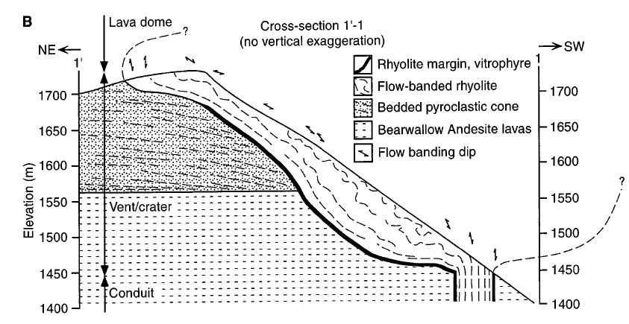
future applications
■ 3D density map → 3D porosity map
Non-invasive measurement of porosity inside the vent. (c.f. Stasiuk et al., BV 1996)
measured
from composition

Slide 9
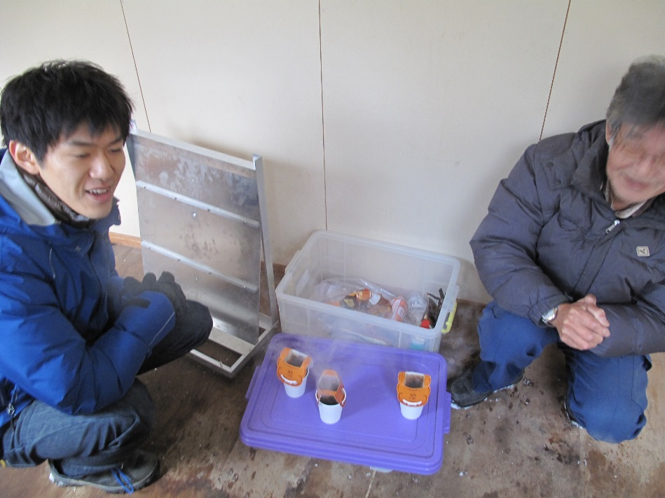
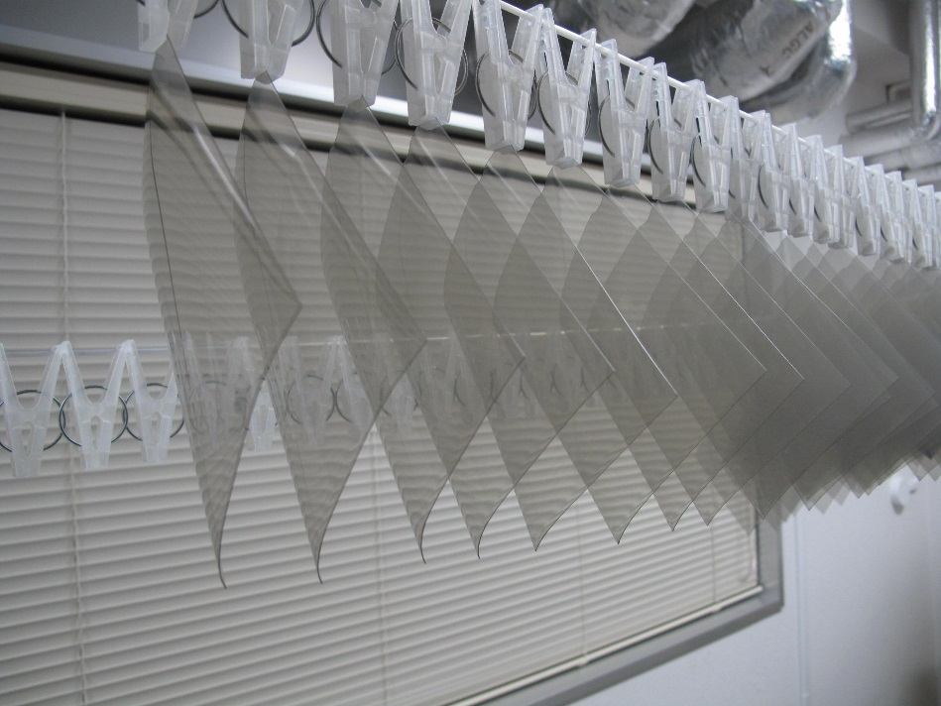
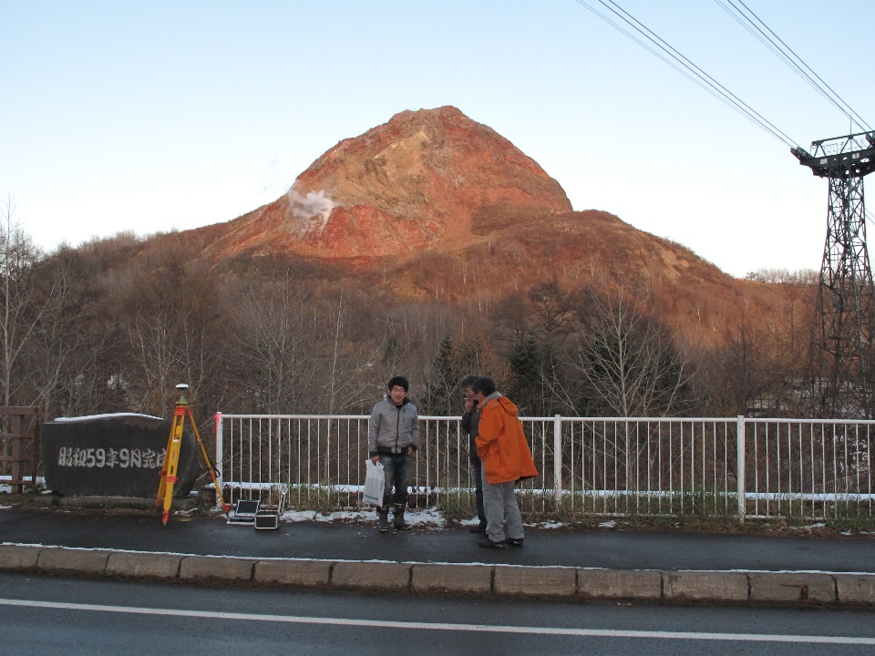
Thank you.

