Slide 1
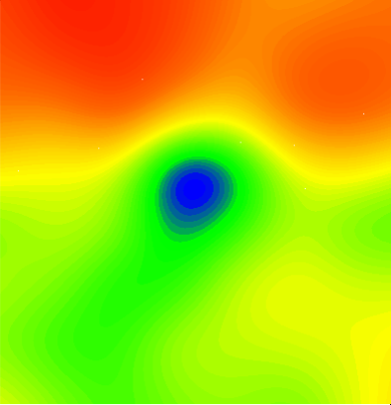
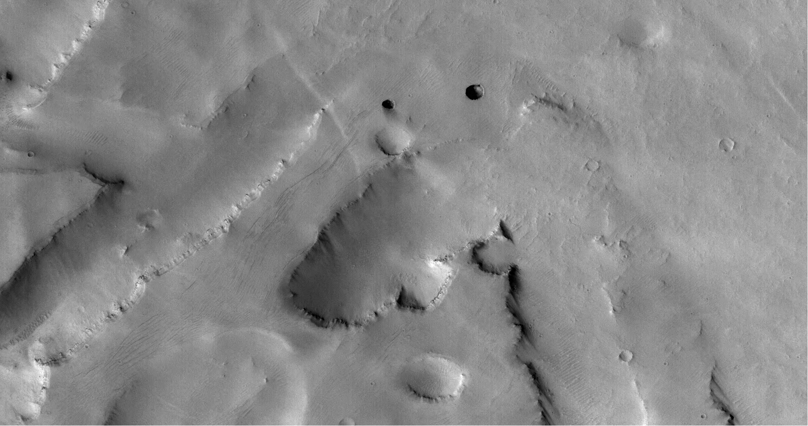
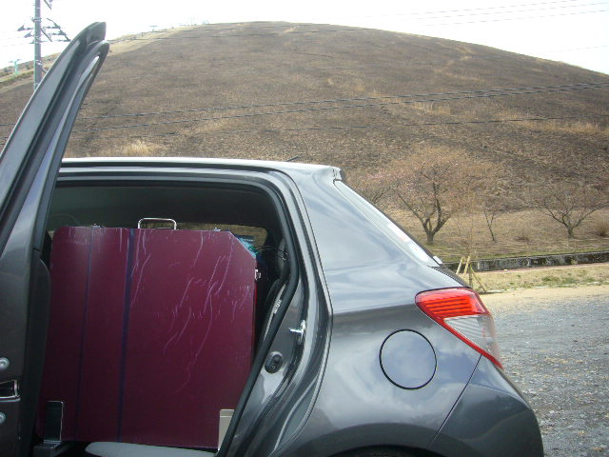
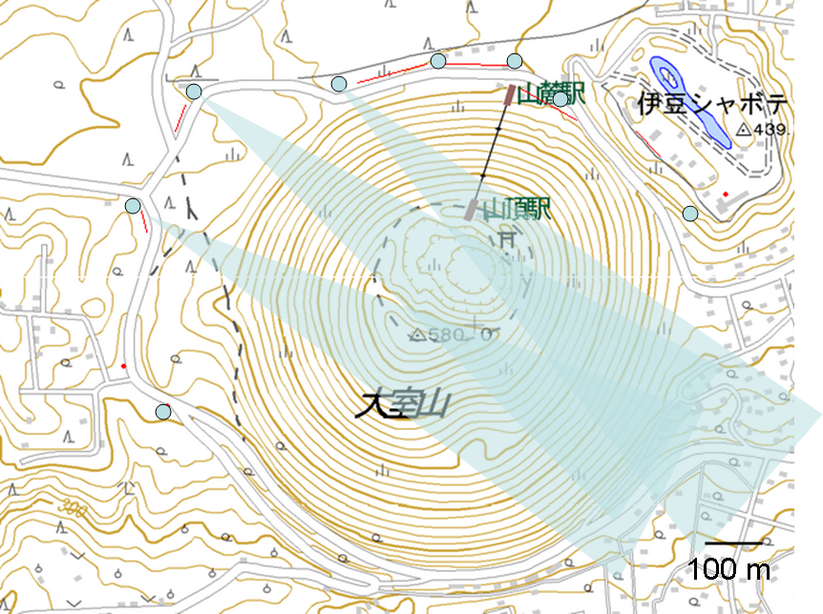
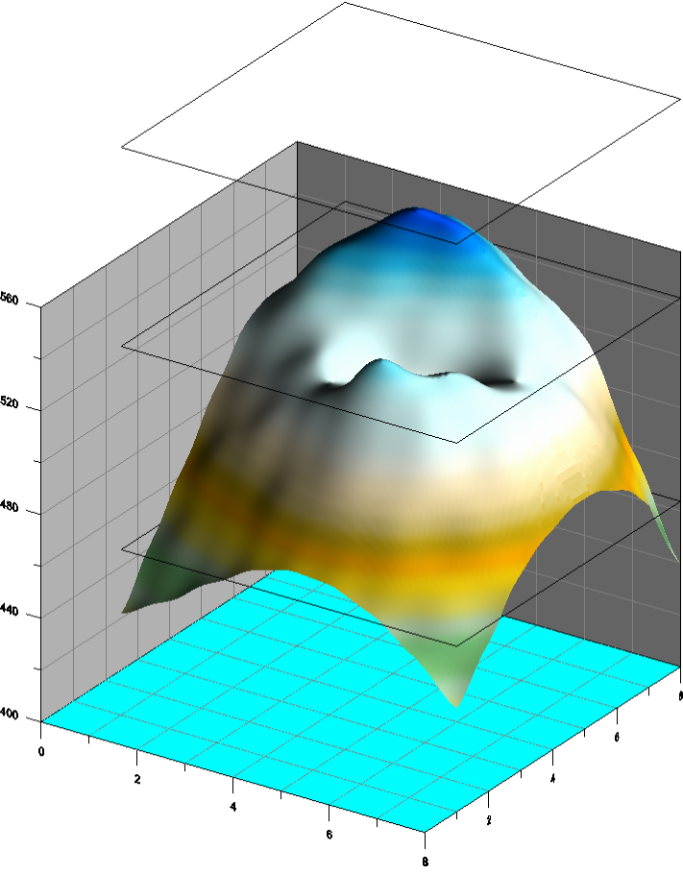
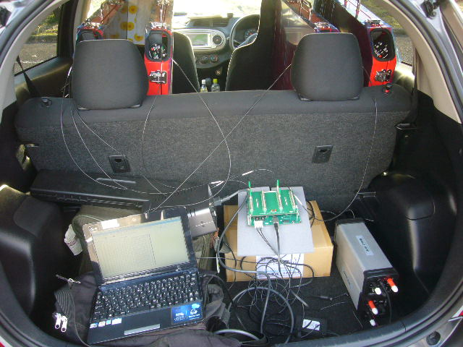
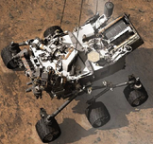
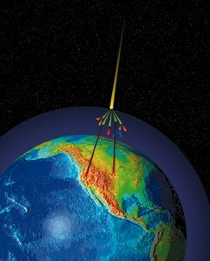
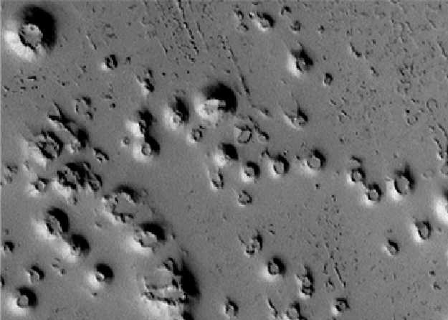
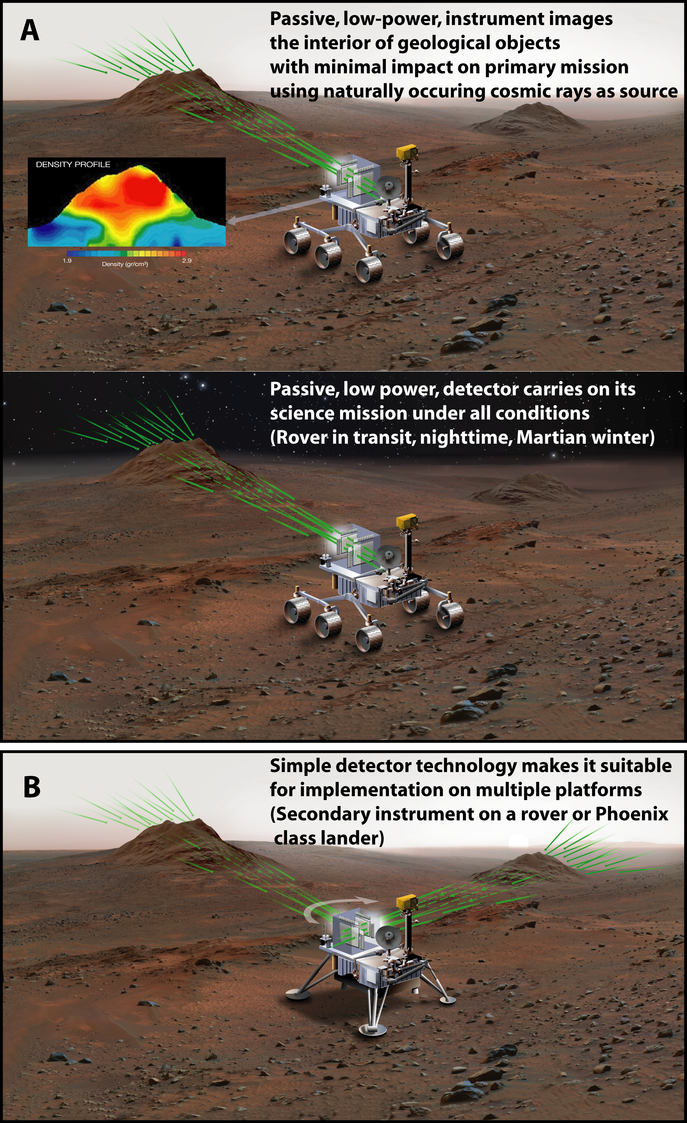
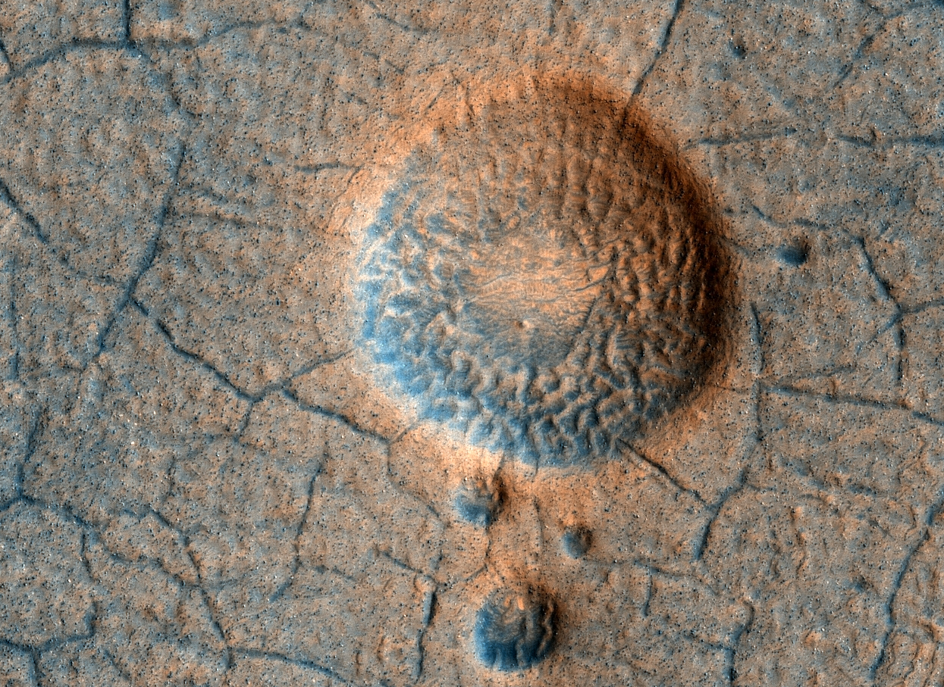
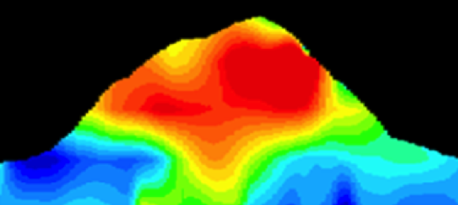
Jet Propulsion Laboratory
California Institute of Technology
Interrogating the Martian Subsurface using Muon Radiography
C. Naudet¹, H. Tanaka², S. Kedar¹, J. Plaut¹, C. E. Jones¹, and F. H. Webb¹,
¹Jet Propulsion Laboratory, California Institute of Technology, 4800 Oak Grove Dr., Pasadena, CA,
²Earthquake Research Institute, University of Tokyo
Introduction: Muon radiography is a technique that uses naturally occurring showers of muons, generated by cosmic rays, to image the interior of geological structures in much the same way as standard X-ray radiography. Unlike gamma rays and neutrons that penetrate only a few meters of rock, muons can traverse through up to several kilometers of a geological target. Recent developments [1] and applications [2] of the technique to terrestrial volcanoes, caves, and mines have demonstrated that a low-power, passive muon detector can image deep into kilometer-scale geological structures and provide unprecedentedly crisp density profile images of their interior. Preliminary estimates of muon production on Mars [3] indicate that the near-horizontal Martian muon flux, which is used for muon radiography of surface features, is at least as strong as that on Earth, making the technique suitable for geological exploration of Mars.
Field Demo of a Mobile Low-Power, Lightweight Muon Detector
A MSL-sized mobile muon detector roves around Mt Omuro
Imaging the interior in 6 hours
Lava tubes and caves
Muon radiography is a proven, simple, low cost, and efficient technology that could detect subsurface radiation shielded habitable environments that would not be detectable by any other technique available today.
Mobile
Muon Detector
Possible cave skylights
Mt. Omuro
Valleys offer ideal surface conditions
for a muon–rover to cruise probing
for ice caves or voids
700 m
Observation time
20 min at each point
Height
~50 m
Muon Tomography of lava caves in
La Soufrier, West Indies
Battery operated electronics
(< 1 watt)
Total observation time
20 x 18 = 360 min
Volcanes and small cones
How does Muon Tomography Work?
Muons are omnipresent charged particles. On Earth and on Mars they are generated from the decay of secondary particles created when galactic cosmic rays interact with matter in the planet’s atmosphere. Muons do not interact strongly with matter, so those with high energy can travel long distances before decaying, penetrating deep into rock.
Exterior shape information is not necessary.
Real-time changing target is possible, e.g., growing lava dome
Small cones, ice volcanoes, possibly due to lava vaporizing sub- surface ice. Superheated steam punches through the cooling lava creating the surface structures.
Muon Tomography of lava caves in La Soufrier, West Indies
Mars Surface Exploration
Trade space between detector size and integration times makes it suitable on multiple platforms and numerous targets.
It is a low power, passive detector with high spatial resolution using nature’s cosmic rays as a source. Can used as a primary or secondary instrument.
Ideal for deep penetration (1-3 Km) of geological structures or for quick interior views from a rover on the go.
Muons are omnipresent negatively charged particles. On Earth and on Mars they are do not interact strongly with matter, so those wit
Mars Gullies
Detector comprised of two arrays of orthogonally oriented scintillation counters (hodoscope) that enables tracking of the incoming muons’ paths is placed to observe target from a distance.
Horizontal Cosmic
Rays penetrate target
from one side
Recent MRO observations show flows that appear in spring and summer on a slope inside Mars' Newton crater. Sequences of observations recording the seasonal changes at this site and a few others with similar flows might be evidence of salty liquid water active on Mars today. If further study of the recurring dark flows supports evidence of brines, these could be the first known Martian locations with liquid water, and a prime candidate for an impact mission.
A density profile of the target is calculated by convolving muon counts per pixel (muogram) with knowledge of target area topography and nominal material properties.
2km
Muogram
100m
Density Profile
< 1.75
Density (g/cm³)
1.96 <
Small density variations detected with a single detector (Satsuma-Iwojima Volcano)
Oblique View of Warm Season Flows in Newton Crater
Recent volcano studies using cosmic ray muon tomography
Potential Geological Targets on Mars
Summary
Muon Tomography is an entirely new class of planetary instrumentation that is ideally suited to address key areas in Mars science, such as:
  the search for life and habitable environments,
  the distribution and state of water and ice, and
  the level of geologic activity on Mars today.
and address a key priority of the decadal survey and MEPAG.
  To detect deep and shallow subsurface habitable environments
References: [1] Tanaka, H., et. al. (2008) Am. Jour. Sci., V. 308, 843-850. [2] Tanaka, H., et. al. (2009) Geophys. Res. Lett., V 36 L01304. [3] Tanaka, H., et. al. (2007) Icarus 191 603-615. [4] Kedar, S., Tanaka, H. K. M., Naudet, C. J., Jones, C. E., Plaut, J. P., and Webb, F. H., Muon radiography for exploration of Mars geology, Geosci. Instrum. Method. Data Syst. Discuss., 2, 829–853, 2012
Two detectors yield a 3D tomography of the density anomaly (Mt. Asama)
Temporal density variations detected (Mt. Asama)
Pingoes: small uplifts formed (on earth) by injection of pressurized groundwater beneath permafrost.
Jan. 6, 2009 – Feb. 2, 2009 Feb. 2, 2009 – Mar. 5, 2009
~200m
Muon Tomography
  Detect density variations inside the landform
  Delineate ice body and overlying regolith
  Address larger goal: What is hydrologic history of these areas?
  Identify possible targets for ice sampling
The muon telescope represents an entirely new class of instruments for planetary exploration, providing a wholly new type of measurement for delineation of potentially habitable subsurface environments through detection of caves, sub-surface ice, and water, and for the interpretation of composition and evolutionary state of the Martian surface
Small scale (tens of meters) dike visible
Muon Tomography of lava dome at Usu volcano
International in Japan Workshop on High Energy Geophysics 2011
Copyright 2013 California Institute of Technology. Government sponsorship acknowledged

