Slide 1
ASTRI MUOGRAPHY
ASTRI MUOGRAPHY
Osvaldo Catalano
INAF: IASF-Palermo
on behalf of the ASTRI Collaboration

Slide 2
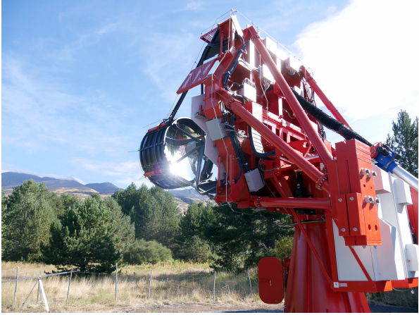
THE LANDSCAPE
The majestic Etna volcano rises at North-Est of the Serra La Nave Observatory where the ASTRI SST-2M telescope is located.

Slide 3
THE ACTORS
Volcano
ASTRI

Slide 4
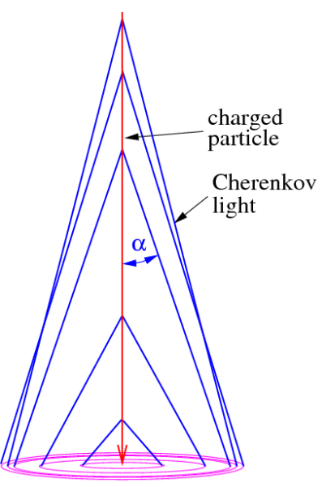
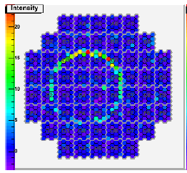
CHERENKOV MUON RING
Volcano imaging through cosmic-ray muons is a promising technique (Tanaka et al.)
First radiographic observation of the ascent and descent of magma along a conduit utilizing
muography with dynamic radiographic imaging.
(Tanaka+14, Nature)
CHERENKOV RINGS PRODUCED BY MUONS ARE CURRENTLY USED IN ALL THE EXISTING CHERENKOV TELESCOPES TO CALIBRATE THE SENSORS AT THE FOCAL PLANE OF THE CAMERA
CHERENKOV TELESCOPE ARRAY (CTA) REQUIRES EACH TELESCOPE SHOULD BE ABLE TO DETECT MUONS
ACCURATE AND CONSOLIDATE TECHNIQUE
real muon ring image in a H.E.S.S telescope.
Osvaldo Catalano– Muographers 2016: General Assembly
4

Slide 5
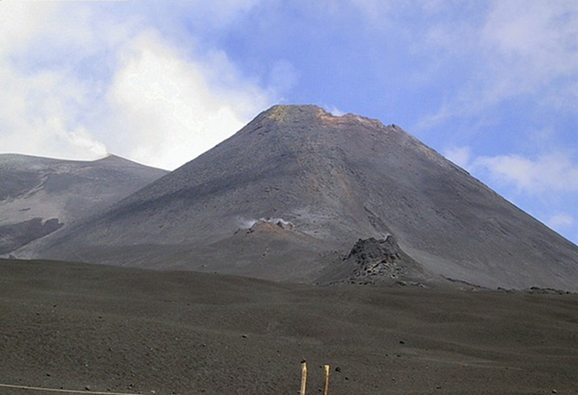
THE FEASIBILITY
IS VOLCANO MUON RADIOGRAPHY FEASIBLE WITH CHERENKOV TELESCOPES?
Are they able to determine width, structure and shape of volcano conduit?

Slide 6
THE ASTRI PROJECT
ASTRI (Astrofisica con Specchi a Tecnologia Replicante Italiana) is a project of the Italian Ministry of Education, University and Research, led by the Italian National Institute of Astrophysics (INAF).
ASTRI SST-2M is an Imaging Atmospheric Cherenkov Telescope located at the Serra La Nave Astrophysical Observatory (Catania).
The first aim is to develop an end-to-end prototype proposed for the small-sized telescopes of the CTA dedicated to very high-energy gamma-ray Astrophysics.
After the commissioning phase (Spring 2017), ASTRI SST-2M will perform scientific observations of the Crab Nebula, Mrk 421, and Mrk 501 with the maximum sensitivity range above 2 TeV.
6

Slide 7
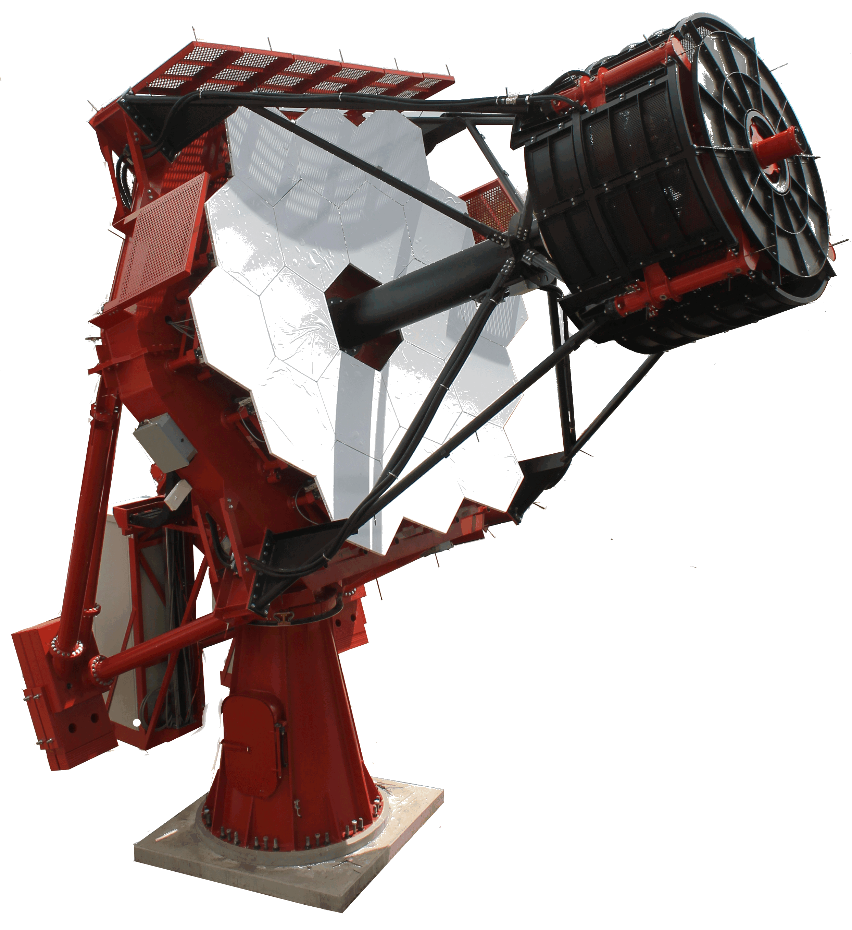
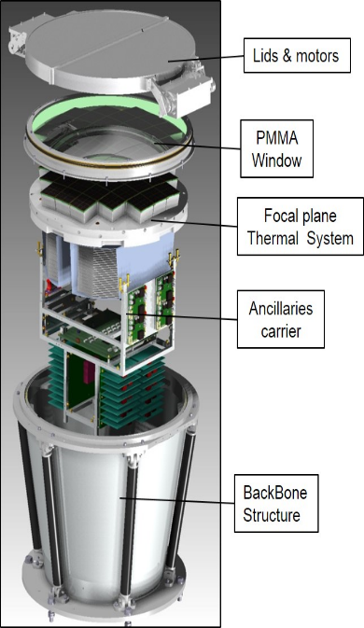
ASTRI SST-2M TELESCOPE
Optics characteristics
dual mirror optical design (Schwarzschild-Couder config.)
small size camera (50x50x50 cm³ – ~50 kg)
Segmented primary mirror: 4.3m
Monolithic secondary mirror: 1.8m
Equiv. Focal Length = 2.15m
Field of View ~ 9.6°
Focal Plane characteristics
radius of curvature: ~ 1m
~2000 pixels (6.9x6.9mm²)
pixel FoV = 0.19°
Modular (37 Photon Detection Modules of 8x8 SiPM pixels)
7

Slide 8
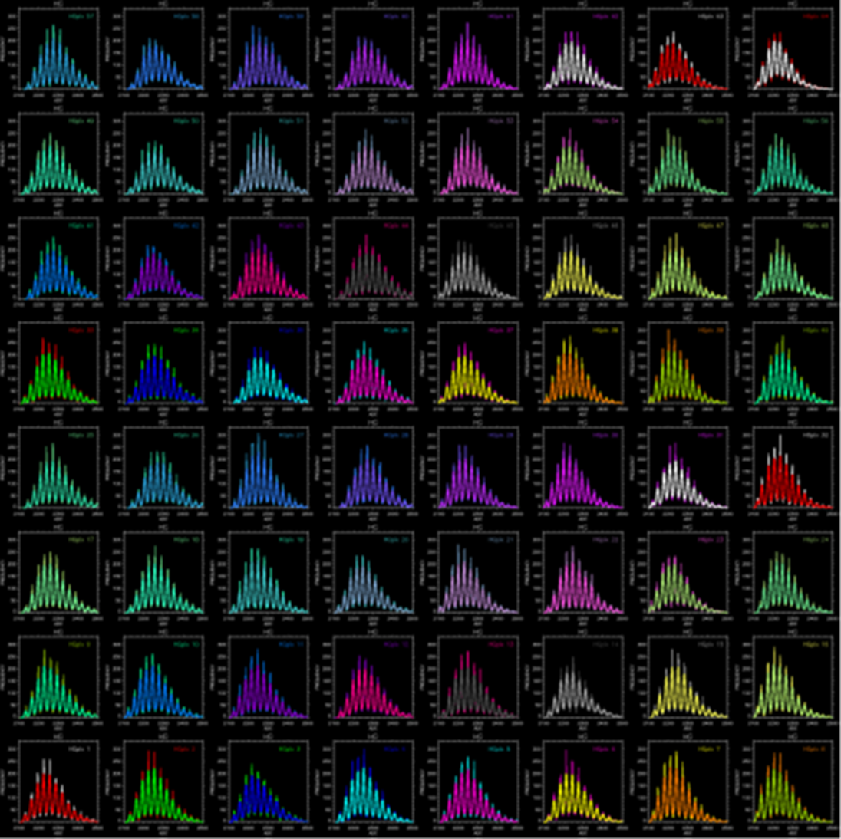
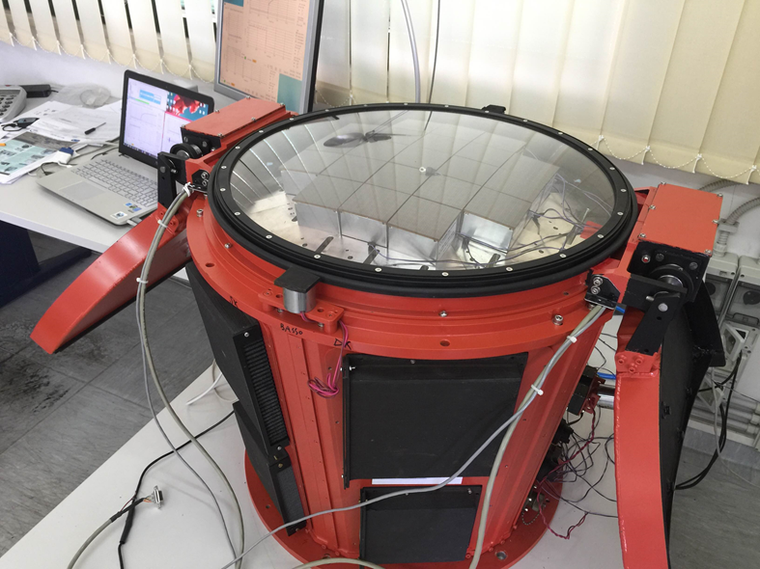
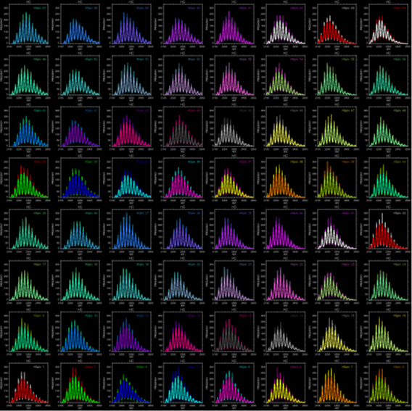
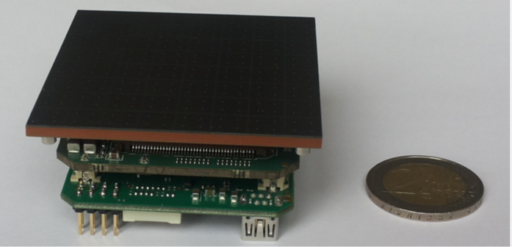
ASTRI SST-2M FOCAL PLANE
SiPM performance
Excellent single photo-electron resolution
high PDE (~40% @400nm)
safe to ambient light exposure
insensitive to magnetic field
Pulse height distribution of one 64 pixels Tile
8

Slide 9
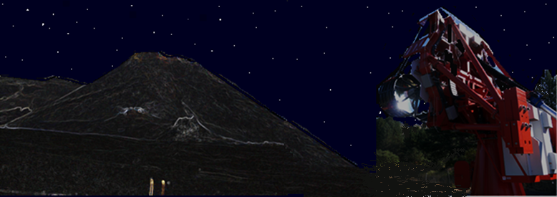
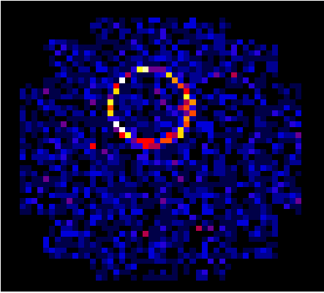
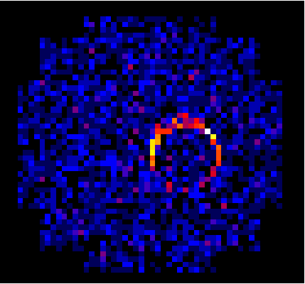
THE INTUITION
Muon Cherenkov ring
Muons crossing the SE crater at Mt Etna Cherenkov light ASTRI telescope
As muons interact very little with matter they can travel through large extent of rocks, losing a fraction of energy proportionally to the thickness of the rocks crossed. Density distribution of the interior of a volcano can be determined by measuring the differential attenuation of the muon flux as a function of the amount of rocks crossed along different directions.
Etna volcano
ASTRI SST-2M at 5 km from the SE crater
Muon detection capability only at night
9

Slide 10
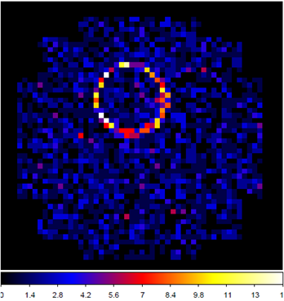
PHYSICAL PARAMETERS DETERMINATION
A relatively simple geometrical analysis of the ring allows us to reconstruct
the muon physical parameters, in particular the arrival direction.
The radius of the ring corresponds to the Cherenkov angle Θ
E_{µ} is given by:
The position of the center gives the direction of the detected muon with respect to the telescope optics axis.
+
+
OPEN SKY INTEGRAL MUONS FLUX
The capability to reconstruct muon rings depends on the impact point on the telescope mirror, on the telescope entrance pupil area and on the camera efficiency.
10

Slide 11
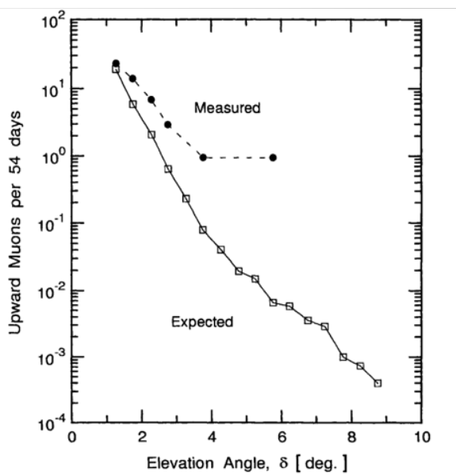
PHYSICAL PARAMETERS DETERMINATION
The background is due to muons hitting the primary mirror with an incidence angle within the FOV
mainly back-scattered from the ground.
ground level measurement of upward directed atmospheric muons: 3x10⁻⁶ cm⁻² sr⁻¹ day⁻¹
≈3x10⁻³ ”fake” events per observation night (8 hours) within the field of view of ASTRI SST-2M
compared
5000 muons/night are expected to hit the telescope mirror
NEGLIGIBLE BACKGROUND
11

Slide 12
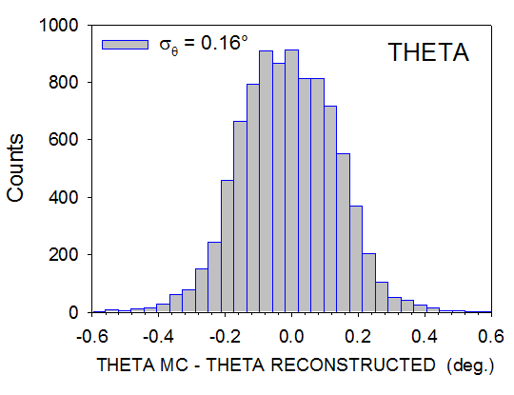
BASIC FORMULAS & SIMULATIONS
Muons with Cherenkov Telescopes
The ASTRI telescope is able to reconstruct muons with energy higher than 20 GeV with a precision on the direction reconstruction of about 0.16◦, which is of the same order of the camera pixel.
RAW DATA
RECONSTRUCTED (96%)
12

Slide 13
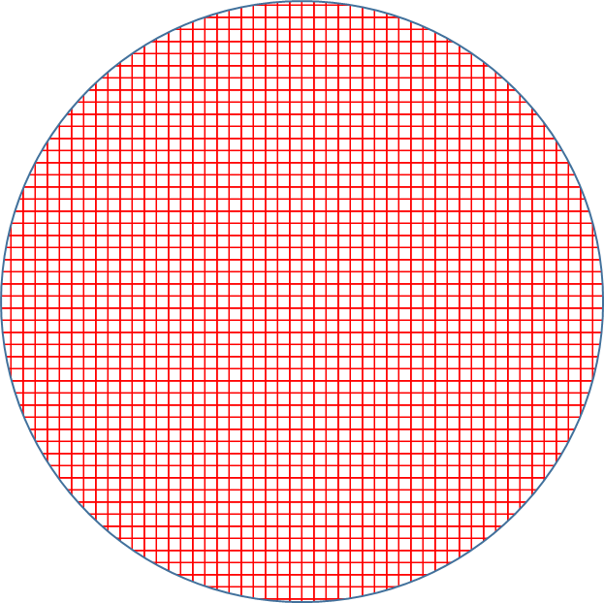
BASIC FORMULAS & SIMULATIONS
Conduits of various dimensions are simulated as hollow cylinders embedded into a filled cone with the vertical axis coincident with that of the cone (volcano).
Angular Resolution ≈ 0.5 degrees
Projected Spatial Resolution ≈ 14 m
A grid with bins of 0.5° x 0.5° maps the crater
Bin detector acceptance ≈ 10 cm² sr
Differential muon flux (I(X,θ for θ =85°) calculated for standard rock (ρ =2.65 g cm⁻³ ) and propagated
+
RECEPTION FLUCTUATION
This pixel size is comparable to the muon angular deviation expected from multiple scattering in crossing the mountain
Projected Spatial Resolution
113

Slide 14
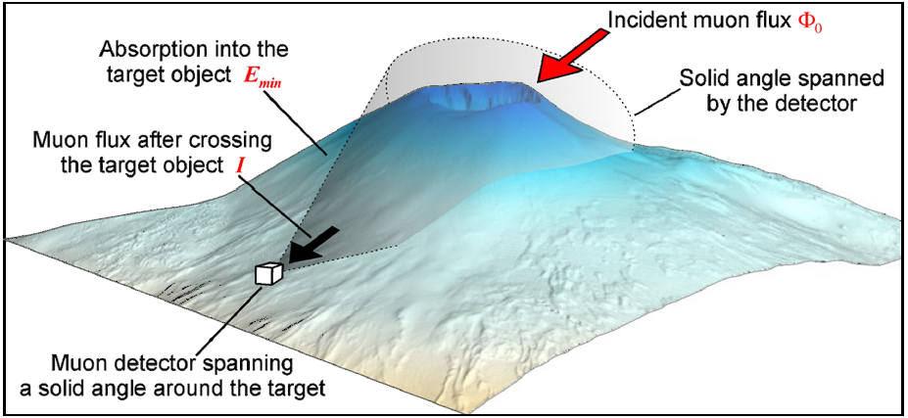
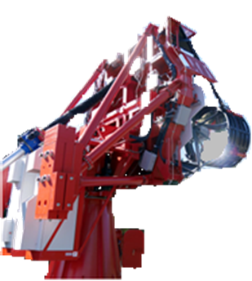
BASIC FORMULAS
Principles of muon imaging
The density distribution of the interior of a volcano can be determined by measuring the differential attenuation of the muon flux as a function of the amount of rock crossed along different directions. Any muon flux variation translates in a difference in the opacity (X) which is defined as:
where ρ is the density and ξ is the spatial coordinate measured along the trajectory L.
Credit :D. Carbone
14

Slide 15
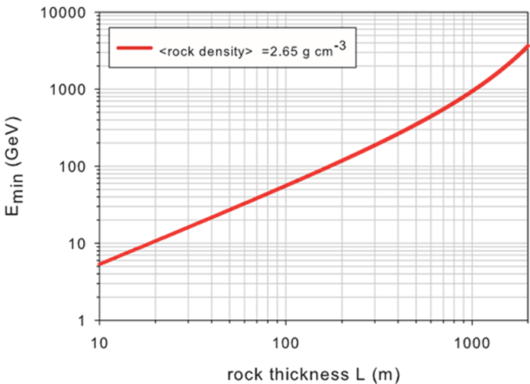
BASIC FORMULAS
Principles of muon imaging
The integrated cosmic muon flux after the volcano has been crossed, as a function of the opacity and of the zenith angle θ, is defined as:
With the differential flux of incident muons
The minimum muon energy required to cross a depth X:
15

Slide 16
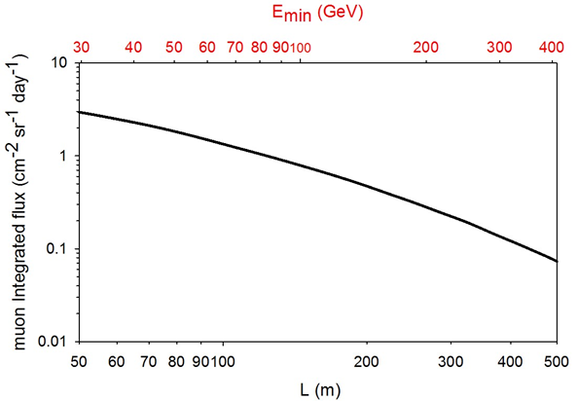
BASIC FORMULAS
Principles of muon imaging
Muon integrated flux as a function of the standard rock thickness (2.65 g cm⁻³). The top axis gives the required minimum energy to cross the corresponding rock thickness.
The feasibility of the method proposed to investigate the density distribution inside a target structure can be inferred through the relation (Lesparre et al.) :
with ∆T the acquisition time,
∆I(X0,δX) = I(X0 + δX) − I(X0) and Γ the detector acceptance.
This equation establishes a useful relationship between the acquisition time ∆T necessary to collect a statistically significant number of muons and the integrated flux differences ∆I(X0,δX) = I(X0 +δX)−I(X0) of muons crossing different directions inside the target.
16

Slide 17
SIMULATIONS
Projected resolution= 13.5 m @ 1 σ
RESOLVING TIME (Nights ≡ 8 hours)
No Conduit: Muon Flux per bin
500 m
200 m Conduit: Muon Flux per bin
240 m

Slide 18
SIMULATIONS
Projected resolution= 9 m @ 3 σ
Muon flux per bin: no conduit
CONTRAST RATIO
Muon flux per bin: 100 m conduit

Slide 19
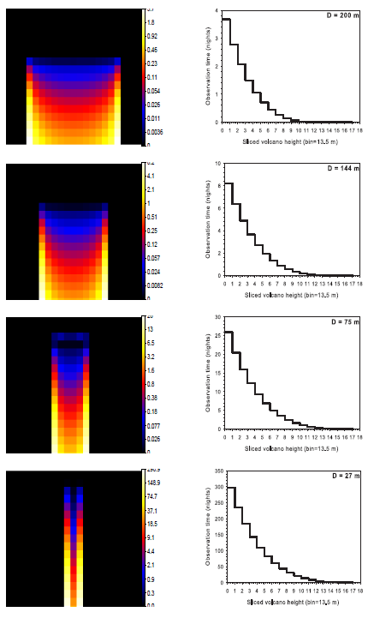
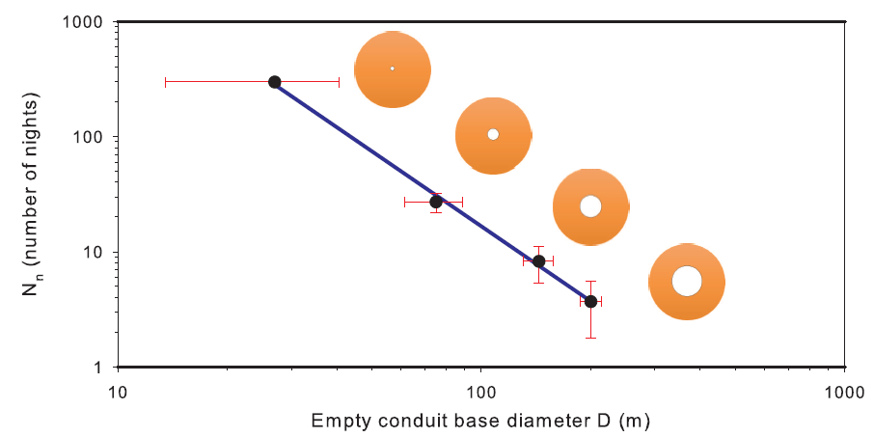
SIMULATIONS
LONG TERM OBSERVATION
Increasing observation time
≡
Higher confidence level in opacity measurement and detailed map of the interior of the volcano within the limit of the telescope resolution.
SHORT TERM OBSERVATION
Capability to detect the rising magma in the conduit
≡
200 m conduit resolvable if <v> magma < 5m/h
19

Slide 20
MUOGRAPHY TELESCOPE
WHAT NEXT ?
20

Slide 21
MUOGRAPHY TELESCOPE PROTOTYPE
The new IACT will be ASTRI-like, i.e. with a double mirrors optics and
multi-pixel focal plane made-up of SiPM
However:
it will be smaller, lighter (200 kg) and low-cost.
In particular:
focal plane: 16 Photon Detection Modules of 8x8 SiPM pixels (each module of 57mm x 57mm x 30mm)
primary mirror with 8 hexagonal facets (aperture 2.1 m), monolithic 0.8 m secondary mirror)
FOV: 12º
lighter structure
no pointing system
(Patent n. 102015000075497 registered at Ministero dello Sviluppo Economico, Italy).
16
21

Slide 22
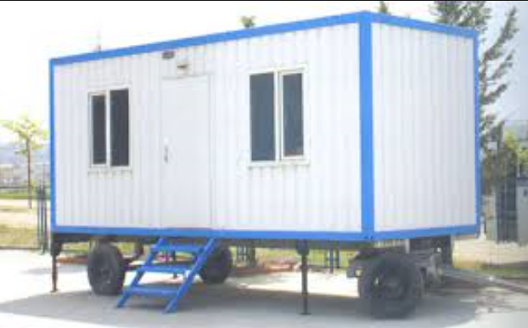
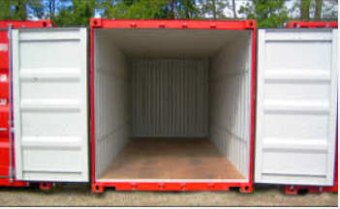
MUOGRAPHY TELESCOPE PROTOTYPE
Telescope installed on mobile vehicles and solar powered.
Such Cherenkov telescopes do not need to be ASTRI-like and do not need a pointing system
22

Slide 23
POSSIBLE CONFIGURATION
Our idea is to install the instrumentation on mobile vehicles, possibly solar powered, in order to realize ecologic instrumentations which can be positioned in the desired and variable configuration and can be easily removed.
23
Notes:
control station

Slide 24
CONCLUSIONS
From our simulations it results that imaging Cherenkov telescopes could be able to perform muon radiography of volcanoes with a good spatial resolution.
Cherenkov telescope do not suffer of high muon background.
ASTRI SST-2M will be used to test the new method proposed.
The new proposed Cherenkov telescope is low cost, transportable, easily removable and ecologic.
The volcano tomography could be performed by using 2 or more telescopes that can be positioned in different configuration around the volcano.
24

Slide 25
THANKS
I am grateful to the entire ASTRI collaboration and to the INAF HQ for encouraging this work
25

