Slide 1
Muography of 1949 fault in La Palma, Canary Islands, Spain
Seigo Miyamoto^{1*},
J. Barrancos^{2,3}, C. Bozza⁷, L. Consiglio⁴, C. De Sio⁷, G. Padilla^{2,3}, P. Hernández^{2,3,5}, R. Nishiyama¹, E. Padrón^{2,3}, C. Sirignano⁶, S. M. Stellacci⁷, H. Tanaka¹, V. Tioukov⁴
Earthquake Research Institute, The University of Tokyo¹, Instituto Tecnológico y de Energías Renovables (ITER)², Instituto Volcanológico de Canarias (INVOLCAN)³, Department of Physics of the University of Napoli⁴, Agencia Insular de Energía de Tenerife (AIET)⁵, Dipartimento di Fisica e Astronomia, Galileo Galilei, University of Padova & INFN⁶, Department of Physics of the University of Salerno⁷

Slide 2
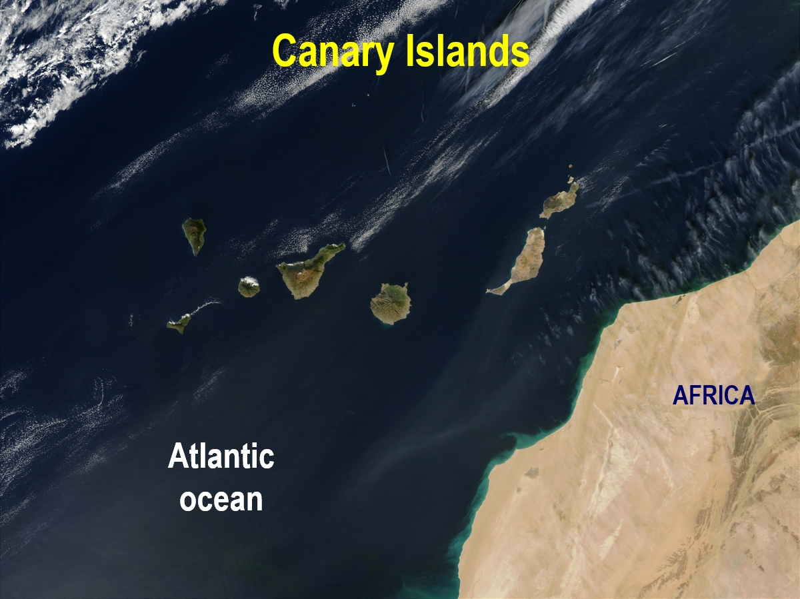
Canary Islands
AFRICA
Atlantic
ocean
Notes:
The Canary Islands are located west off northwestern Africa. The islands were created by hot spot volcanism. El Hierro is the youngest volcanic island in the whole archipelago whose volcanic activity started about 1 Ma ago, and is located in the western end.
2

Slide 3
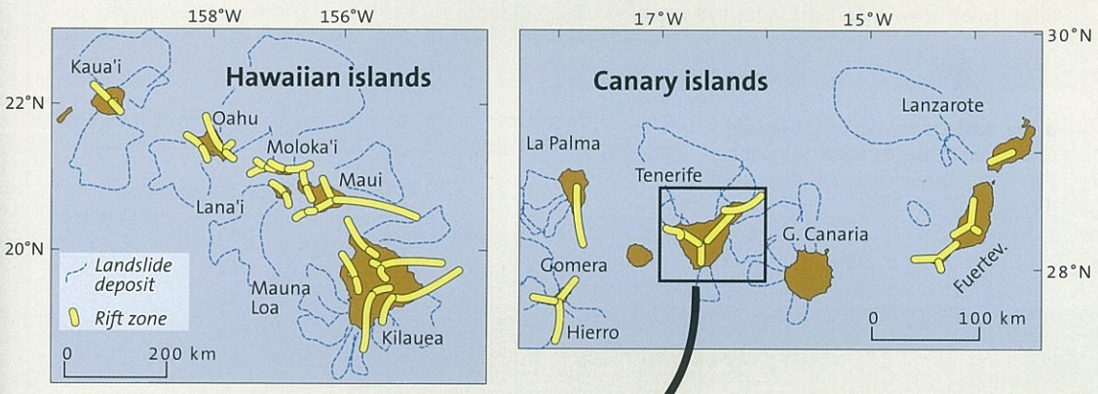
Landslide by large-scale mountain collapse is ordinary for volcanoes

Slide 4
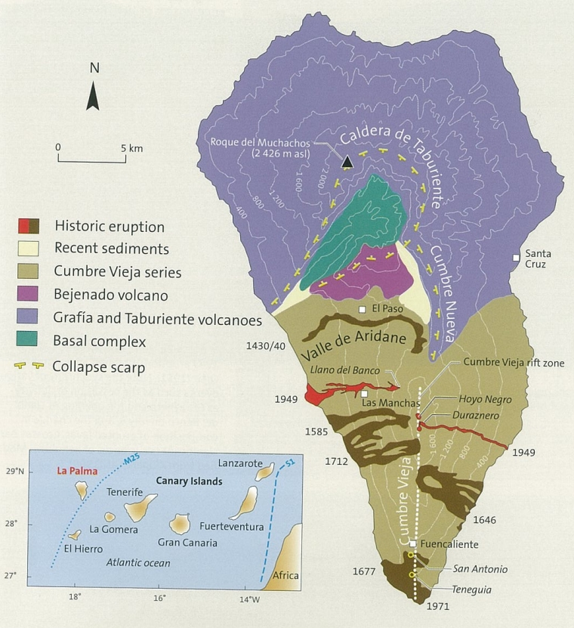

Slide 5
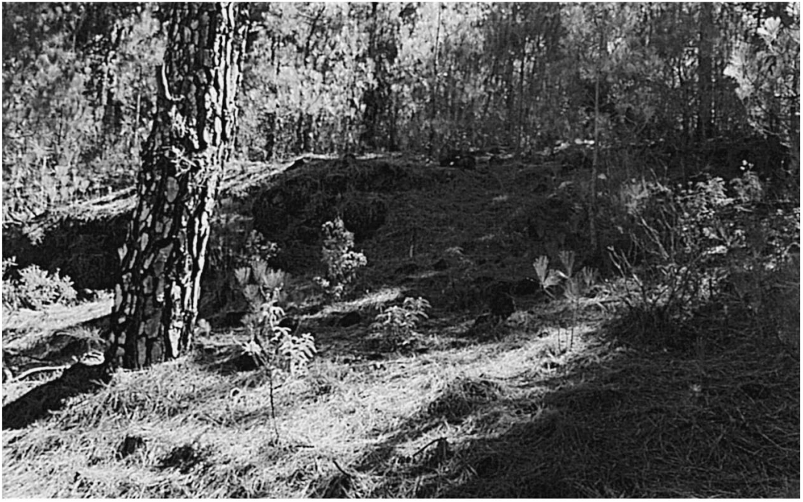
1949 fault

Slide 6
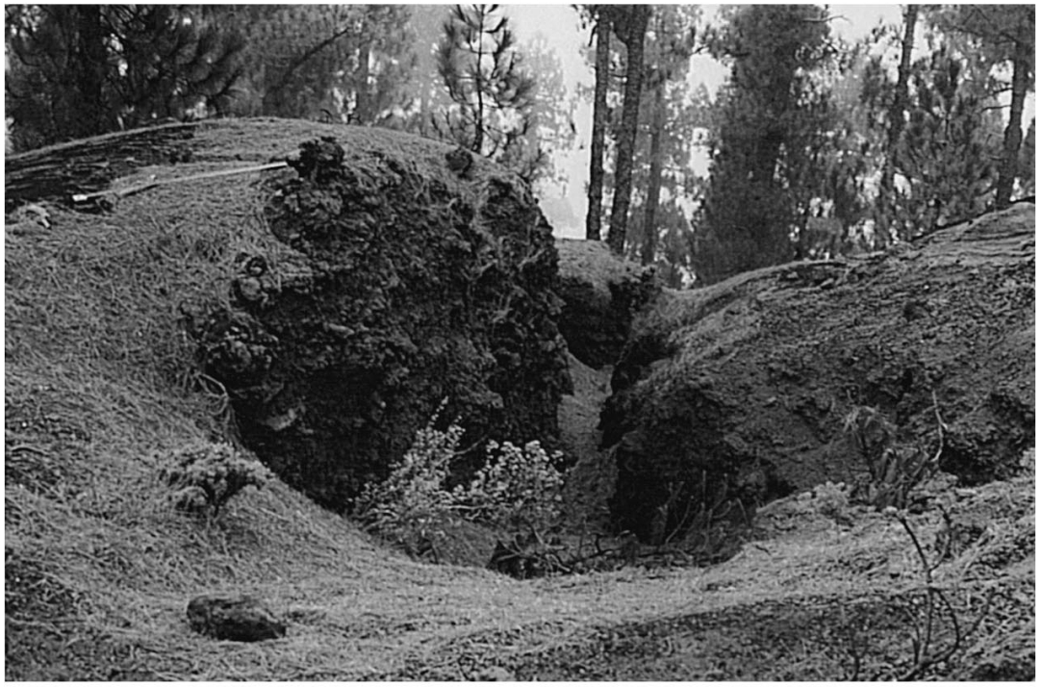
1949 fault

Slide 7
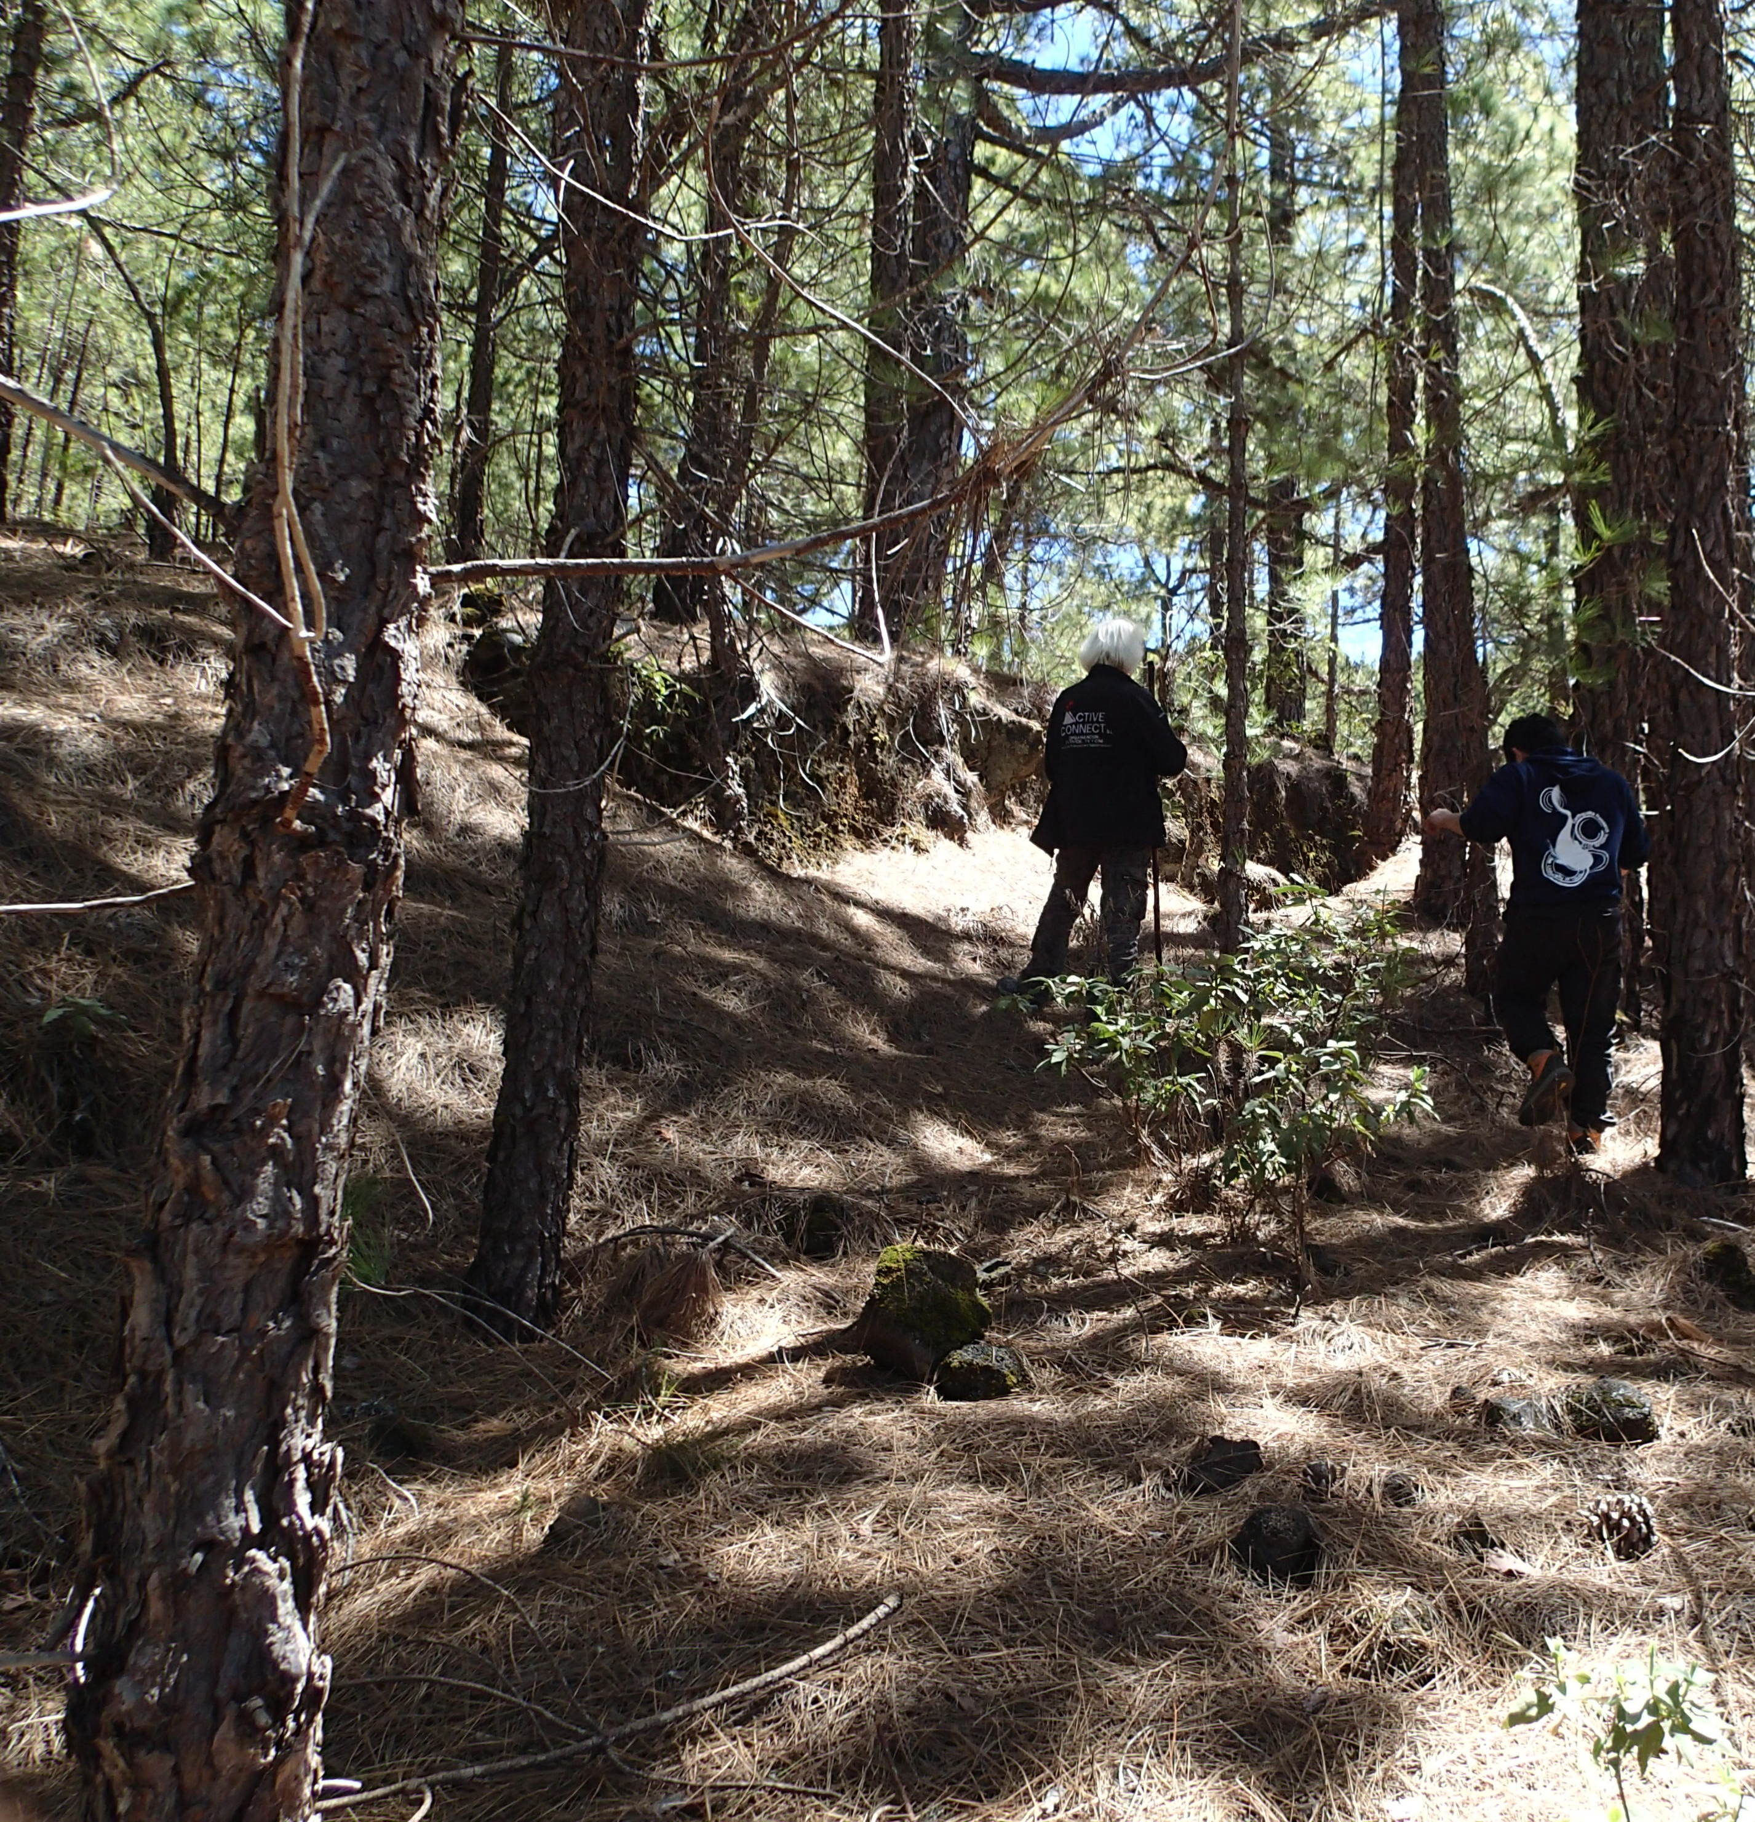
1949 fault

Slide 8
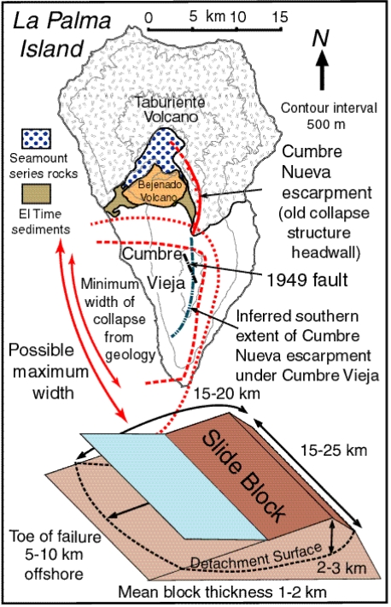
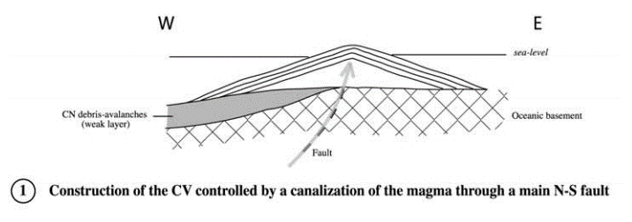
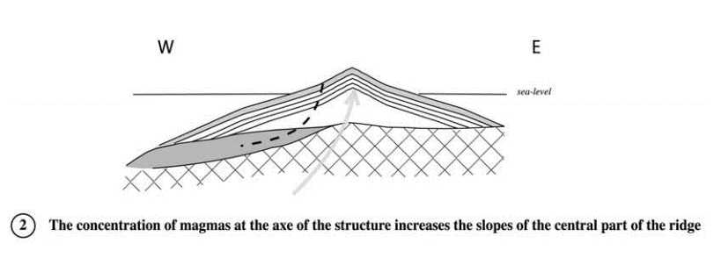
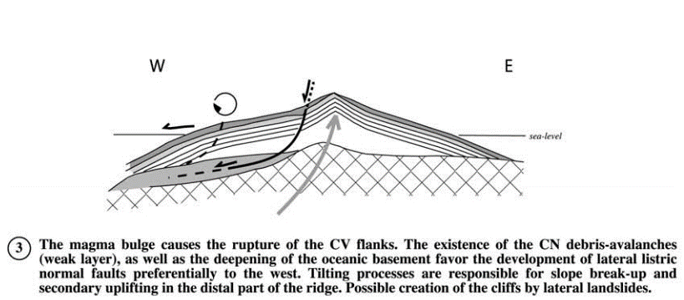
Story of large-scale land collapse
PROJECTS
Day et al., 1999 , Day and Ward, 2001

Slide 9
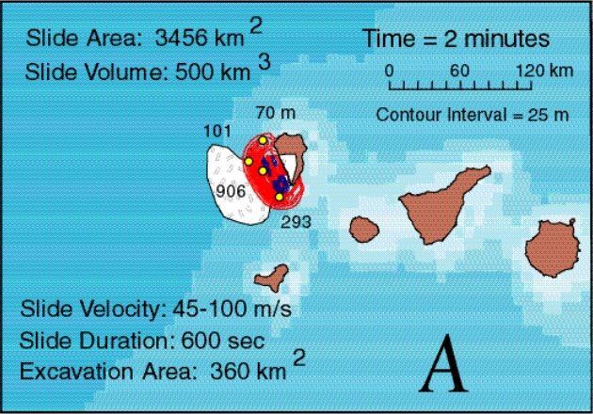
大規模な地滑り→大津波？
進行中

Slide 10
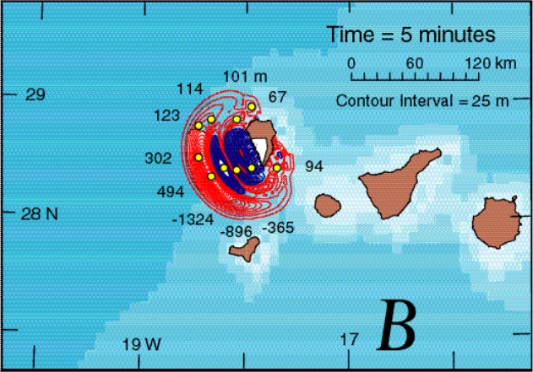
大規模な地滑り→大津波？
進行中

Slide 11
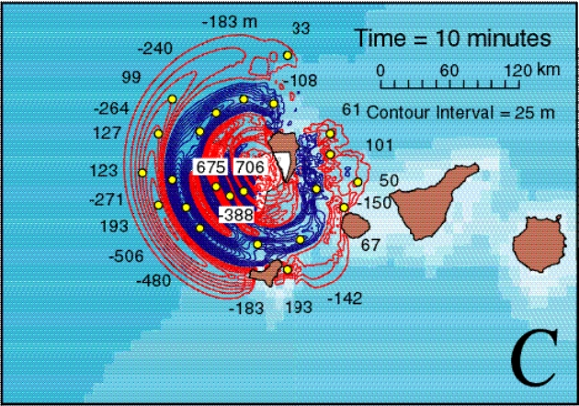
大規模な地滑り→大津波？
進行中

Slide 12
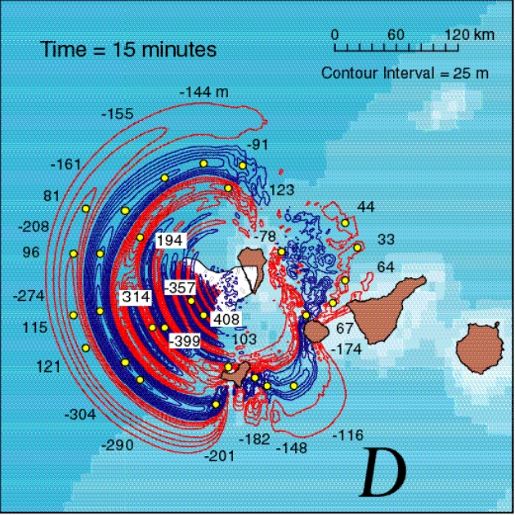
大規模な地滑り→大津波？
進行中

Slide 13
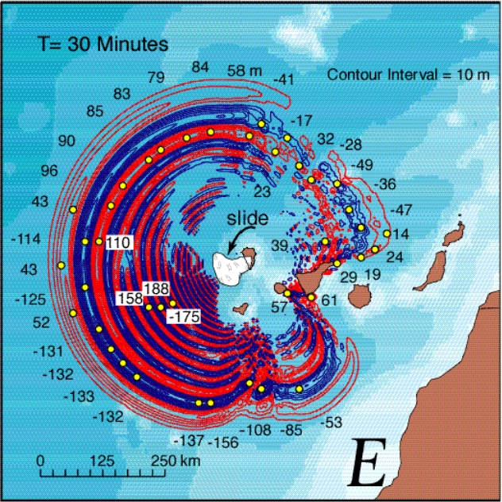
大規模な地滑り→大津波？
進行中

Slide 14
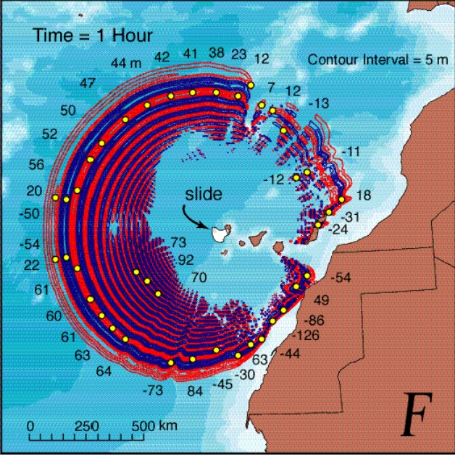
大規模な地滑り→大津波？
進行中

Slide 15
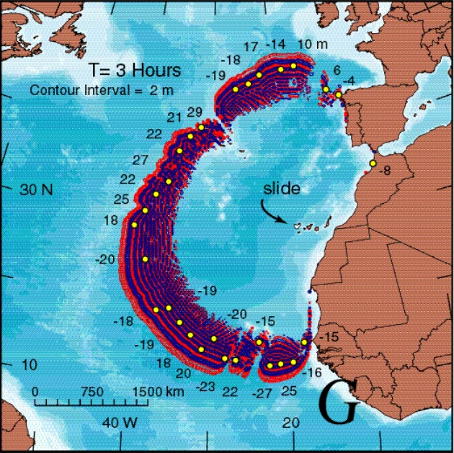
大規模な地滑り→大津波？
進行中

Slide 16
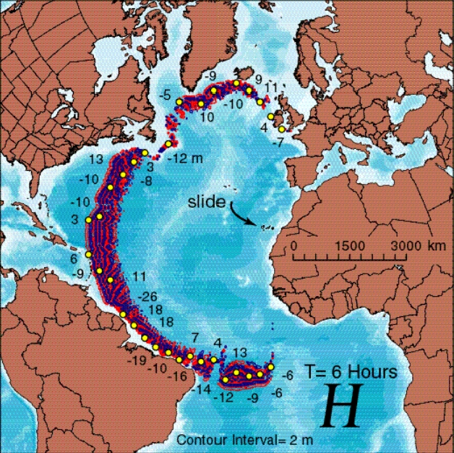
大規模な地滑り→大津波？
進行中

Slide 17
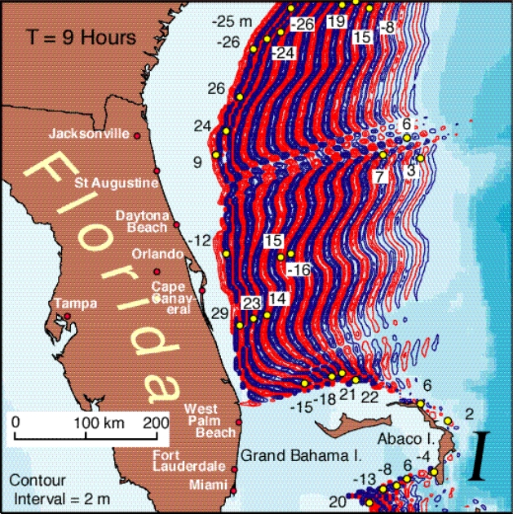
大規模な地滑り→大津波？
進行中

Slide 18
Motivations
It is significant to investigate this fault by not only geological approach, but also any other geophysical exploration.
Does the deep fault really exist in the subsurface along the 1949 fault line ?
If exists, to what depth does the crushing zone extend ?
How does it vary with depth ?
If not exist, we should show which parameter region we searched.

Slide 19
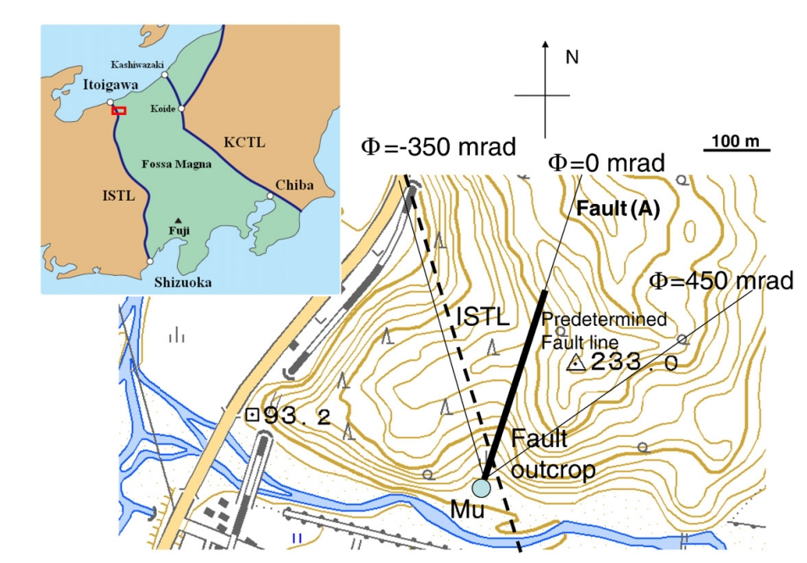
Seismic fault detection at Itoigawa, Japan, (Tanaka et al. 2011)

Slide 20
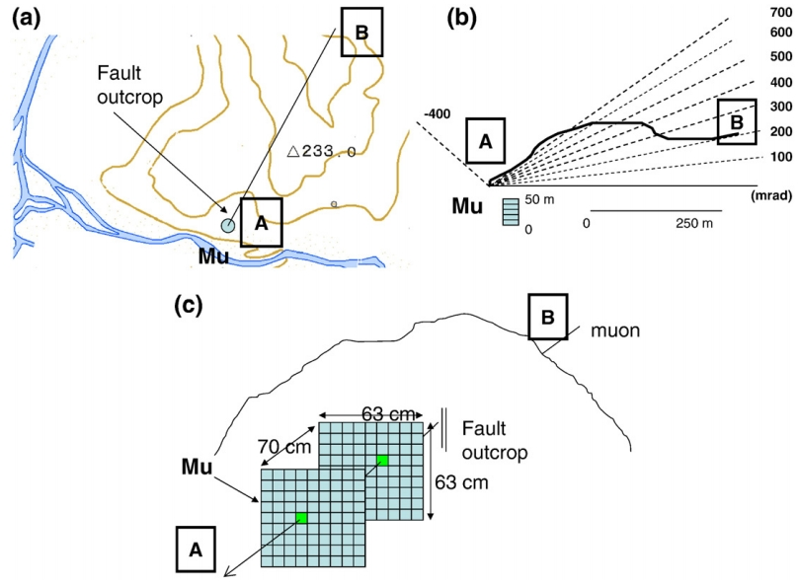
Seismic fault detection at Itoigawa, Japan, (Tanaka et al. 2011)
Top view
side view
Front view

Slide 21
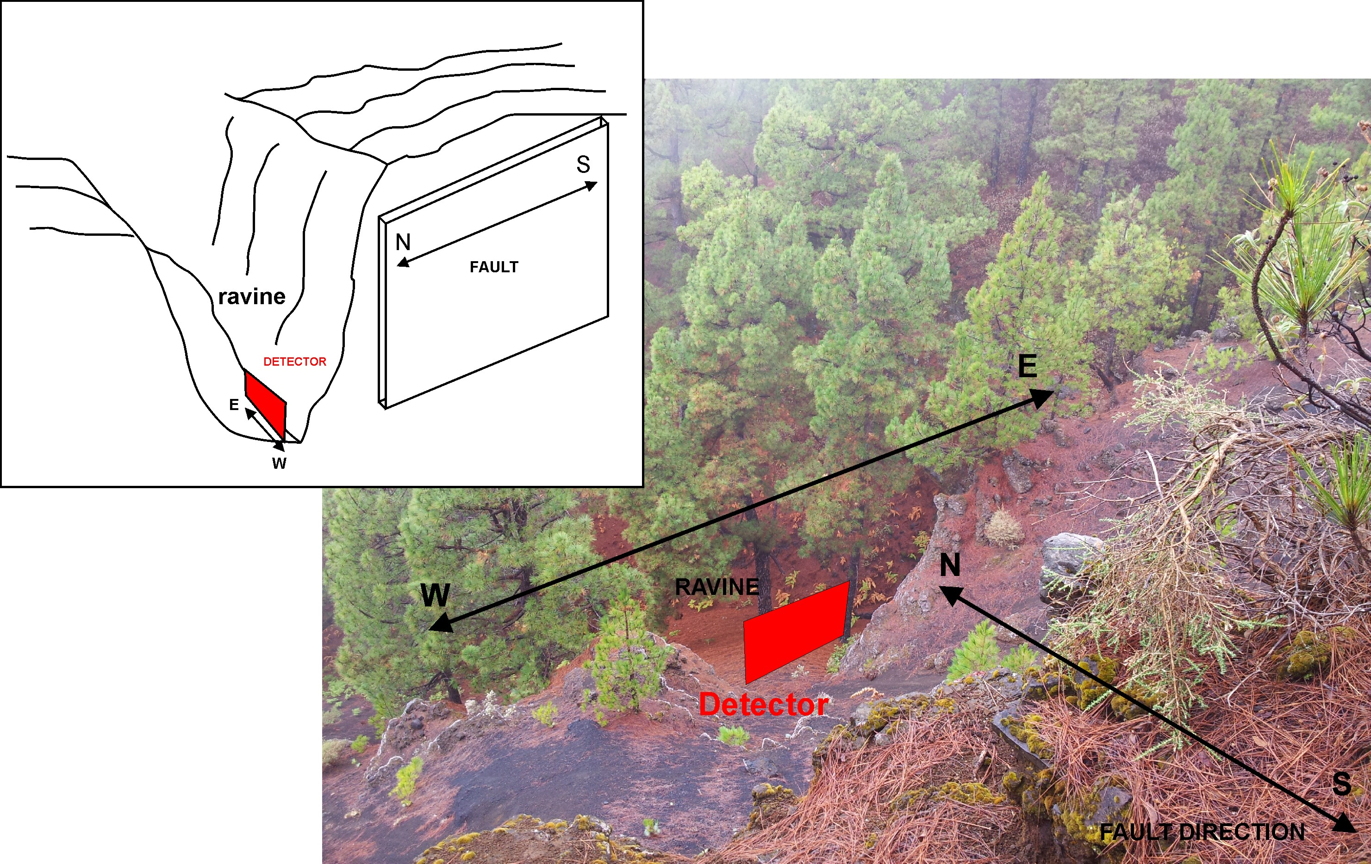

Slide 22
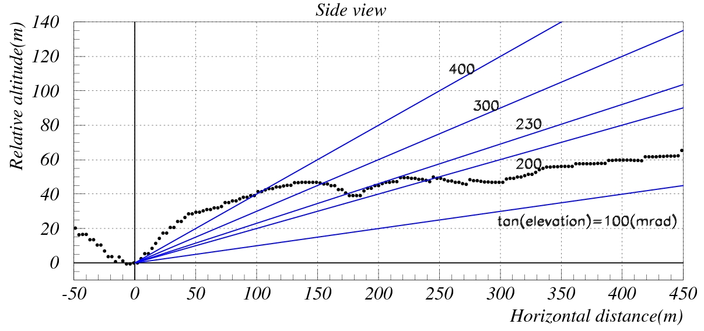
Side View
North
South

Slide 23
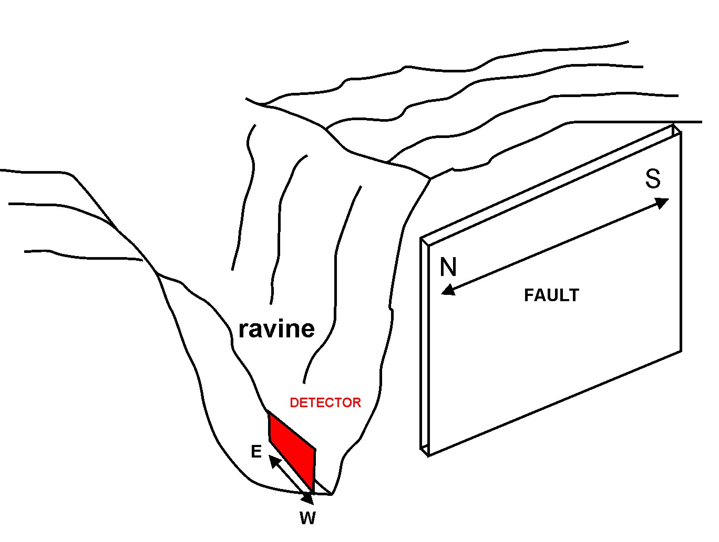
Expected width of crushing plane
Expected width : a few meter ?

Slide 24
Nuclear emulsion as muon detector
High angular resolution( = high spatial resolition) intrinsically , typically 5 mrad = 0.29degree = ±5m @ 1,000m far from detector
No power supply. Typically it’s very difficult to get stable and continuous power supply at such a place.
But no time information
→ It is suitable to investigate 1949 fault

Slide 25
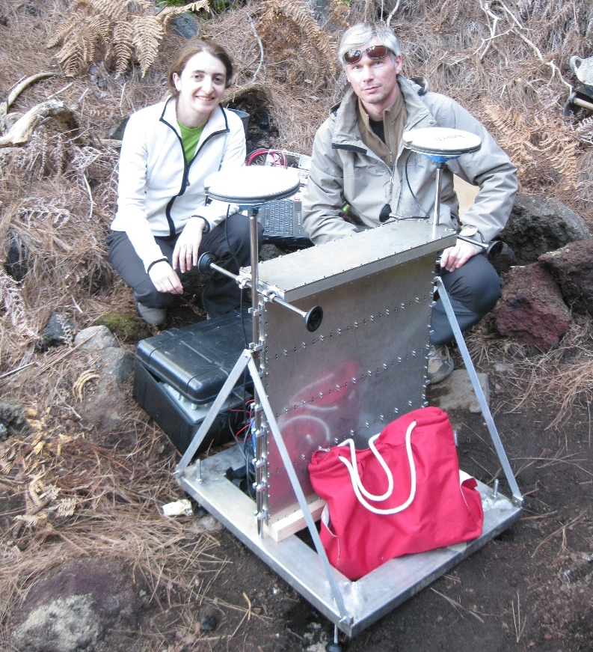
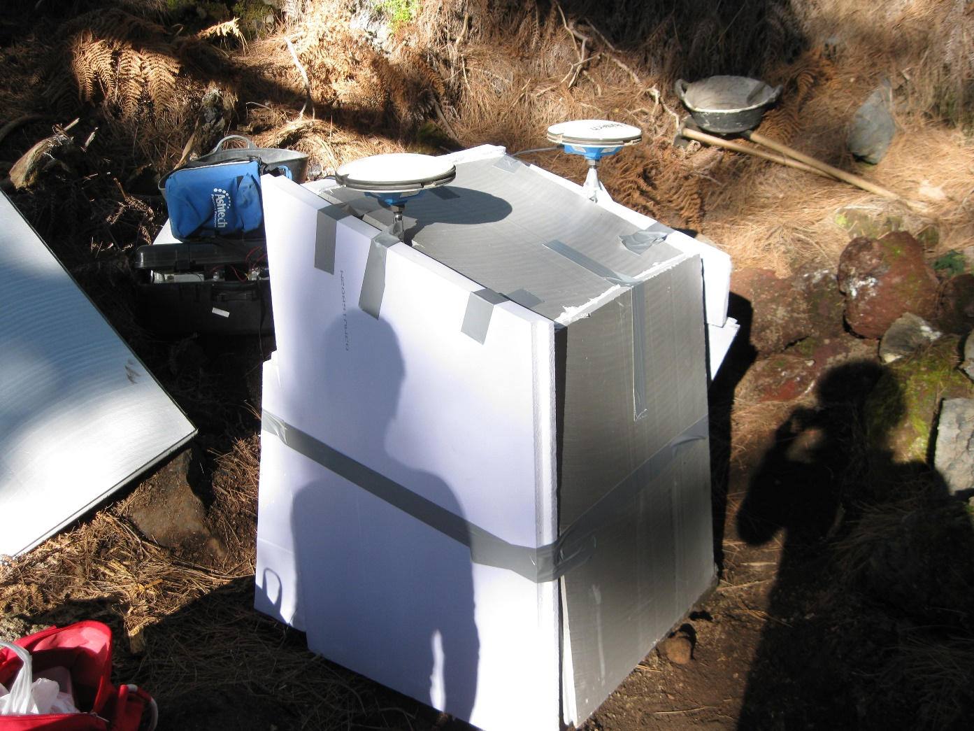
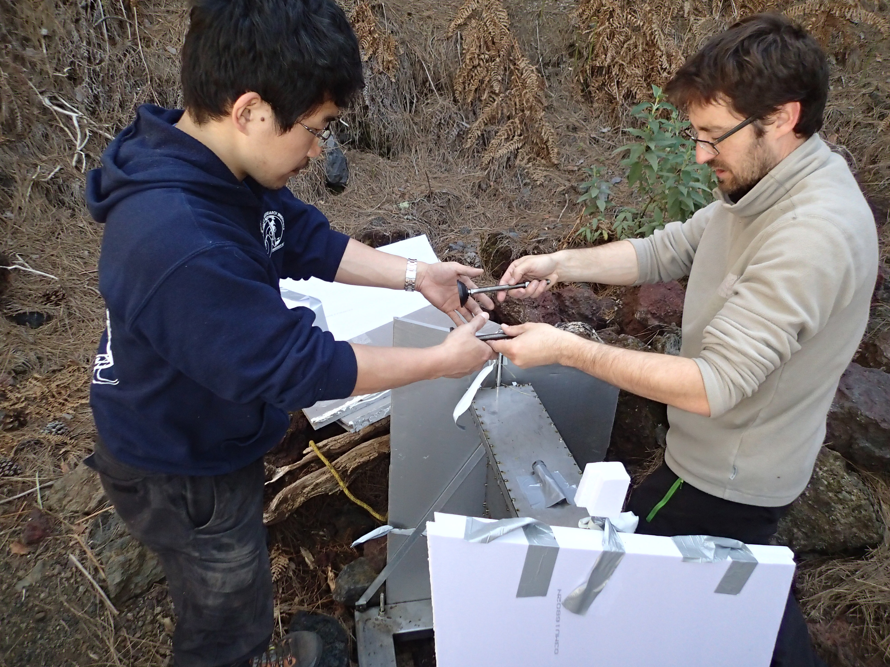
Detector implementation (21st , Jan - 07th, May, 2014, 106 days )
muon
muon

Slide 26
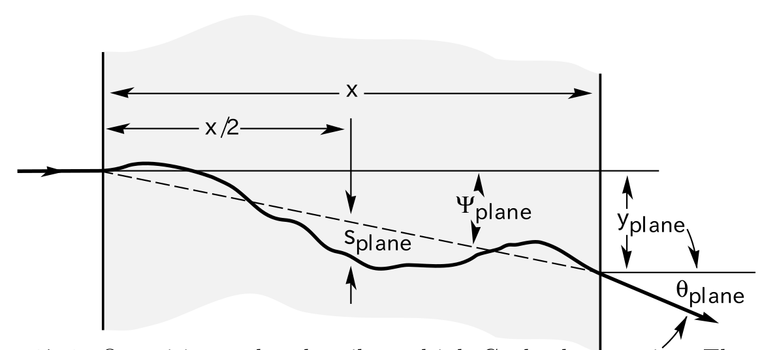
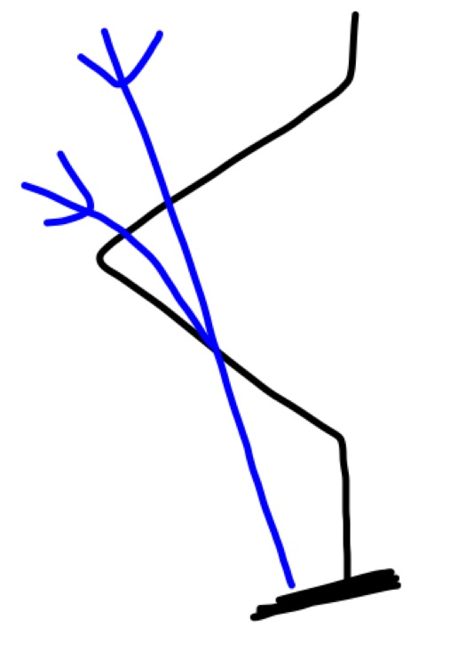
Internal structure: Emulsion Cloud Chamber(ECC)
Multiple Coulomb Scattering
θ₁
θ₂
Δθ_{i}
θ₃
Lead plates
1mm- thick
θ_{i}
θ_{i+1}
ECC can reject the low energy charged particles (<1GeV), which is background particles because they are deflected in the material around the detector largely and losing their original direction information.

Slide 27
Estimation of the detectable width and depth of the crushing fault plane by simulation
Effective area : 0.19m2
Exposure time : 106 days
The rock density around the fault plane is uniform and assumed to be 2.30g/cm3, while in the crushing plane it is 1.84g/cm3 which means that the porosity of the crushing zone is 20%
Muon flux by Honda et al. 2004

Slide 28
Relationship between fault width, solid angle, and muon statistics
muons
muons
TOP VIEW
Low density zone
※ typically fault width ↓ , solid angle ↓
Muon statistics ↓
performance of detection of density anomaly↓
detector

Slide 29
North
South
※ typically fault width ↓ , solid angle ↓
Muon statistics ↓
performance of detection of density anomaly↓
※ We want to see deeper part, muon path in the rock ↑
muon attenuation ↑, muon statistics↓
→ performance of detection of density anomaly↓

Slide 30
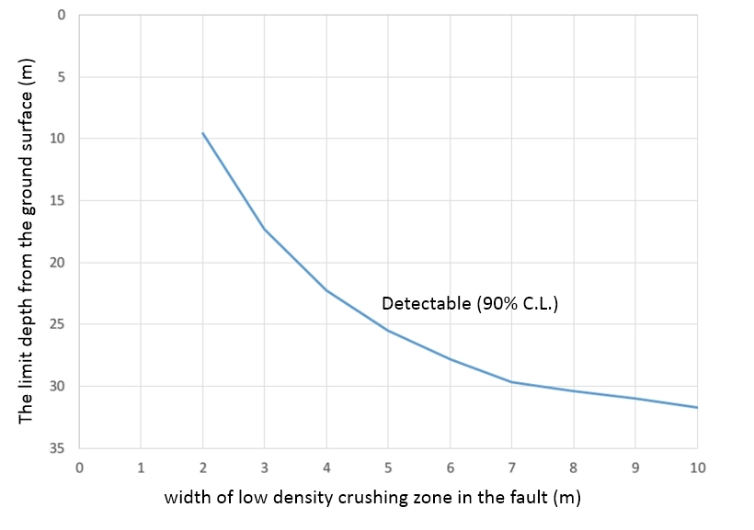
Relationship between the detectable width and depth of the crushing fault plane

Slide 31
Summary
Muography with nuclear emulsion detector is one of best tools to see “1949 fault” because 1) sensitivity for density anomaly, 2) linearity , 3) high spatial resolution
The 0.19m2 emulsion film detector placed to search 1949 fault at the end of this January, for 106days. All films are under analysis.
By simulation, we can detect 2m-width @ 10m depth, 4m-width @ 22m depth from ground surface if we assume very simple model case.
All emulsion films were already removed and developed. Now under data acquisition in Napoli, Salerno, and Tokyo

Slide 33
Emulsions orientation and numeration
Cell 5
Cell 4
Cell 3
Cell 2
Cell 1
Labeled as : Module.Cell.Emulsion as (4.5.1)
Emulsion 1 is down in the module (nearest
to the fault in Mod1,3,4)
Note: Module 3 by mistake was taking data for about 1 hour rotated
180 deg in respect to fault axis, then it’s position was corrected

Slide 34
5 minimodules were installed
Module 5 BG: 1 cell (central with 6mm Al spacer), 23 em, 10 Pb
5mm inox
7 emulsions
Pb1emPb2em…emPb10
7 emulsions
6mm Al
5mm Inox
Module 4: 5 cell x 10 emPb + 0.3 mm plastic spacer, 10 mm Al spacer
Module 3 as Mod4
Module 2 as Mod5 (BG)
Module 1 as Mod4
This photo was made toward the fault
The detector was installed orthogonal to the fault axis (170 degree)

Slide 35
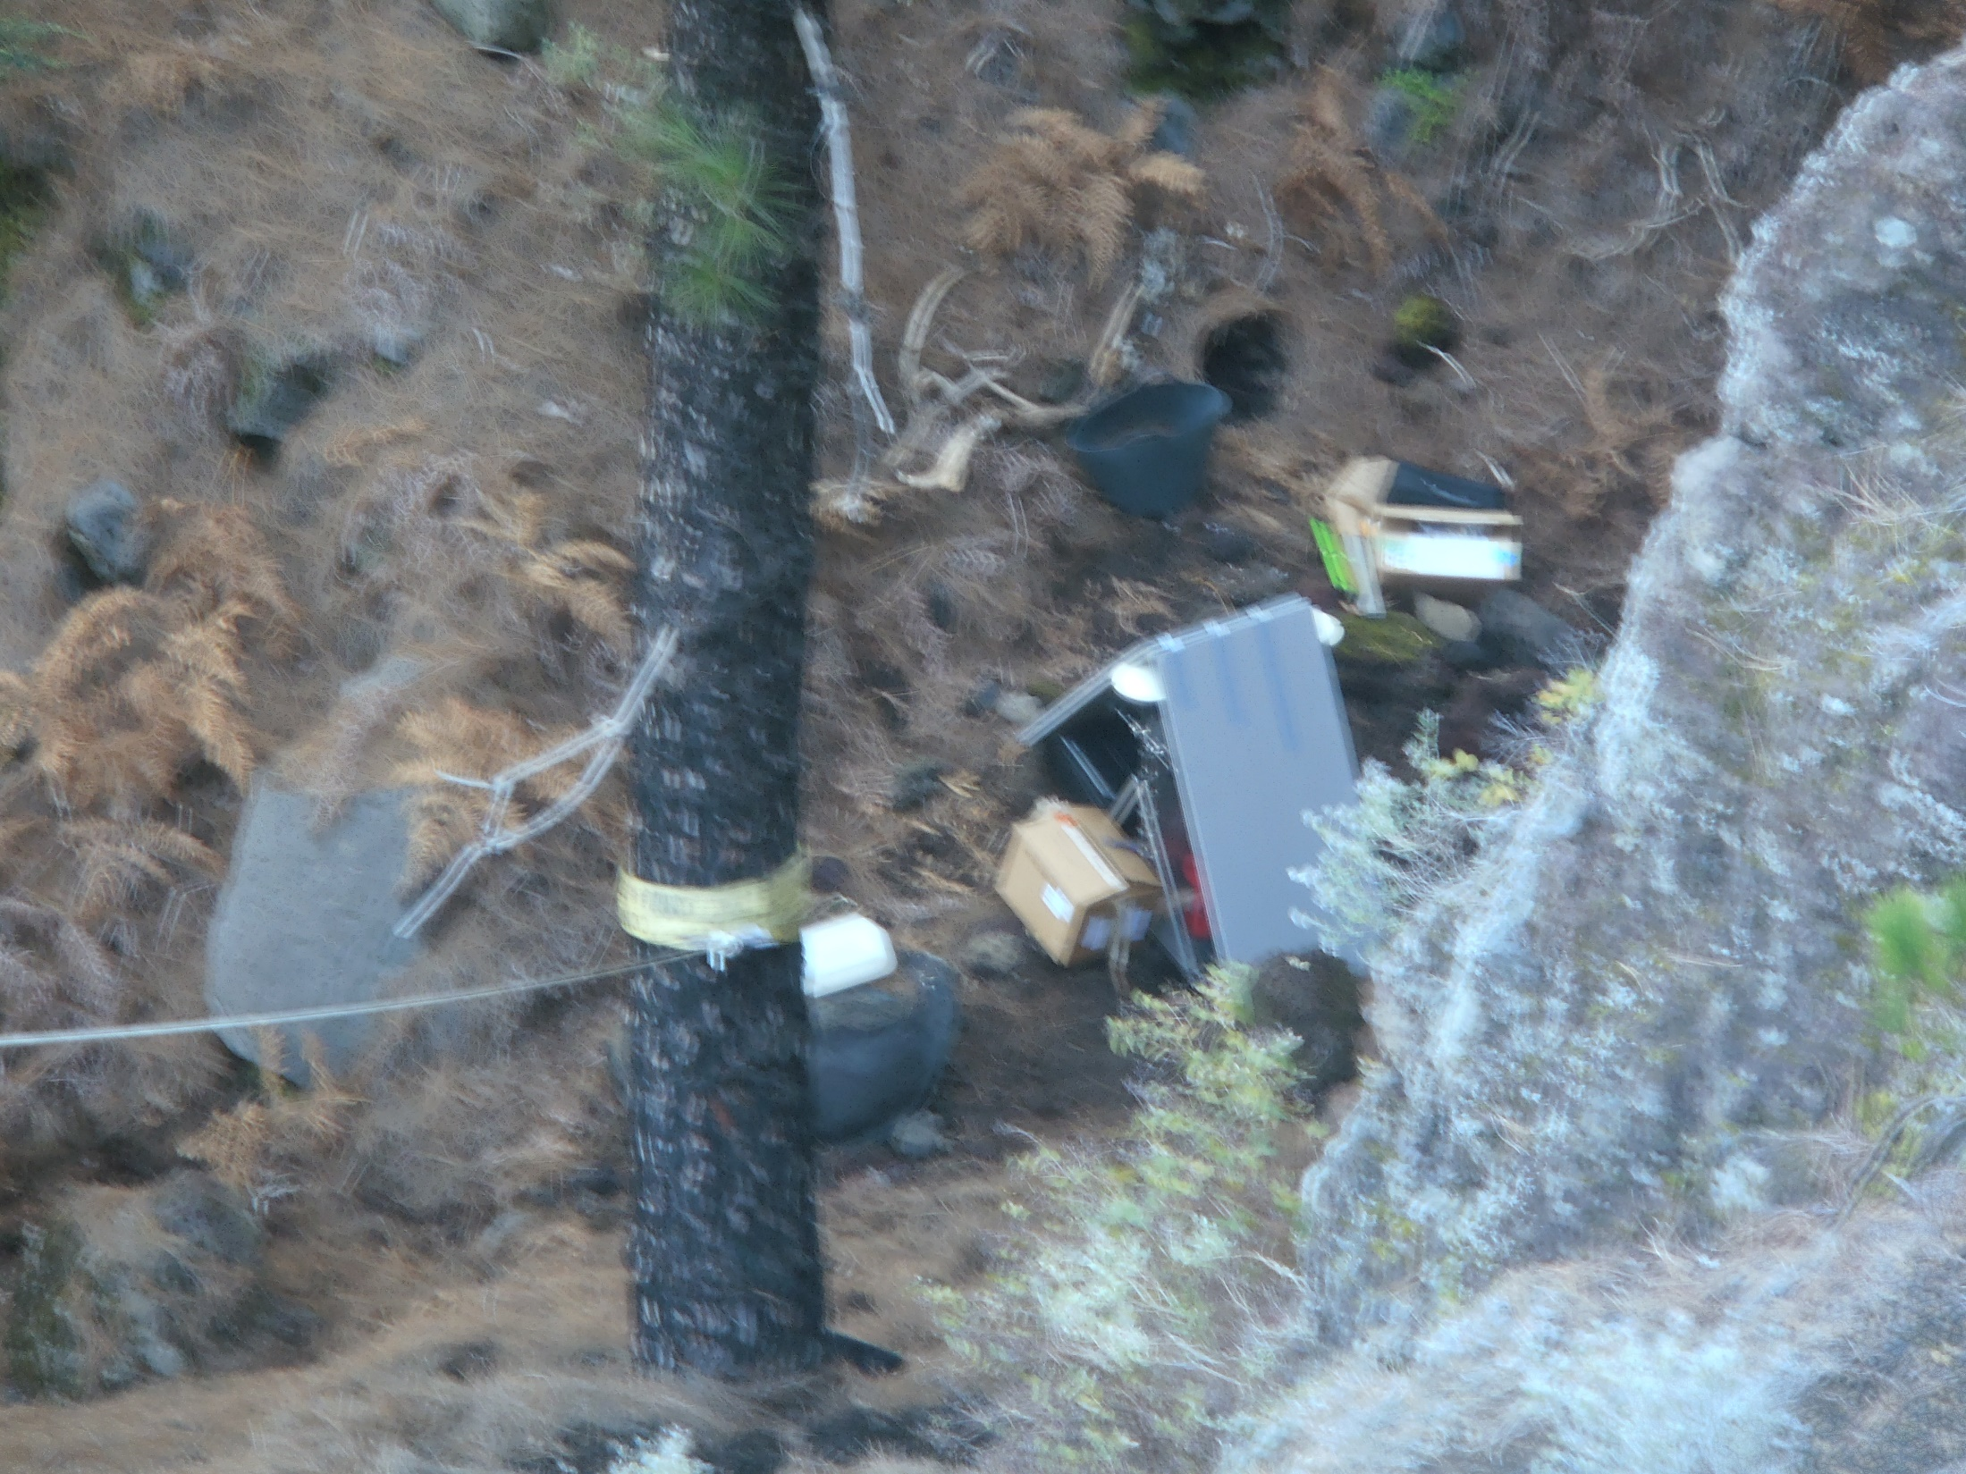
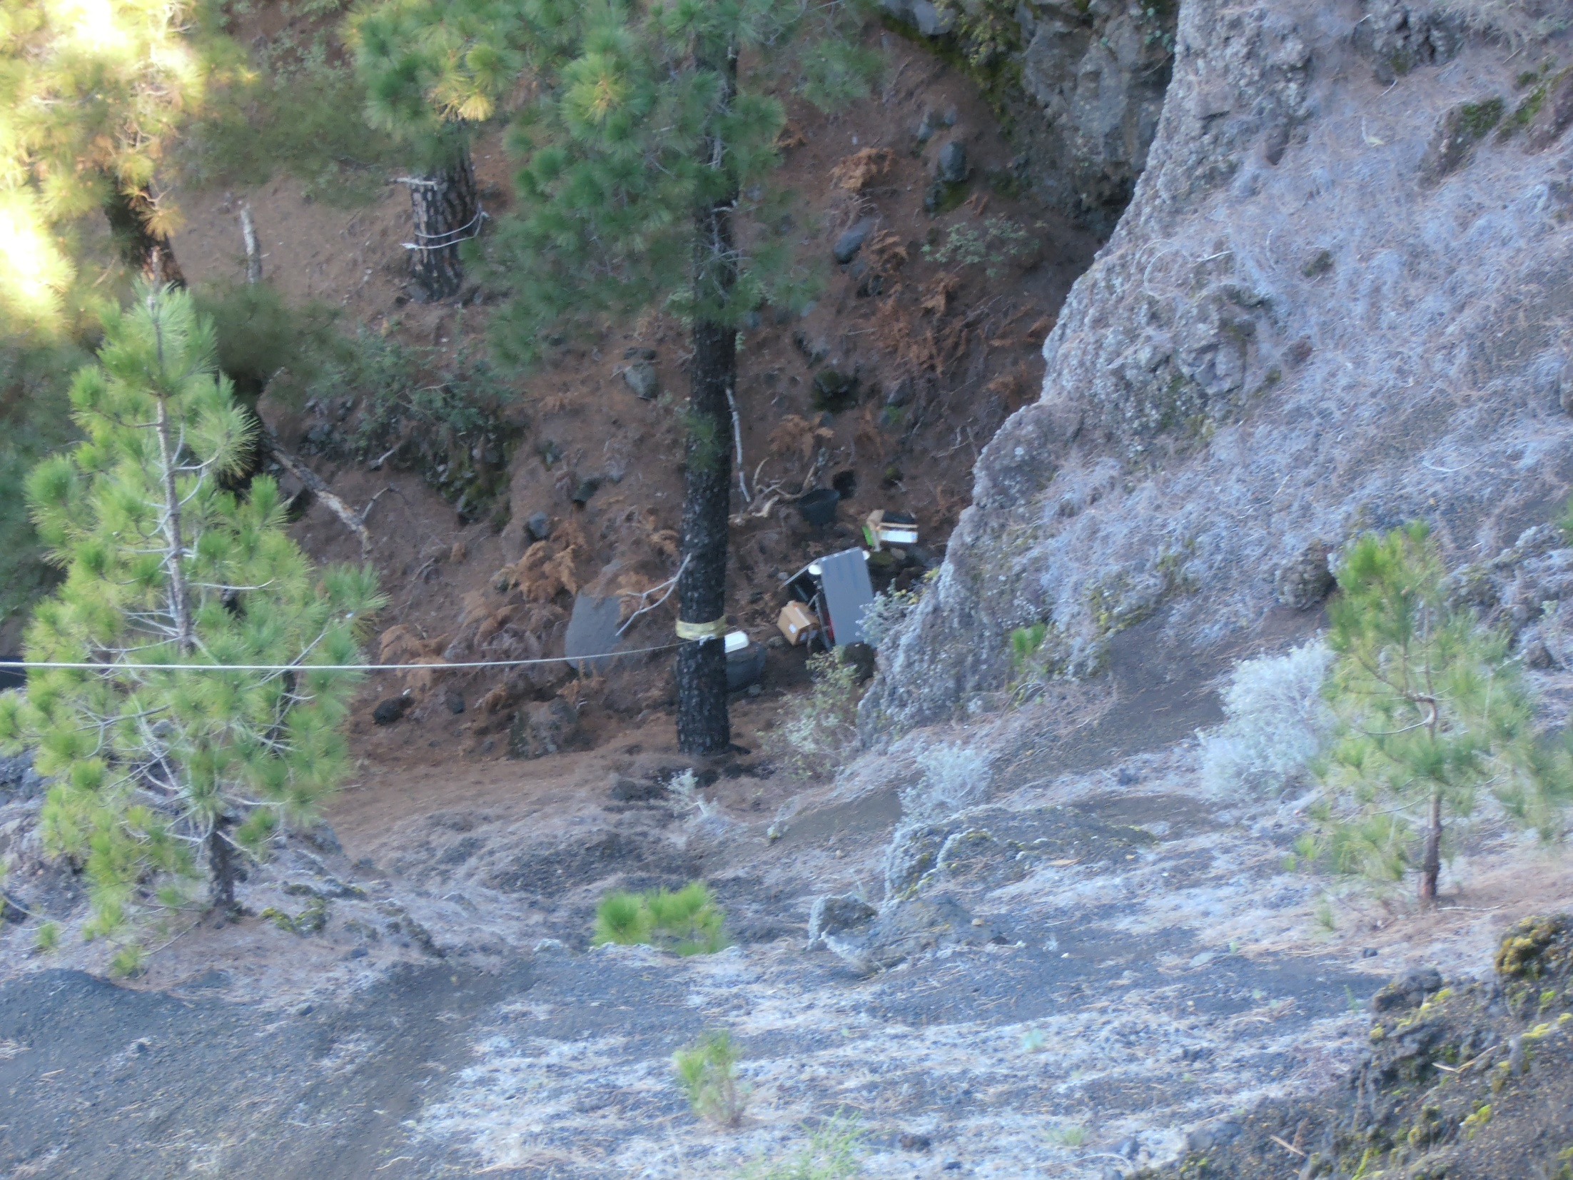
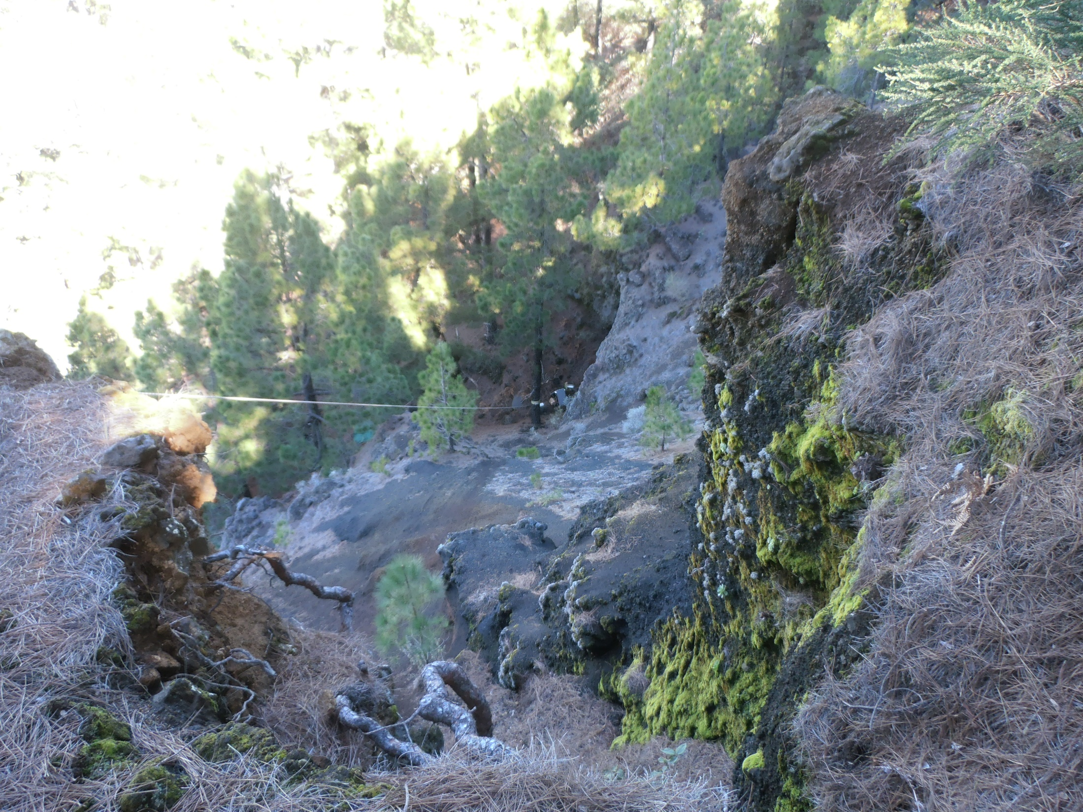

Slide 36
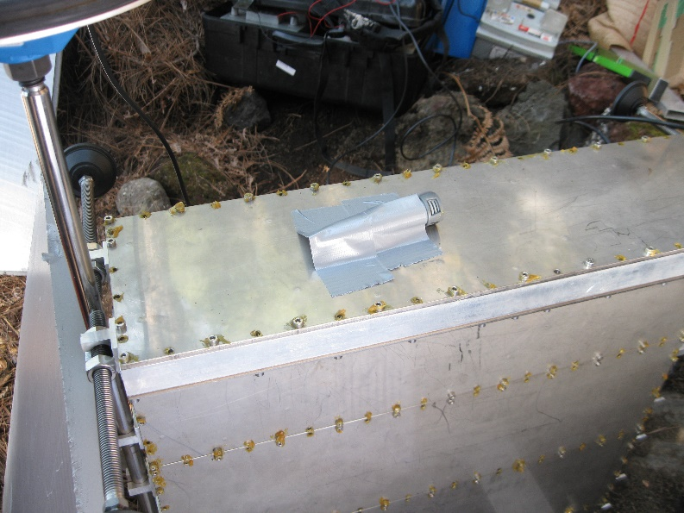
The temperature datalogger was left on the top of
The 5-th module
The module was covered with polystyrene sheets
Note: two special adapter screws for GPS were prepared at ITER for this structure only
muon
muon

Slide 37
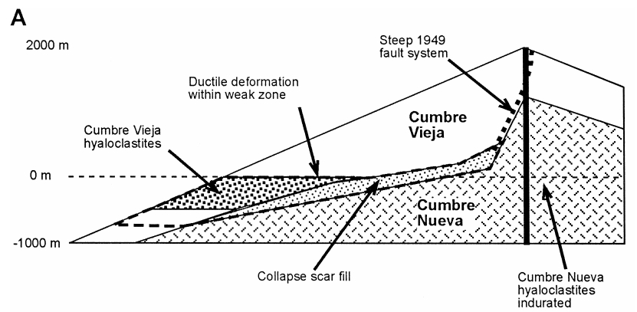
Story of large-scale land collapse
WEST
EAST

Slide 38
