Slide 1
Muography in Usu
Taro KUSAGAYA¹, Hiroyuki TANAKA¹, Akimichi TAKETA¹,
Hiromistsu OSHIMA², Tokumitsu MAEKAWA²,
Izumi YOKOYAMA³
1. Earthquake Research Institute, University of Tokyo
2. Usu Volcano Observatory, Hokkaido University
3. The Japan Academy
Notes:
Thank you Mister/Madam Chairperson.
Good morning, everyone.
I’m going to talk about “Muography in Usu volcano”
“development of multilayer muography for imaging a middle-scale volcano.”

Slide 2
Table of Contents
Introduction
  Motivation: why development ?
  The issue of noise in conventional detector
Methods
  Linear cut method with multilayer detector
Results and discussion
  Improved data of test measurement in Usu volcano
Summary
Notes:
In this presentation, first I’m going to talk about motivation of this work and the issue of background noise in conventional detector.
And I’ll show you the linear cut method with multilayer muon detector for reducing the background noise.
After that I will show you improved data of a test measurement in Usu volcano, Hokkaido, Japan.
Finally, I will make a summary.

Slide 3
Motivation: why development?
If cosmic ray muons penetrate a volcano with a thickness of > 1 km, muography is difficult.
↓Because
More thickness of rock results in less muons(signal), that is, worse signal-to-noise(S/N) ratio.
↓Then
In order to obtain a real density structure of a large volcano, muography needs improvements.
↓So
We developed a low noise muon detection system.
昭和新山[Tanaka et al., 2007]
  火道構造
薩摩硫黄島硫黄岳[Tanaka et al., 2009a]
  脱ガス現象
浅間山[Tanaka et al., 2009b]
  2009年噴火前後の変化
La Soufrière（フランス）[Lesparre et al., 2012]
  溶岩ドーム密度異方性
Puy de Dôme（フランス）[Cârloganu et al., 2012]
  Puy de Dome上部の密度
Notes:
muon flux steeply decreases as a path length of a muon become longer.
If cosmic ray muons penetrate a volcano with a thickness of more than 1 kilometer, muography is difficult for the conventional detector because the background noise doesn’t depend on a thickness of a volcano.
Then, in order to obtain a real density structure of a large volcano, we need to improve signal-to-noise ratio.
So, we developed a low noise muon detection system.

Slide 4
The issue of Background(BG) noise in conventional detector
EM shower particle
(electron, positron, gamma ray)
Conventional
detector
μ?
A fake track is generated by accidental coincidence of electromagnetic(EM) shower particles
Notes:
Then, I'll show you the issue of the background noise.
We assumed the background noise as fake tracks generated by accidental coincidence of electromagnetic EM shower particles.
They consist of electron, positron, and gamma ray.
With a conventional detector that consists of two PSDs, we cannot discriminate EM shower particles from muons in this case.

Slide 5
Noise reduction by software
-Linear cut method-
Use multilayer detector
→Check the linearity of a detection pattern by software.
μ?
Notes:
So, we used multilayer detector and processed data with software.
Multilayer detector consists of many PSDs.
When muons penetrate the multilayer detector, the detected positions of each PSD make straight line.
On the other hand, EM shower particles make a detection pattern at random.
So, we can discriminate EM shower particles from muons.

Slide 6
Noise reduction by software
-Linear cut method-
μ
Notes:
We call this discrimination method Linear cut method and I will show you in some detail.
This is the side view of a multilayer detector.
When each PSD detects a particle, we connect two detected position at the ends of a multilayer detector with a band.
The width of the band derives from a position resolution of a PSD.
Then, if all detected positions are included within the band, we count as a muon.

Slide 7
Noise reduction by software
-Linear cut method-
Text data of WHEN and WHERE muons passed in each position sensitive detector is recorded.
Time, X1,Y1, X2,Y2, X3,Y3, …
Then process the text data with our AWK code.
  X_i_min = linearcut1_slopeX * (plane_combination[i]-1)
    X_i_max = linearcut1_slopeX * (plane_combination[i]-1)
gridX_i_min = $(4*(plane_combination[i]-1)+3)
gridX_i_cen = gridX_i_min + 0.5*width_of_scintillator
gridX_i_max = gridX_i_min + width_of_scintillator
. . . . . .
μ
Notes:
But, if any detected position is not included within the band, we remove this event as an EM shower particles event.
The measured data include arrival time and detected positions of each PSD.
The data are text format, so we processed with our AWK code.

Slide 8
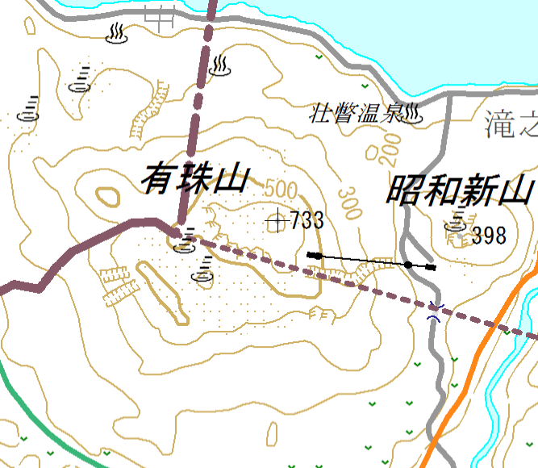
Verification test
Usu Volcano, Hokkadio, Japan
1 km
Measurement range（±30°）
Negative azimuth
−φ
Positive azimuth
+φ
Oo-Usu
Ko-Usu
Showa-Shinzan
Usu-Shinzan
Lake Toya
Meiji-Shinzan
Installed place
（Usu Volcano Observatory, Hokkaido Univ.）
Notes:
Then we performed verification test of our detection system.
This is the topographic map of southwest of Hokkaido, Japan.
And we tested our detection system in Usu volcano.
Usu volcano has a suitable size for our verification test that has a thickness of about a few kilometers.
The red star is an installed place.
In our test measurement, a horizontal measurement range was like this.

Slide 9
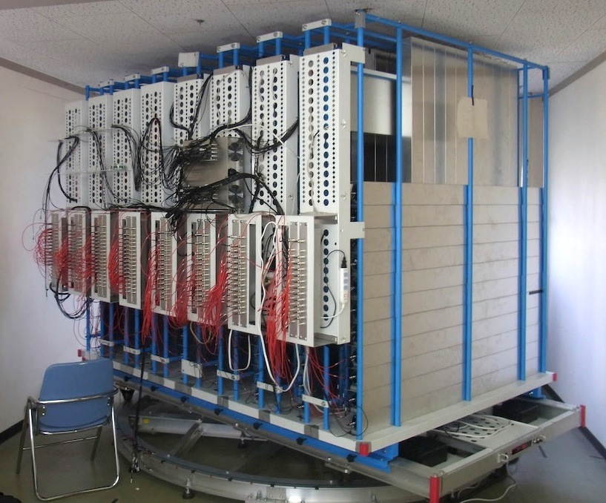
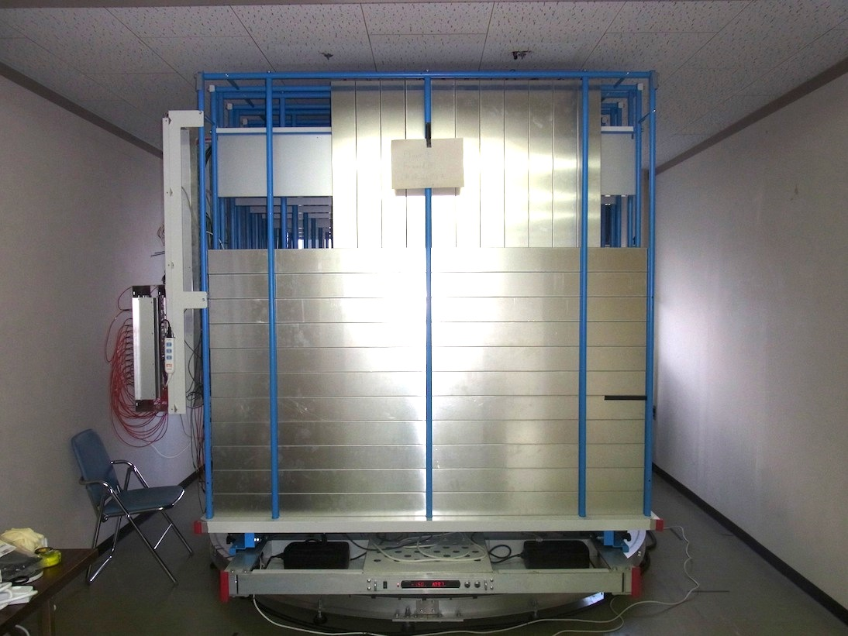
Verification test
Detector configuration
From Oct. 20, 2012
7 layers, effective area 1.21 m²
10x10 cm²/segment
Angular resolution ±3°
Installed place
（Usu Volcano Observatory, Hokkaido Univ.）
Meiji-Shinzan
Lake Toya
θRMS=1.4°（角度分解能）
Usu-Shinzan
Showa-Shinzan
Oo-Usu
Ko-Usu
Oo-Usu
1.21 m²
2[{1+(1-x/3}x/2]/(6×1/2)=0.68
x=1.4
Positive azimuth
+φ
Negative azimuth
−φ
7
6
5
4
3
Oo-Usu
2
1
Measurement range（±30°）
1 km
Rotatable mount
Notes:
I'll show you detector configuration.
Our detector consisted of seven PSDs.
And effective area was 1.21 square meters.
Angular resolution was about plus or minus 3 degrees.
The observation started from October 20th, 2012.

Slide 10
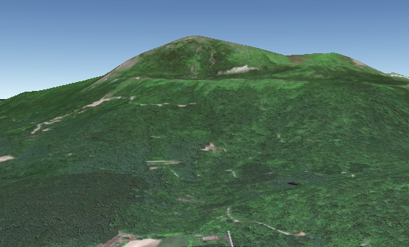
Verification test
Muon path length distribution
Oo-Usu
Usu-Shinzan
3000
300
Open sky
2000
elevation θ [mrad]
Path length[m]
200
> 1 km
1000
100
0
-600
-400
-200
0
200
400
600
azimuth φ [mrad]
South
Oo-Usu
Usu-Shinzan
地形図作成時の等高線水平誤差：±7.5m
Path Length
地形図からの水平読み取り誤差：±1.5m
θ
φ
©Google Earth
0 m
1000 m
2000 m
3000 m
空や薄い岩盤を含まない領域を使って解析するために、
仰角 166±55 mRad、 222±55 mRad
（ただし方位角 -55±55〜556±55 mRad）
の角度領域を選んだ。
Notes:
How long do muons penetrate in Usu volcano?
Read from topographical map, the path lengths of muons for each azimuth angle and elevation angle are shown in this figure.
The violet color means open sky that muons reach our detector directly from sky.
As the color figure shows, most of path lengths are more than 1 kilometer.

Slide 11
Results raw data from conventional 2-layer detector
Oo-Usu
Usu-Shinzan
300
elevation θ [mrad]
200
The data do NOT reflect the distribution of path length.
> 1km
thickness
100
-600
-400
-200
0
200
400
600
azimuth φ [mrad]
地形図作成時の等高線水平誤差：±7.5m
μ
地形図からの水平読み取り誤差：±1.5m
0 m
1000 m
2000 m
3000 m
空や薄い岩盤を含まない領域を使って解析するために、
仰角 166±55 mRad、 222±55 mRad
（ただし方位角 -55±55〜556±55 mRad）
の角度領域を選んだ。
Notes:
Here I show result of the raw data from conventional two-layer detector.
The redder color means more muons we observed and the bluer color means less muons.
On the range with a path length of more than 1 kilometer, the data do NOT reflect the path lengths distribution.
This was caused by the background noise.
Well, how about our seven-layer detection system?

Slide 12
Results raw data from 7-layer with software analysis
Oo-Usu
Usu-Shinzan
300
elevation θ [mrad]
200
The data reflect the distribution of path length.
> 1km
thickness
100
-600
-400
-200
0
200
400
600
azimuth φ [mrad]
地形図作成時の等高線水平誤差：±7.5m
μ
地形図からの水平読み取り誤差：±1.5m
0 m
1000 m
2000 m
3000 m
空や薄い岩盤を含まない領域を使って解析するために、
仰角 166±55 mRad、 222±55 mRad
（ただし方位角 -55±55〜556±55 mRad）
の角度領域を選んだ。
Notes:
This is a result.
As you see, the data reflect the path length distribution.
Then, how much background noise did we reduce?

Slide 13
Results
Noise reduction rate
Noise reduction rate[%] =
400
100
90
300
elevation θ [mrad]
50
Noise reduction rate[%]
200
> 1km
thickness
100
0
-600
-400
-200
0
200
400
600
azimuth φ [mrad]
Notes:
This figure shows noise reduction rate.
Noise reduction rate is the amount of noise of conventional two-layer detector.
We reduced more than 90% of the noise with a path length of more than 1 kilometer.

Slide 14
Results
Density distribution
Lake Toya
Usu-Shinzan
Oo-Usu
A
B
Showa-Shinzan
Usu Volcano
大有珠小有珠有珠新山の位置を明確に
Notes:
Then, with our low noise detection system, we measured density distribution of Usu volcano.
I will project the density distribution on A-B vertical cross section including Oo-Usu peak and Usu-Shinzan peak.

Slide 15
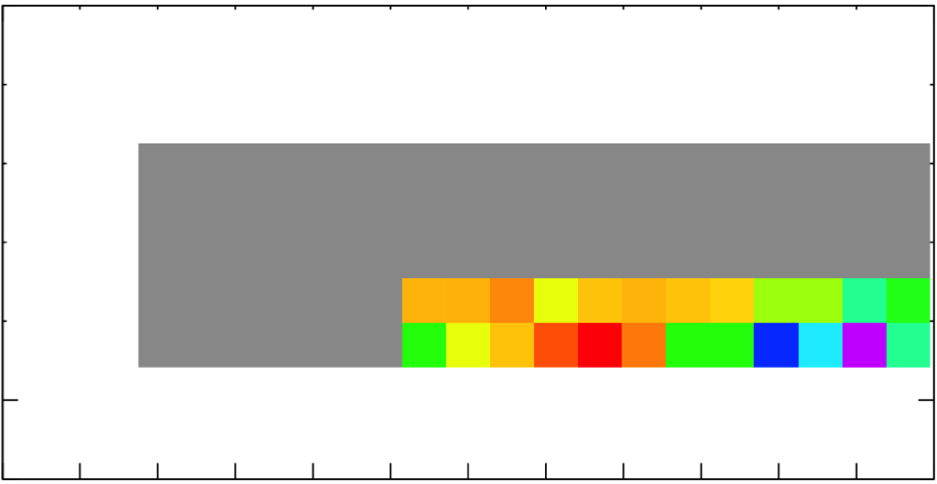
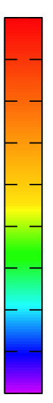
Results
Density distribution on AB cross section
Measurement duration
1977 hours
Altitude
[m]
Elevation[mrad]
1185 600
2.4
2.1
1.8
1.5
A
B
1011 500
A
B
Oo-Usu
(φ=0 mrad)
836 400
Usu-Shinzan
(φ=398 mrad)
662 300
density [g/cm³]
488 200
314 100
140 0
−600
−1044
−500
−871
−400
−696
−300
−522
−200
−348
−100
−174
0
0
100
174
200
348
300
522
400
696
500
871
600
1044
Azimuth[mrad]
Distance[m]
Notes:
This figure shows the result of muography.
The density distribution is projected after smoothing and I adopted the central value of density.
The measurement duration was about 80 days.
The horizontal axis is azimuth angle.
The vertical axis is elevation angle.
In this work, we analyzed only the region with a path length of more than 1 kilometer, so we didn’t analyze the gray area.
(And another reason is because of a difficulty of evaluating correct amount of muons from open sky.)
(In evaluating amount of muons, we integrate the energy spectrum of muons from Cut-off energy to infinity energy. But, in large zenith angle, I don’t know there are data of low-energy muon spectrum. So I couldn’t evaluate.)
But you can see there are high- and low- density anomalies.

Slide 16
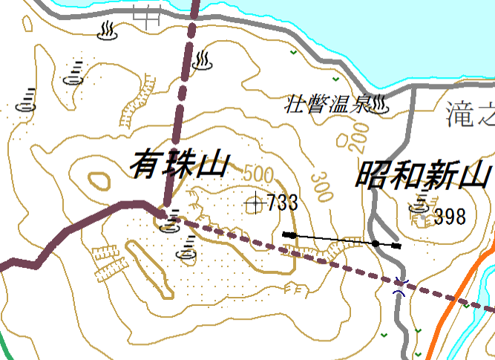
Discussion
Comparison with resistivity
Lake Toya
Ogawa et al.(1998)により貫入マグマの存在が示唆された位置。有珠新山から南西に300 m。
（NE-SW測線）
Ogawa et al.の図を挿入
Oo-Usu
SW
A
B
Showa-Shinzan
Usu Volcano
NE
Usu-Shinzan
1977年噴火時にできた断層
Notes:
Then we compared the region of high-density anomaly with resistivity.

Slide 17
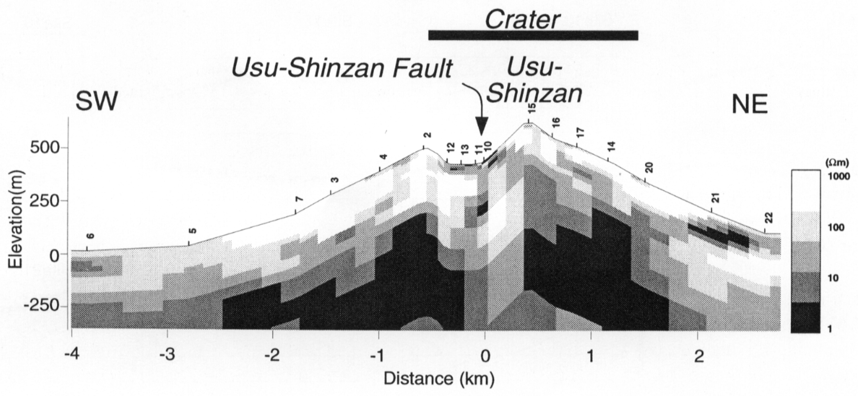
Discussion
Comparison with resistivity
Lake Toya
Fault
Usu-Shinzan
SW
NE
Ogawa et al.(1998)により貫入マグマの存在が示唆された位置。有珠新山から南西に300 m。
（NE-SW測線）
Ogawa et al.の図を挿入
500
(Ωm)
10000
250
Altitude (m)
SW
100
0
Fault
Usu-Shinzan
A
10
-250
SW
NE
1
500
Fault zone
(Ωm)
-1
0
1
Usu Volcano
10000
Distance (km)
250
Altitude (m)
NE
100
After Ogawa et al.(1998)
0
10
-250
1
-1
0
1
Distance (km)
After Ogawa et al.(1998)
1977年噴火時にできた断層
Notes:
According to the previous study of resistivity, the high resistivity region is below Usu-Shinzan Fault projected on NE-SW cross section.
It implies intruded magma.
And a developed fault zone is here.
Assuming that the magma intruded along this fault zone, the high-density anomaly might be the intruded magma.
And the low-density anomaly might imply a fault fracture zone because there can be many pores in the zone.

Slide 18
Summary
We developed a discrimination method with multilayer muon detector.
We obtained a density distribution with a path length of more than 1 km in Usu volcano.
We found high- and low-density anomalies beneath between Oo-Usu and Usu-Shinzan
We’re planning to apply our new detection system to other active volcanoes (e.g., Shinmoe-dake).
Notes:
This is summary.
We developed a discrimination method with multilayer muon detector.
We obtained a density distribution with a rock thickness of more than 1 km in Usu volcano.
We found high- and low-density anomalies beneath between Oo-Usu and Usu-Shinzan
And, in the future, we're planning to apply our new detection system to other active volcanoes, for example Shinmoe-dake.
Thank you for your attention.

