Slide 1
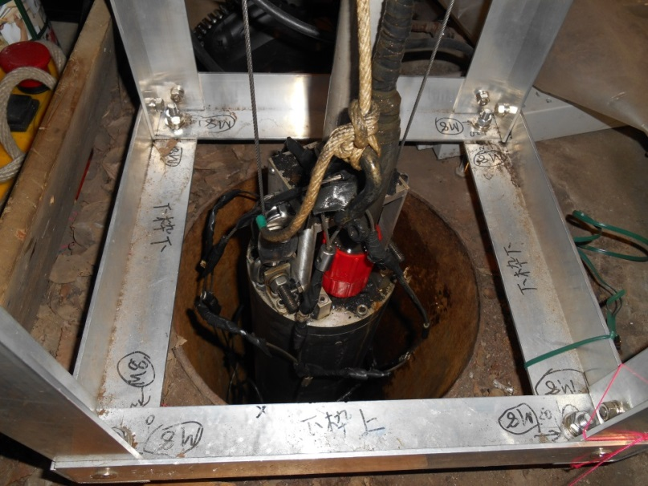
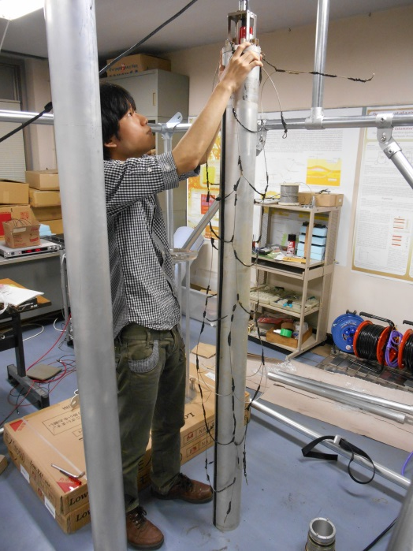
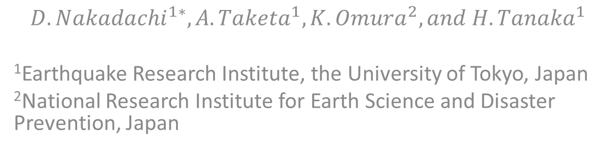
Borehole Muography
$${D. Nakadachi}^{1∗}, {A. Taketa}^{1}, {K. Omura}^{2}, and {H. Tanaka}^{1}$$
¹Earthquake Research Institute, the University of Tokyo, Japan
²National Research Institute for Earth Science and Disaster Prevention, Japan

Slide 2
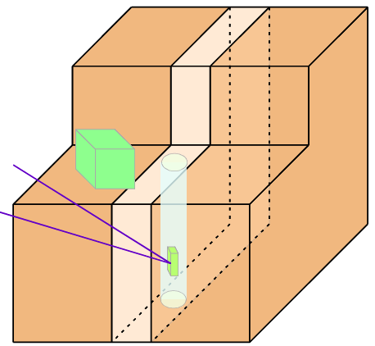
Purpose
p
Atmosphere
Extension to the underground of MUOGRAPHY
Target : Fault zone structure
－position, strike, dip ,width, and density
→Prediction on seismic intensity
BOREHOLE MUOGRAPHY
μ
μ
Fault
Typical surface detector cannot measure underground structures
because muons only come from the sky
How do we measure underground structure?
→Put a detector into underground
Detector
There are boreholes near the fault

Slide 3




Development of a new method ＆ detector
1m
PMT
Zenith Z
Muon
Scintillator
1m
Only 2 coupled scintillators are used
Y
$$70cm$$
X
～10 cm
$$4cm$$
Borehole
We count when muons come common section
$$7cm$$
・ New detector
4cm×7cm×70cm
Angular resolution ~30°
Need scanning in boreholes (rotation and up-down)
Traditional detector
1m×1m×1m
→CANNOT be put into the borehole
good angular resolution ~ 1°
3
Notes:
The problem is its Size of sci.

Slide 4
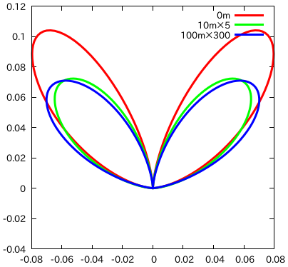
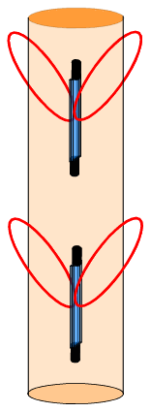
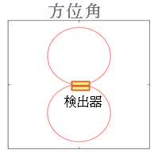








Sensitivity of the detector
Zenith angle
Two factors of sensitivity
・Shape of detector
Most sensitive from perpendicular to the detector’s section
・Angular distribution of muons
Most of muons come from vertical directions
Horizontal muons are absorbed by the ground
$$36°$$
$$Z$$
Muons
Borehole
$$Z$$
Detector
$$X$$
Azimuth angle
Change depth
Change angle
Perpendicular
to the section
Perpendicular
to the section
$$Y$$
$$X$$
$$X$$
Detector
Using this detector as a probe, we count muons as a function of depth and azimuthal angle
4
$$Y$$
Notes:
シンチの絵 ボアホール内シンチ ボアホール内のシンチからsensitivityの輪 tilt
Sensitivityの図の中にボアホールの絵（軸

Slide 5

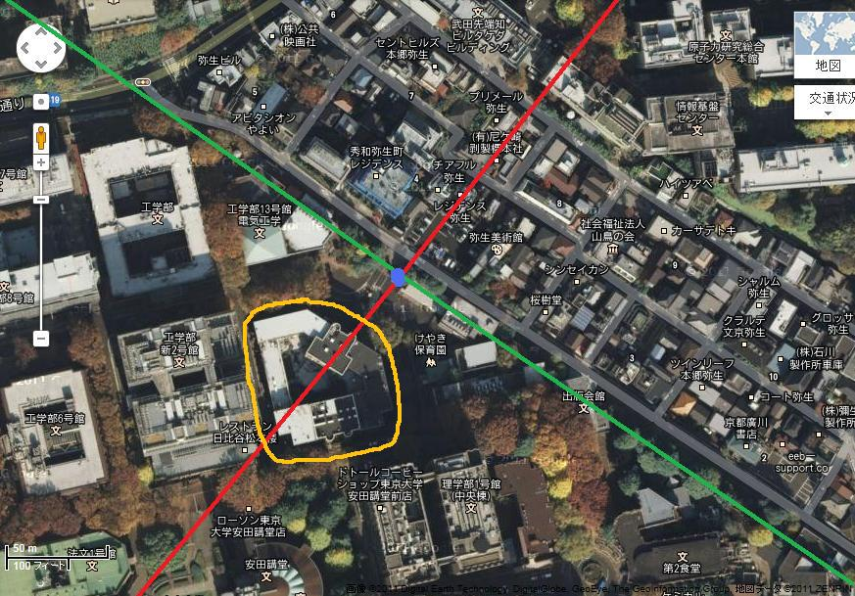
Test observation at Yayoi well (borehole)
Does the detector have an ability
to measure the density deficit of
the low density area(Cavity) ?
Well
20cm
～70m in depth
C
Yayoi well, located in U Tokyo, was dug by Earthquake Research Institute in 1897.
A
D
B
Notes:
Aerial photograph To test our detector and method, we performed test experiment at Yayoi well

Slide 6
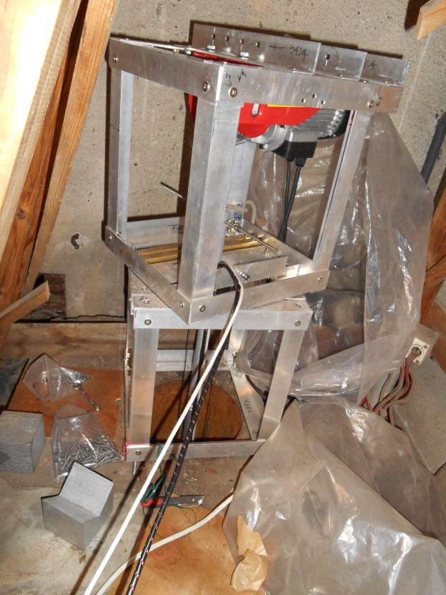

Observation
D
4 directions
A
Period ： March～April, 2013
Points ：
Depth=10m～60m at 10m intervals
4 directions at 45°intervals
Time ： about 24h at each point
C
B
Rods for directional control
200cm
Interval : 10m
Wire
Detector
12cm

Slide 7
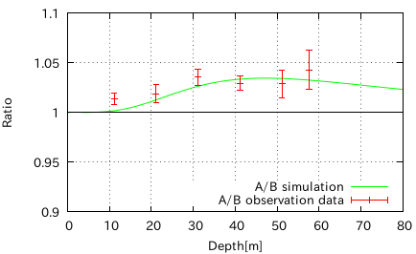
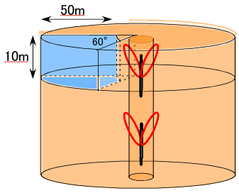


Result
Does detector know the existence of cavity?
Cavity exists in the direction A from well
Counting rate A ＞ Counting rate B
$A/B$Ratio
A
B
Cavity is detected！
Cavity
0.3g/cc
Layer
2.0g/cc
Depth$(m)$
Notes:
ボアホール作って装置から輪
First of all we want to know

Slide 8
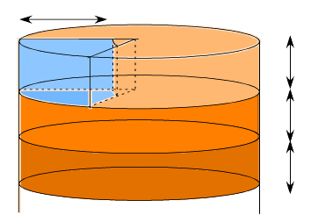
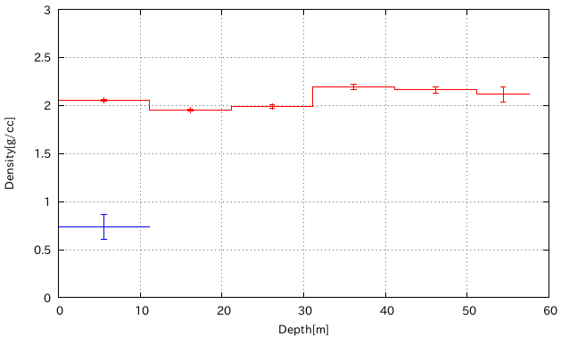

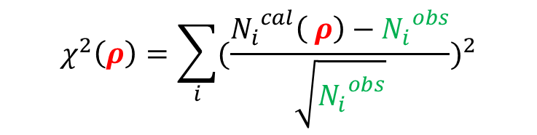

Analysis Result：Density
Estimating density of layers and cavity simultaneously
50m
60°
10m
Cavity
Layer 1
$ρ=(ρ_{cavity},ρ_{layer 1},ρ_{layer 2},ρ_{layer 3}, ・・・)$
10m
Layer 2
3.0
2.5
2.0
1.5
1.0
0.5
0
Layer 3
10m
Density $(g/cc$)
Layers
300°
360°
360°
360°
360°
360°
$$χ^{2}\left(ρ\right)=\sum_{i}{{(\frac{{N_{i}}_{}^{cal}\left( ρ\right)−{N_{i}}_{}^{obs}}{\sqrt{{N_{i}}_{}^{obs}}})}^{2}}$$
Cavity(60°)
Using all 24 data points
0 10 20 30 40 50 60
Depth $(m)$

Slide 9
Summary
We developed a new method and a detector
to measure the seismic fault zone from boreholes
Test observation at Yayoi well
  We measured density deficit
    Existence of cavity
    Density of cavity and layers

Slide 10
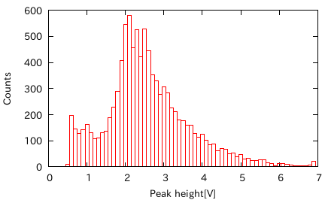
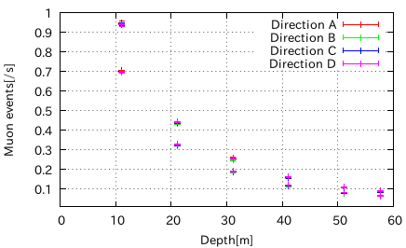


Treatment of observation data
Data got by observation: Muon＋noise counting rate(/s)
→ True muon’s counting rate (/s)
Process1 Process2
Cut noise by energy loss revise detection efficiency in 100％
in the detector
Muon Events $(/s$)
100％
Counts
Noise
Muon
Pulse height
Depth$(m)$
Notes:
We measure PMT pulse height to distinguish muon and noise

Slide 11


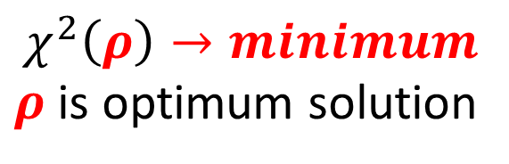
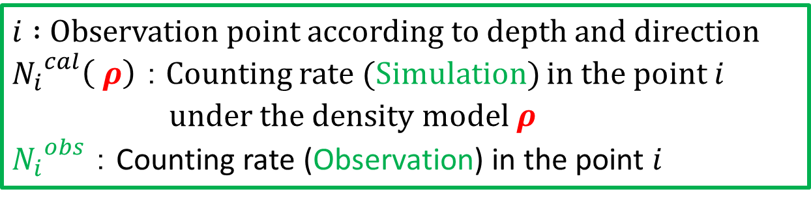

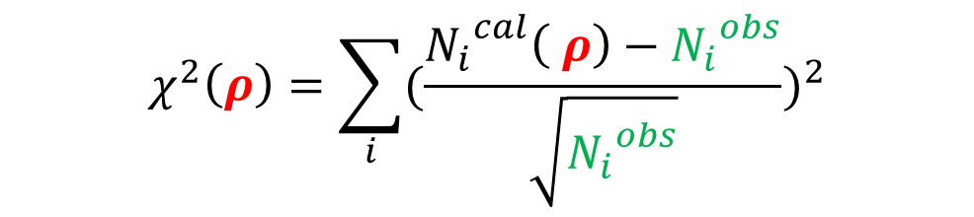

Existence of cavity → Density of cavity
$i :$ Observation point according to depth and direction
${N_{i}}_{}^{cal}\left( ρ\right) ：$Counting rate (Simulation) in the point $i$
under the density model $ρ$
${N_{i}}_{}^{obs}$ ： Counting rate (Observation) in the point $i$
$$χ^{2}\left(ρ\right)=\sum_{i}{{(\frac{{N_{i}}_{}^{cal}\left( ρ\right)−{N_{i}}_{}^{obs}}{\sqrt{{N_{i}}_{}^{obs}}})}^{2}}$$
$$χ^{2}\left(ρ\right)→minimum$$
$ρ$ is optimum solution
Layer-Cavity Model
$ρ=(ρ_{cavity},ρ_{layer 1},ρ_{layer 2},ρ_{layer 3}, ・・・)$
$$ρ_{cavity}$$
$$ρ_{layer 1}$$
$$ρ_{layer 2}$$
$$ρ_{layer 3}$$
・・・

