Slide 1
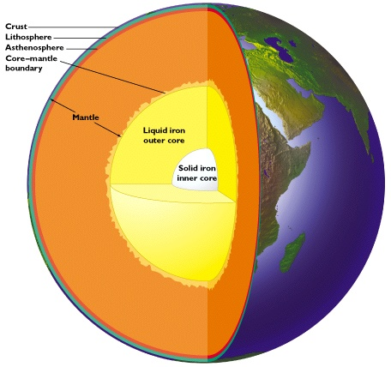






Geoneutrinos: Earth composition, heat production and deep structures
Bill McDonough, *Yu Huang ⁺Ondřej Šrámek and Roberta Rudnick
Geology, U Maryland
Steve Dye, Natural Science,
Hawaii Pacific U and Physics, U Hawaii
Shijie Zhong, Physics, U Colorado
Fabio Mantovani, Physics, U Ferrara, Italy
John Learned, Physics, U Hawaii
*graduate student
⁺post-doc

Slide 2
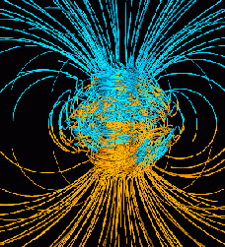
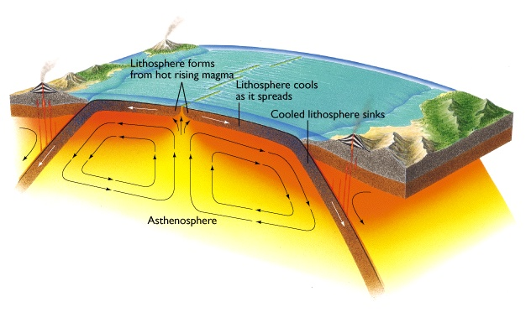
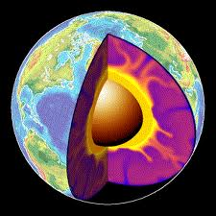
Plate Tectonics,
Convection,
Geodynamo
Does heat from radioactive decay drive the Earth’s engine?

Slide 3
Nature & amount of Earth’s thermal power
radiogenic heating vs secular cooling
- abundance of heat producing elements (K, Th, U) in the Earth
- clues to planet formation processes
- amount of radiogenic power to drive mantle convection & plate tectonics
- is the mantle compositionally layered? or has large structures?
estimates of BSE from 9TW to 36TW
constrains chondritic Earth models
estimates of mantle 1.3TW to 28TW
layers, LLSVP, superplume piles
the future is… Geoneutrino studies

Slide 4

Earth’s surface heat flow 46 ± 3 (47 ± 1) TW
Mantle cooling
(18 TW)
Crust R*
(7 ± 1 TW)
(Rudnick and Gao ’03
Huang et al ‘13)
Core
(~9 TW)
-
(4-15 TW)
Mantle R*
(13 ± 4 TW)
total R*
20 ± 4
*R radiogenic heat
(after McDonough & Sun ’95)
(0.4 TW) Tidal dissipation
Chemical differentiation
after Jaupart et al 2008 Treatise of Geophysics

Slide 5
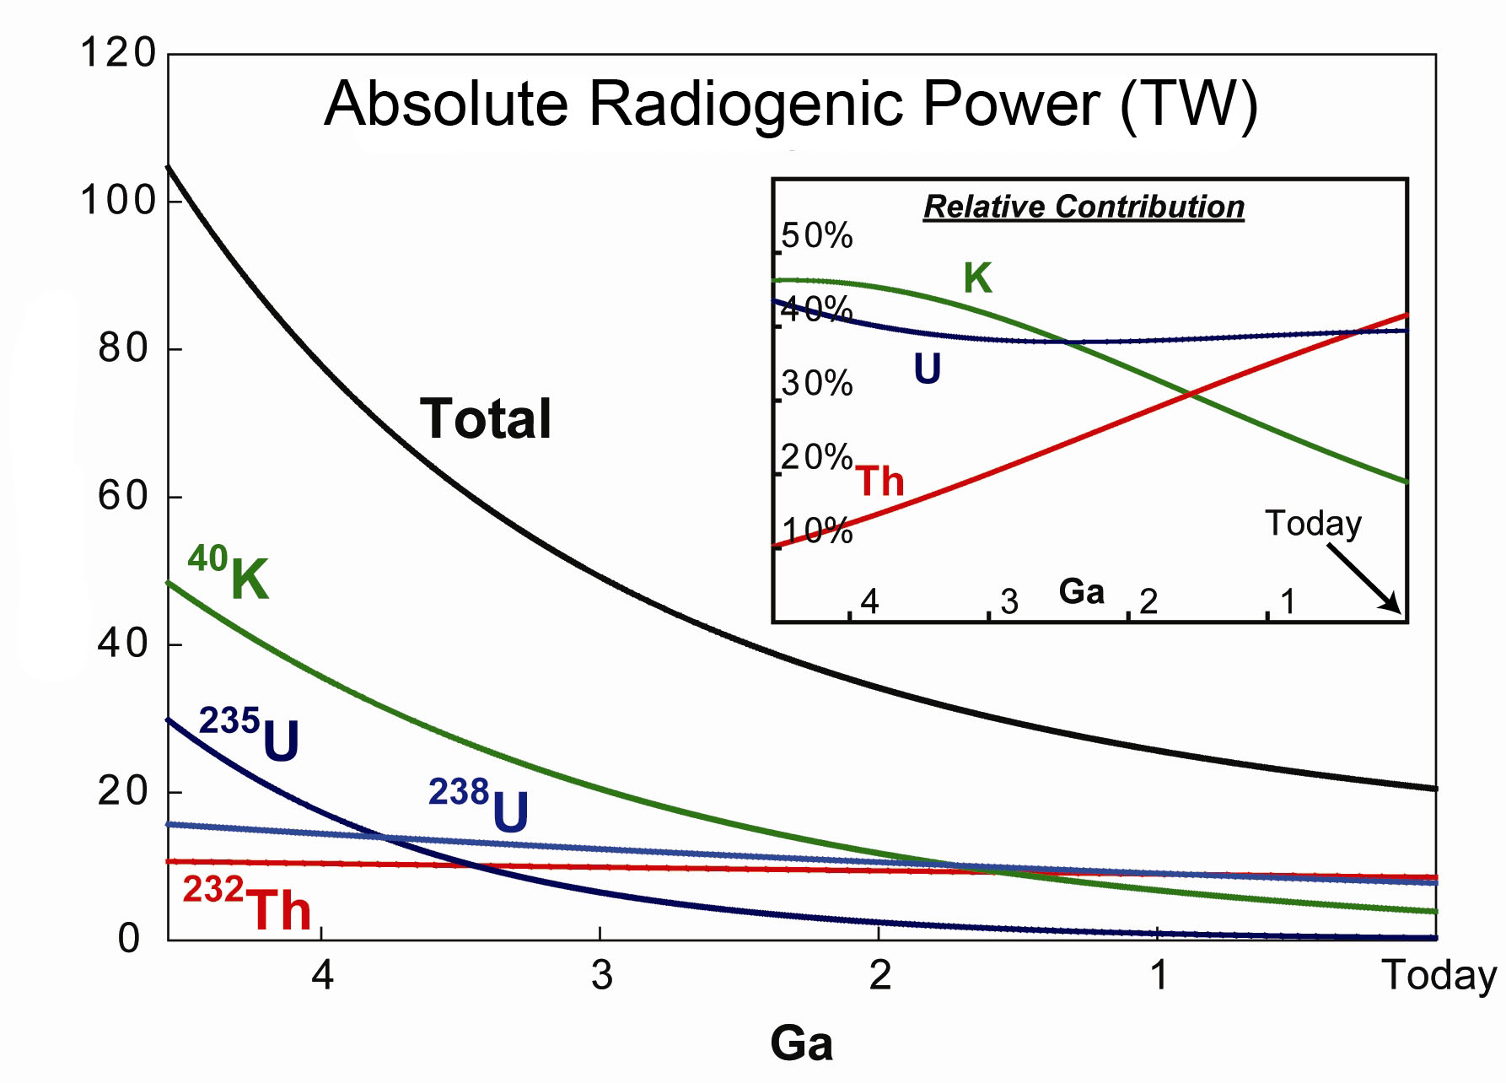
Earth’s thermal evolution: role of K, Th & U
Archean boundary
Power (TW)
Arevalo, McDonough, Luong (2009) EPSL

Slide 6
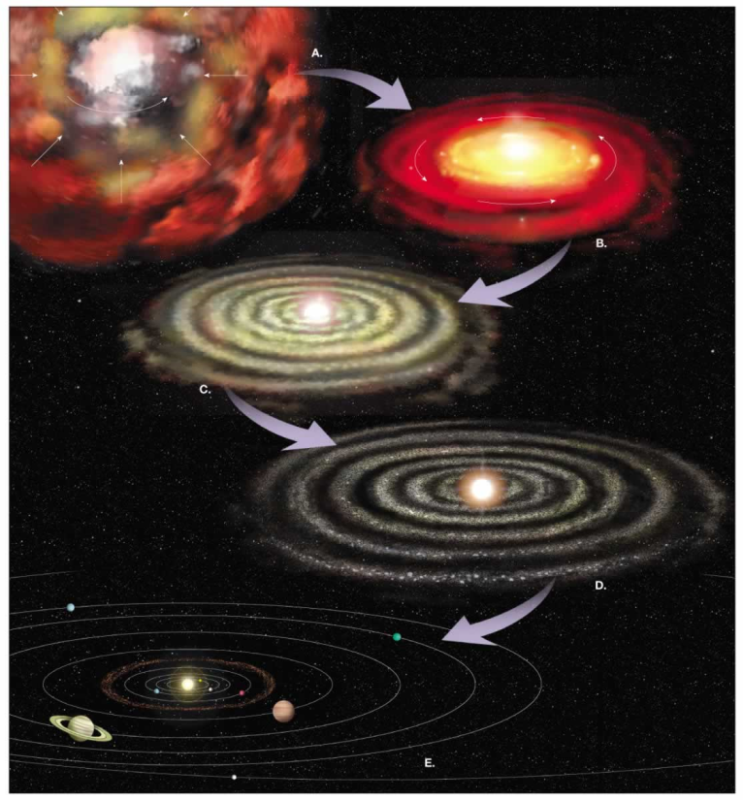
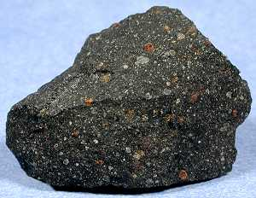

What is the composition of the Earth?
and where did this stuff come from?
Nebula
Meteorite
Heterogeneous mixtures of components with different formation temperatures and conditions
Planet:
mix of metal, silicate, volatiles

Slide 7
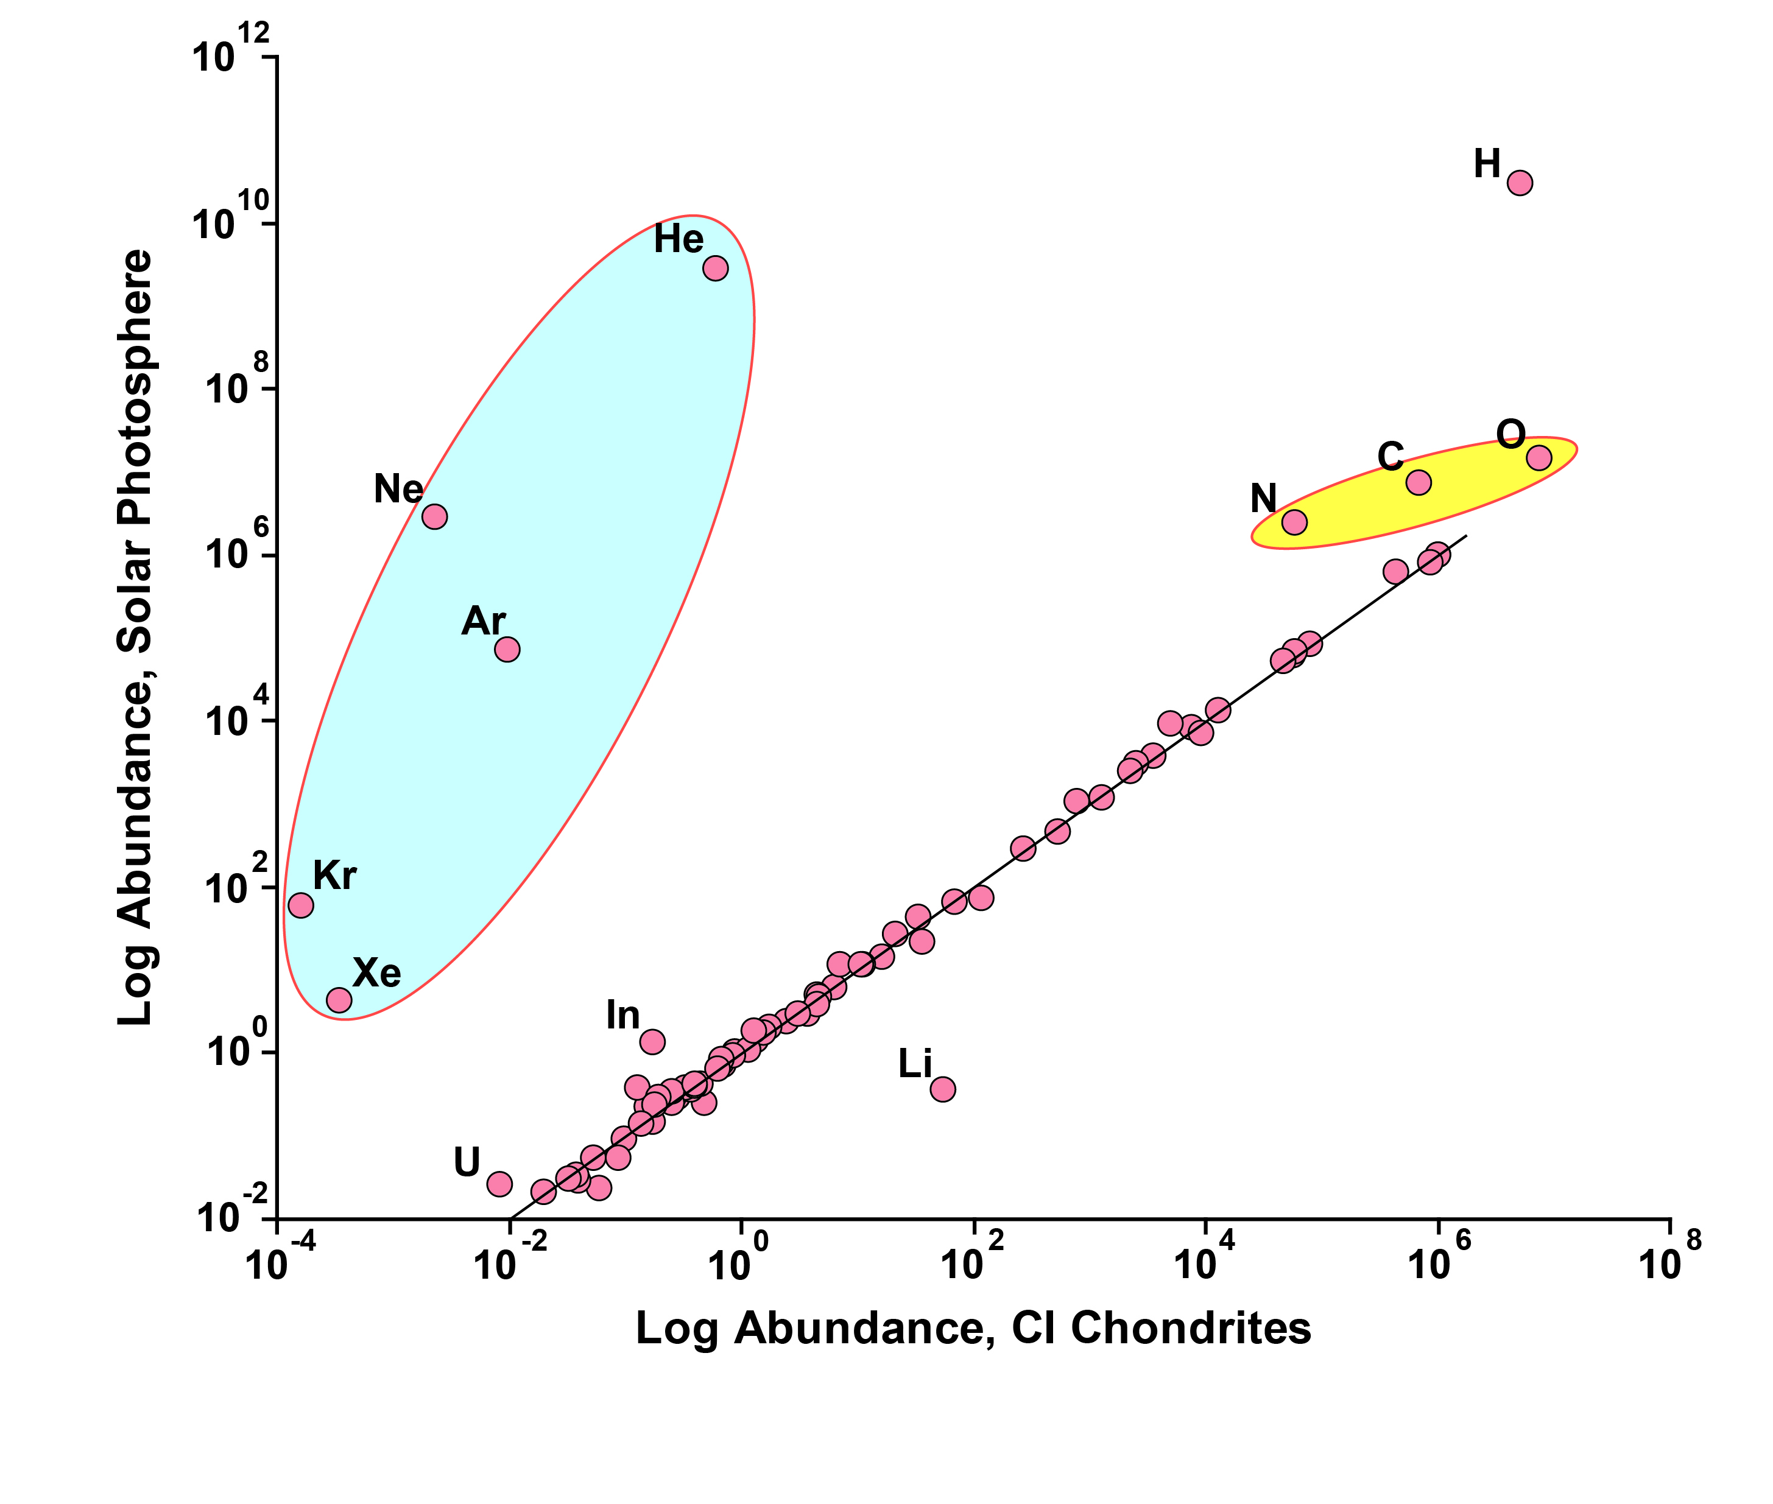
Sun and Chondrites are related

Slide 8
Most studied meteorites
fell to the Earth ≤0.5 Ma ago

Slide 9
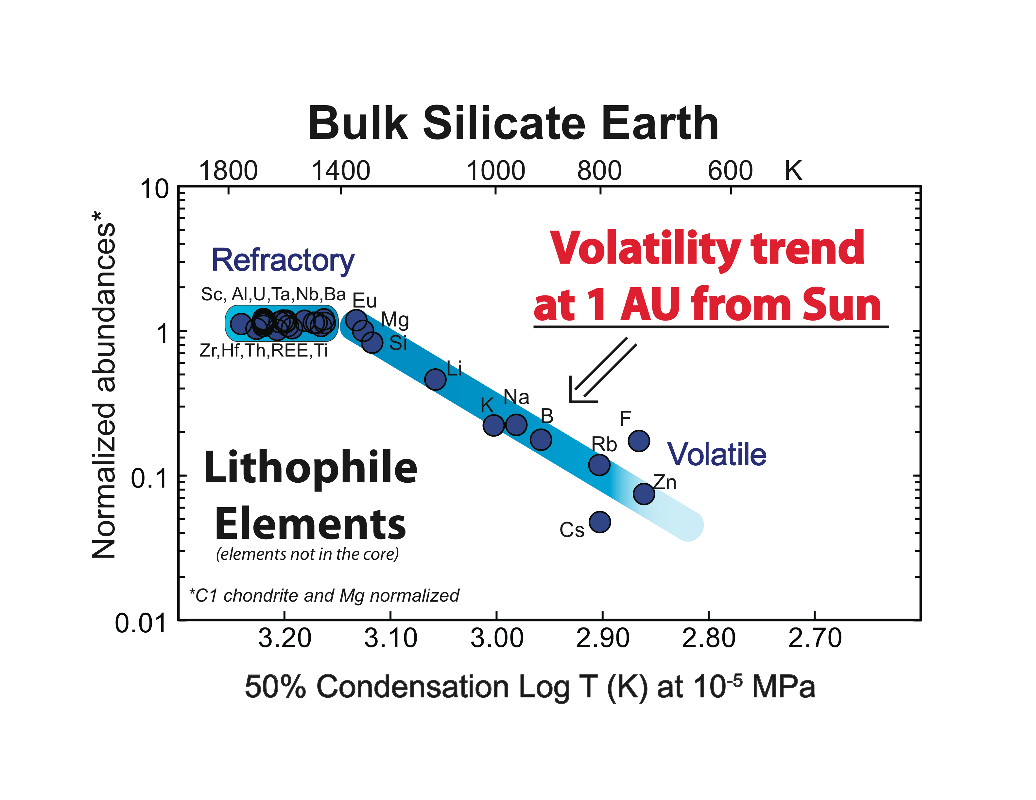
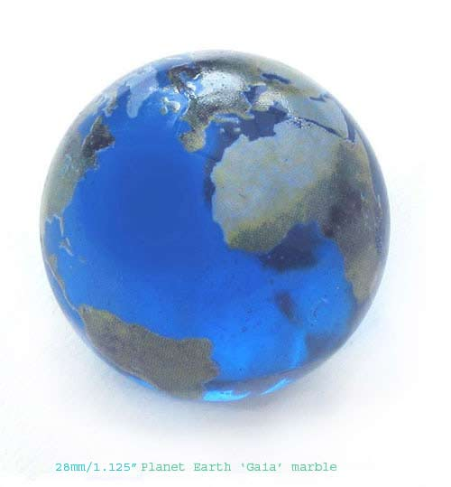
Th & U
K
from McDonough & Sun, 1995

Slide 10
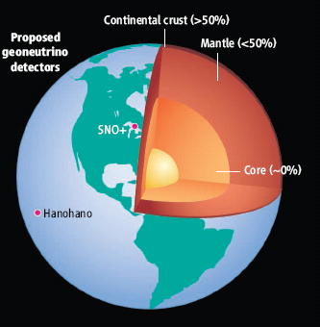
U in the Earth:
~13 ng/g U in the Earth
Metallic sphere (core)
<<<1 ng/g U
Silicate sphere
20* ng/g U
*O’Neill & Palme (2008) 10 ng/g
*Turcotte & Schubert (2002) 31 ng/g
Continental Crust
1300 ng/g U
Mantle
~12 ng/g U
“Differentiation”
Chromatographic separation
Mantle melting & crust formation

Slide 11
Disagreement with chondritic Earth Models
Murakami et al (May - 2012, Nature): “…the lower mantle is enriched in silicon … consistent with the [CI] chondritic Earth model.”
Campbell and O’Neill (March - 2012, Nature): “Evidence against a chondritic Earth”
Zhang et al (March - 2012, Nature Geoscience): The Ti isotopic composition of the Earth and Moon overlaps that of enstatite chondrites.
Fitoussi and Bourdon (March - 2012, Science): “Si isotopes support the conclusion that Earth was not built solely from enstatite chondrites.”
Warren (Nov - 2011, EPSL): “Among known chondrite groups, EH yields a relatively close fit to the stable-isotopic composition of Earth.”
- Compositional models differ widely, implying a factor of three difference in the U & Th abundances of the Earth

Slide 12
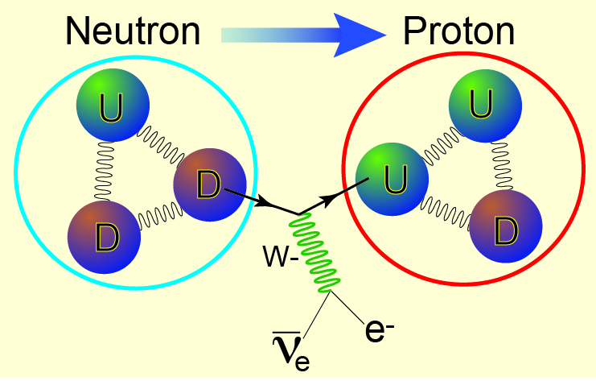
β ⁻ decay process (e.g., U, Th, K, Re, Lu, Rb)
up
quark
down
quark
electron
anti-neutrino

Slide 13
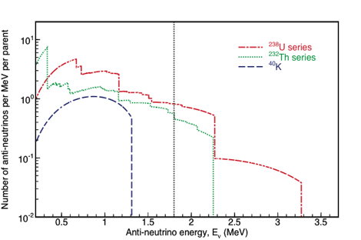
Terrestrial Antineutrinos
²³⁸U
²³²Th
ν_{e} + p⁺ → n + e⁺
1.8 MeV Energy Threshold
1α, 1β
1α, 1β
ν_{e}
²³⁸U
²³²Th
⁴⁰K
ν_{e}
²³⁴Pa
²²⁸Ac
2.3 MeV
2.1 MeV
31%
1%
5α, 2β
4α, 2β
ν_{e}
ν_{e}
²¹⁴Bi
²¹²Bi
3.3 MeV
2.3 MeV
46%
20%
⁴⁰K
⁴⁰Ca
Efforts to detect
K geonus
underway
2α, 3β
1β
1α, 1β
²⁰⁶Pb
Terrestrial antineutrinos from
uranium and thorium are detectable
²⁰⁸Pb

Slide 14
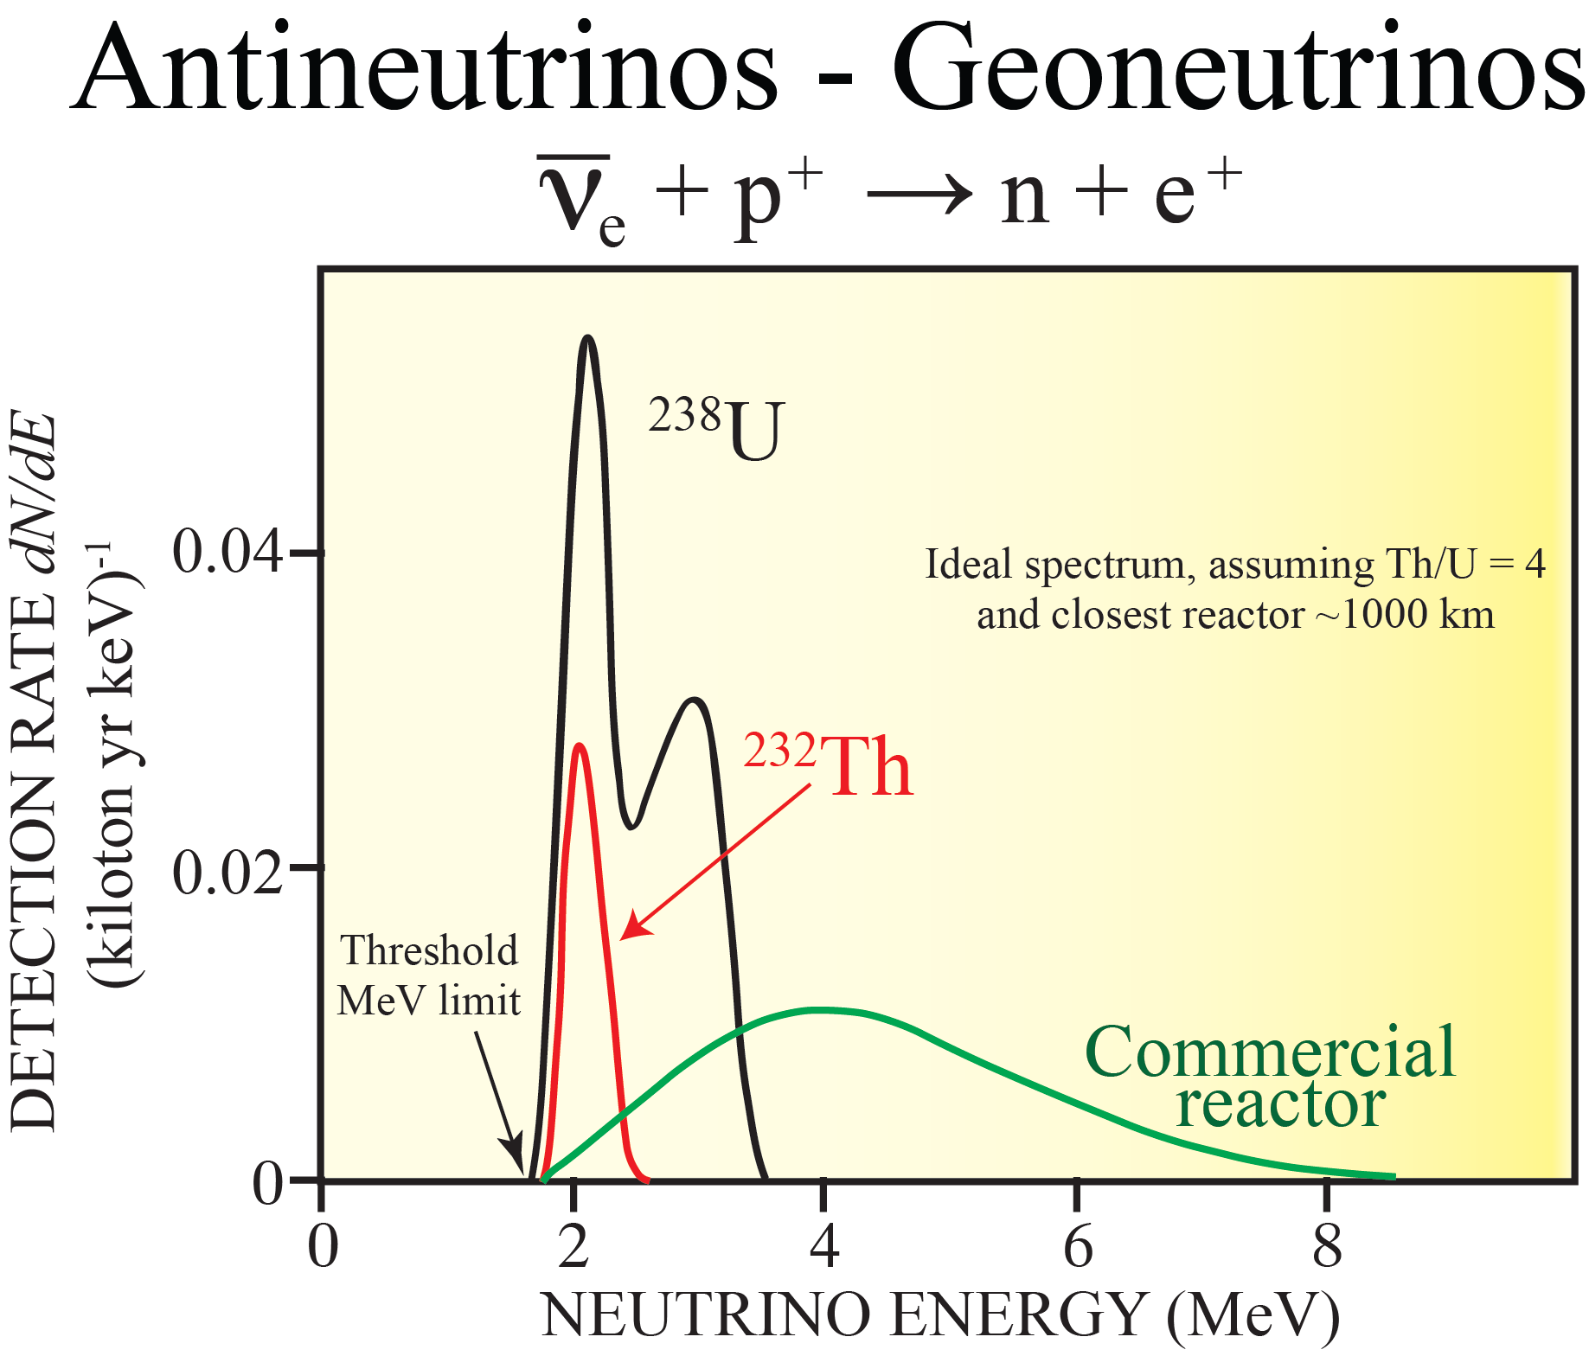

Slide 15
Data improve with more counting
TW scales with U concentration; 10, 20, 30 TW ≈ 10, 20, 30 ppb U in BSE

Slide 16
Geoneutrino Flux on Earth Surface
Activity and number of produced geoneutrinos
Volume of source unit
Survival probability function
Abundance and density of the source unit
Distance between source unit and detector
Earth structure (ρ and L) and chemical composition (a)

Slide 17
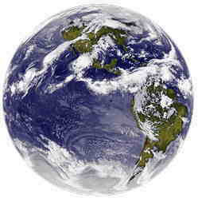
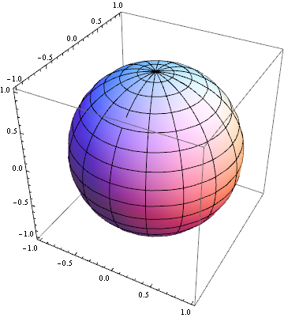
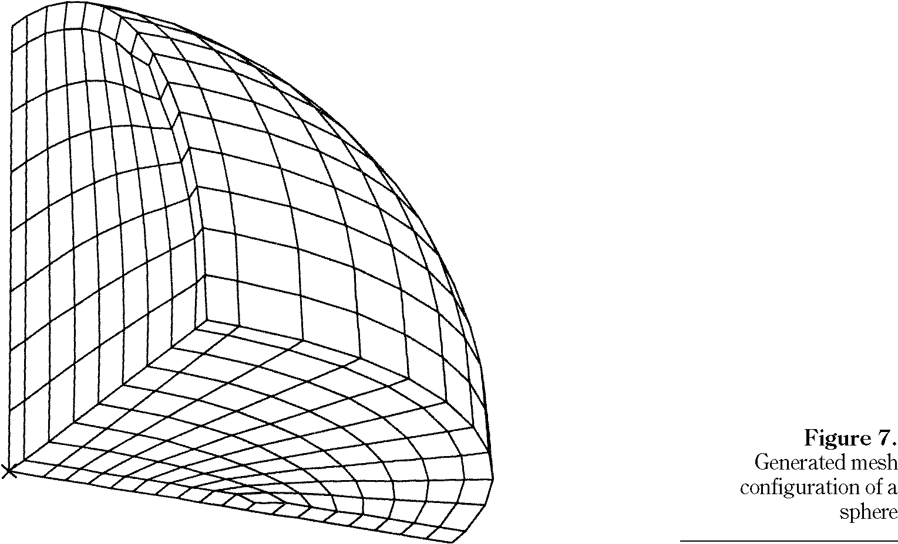
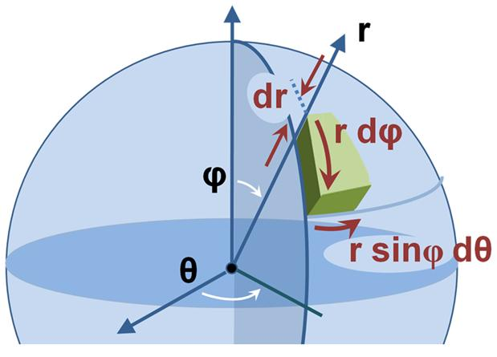
Constructing a 3-D reference model Earth
assigning chemical and physical states to Earth voxels
1º x 1º x “z” tile
mapping of elements
Huang et al (2013) G-cubed arXiv:1301.0365

Slide 18
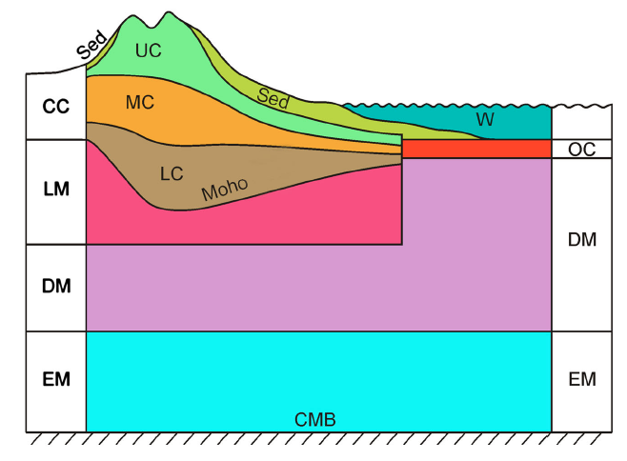
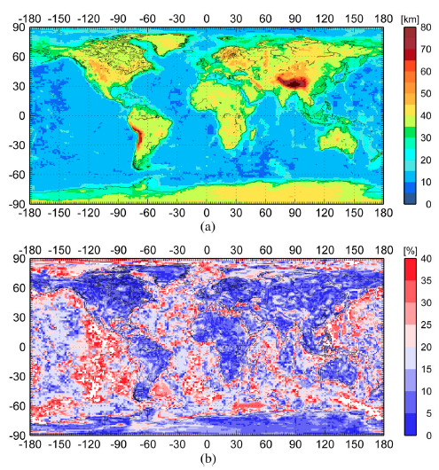
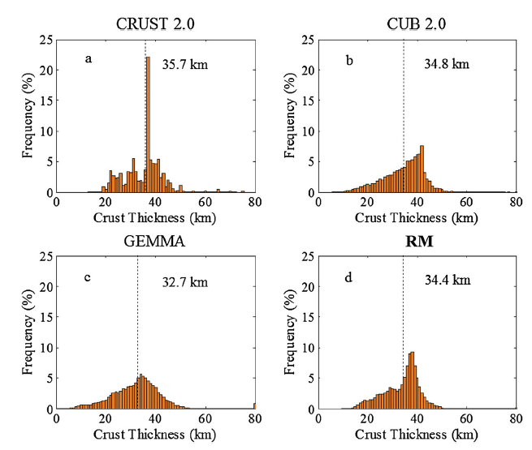
Huang et al (2013) G-cubed
Global Earth Reference Model
7 layers for the top 200 km
Integrate 3 global models for the crust
New crust model with uncertainties

Slide 19
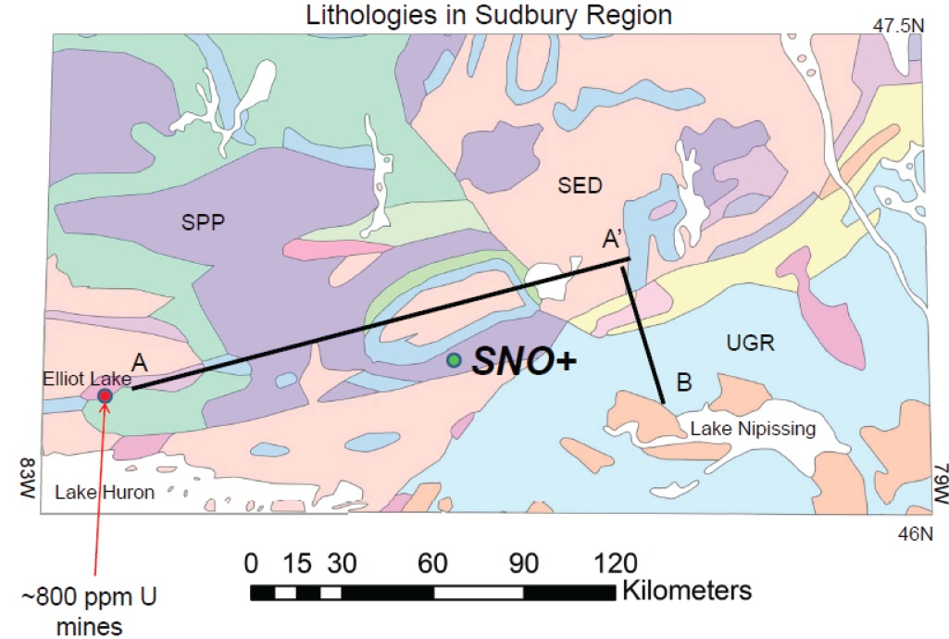
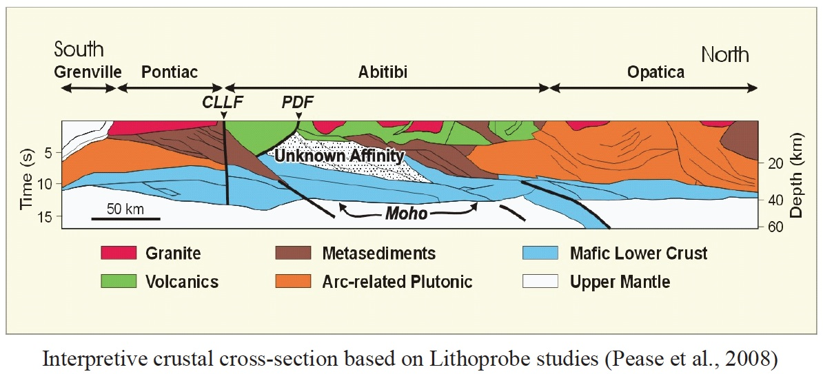
Estimating the geoneutrino flux at SNO+
Geology
Geophysics
seismic
x-section

Slide 20
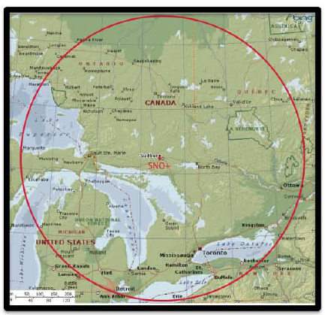
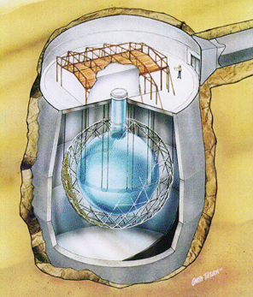

Global to Regional Model
using only
global inputs
SNO+
Sudbury
Canada
improving our flux models
adding the regional geology
Notes:
This map shows the decrease of flux from each tile in the refined regional model. The bottom 5 tiles are covered by sedimentary rock and the upper crust is not be able to be refined. Thus, the signals remain the same. The signal from all the 15 tiles and central tile both decrease by about 10%

Slide 21
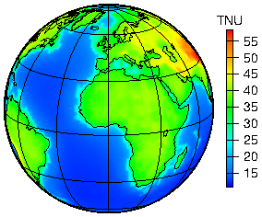
Predicted Global geoneutrino flux based on our new Reference Model
Huang et al (2013) G-cubed arXiv:1301.0365

Slide 22
SUMMARY
Earth’s radiogenic (Th & U) power 22 ± 12 TW or 11.2 TW
Prediction: models range from 8 to 28 TW (for Th & U)
On-line and next generation experiments:
SNO+ online 2013/14 ☺
JUNO (Daya Bay II): good experiment, limited geonu application?
Hanohano: this is FUNDAMENTAL for geosciences
Geology must participate & contribute to the cost
Future:
Neutrino Tomography of the Earth’s deep interior ☺
+ 7.9
- 5.1

