Slide 1


The Mu-ray Detector technology

Slide 2
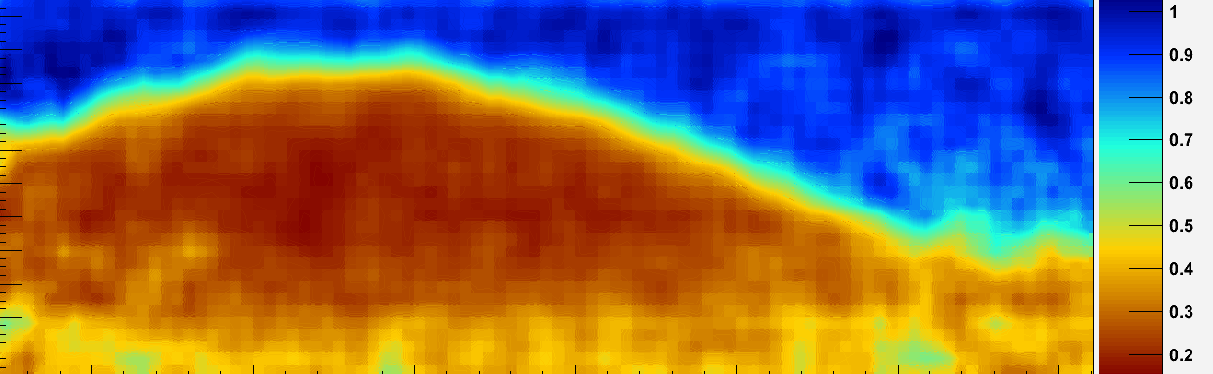

The “Shadow” of the Vesuvius

Slide 3
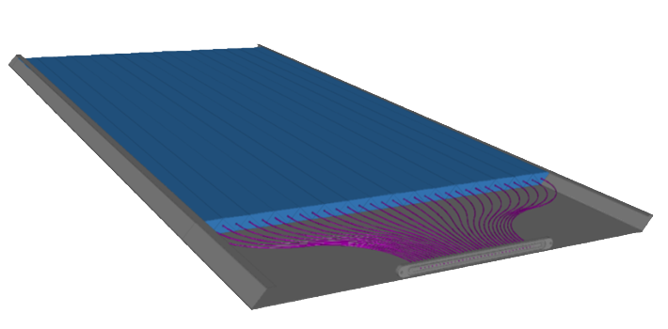
The Basic Module Idea
0.5 m
32 scintillator strips
WLS optical fibers
Opto-electronic connector
to photo-multipliers

Slide 4
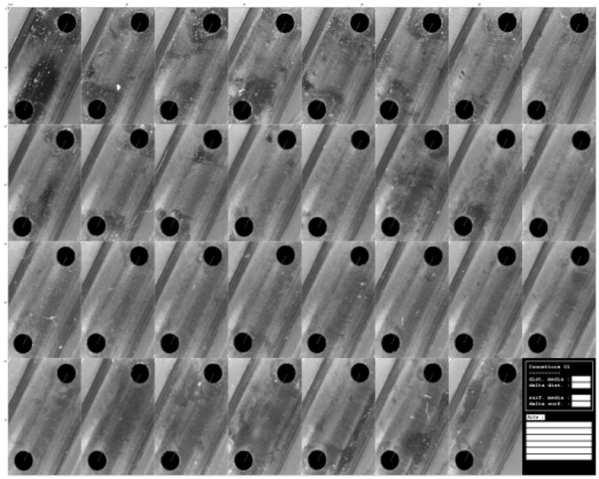
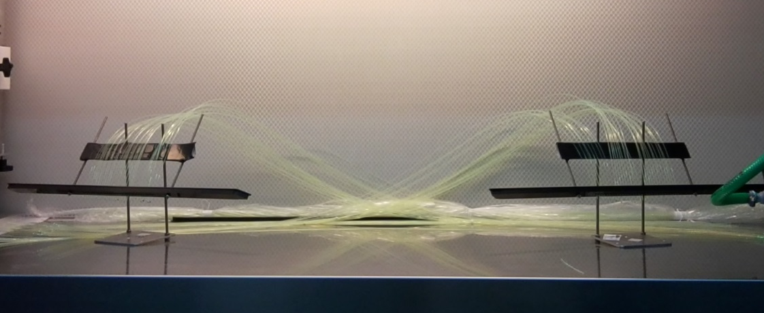
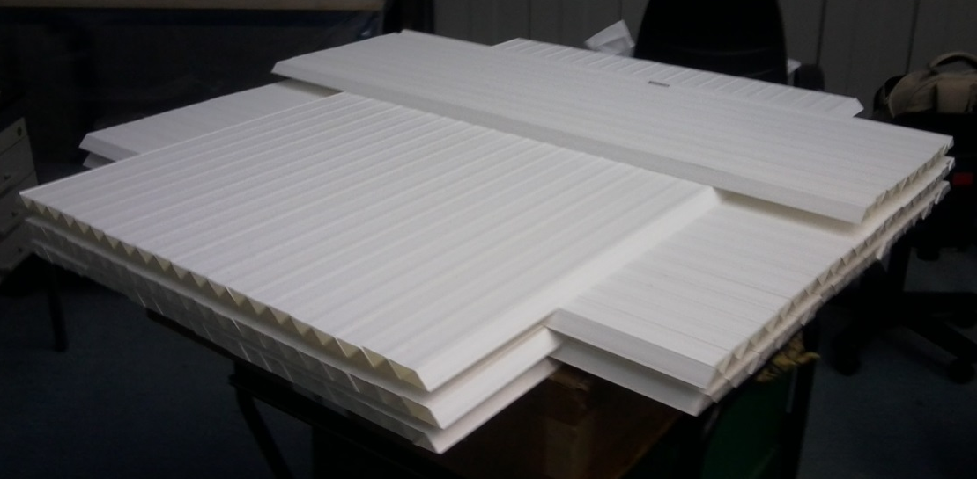
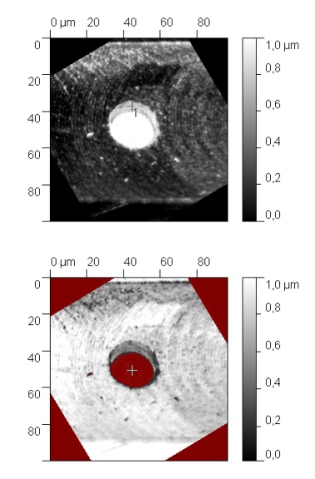
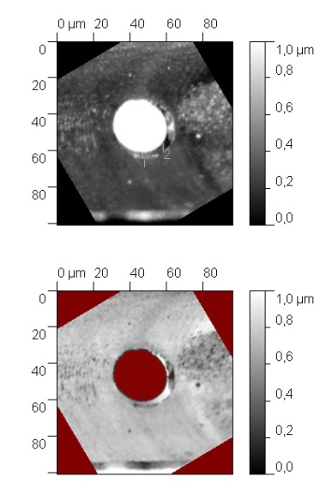
Some Details on Preparation
Optical connector
Fibers
Scintillators
Arbitrary Unit

Slide 5
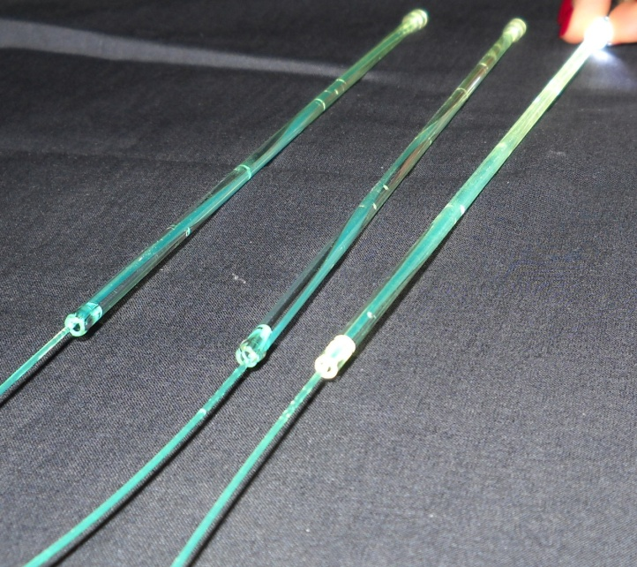
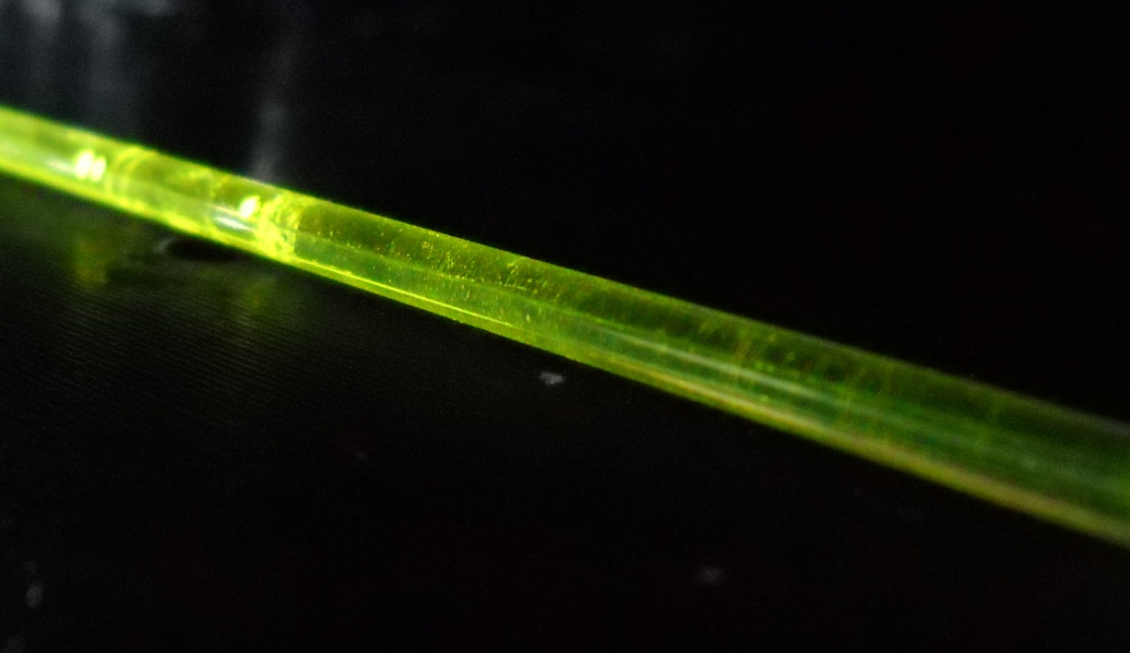
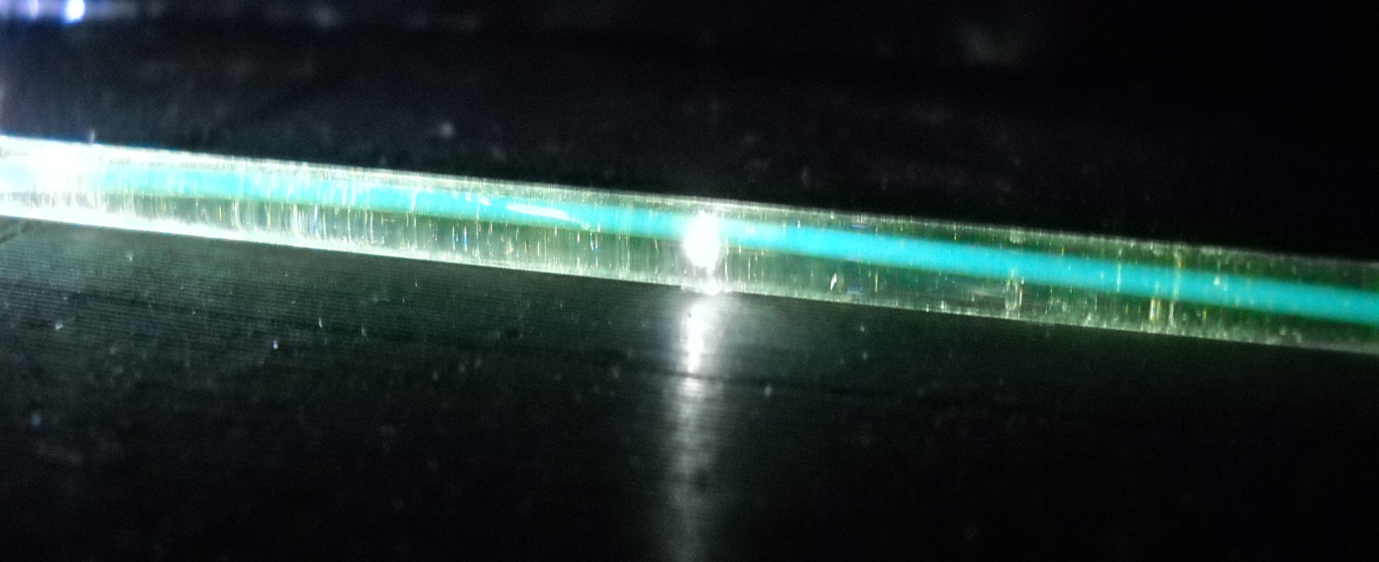
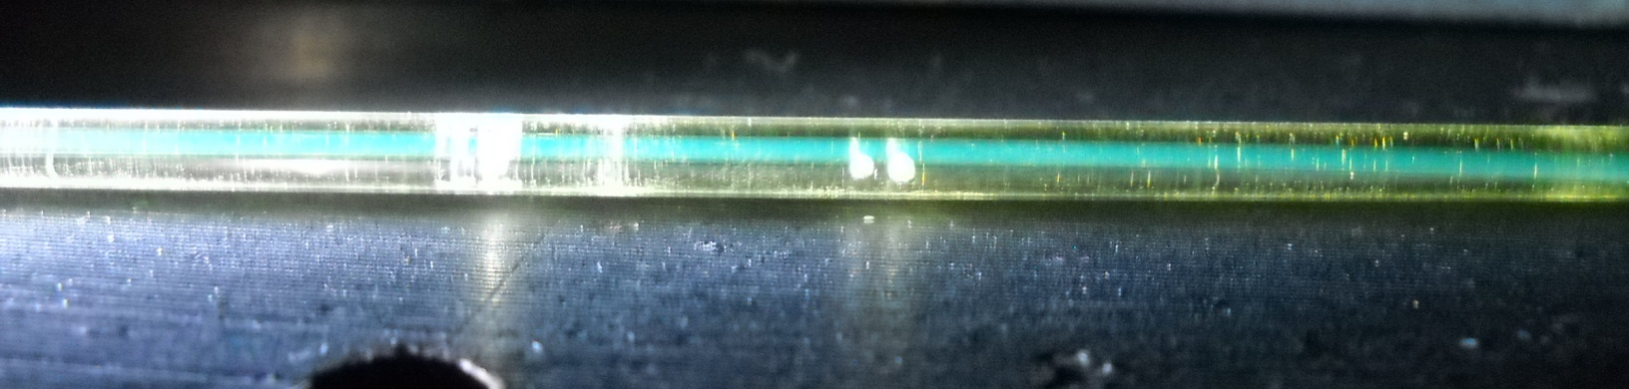
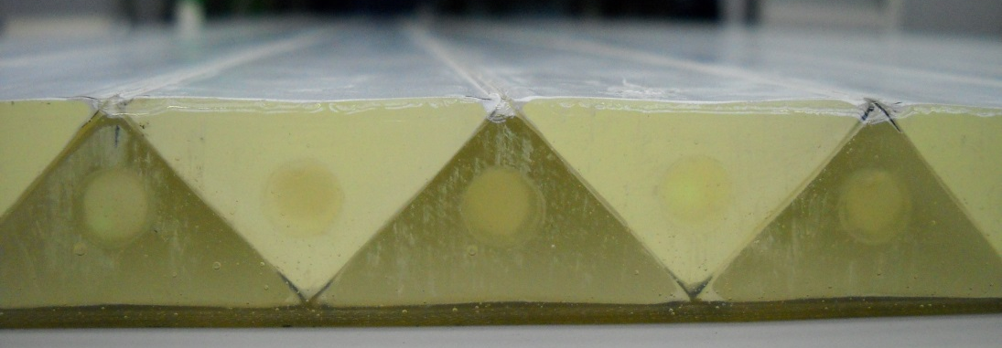
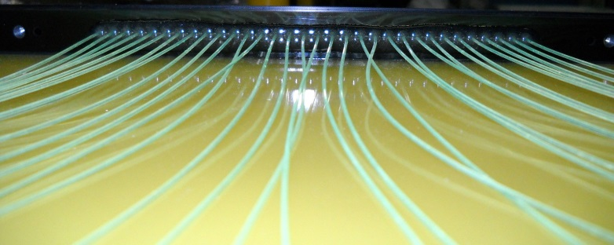
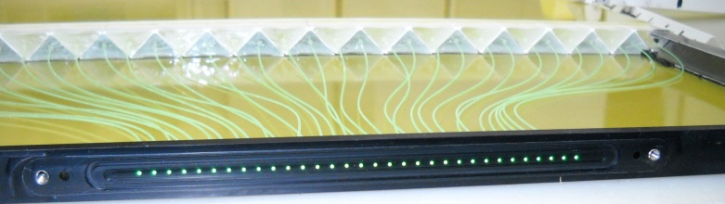
Inside The Basic Module
Triangular shape reduce death spaces, gives more strength to the module and allow for charge balance method
Best optical gluing solution were adopted to avoid light losses due to intra-scintillator scattering or wrong coupling with photon detectors

Slide 6
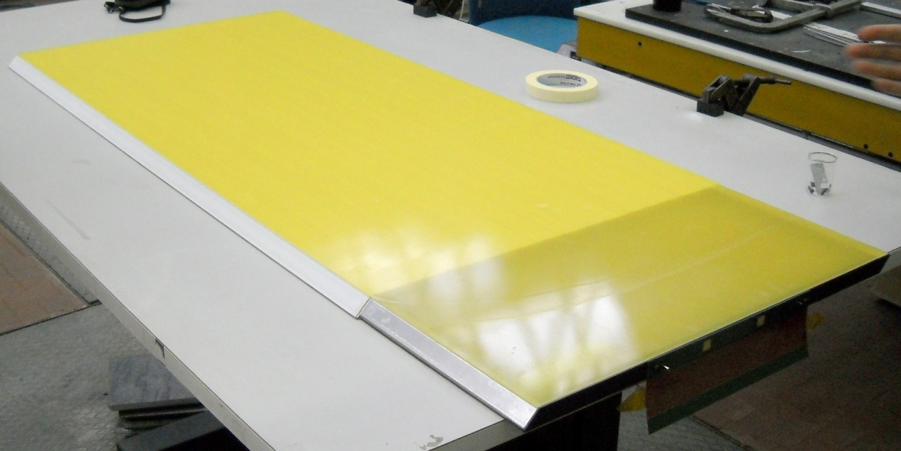
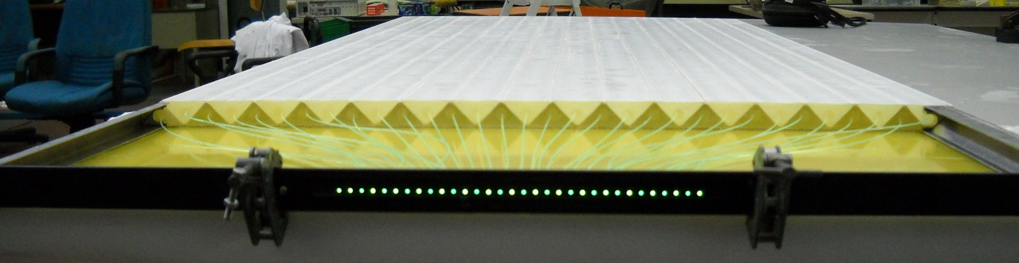
The Basic Module
The Basic Module is an ensemble of 32 plastic scintillators disposed side by side
Each scintillator has a WLS fiber glued inside
The 32 fibers are collected to the so called optical connector

Slide 7
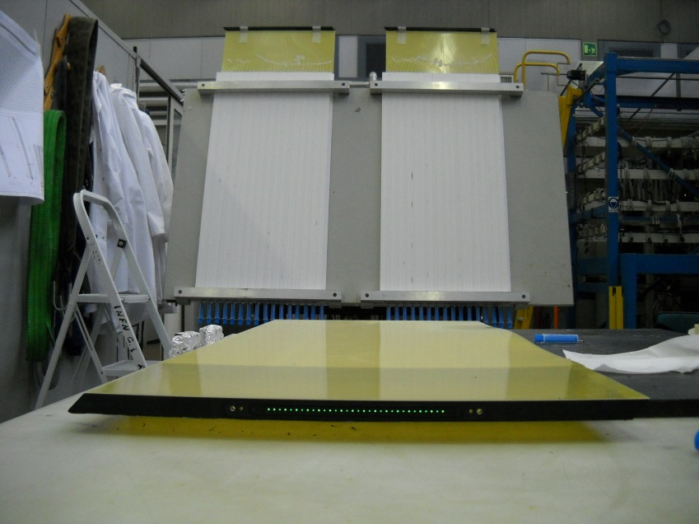
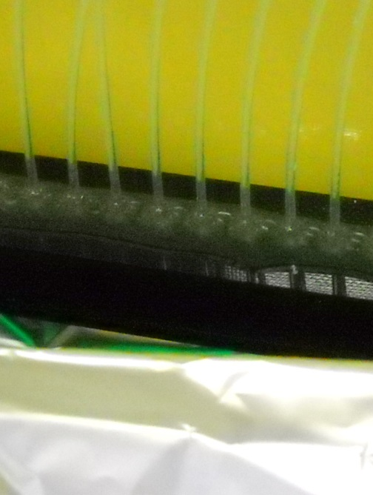
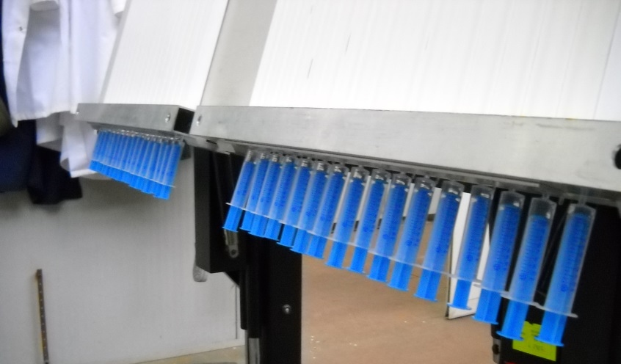
Fibers couplings
FIBERS TO OPTICAL CONNECTOR
FIBERS TO SCINTILLATORS

Slide 8
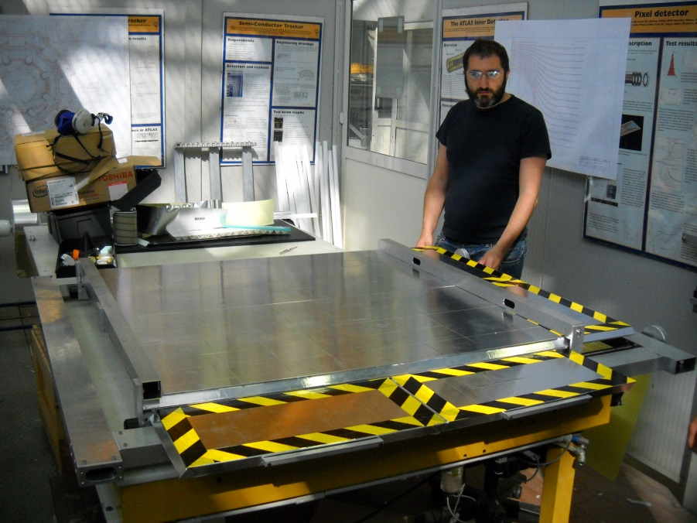
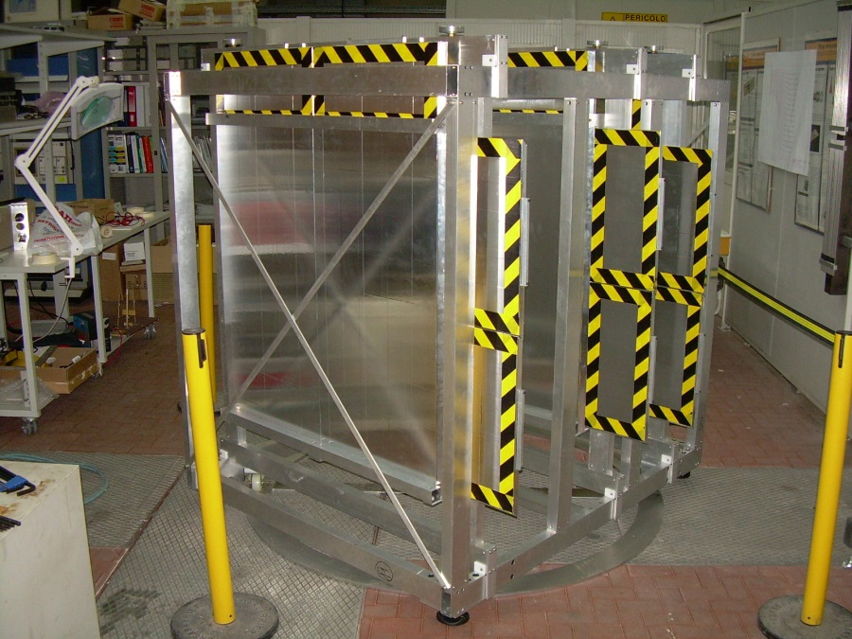
Bare Telescope
The plane is assembled with 4 modules: 2 used for the X coordinate and 2 for the Y one
A telescope is constituted by 3 planes
With this system we are able to track the trajectory of real muons passing through the telescope and reject the events mimicking muons

Slide 9
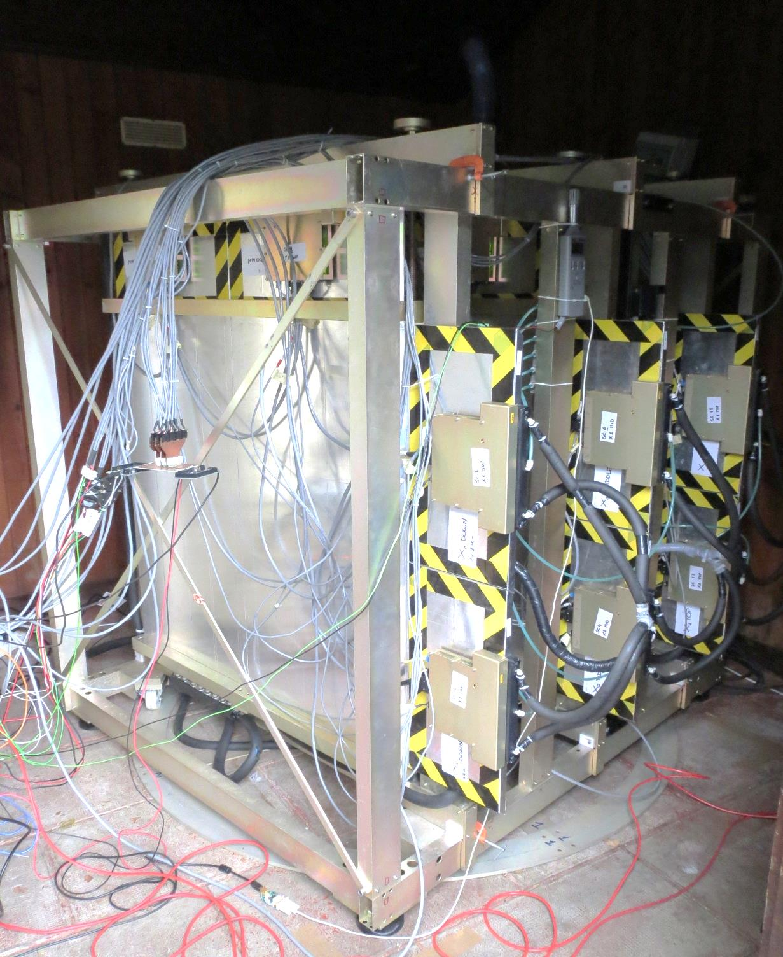
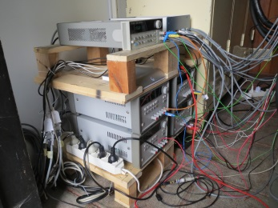
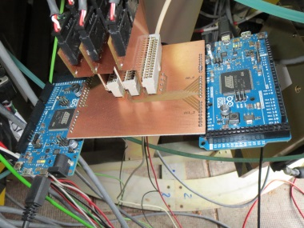
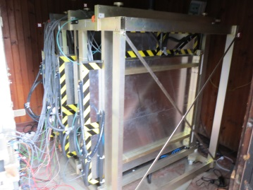
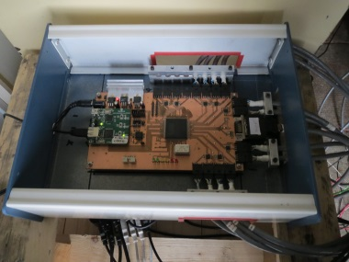
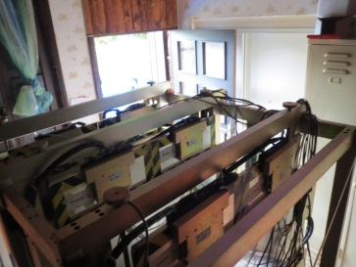
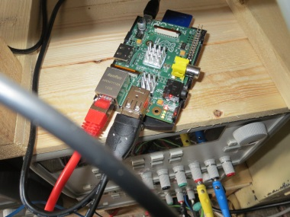
How does it look?

Slide 10
Trace Muons Through Detection of Light
When a muon passes through the MU-RAY detector, deposits a certain amount of energy, turned into blue light by scintillators. The WLS fibers entrap produced light and lead it to the optical connector where it will be revealed by Silicon PhotoMultipliers (SiPM).
Due to the shape of the scintillators, in each station will be switched on two neighbors X SiPMs and two Y ones and if all the three “points” are aligned the trace correspond to the passage of a real muon
fake μ from ‘shower’
μ
fake μ from ‘albedo’

Slide 11
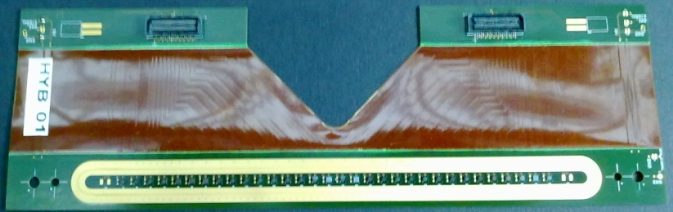
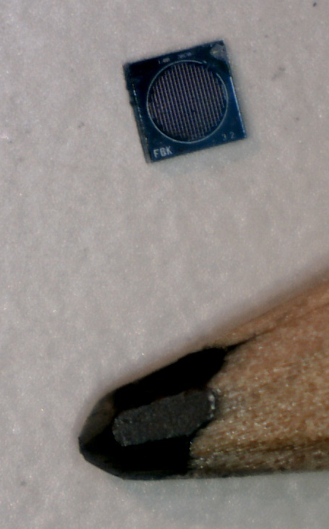
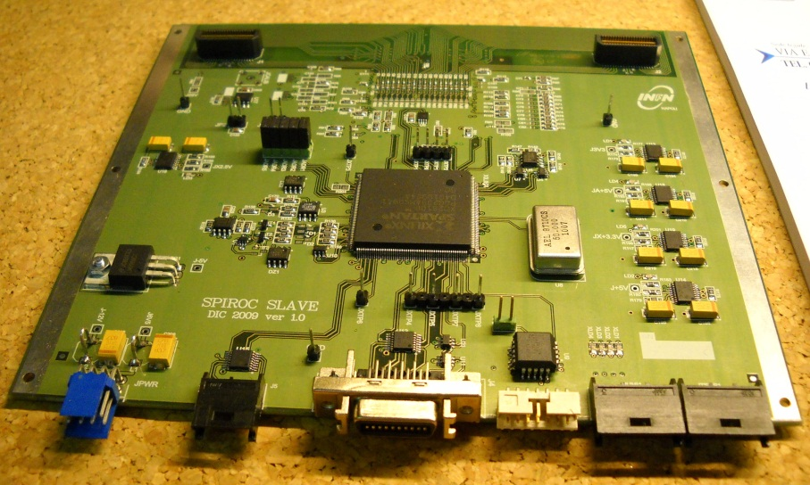
Silicon Photomultiplier and SPIROC
Sensors housing board
SiPM
SLAVE board

Slide 12
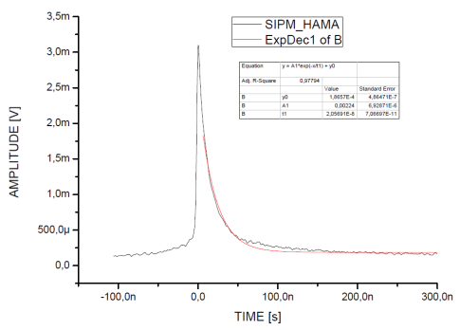
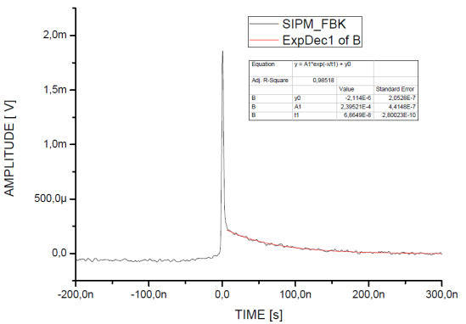
Silicon Photomultiplier in Detail
Photo-detection efficiency (10%-60%)
Linearity ( if n photons << n cells)
High gain (10⁵-10⁶)
Single photon detection sensitivity
Fast (≈ 1 ns rise time)
Good time resolution (< 100 ps)
Low bias voltages ( < 100 V) very low power consumption (10 mW)
Insensitive to B field
Extremely compact and robust
Breakdown voltage and dark rate depend on temperature
SIGNAL CAPTURED BY FAST SCOPE (AVERAGE MODE) WITHOUT INTERMEDIATE ELECTRONICS
LeCroy SDA 760Zi: 6 GHz

Slide 13
EASIROC features
Bi-gain low noise preamp
  Low noise charge preamplifier capacitively coupled = voltage preamplifier
  Gain adjustable with 4 bits common to all preamps : Cf=0.1, 0.2, 0.4, 0.8 pF
Positive input pulse
8 mV/pe in High Gain
Noise : 1.4 nV/sqrt(Hz)
Power : 2 mW (unpulsed)
Low gain at preamp level
0.8 mV/pe, MAX : 2000 pe (300pC)
1.5pF
0.1pF-1.5pF
+HV
8-bit DAC
Si PM
ASIC

Slide 14
EASIROC main Functions
1. 32 CH LOW GAIN, PROGRAMMABLE SHAPING, VOLTAGE MEASUREMENT PATH THAT HAS SAMPLE AND HOLD CAPABILITY
2. 32 CH HIGH GAIN , PROGRAMMABLE SHAPING, LIKE PREVIOUS ONE
3. 32 CH FAST TIMING PATH, WITH COMMON THRESHOLD PROGRAMMABLE COMPARATOR WITH 32 OUTPUTS.
MAIN DATA IN TIMING APPLICATION AND ARE FED TO THE FPGA CHIP TO BE PROCESSED AS REQUESTED.
SiPM BIAS VOLTAGE CAN BE PRECISELY ADJUSTED FOR EACH CHANNEL BY A PROGRAMMABLE 5V DAC
«OR32» FAST SIGNAL USED TO TRIGGER ACQUISITION SEQUENCE
IN ORDER TO PROPERLY CONFIGURE AND PROGRAMM THE CHIP, 3 REGISTERS CAN BE SERIALLY ACCESSED : «SLOW CONTROL» REG, »READ» REG. , «PROBE» REG.

Slide 15
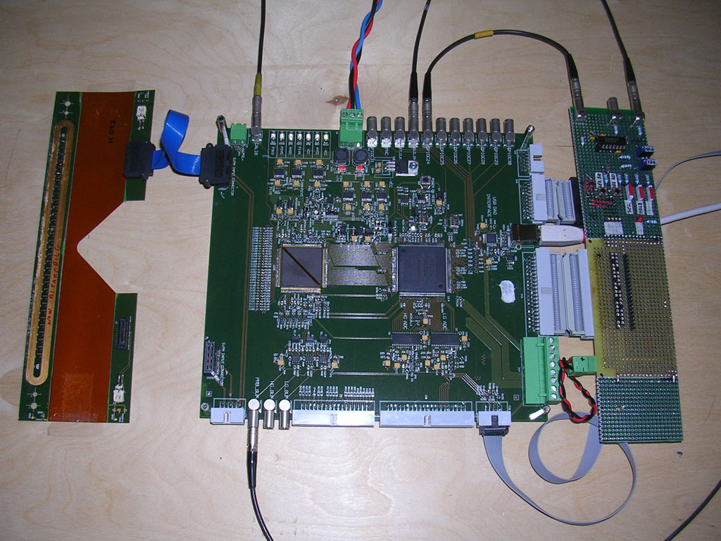
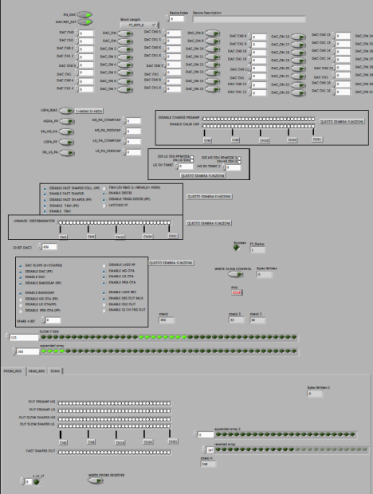

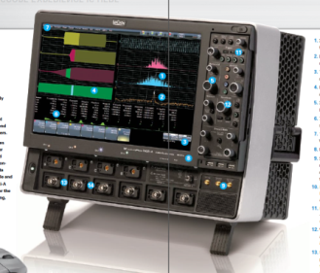
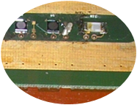
EASIROC with single SiPM
MICROCOAX 100 OHM DIFFERENTIAL CONNECTION TO FE-SIPM-PCB
DISCRETE ANALOG CIRCUIT TO MANUALY ADJUST HOLD TIMING FOR EASIROC CHIP
SIPM TEST SET-UP using the modified hybrid
LABVIEW SIMPLE INTERFACE ALLOW TO PROGRAM EASI-ROC CHIP REGISTERS
SLOW CONTROL,
READ AND PROBE REGISTERS
- WE CAN ALSO SET OVER-BIAS FOR EACH SINGLE SIPM THROUGH A DAC SETTING
EASIROC BASED DAQ BOARD
PROGRAMMABLE PREAMPS GAIN
PC COMMUNICATE THROUGH A USB INTERFACE
USB
MULTILAYER RIGID-FLEX PCB SUPPORT FOR SIPM DETECTOR WITH GOOD SHIELDING PROPERTIES
TRIGGER OUT PROBING AREA
EXTERNAL AUXILIARY CIRCUIT TO EASILY TEST AND DEBUG
TAB SELECT DIFFERENT REGISTERS
COAX CONNECTOR FOR ANALOG SIGNAL PROBING (BUFFERED)
FBK-IRST SIPM BONDED ON PCB.
PLACE AVAILABLE ALSO FOR OTHER DETECTORs (HAMAMATSU)
PRELIMINARY MEASURMENTS MADE WITH A FAST SCOPE

Slide 16
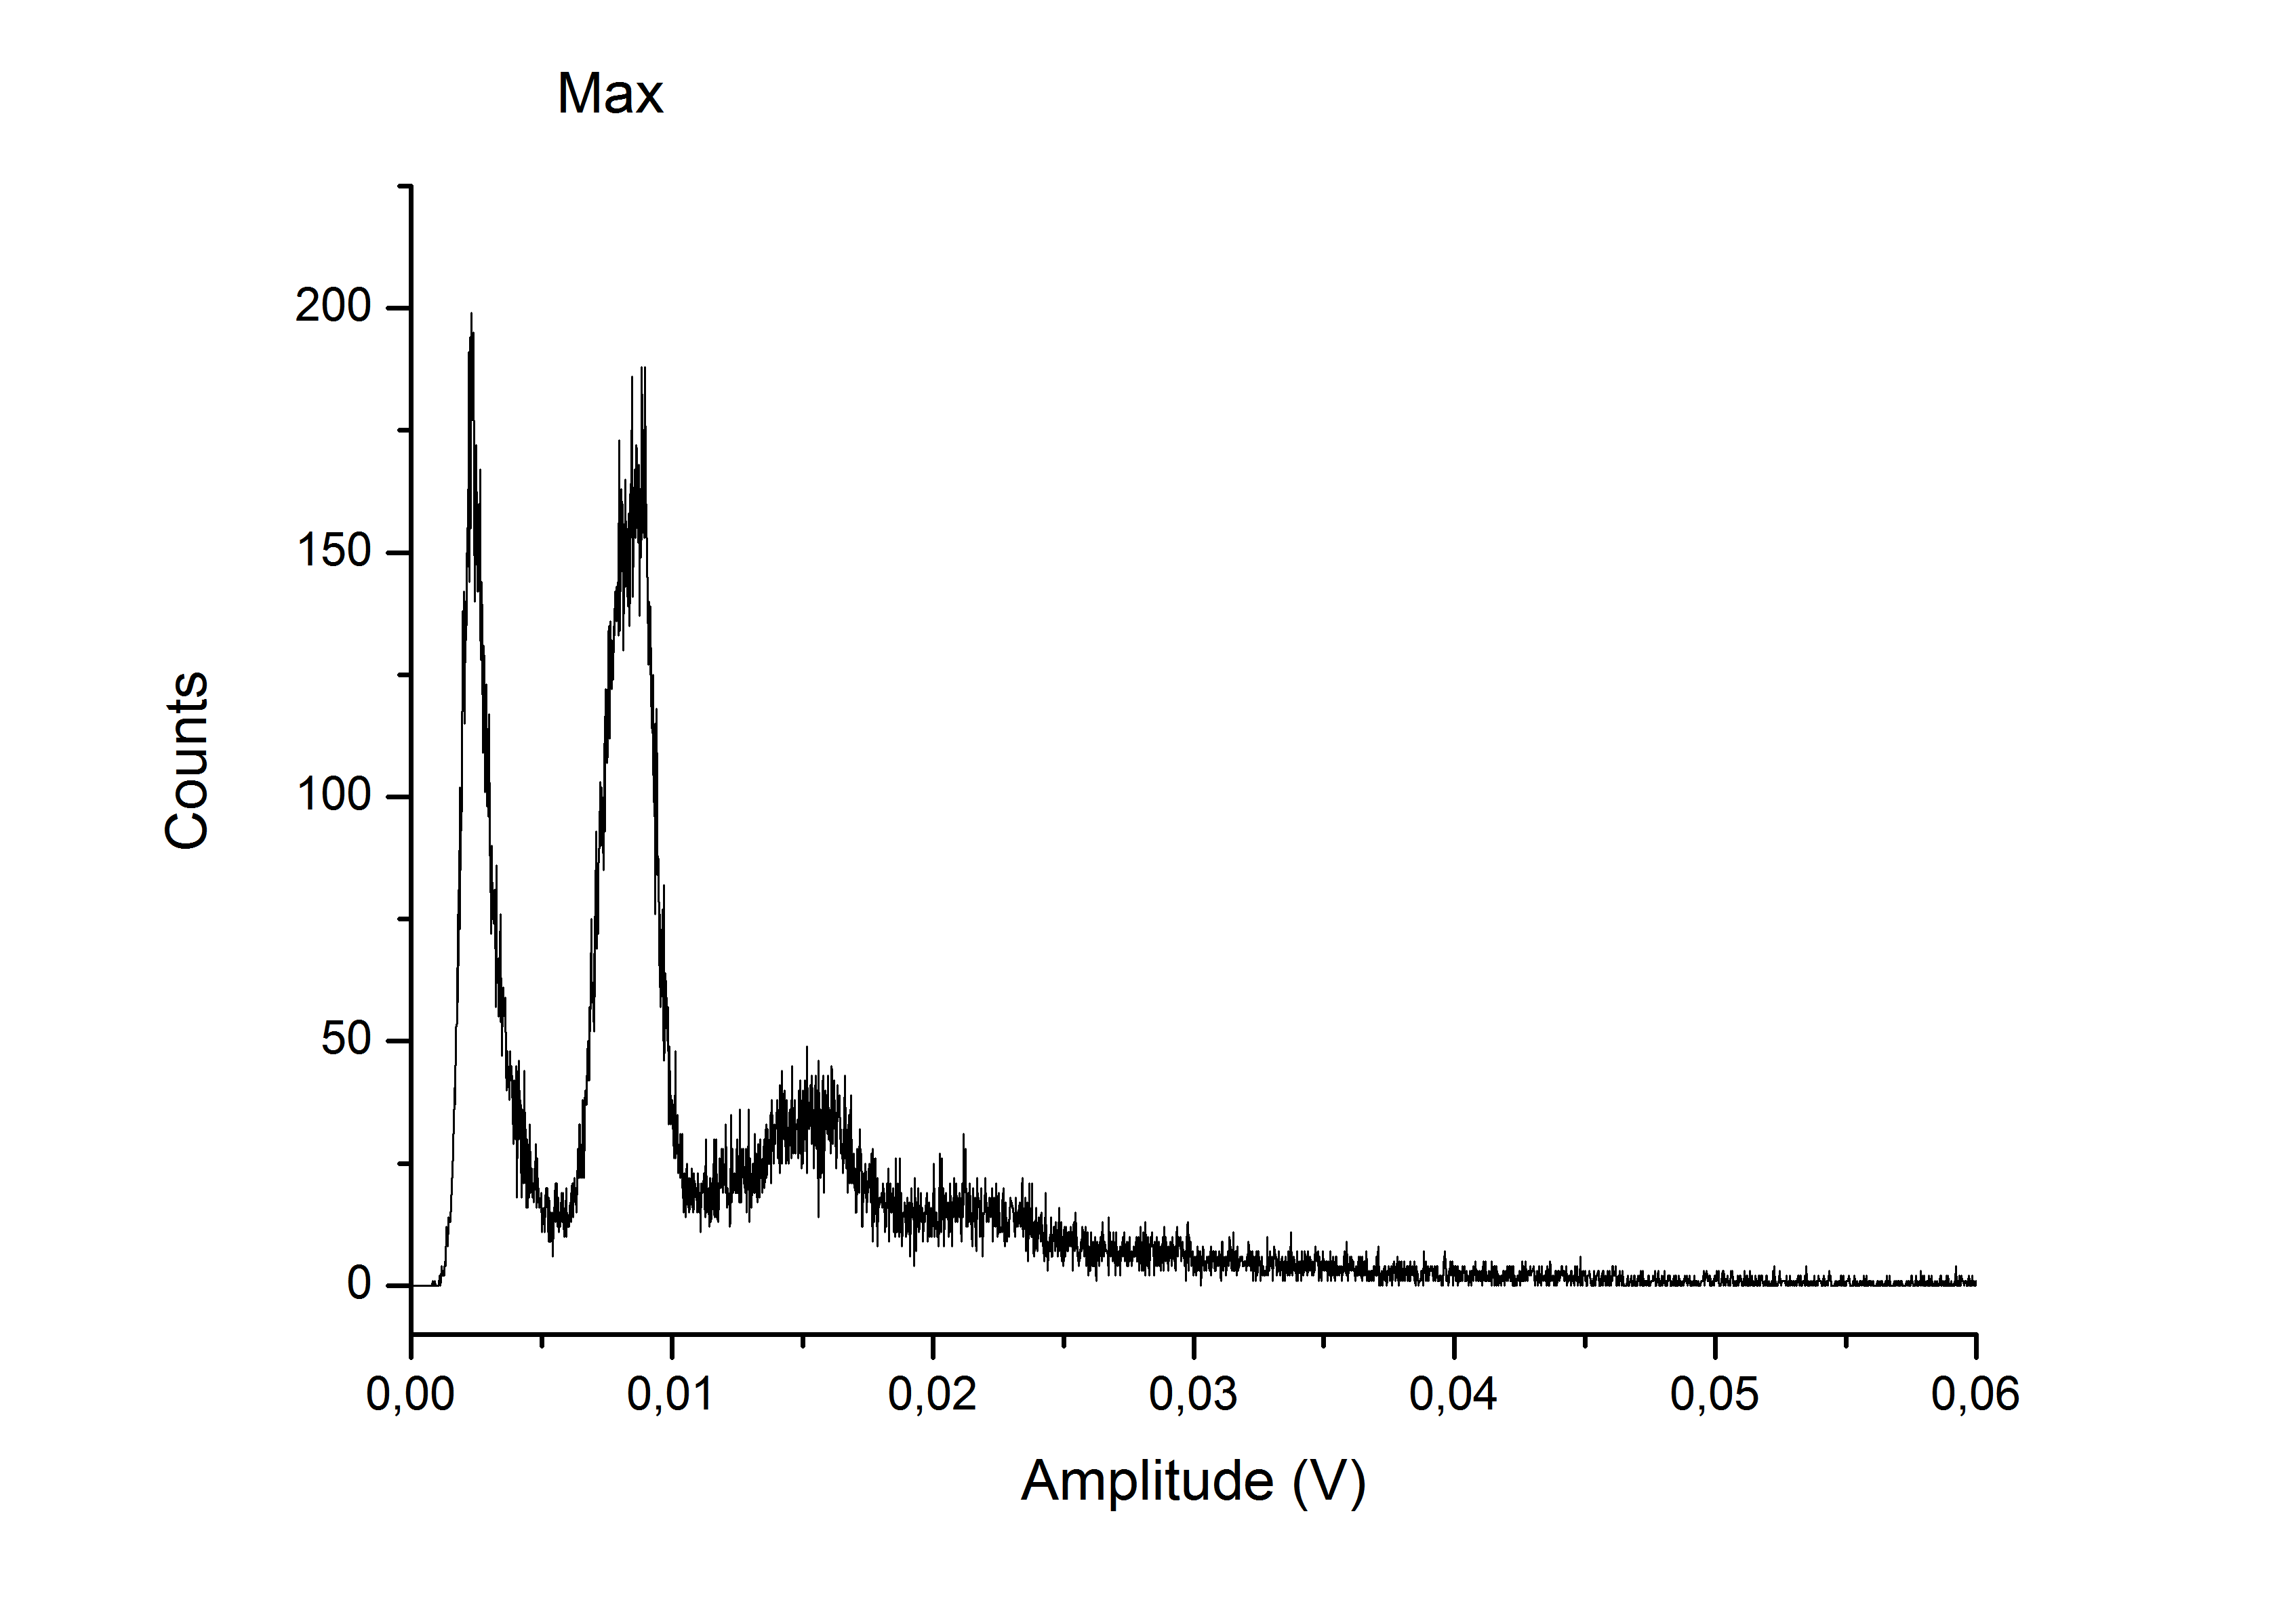
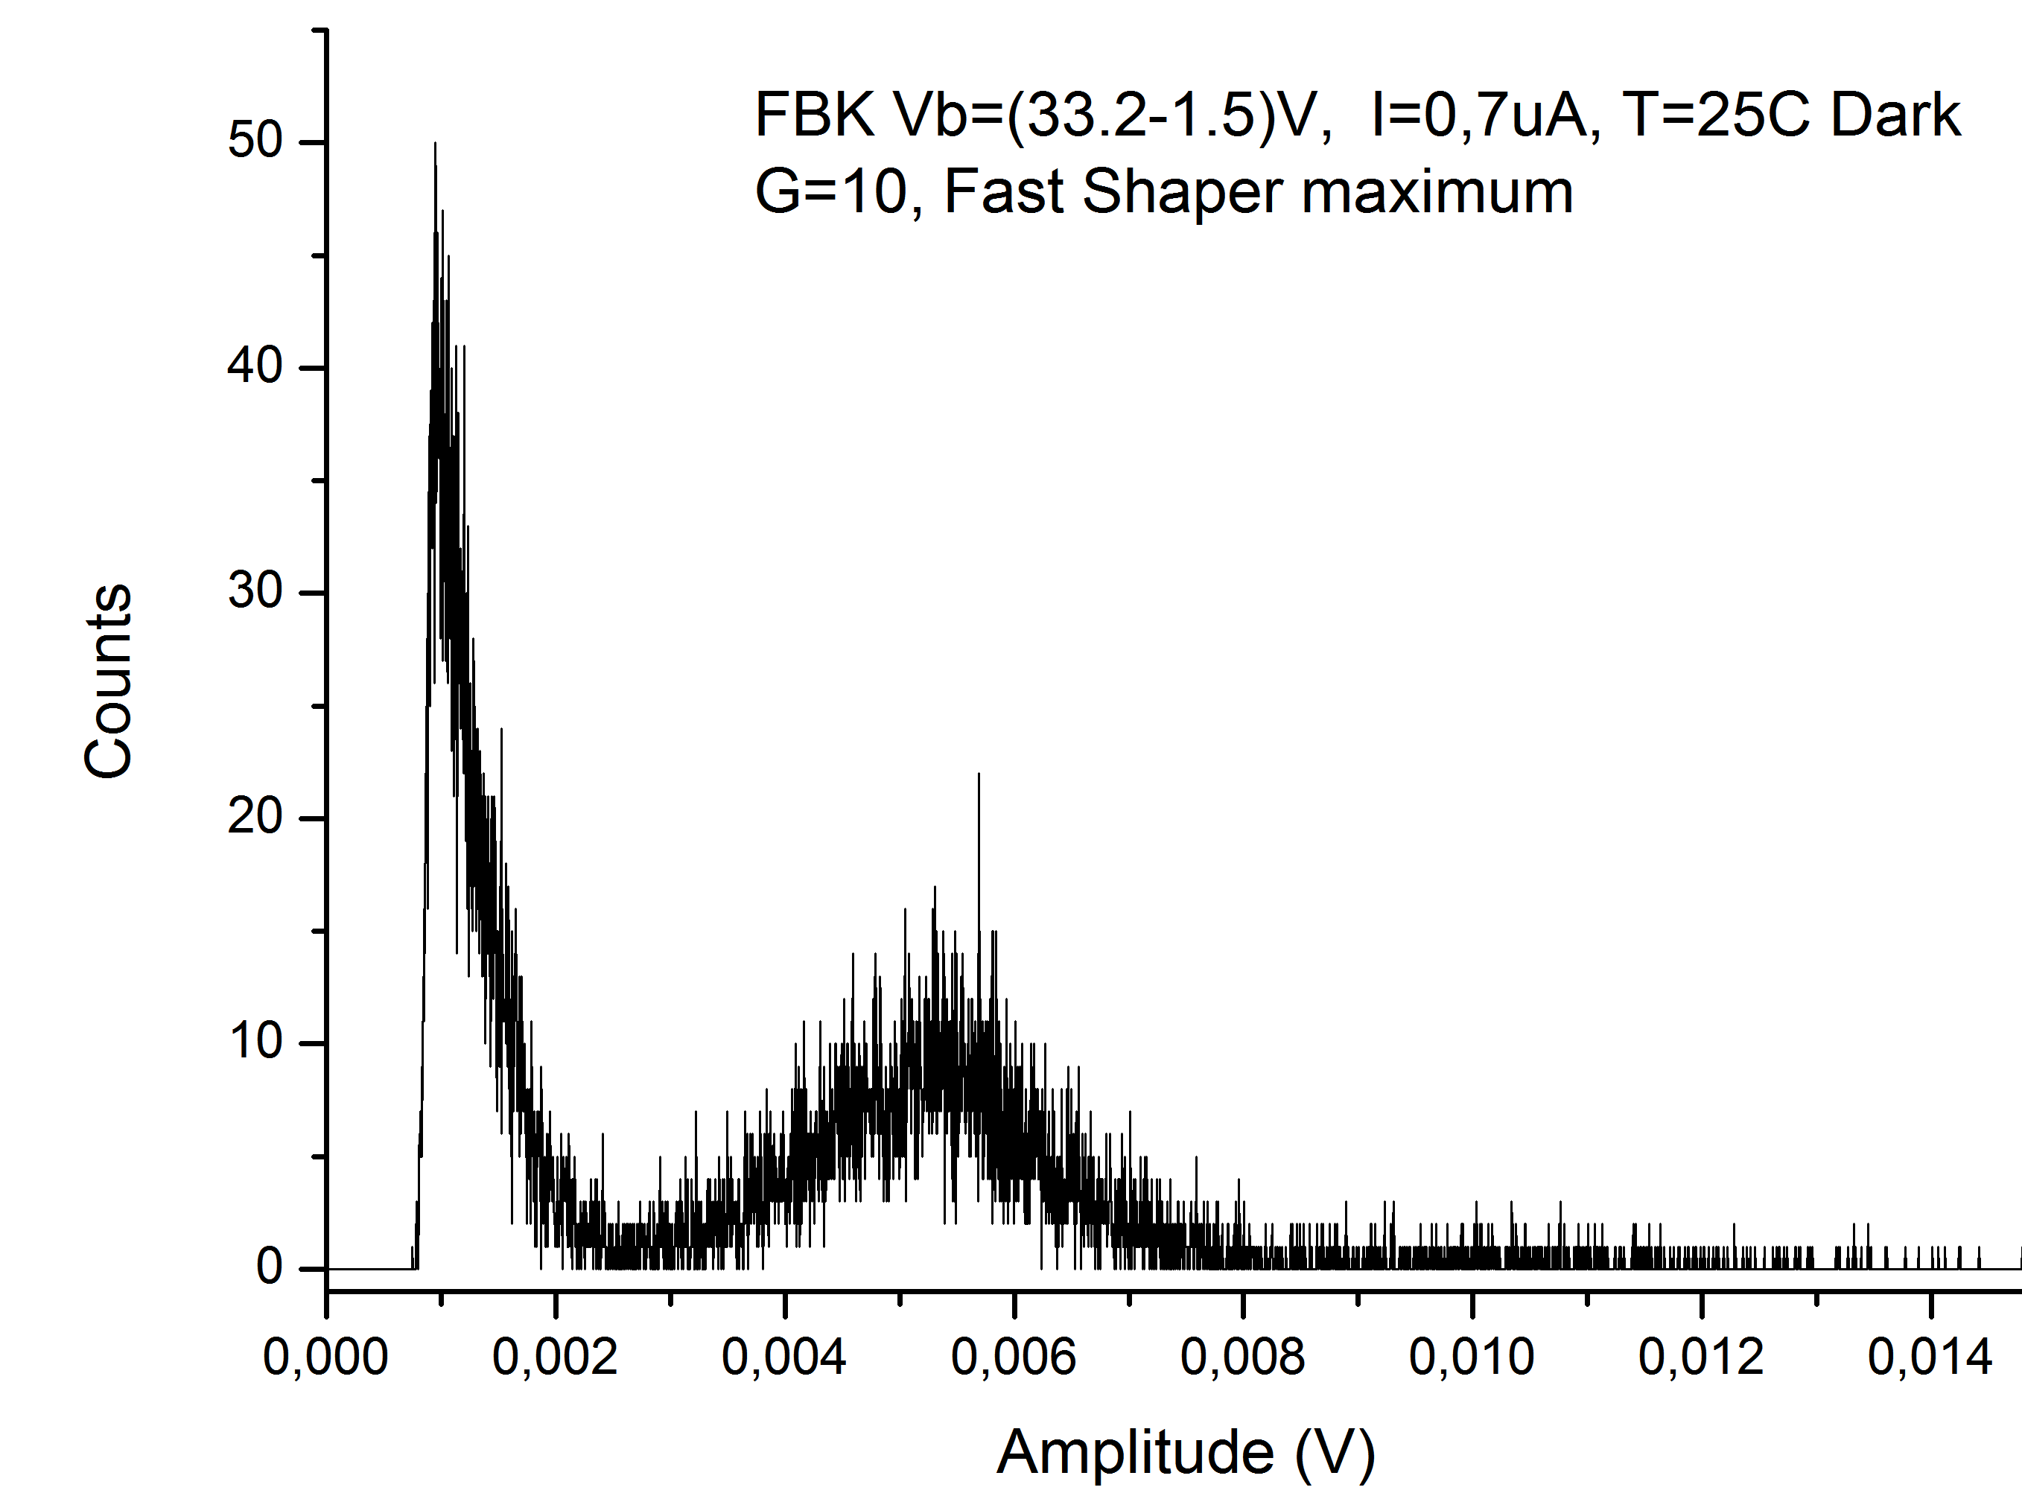
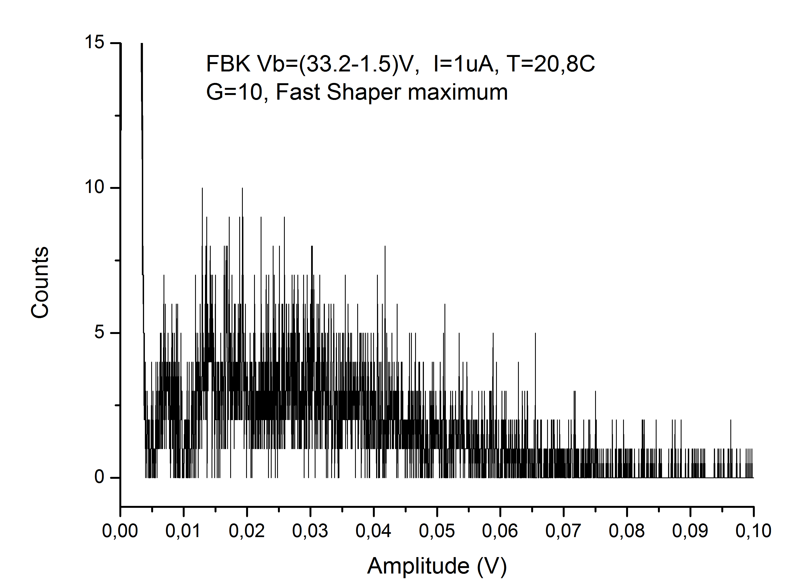
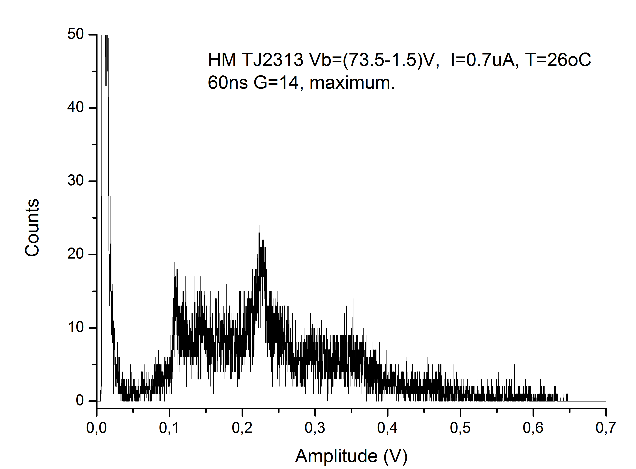
Hamamatzu
FBK
HM TJ2313 Vb=(73.5-1.5)V, I=1.3uA, T=22.4ºC Dark
60ns G=14, F2 - maximum.
EASIROC tests
1 photon peak
4-6 mV / photon
7 mV / photon
2 photon peak
MAX 20-25 mV
MAX 220mV
20mV/Div
100mV/Div

Slide 17
Slave board’s Features
The analog signals produced by SiPMs are converted in digital data
Dynamic tuning of the working point
Onboard pins to read temperature and humidity sensors
Setup for best performances corresponding to environmental conditions
Housing board’s Features
Hosts 32 SiPM and guarantee for best positioning respect to module’s fibers
It has an isothermal surface to setup the same temperature condition to all 32 photomultipliers
Temperature sensors are placed close to the SiPMs
Humidity sensors to not exceed the dew point

Slide 18
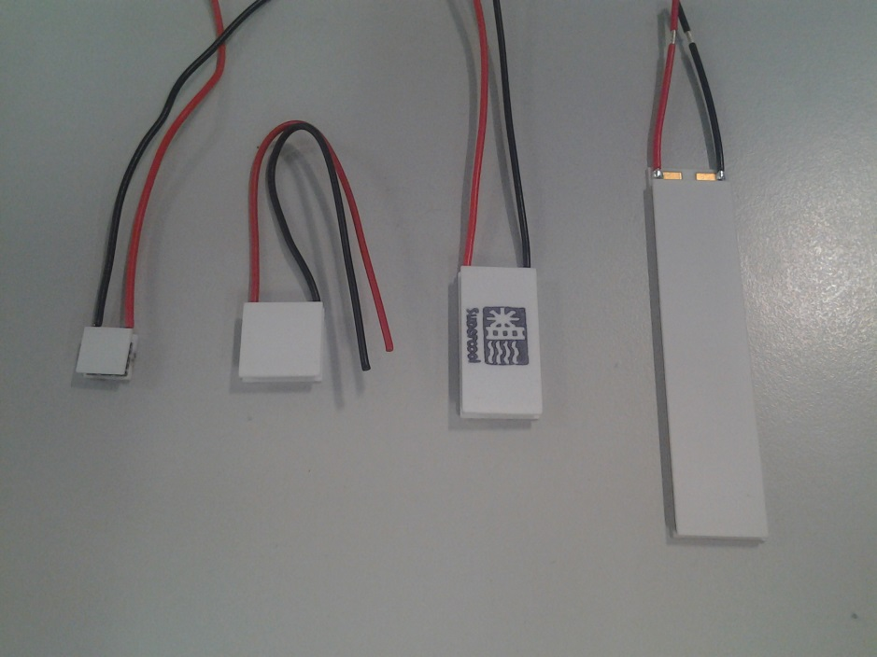
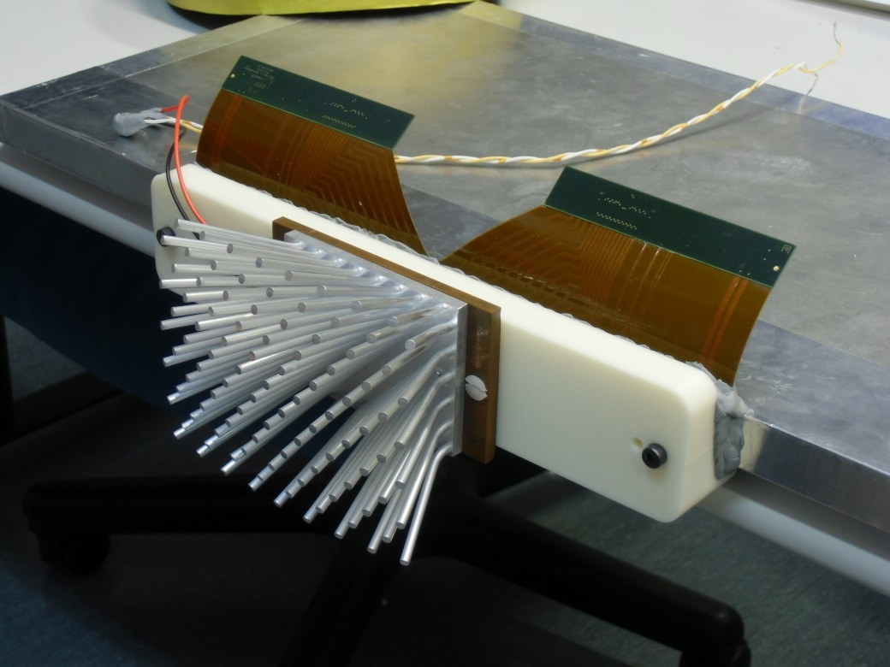
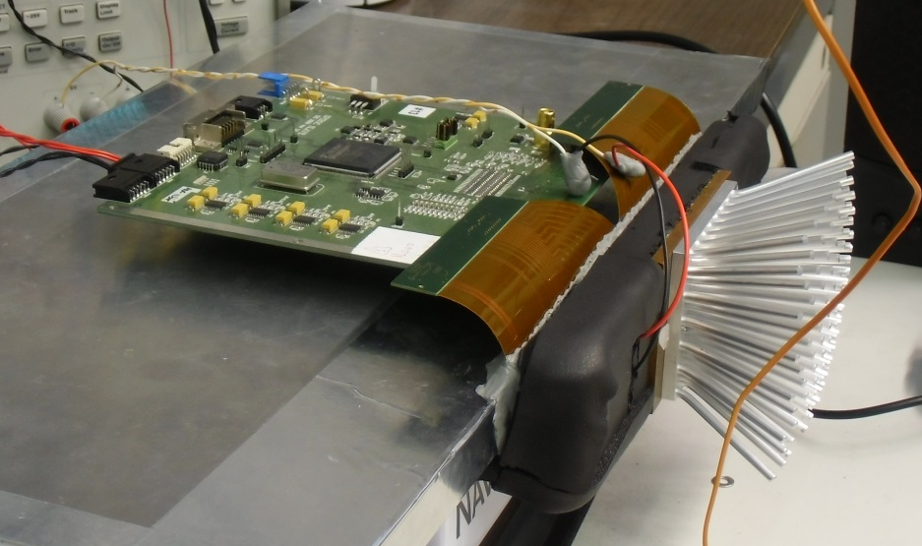
Temperature control system
Based on Peltier cells
Designed to minimize inetrnal temperature variations due to external changes
Sets temperature condition for all housed SiPMs at the same time
Works with passive cooling

Slide 19
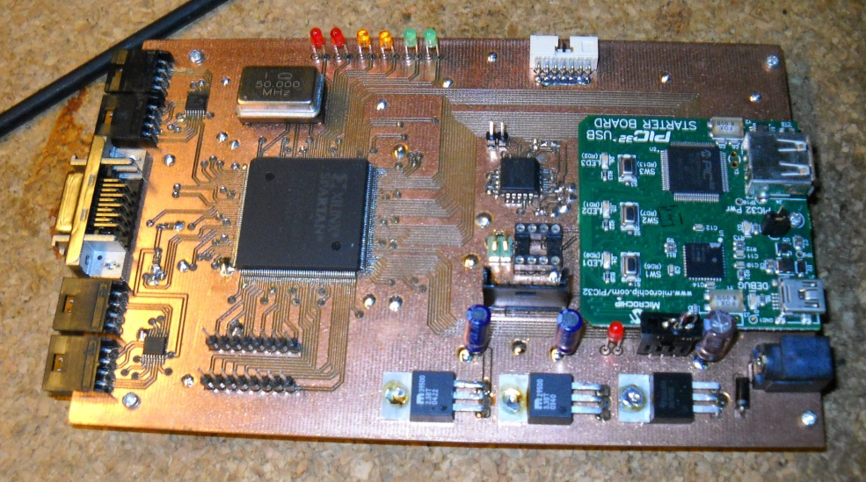
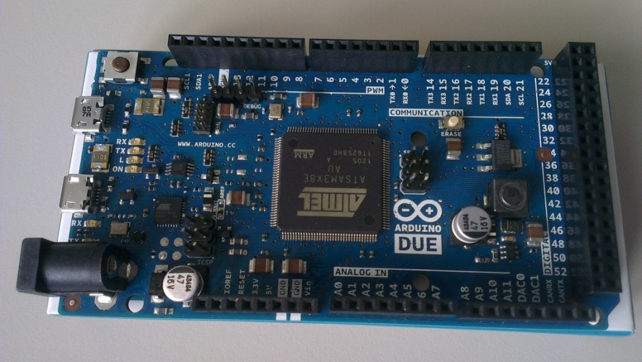
Data Acquisition…
SLAVE Boards
PC
… and Slow Control

Slide 20
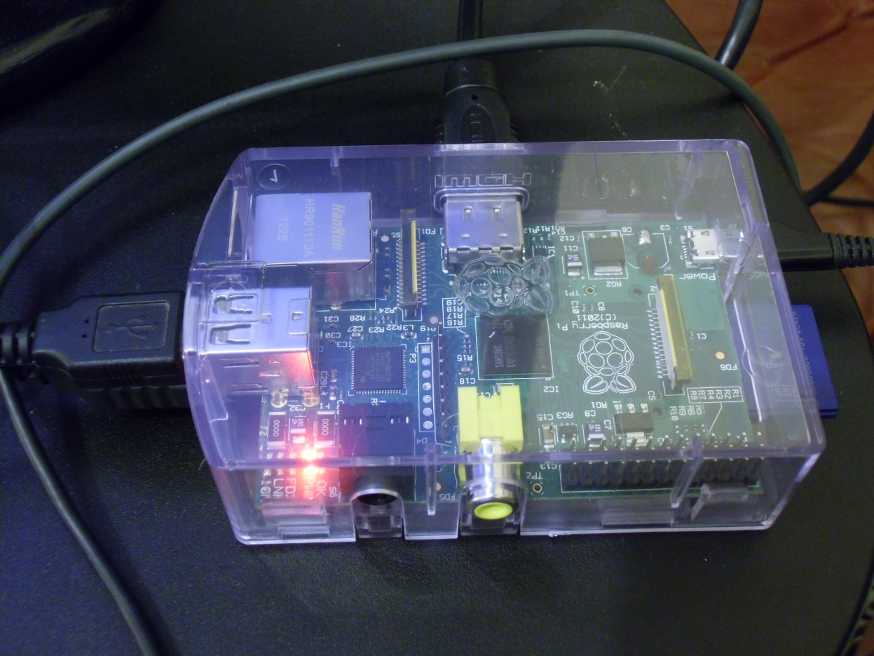
RPi Micro System
MASTER board
Slow Control
Power generators
Thermometer
Internet
Hard Disk

Slide 21
Full Automation
Environment
Sensors
Raw data
Main Program (Python3)
Low Level Functions (C/C++)
Apply new settings
Data Base (MySQL)
Master Board /
Power Supplies

Slide 22
Remarks
The construction of the MU-Ray detector starts in the spring of 2011
Tests and experiments to find best materials, sensors, computing and monitoring solutions lead to the development of an automated muon detector
There have been many improvements during its assembly
Other improvements and new features are scheduled for the 2013/14
Its precise calibration and characterization allowed to set for best performance
In April 2013 we “see” the Vesuvius, our hard playground, for the first time and after few days of data acquisition
Other improvements and new features are scheduled for the 2013/14
Since June 2013, the detector is in Clermont Ferrand (France) at the Puy-de-Dome

Slide 23
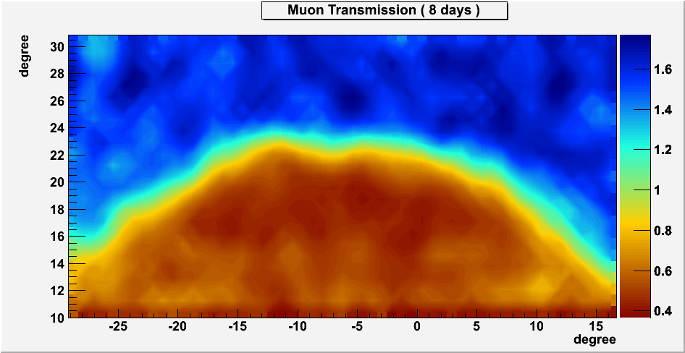

The Puy de Dome’s “Shadow”
MuRay - Tomuvol Experiments collaboration in Clermont-Ferrand
(France)

Slide 24
Thanks
mail :: cimmino@na.infn.it

