Slide 1
Volcanology for muographers
--- Case studies on Usu volcano, Hokkaido ---
July 26, 2013
Izumi YOKOYAMA

Slide 2
Modern Volcanology
Krakatau 1883
Bandai 1888
Tarumae 1909 Lava dome
Usu 1910 “Mound” Seismometric observ.
Sakurajima 1914
AVO (Omori, Minakami)
Paricutin 1944 Scoria cone
Showa-Shinzan 1944 Lava dome Leveling
Izu-Ooshima 1950 Gravimetry
Mt. S. Helens
Pinatubo
Unzen 1993 Lava dome, Pyroclastic flows Drilling
Asama
Satsuma-Iwo-shima
---------------------------------------------------------------------------------------------------------------------------------------
Eye observ. ▶ Drilling ▶ Prospecting ▶ Muon radiography
Magma 〜 Lava

Slide 3
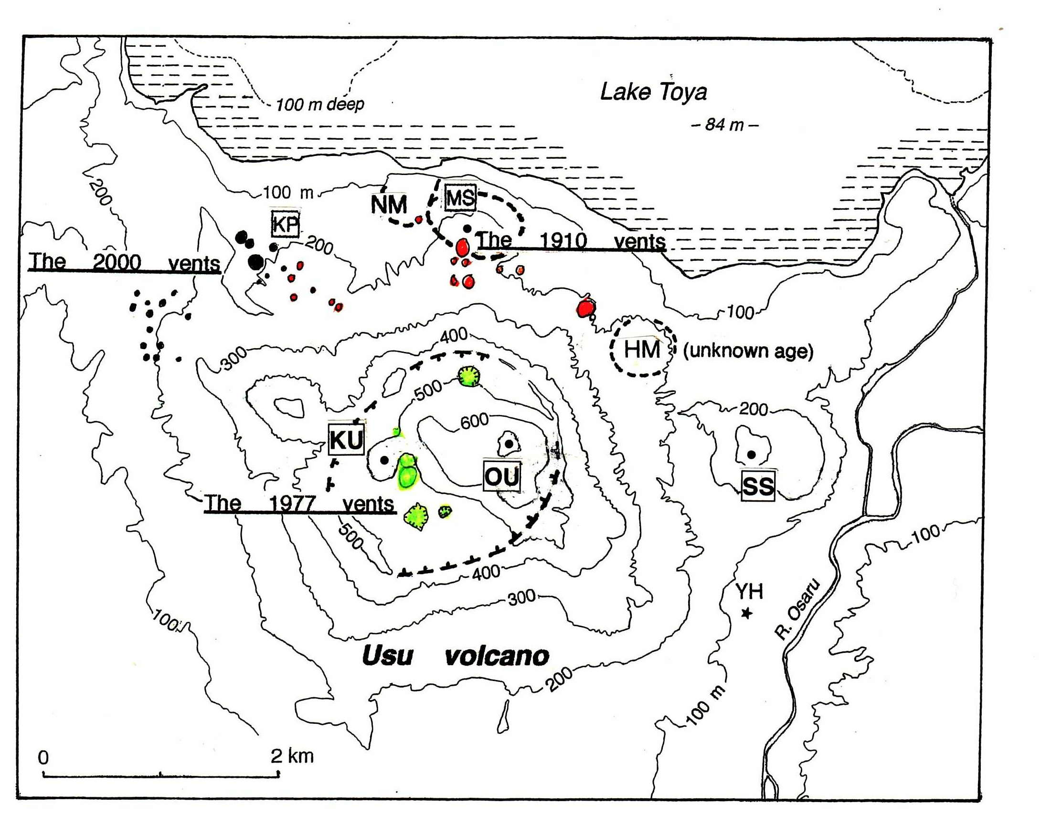
Usu volcano, Hokkaido
A) Upheaval without eruptions in 1944 (YH)
B) Mound (so called cryptodome) formation with eruptions in 1910 (MS: Meiji-Shinzan)
C) Dome formation in 1944 (SS: Showa-Shinzan)

Slide 4
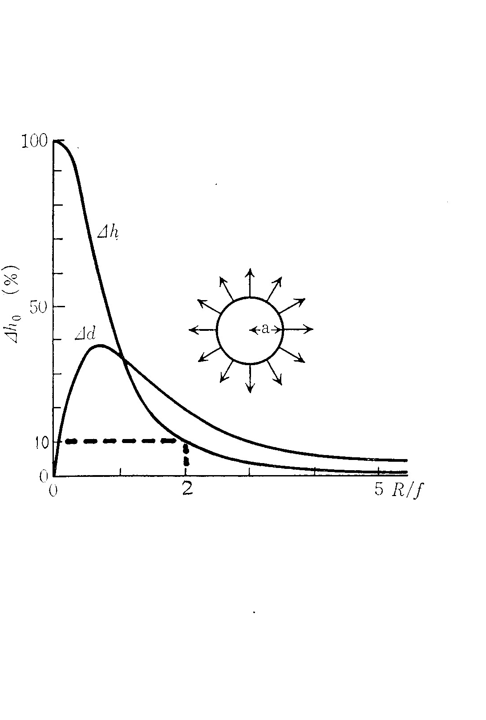
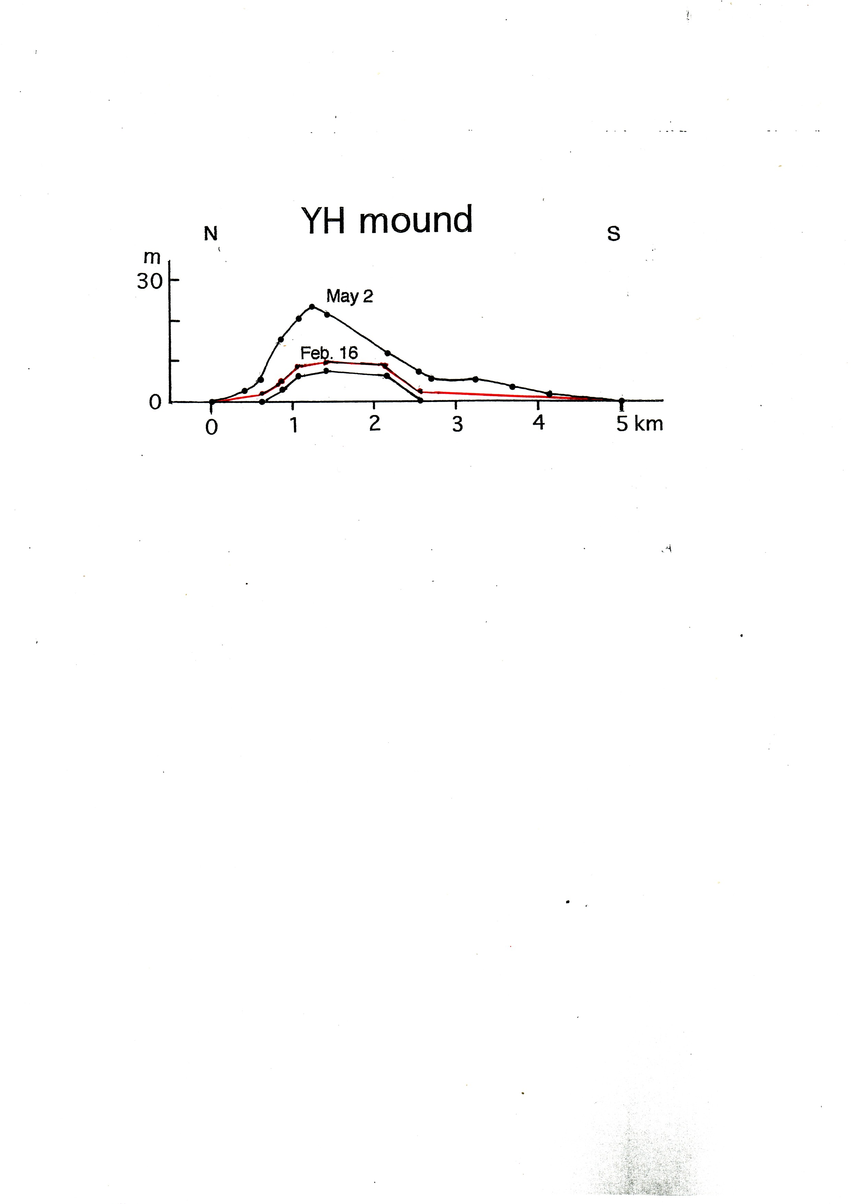
(A) YH mound

Slide 5
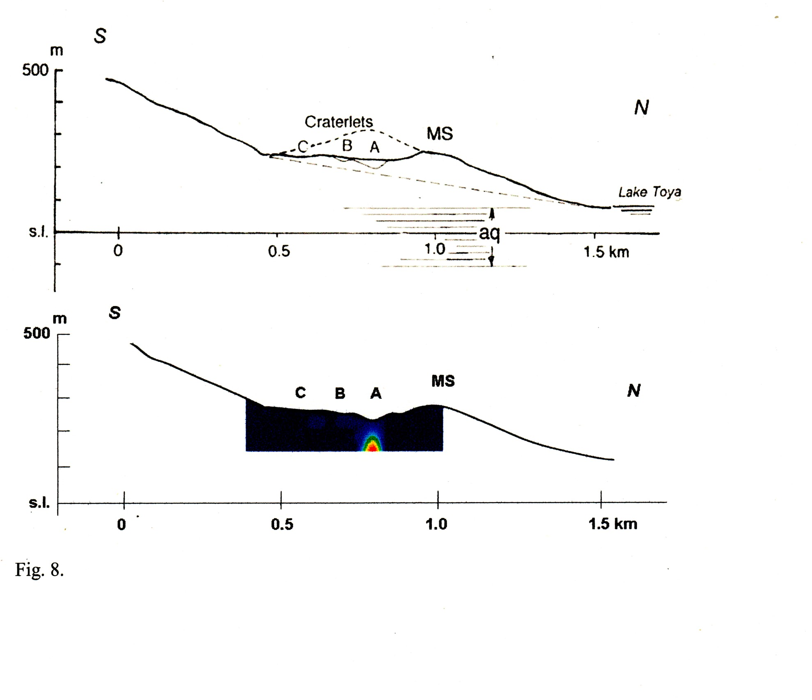
(B) MS mound

Slide 6
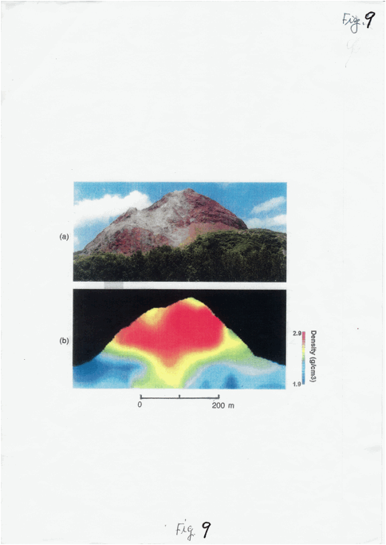
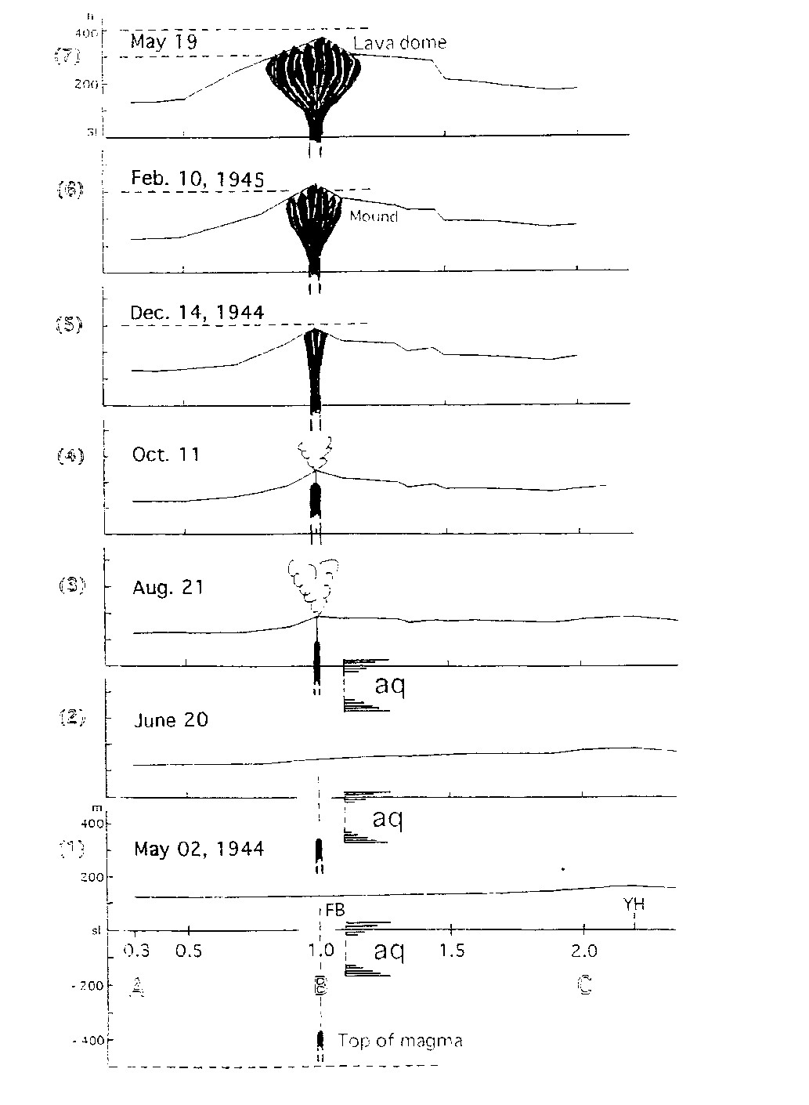
(C) SS-dome

Slide 7
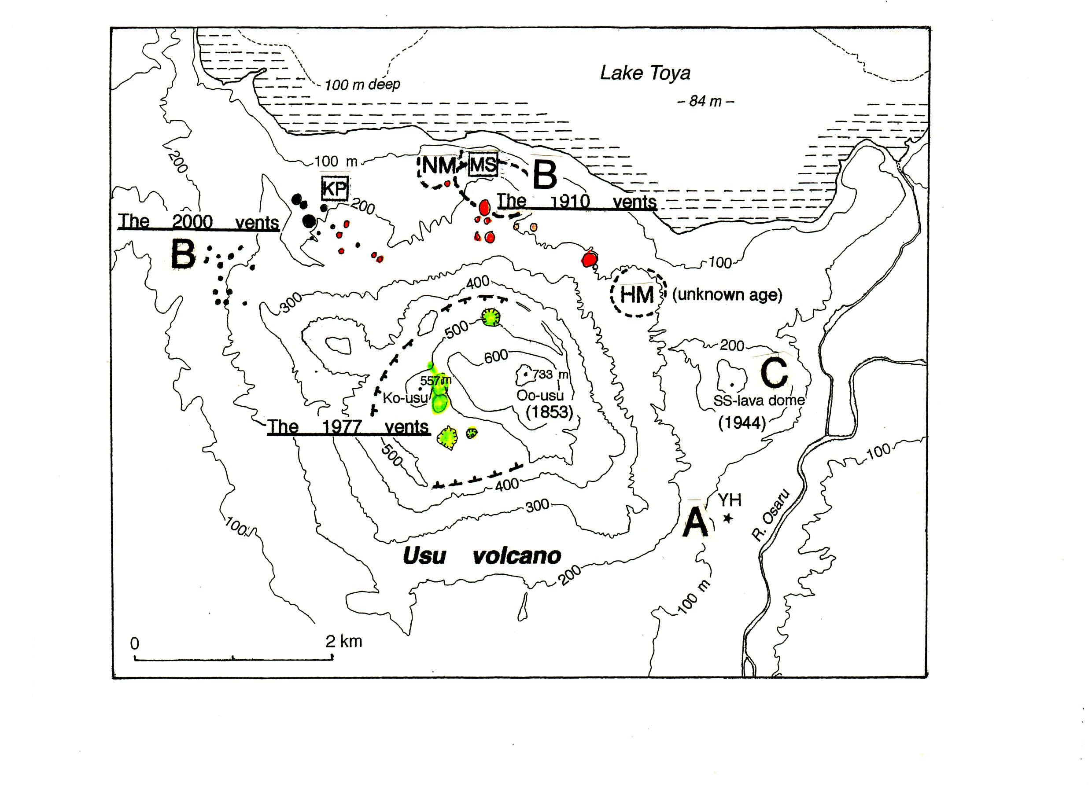
Three types of dome intrusion on Usu volcano

Slide 8
Volcanic structures as targets of muography
Main cones : small,
large --------------- not always suitable
Parasites : explosion craters, ]
cinder cones, ] viscosity of magma
lava domes and spines, ]
mounds ]
Parasites are all monogenetic.

Slide 9
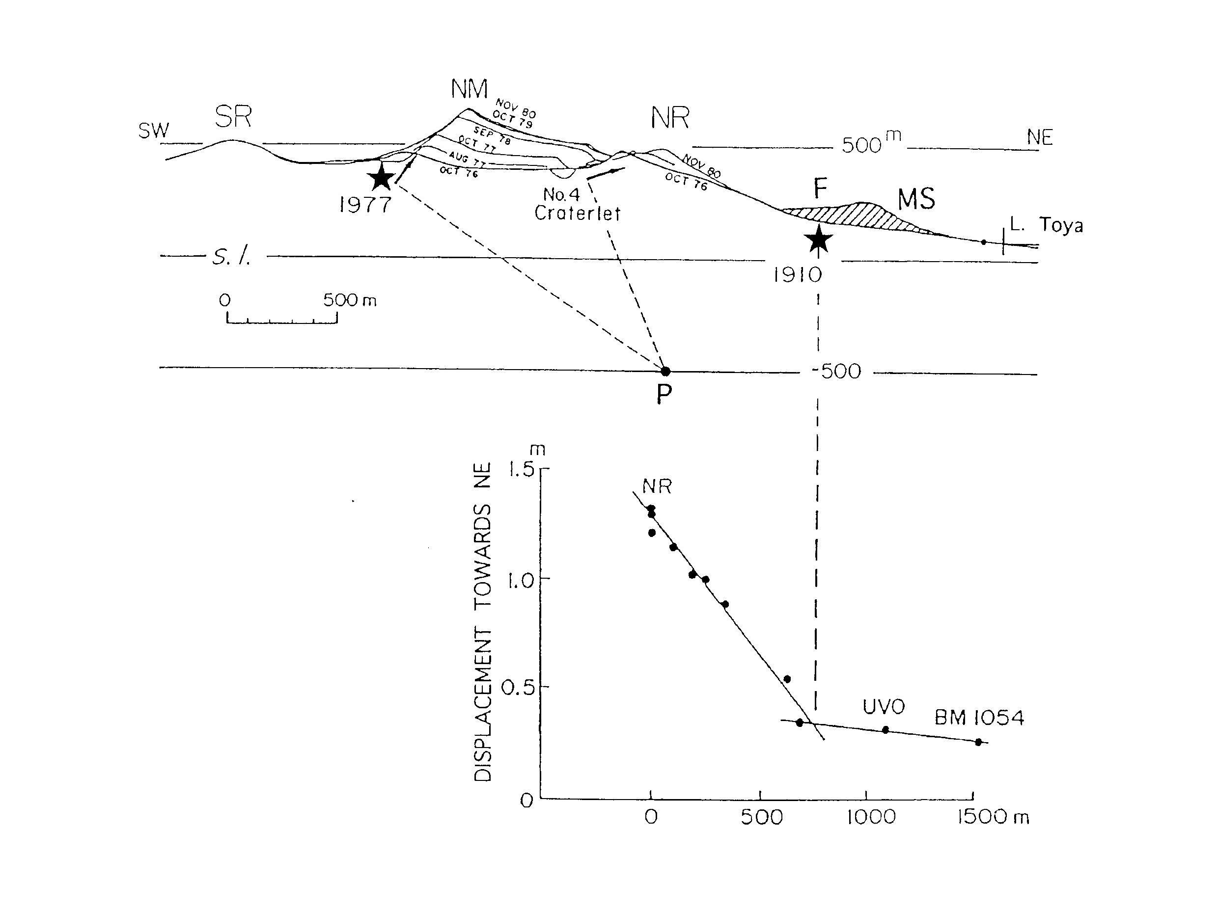
Tilt of the summit part (NM) in 1977

Slide 10
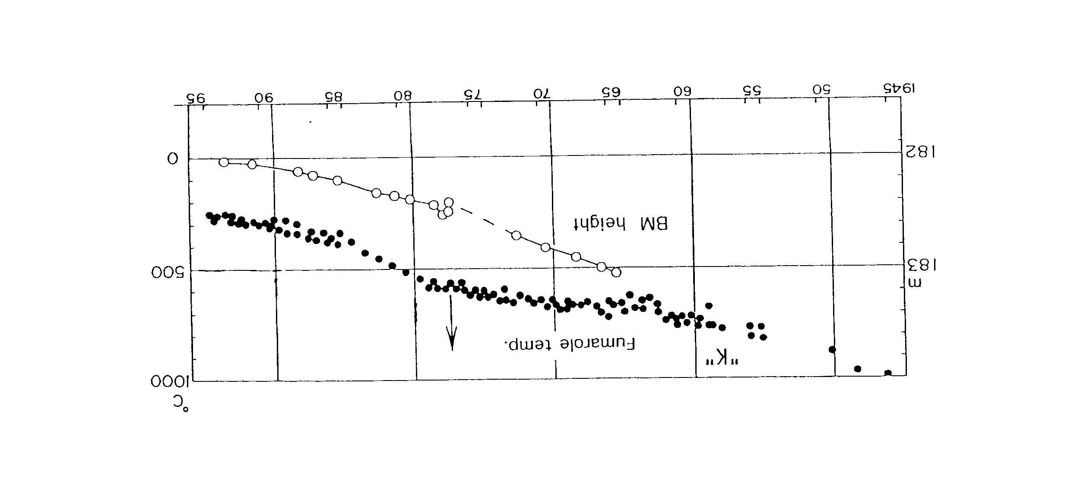
The 1944 lava dome (SS)
Secular changes of fumarole temp. and dme height

Slide 11
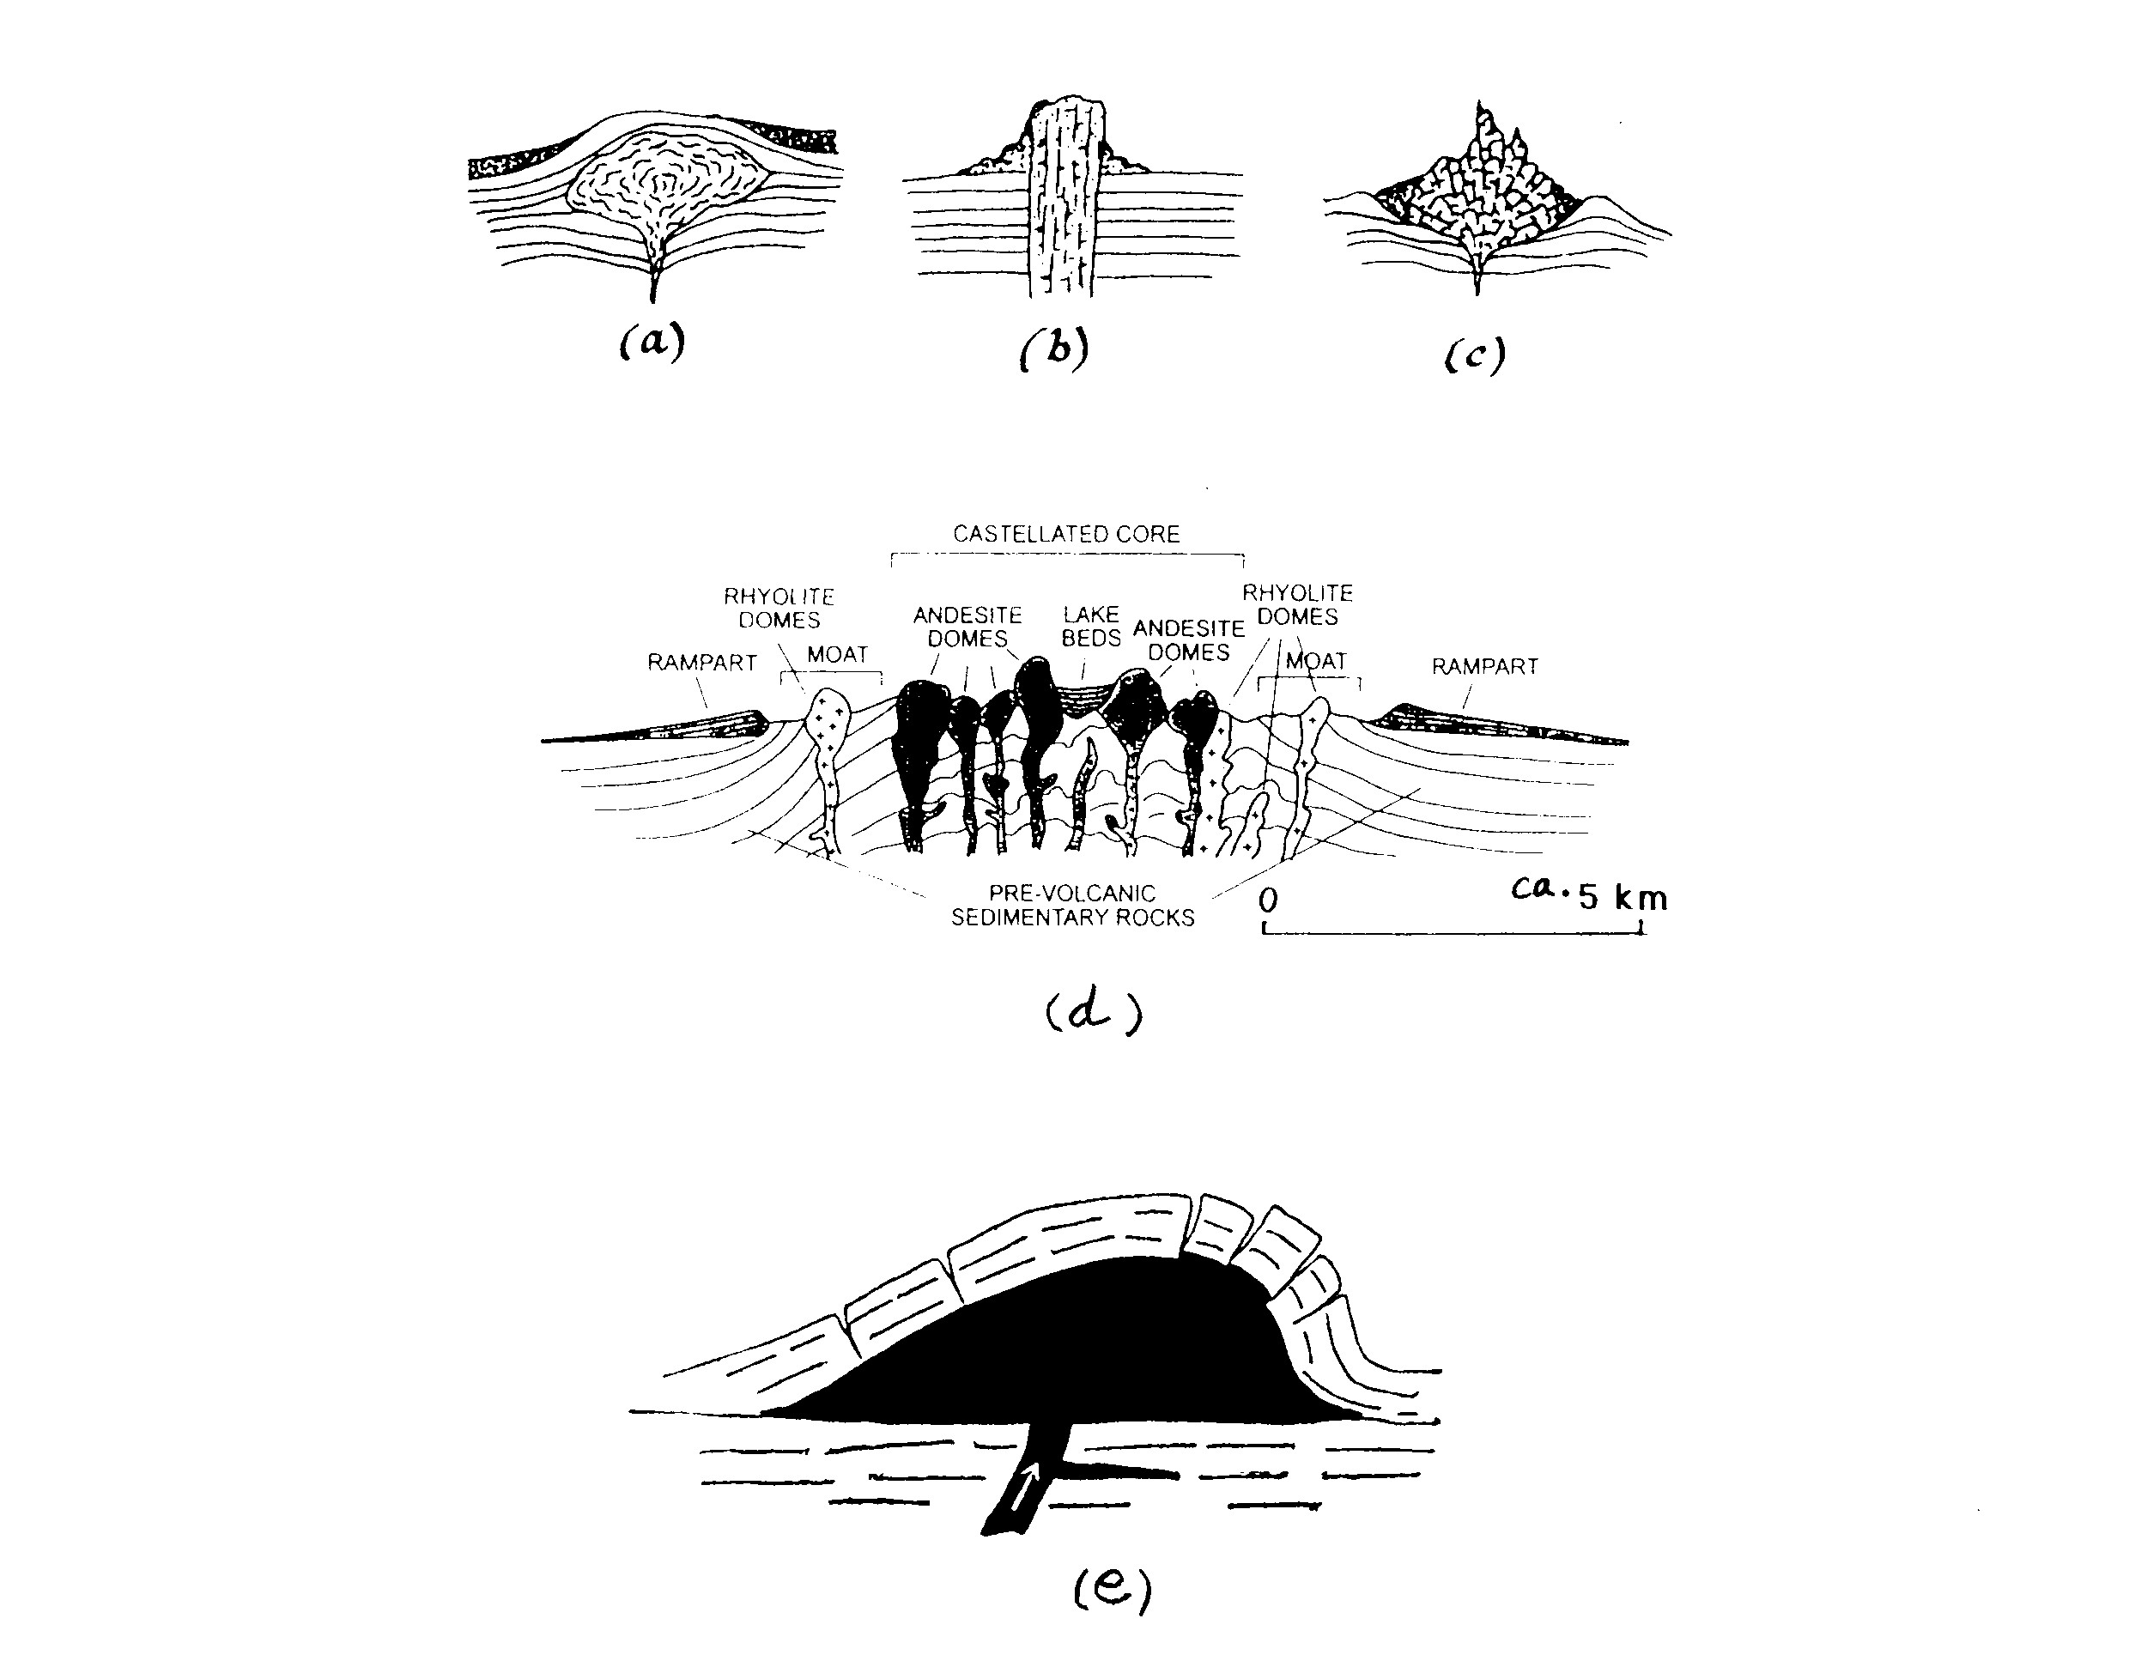
A definition of lava domes

Slide 12
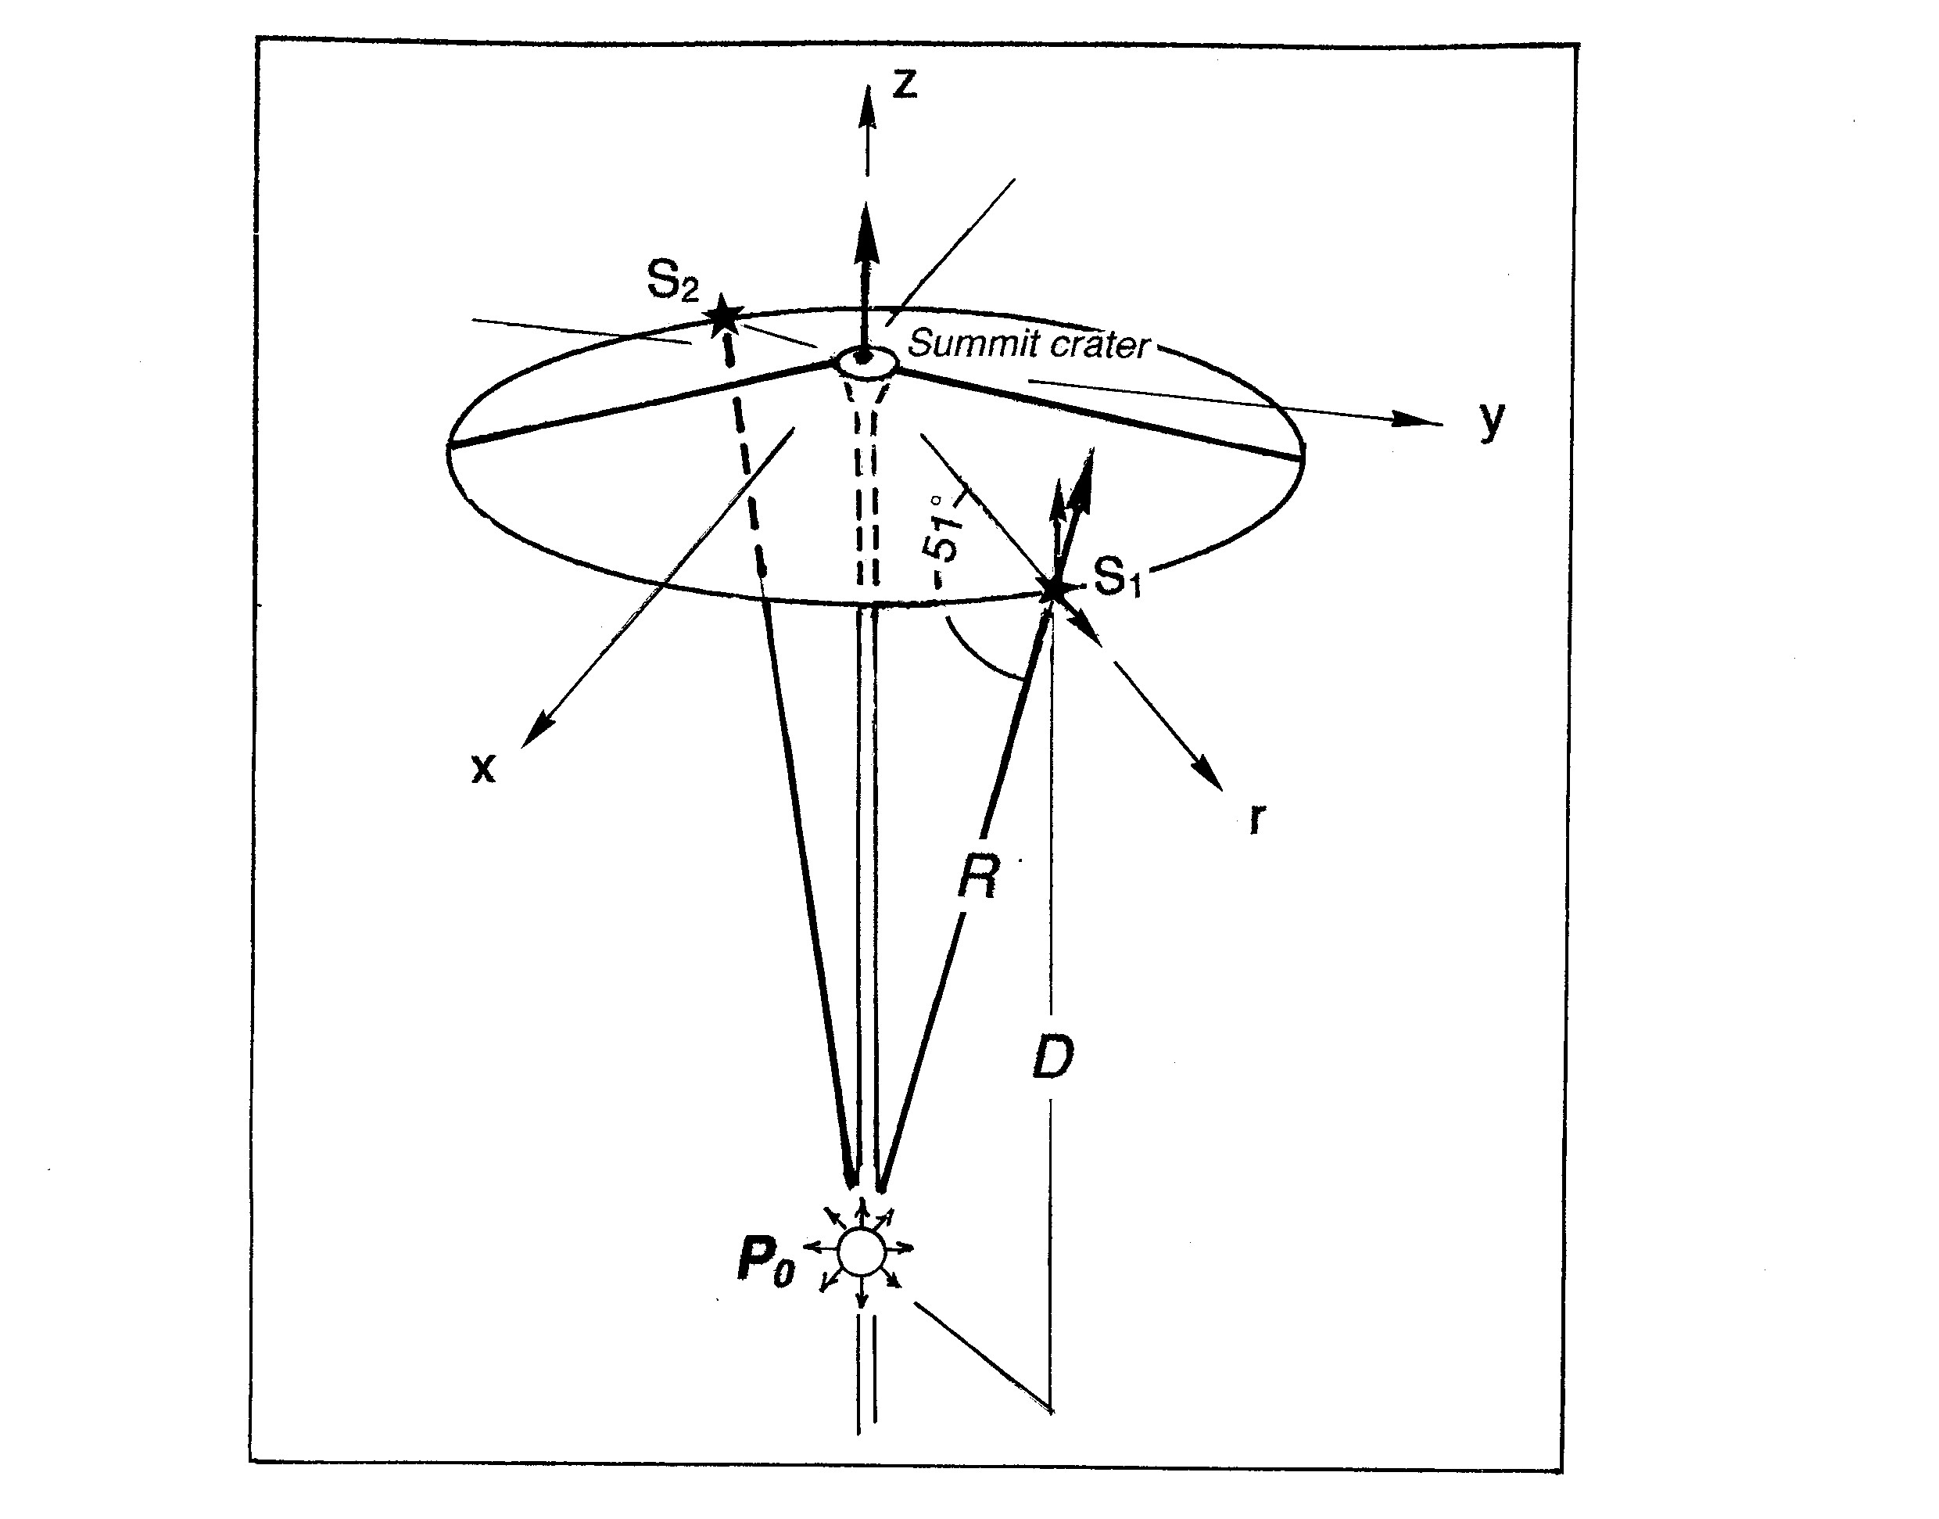
A model of parasite formation

Slide 13
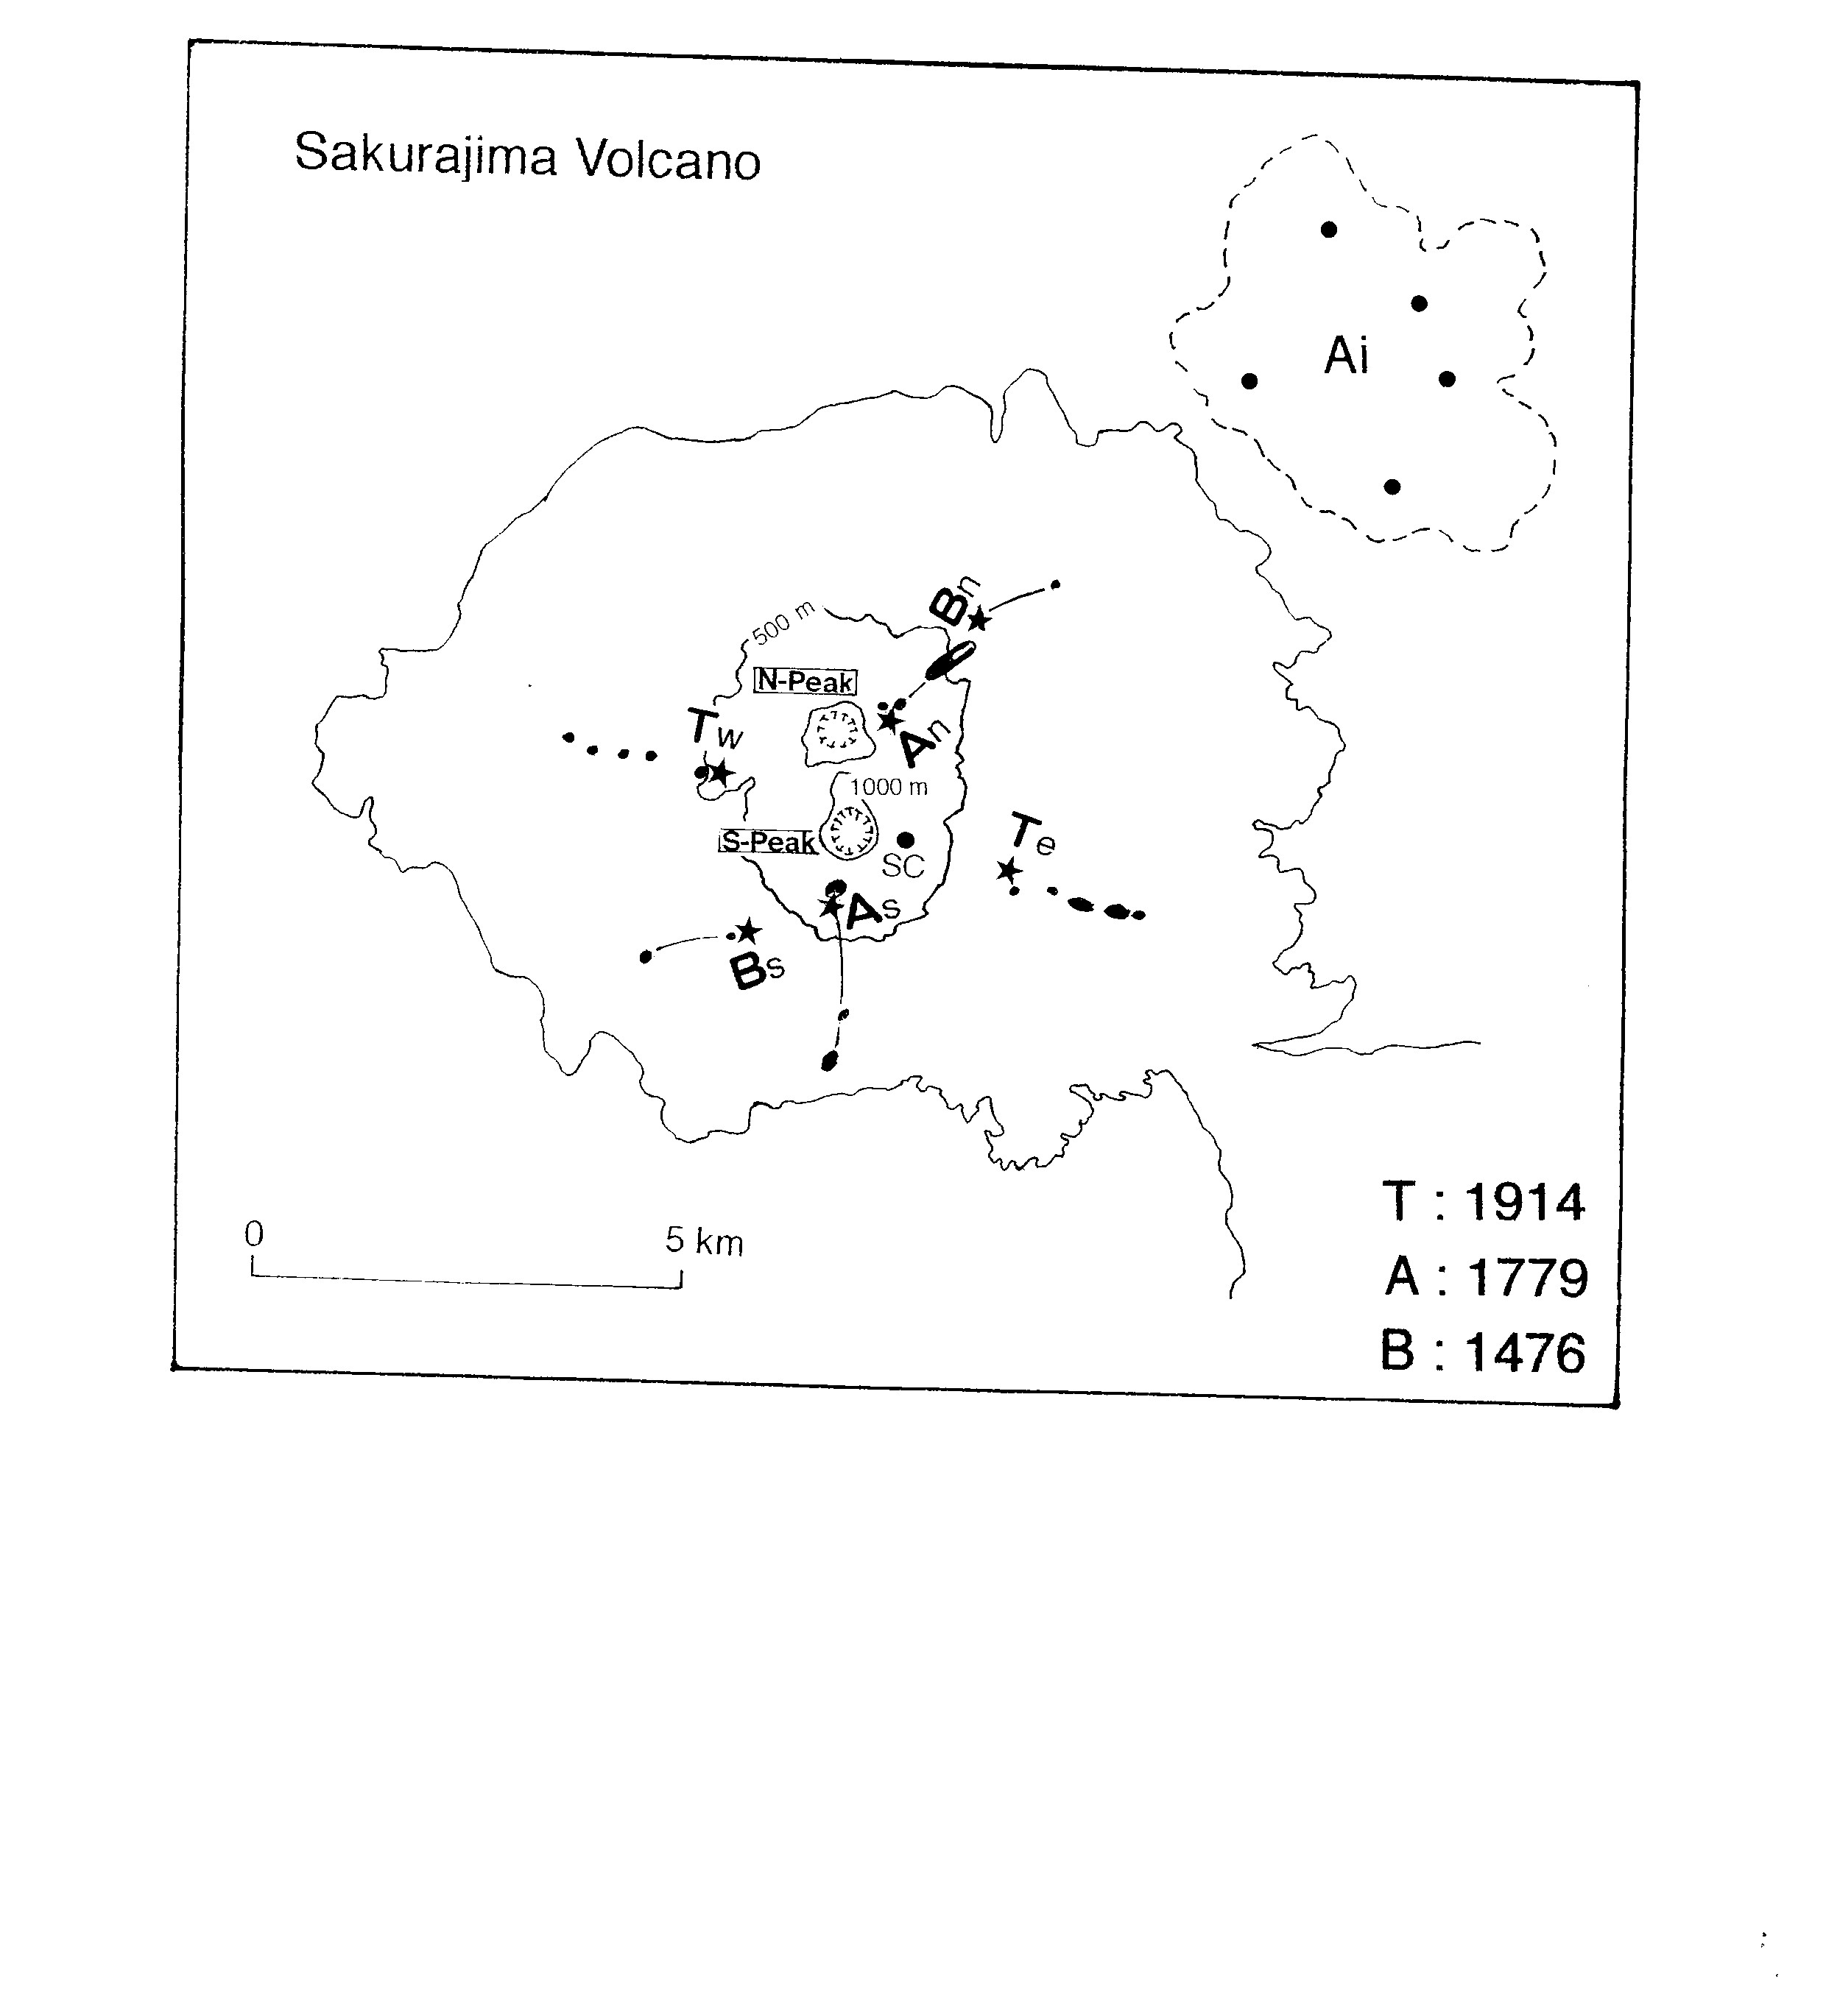
Three examples of twin parasitic vents on
Sakurajima volcano, Kyushu

Slide 14
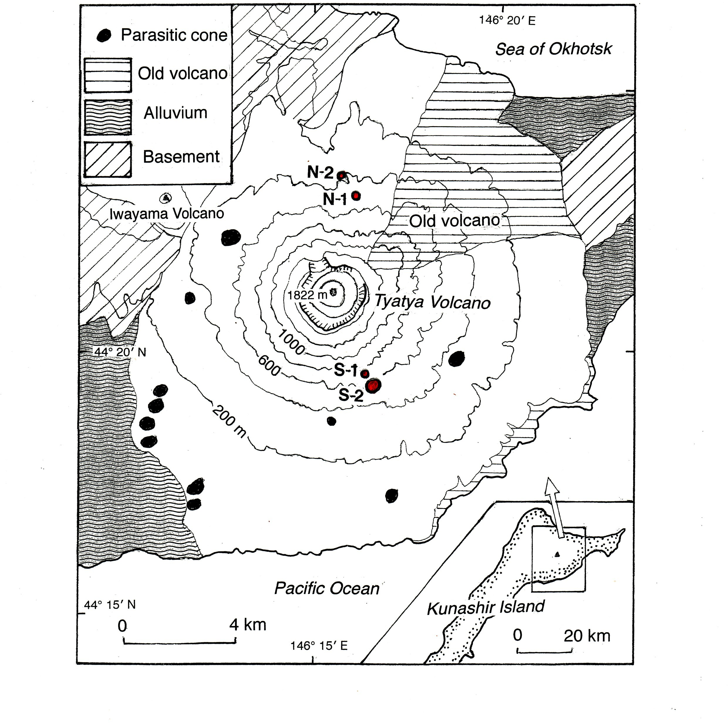
Twin parasitic vents formed in the 1973 eruption of Tyatya volcano, Kunashir (Nakagawa et al., 2002)

Slide 15
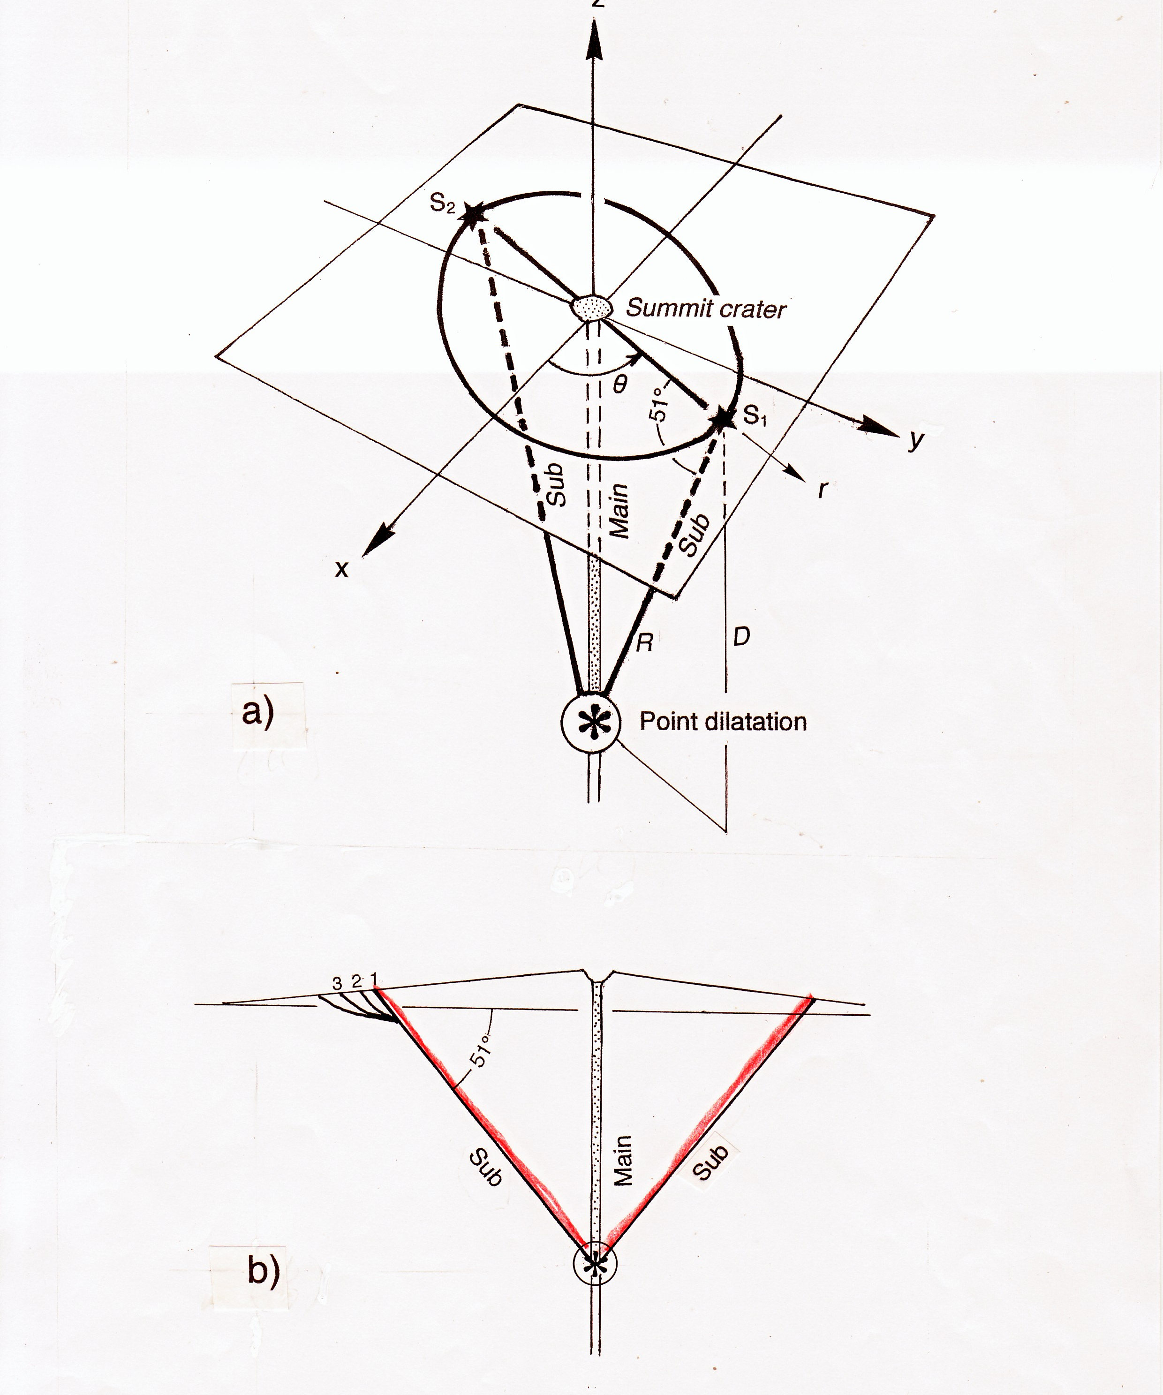
One of the next targets of muography beneath volcanoes

Slide 16
Thank you very much for your attention.

