Slide 1
Muography on Volcanoes
July 26, 2013

Slide 2
Development of Volcanology
Santorini caldera (Thera) Outcrops (Neuman van Padang)
Vesuvio 0079 Plinio Jr.
Stromboli
-------------------------------------------------------------------------------------------
Jorullo 1759 250th Anni. Humboldt Alexander von (1769-1859)
Lyell Charles (1797-1875)
Asama 1783 Pyroclastic flows
Ries Kessel (crypto-caldera) Suevite
Krakatau 1883 Verbeek (1885), Roy. Soc. (1888)
Modern Volcanology
Bandai 1888

Slide 3
Modern Volcanology
Bandai 1888
Tarumae 1909 Lava dome
Usu 1910 “Mound” Seismometric observ.
Sakurajima 1914
AVO (Omori, Minakami)
Paricutin 1944 Scoria cone
Showa-Shinzan 1944 Lava dome Leveling
Izu-Ooshima 1950 Gravimetry
Mt. S. Helens
Pinatubo
Unzen 1993 Lava dome, Pyroclastic flows Drilling
Asama
Satsuma-Iwo-shima
---------------------------------------------------------------------------------------------------------------------------------------
Eye observ. ▶ Drilling ▶ Prospecting ▶ Muon radiography
Magma 〜 Lava

Slide 4


Slide 5
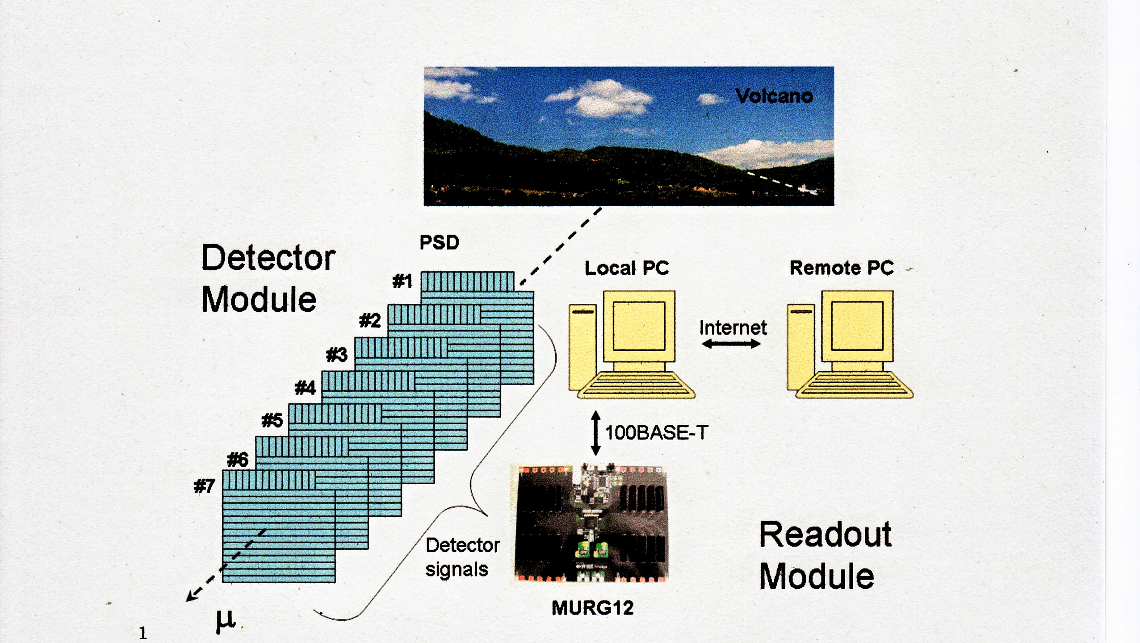
Rotational multilayer muon hodoscope

Slide 6
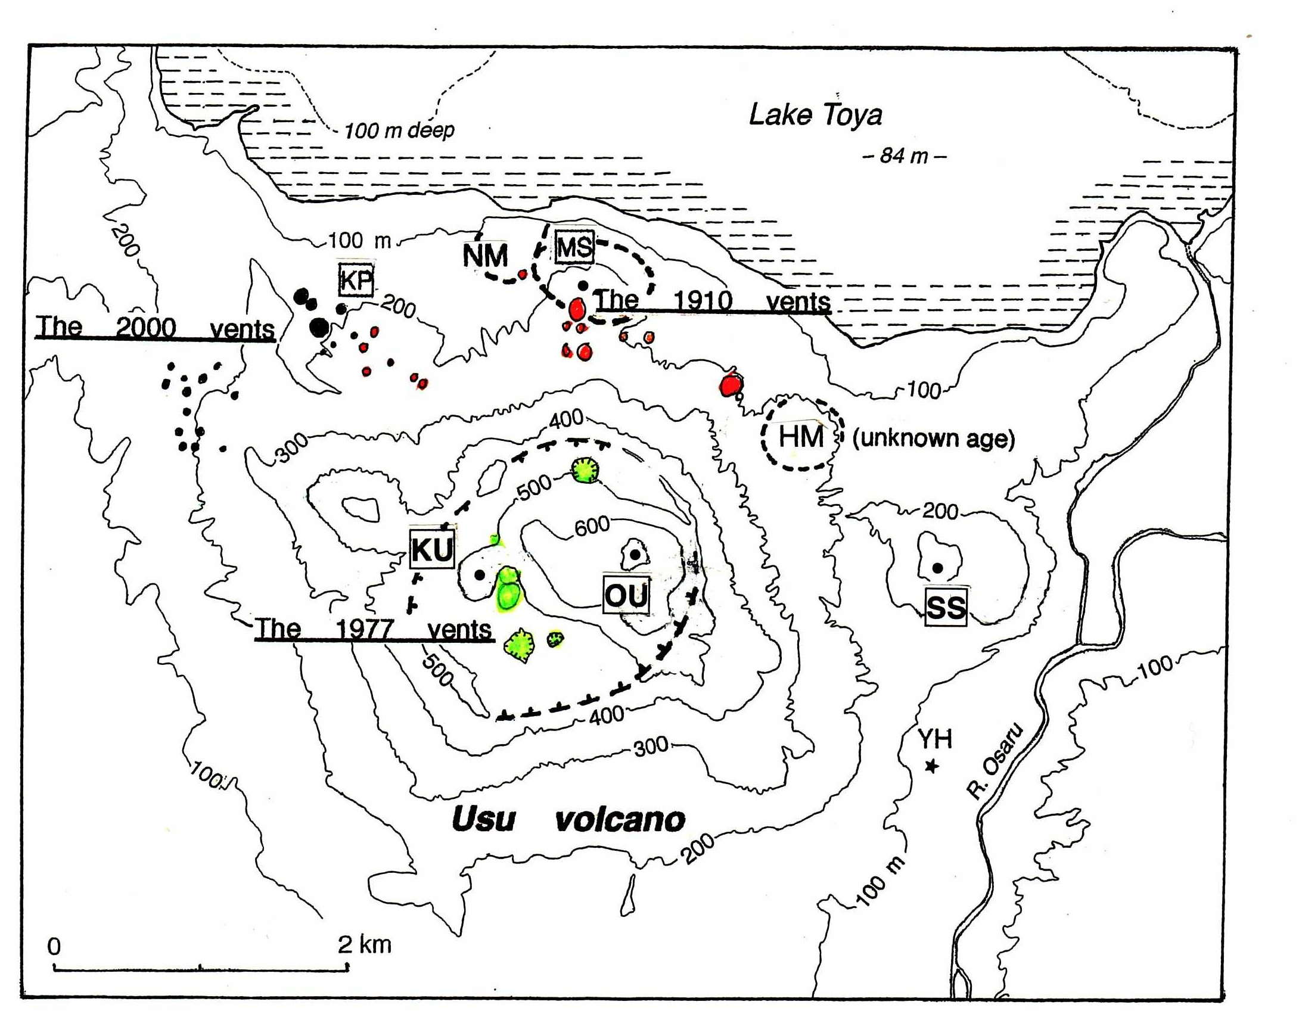
Usu volcano, Hokkaido
A) Upheaval without eruptions in 1944 (YH)
B) Mound (so called cryptodome) formation with eruptions in 1910 (MS: Meiji-Shinzan)
C) Dome formation in 1944 (SS: Showa-Shinzan)

Slide 7
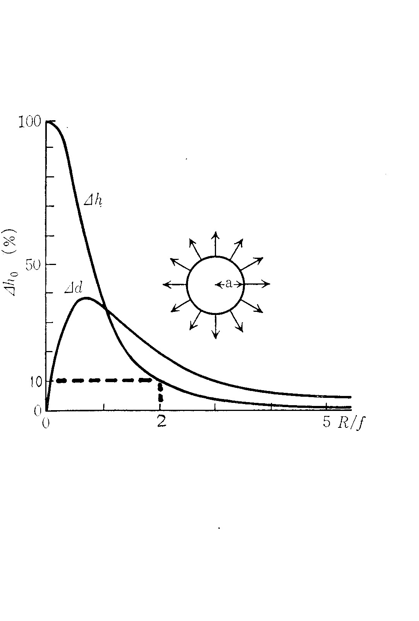
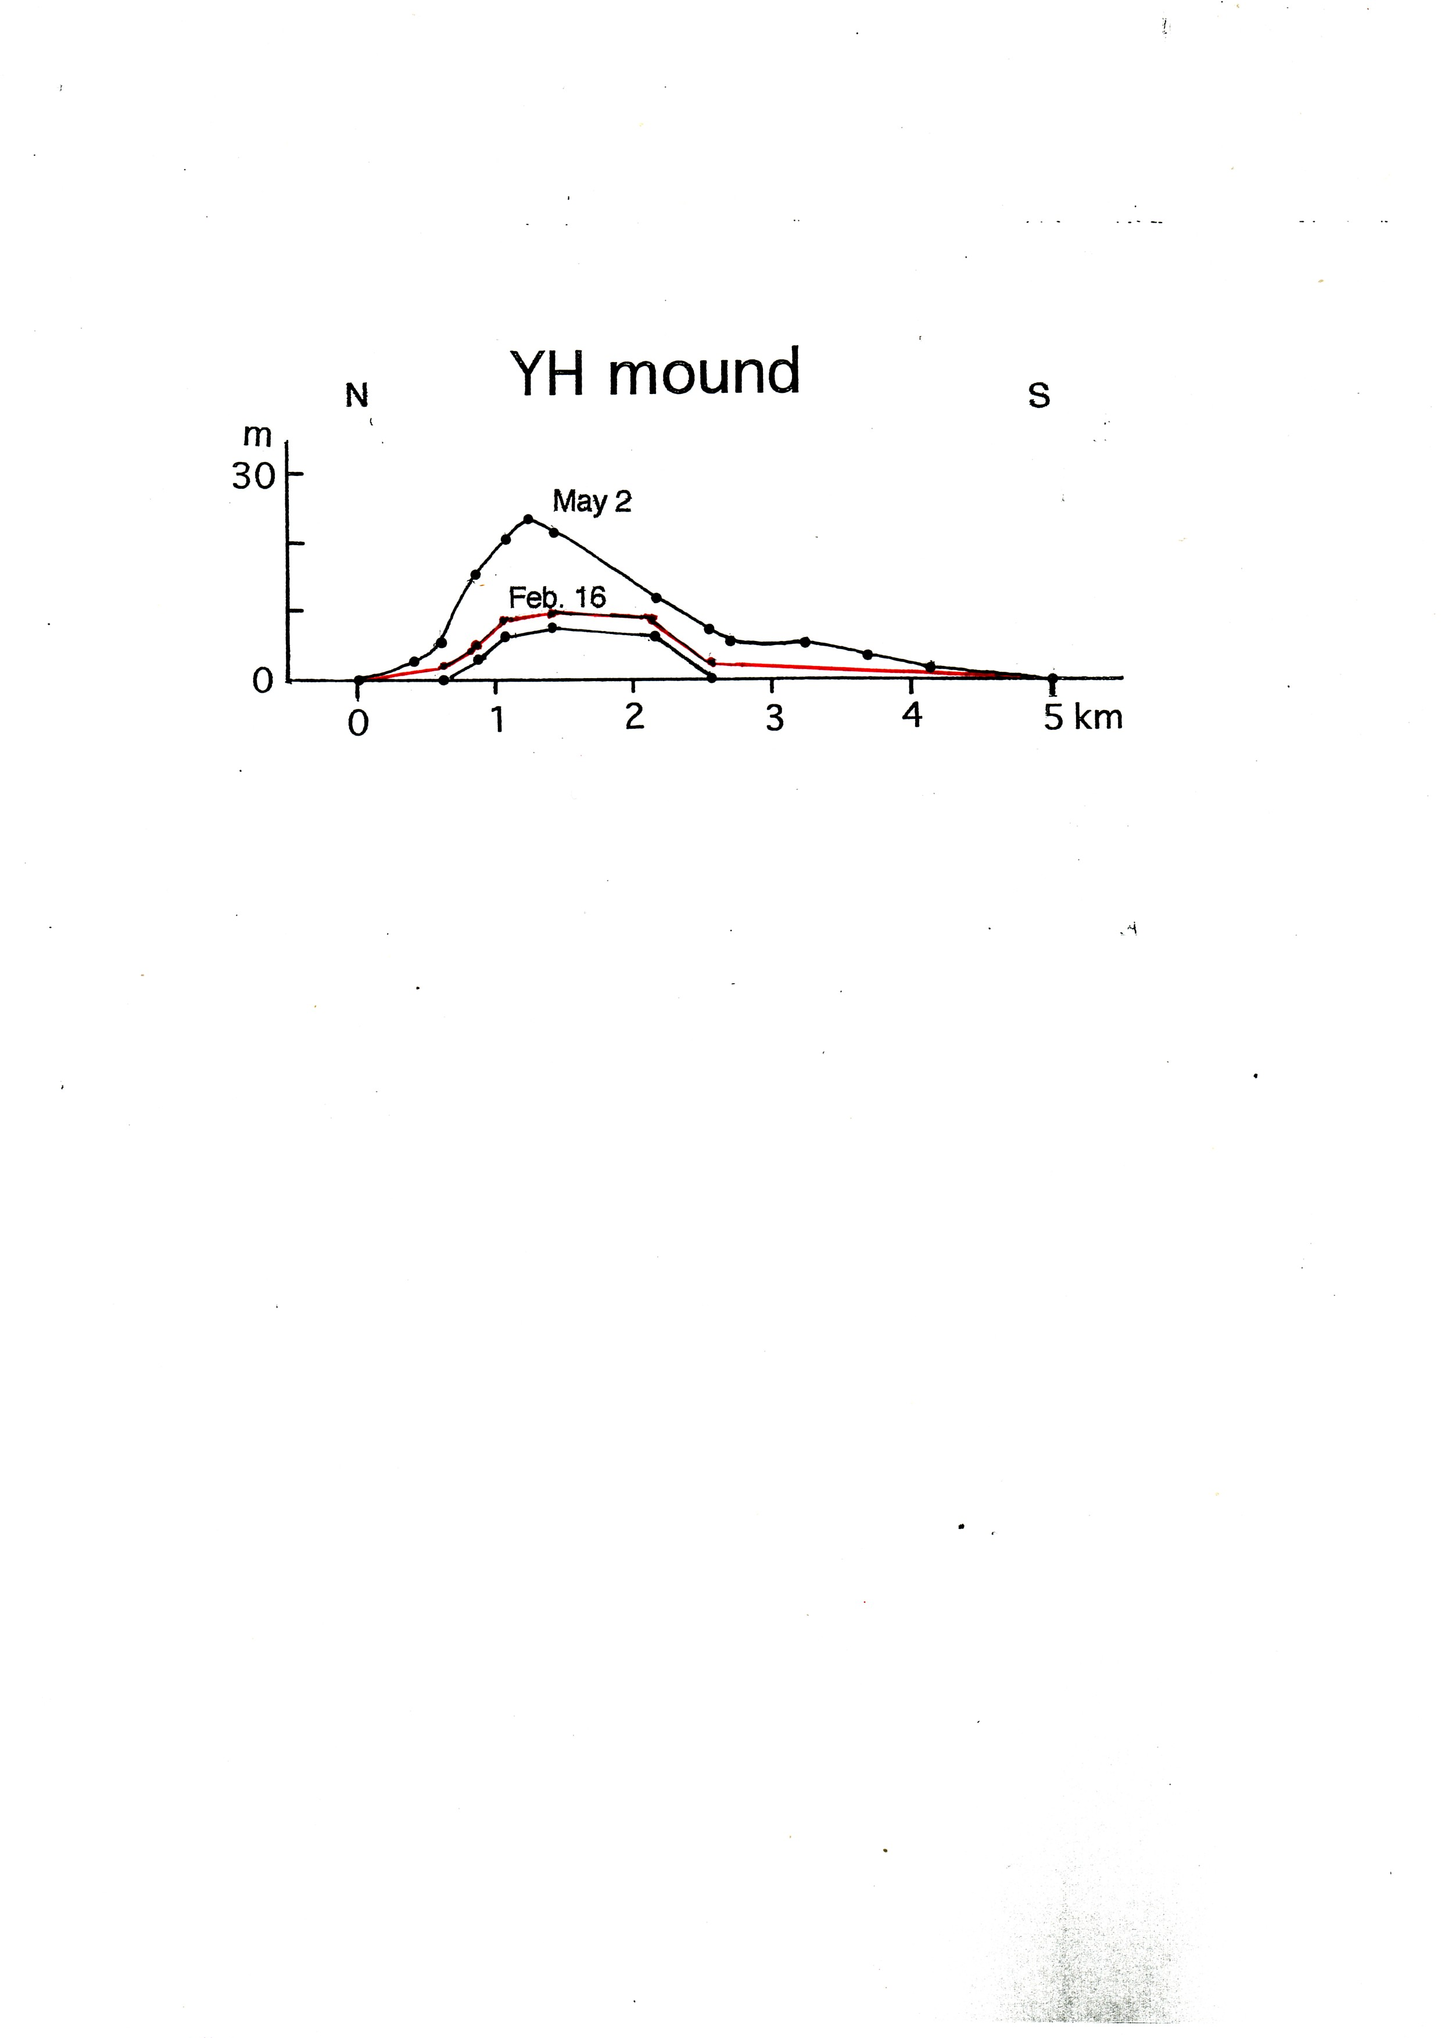
(A) YH mound

Slide 8
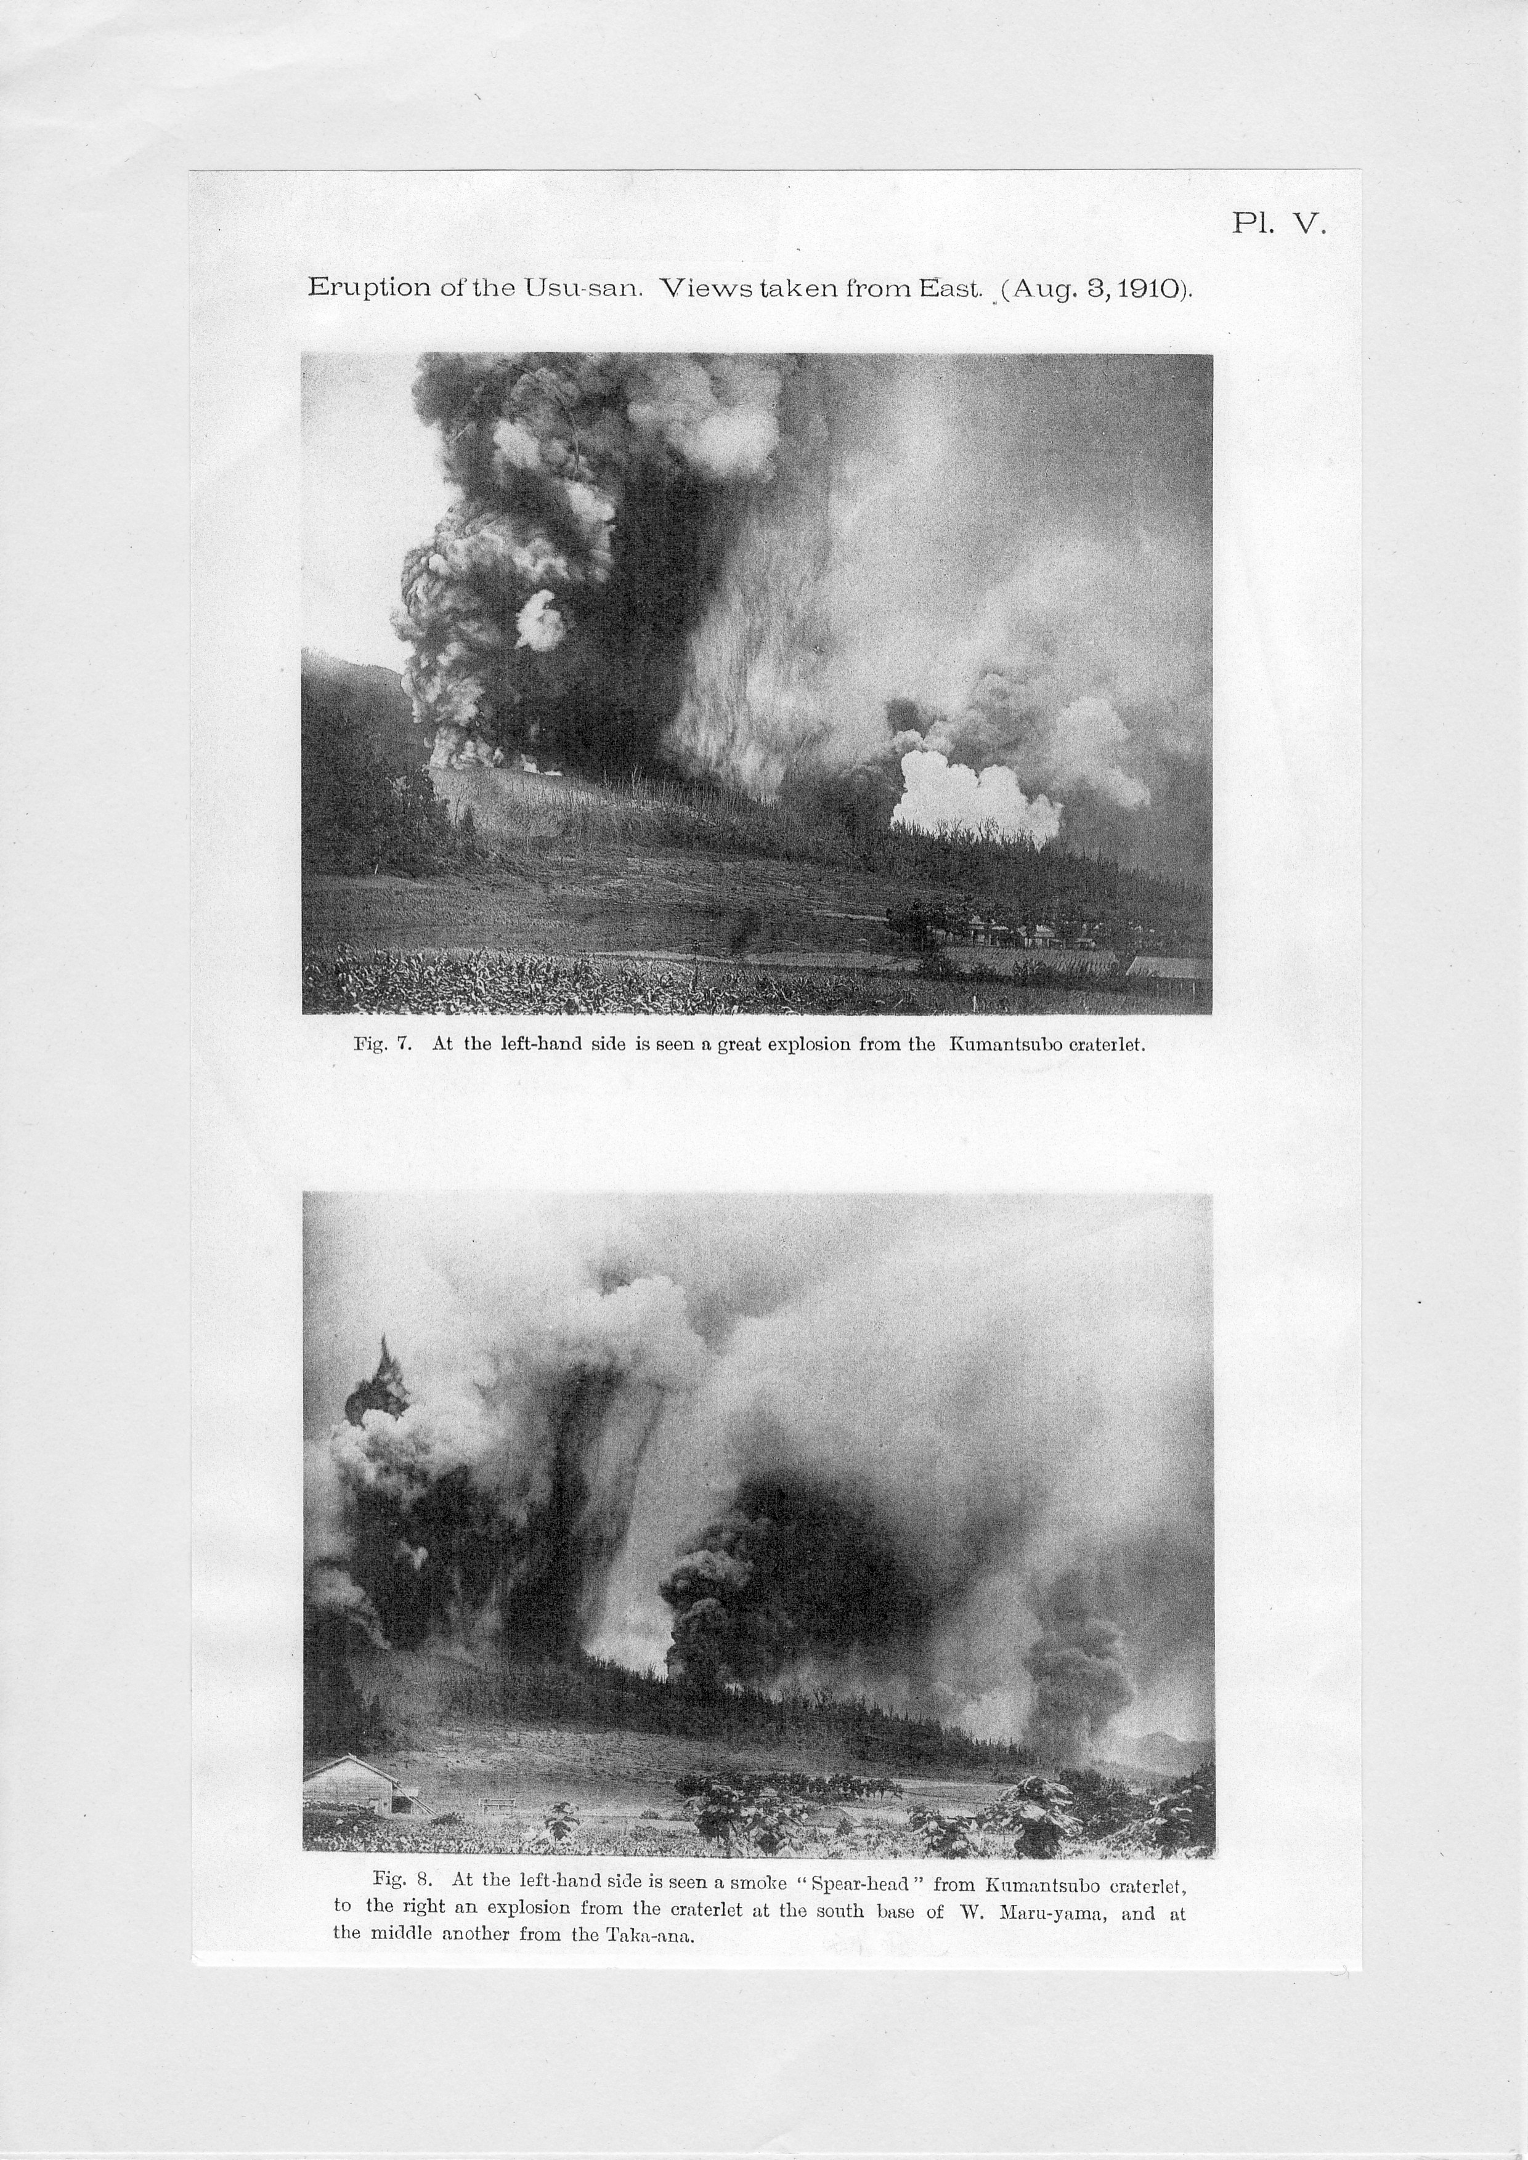
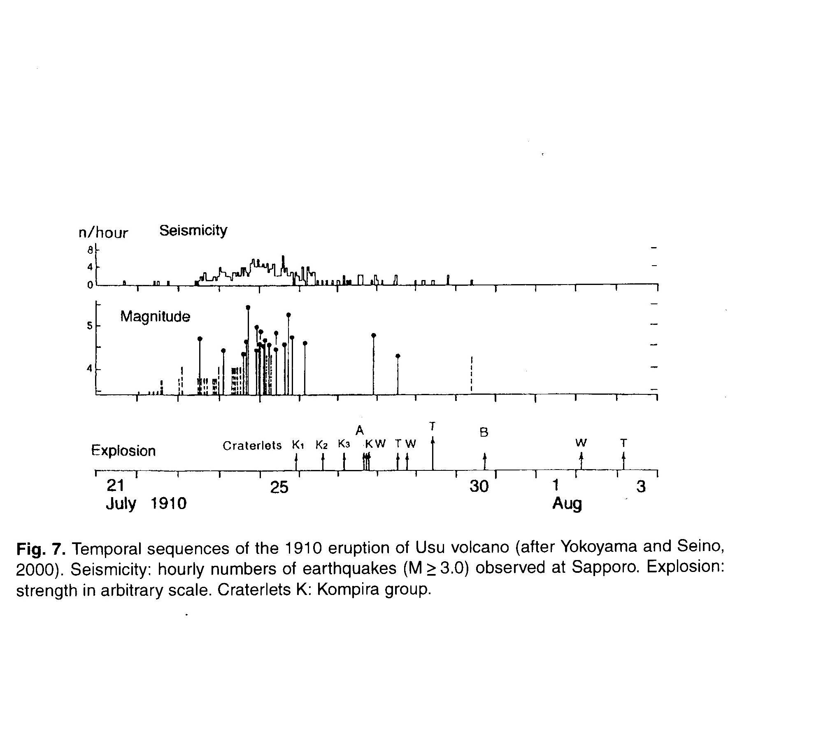
(B) Eruptions of MS

Slide 9
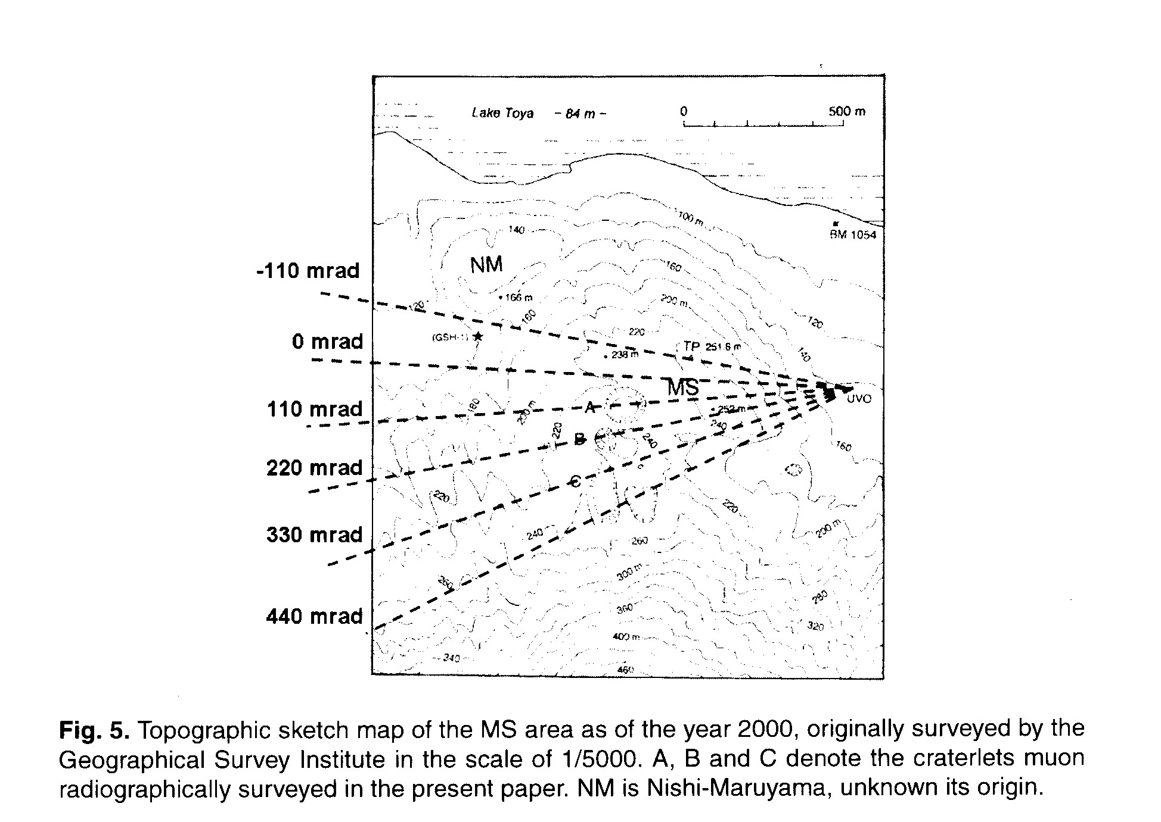
(B) MS

Slide 10
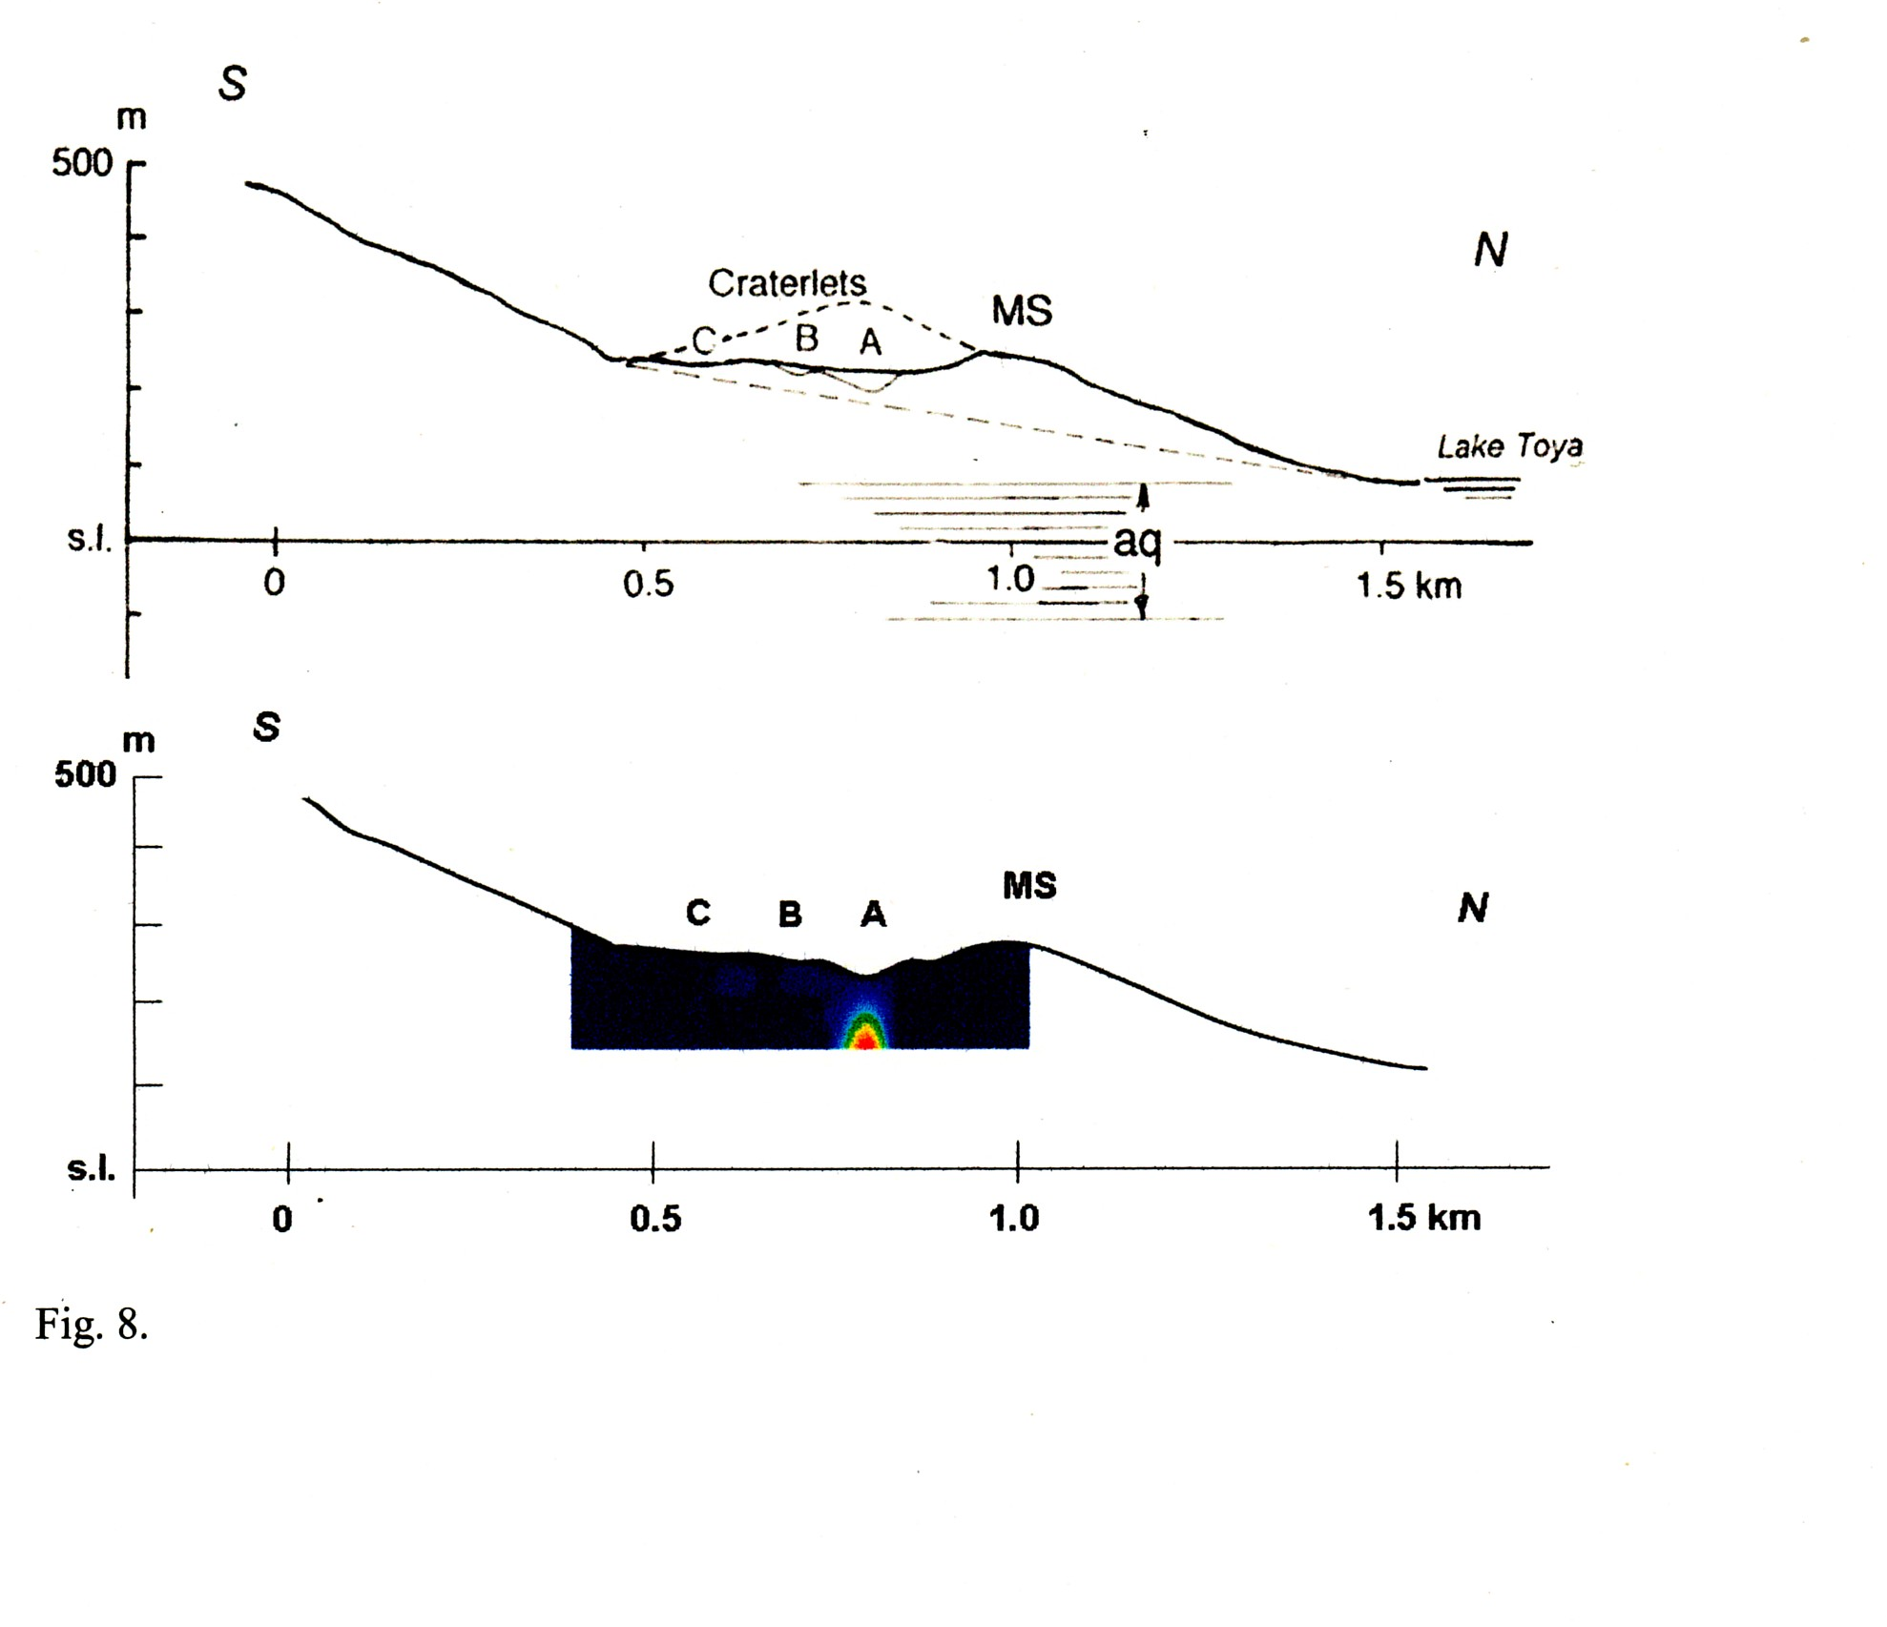
(B) MS mound

Slide 11
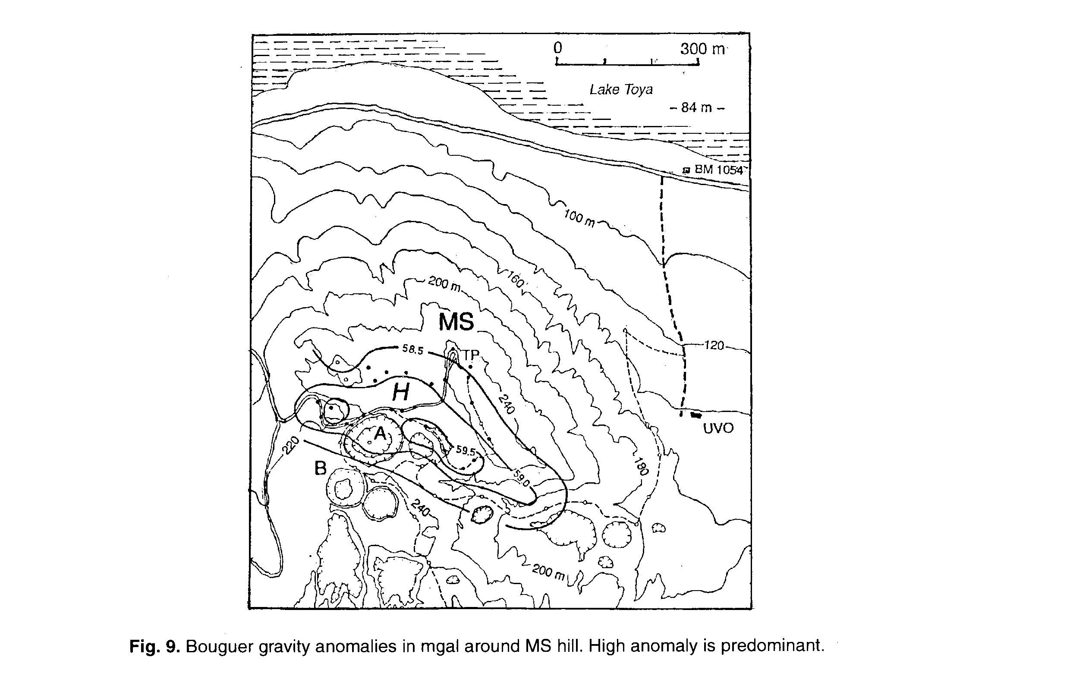
High gravity anomalies over MS

Slide 12
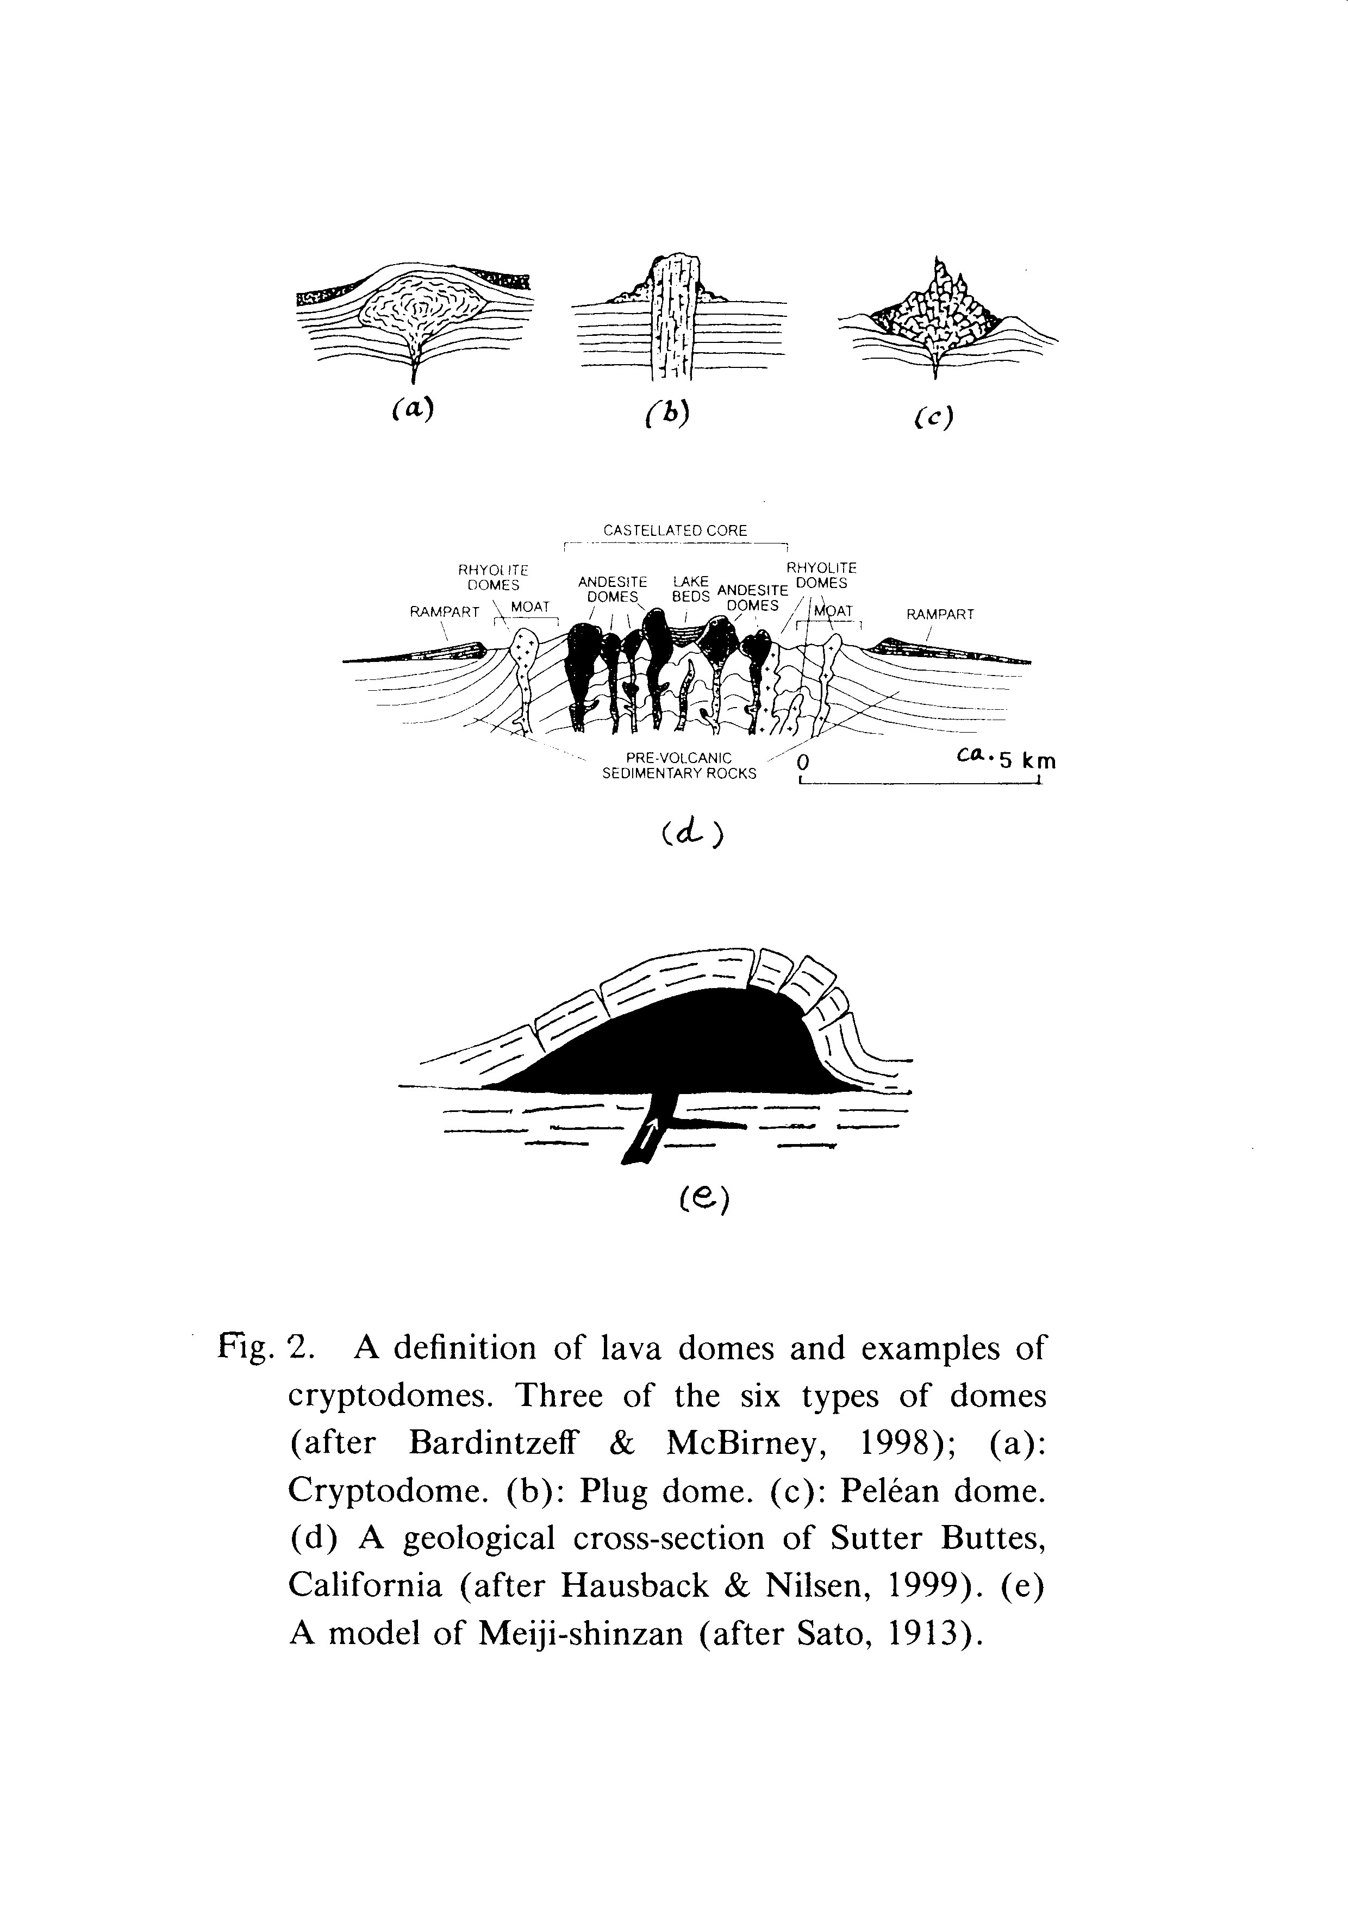
A definition of lava domes

Slide 13
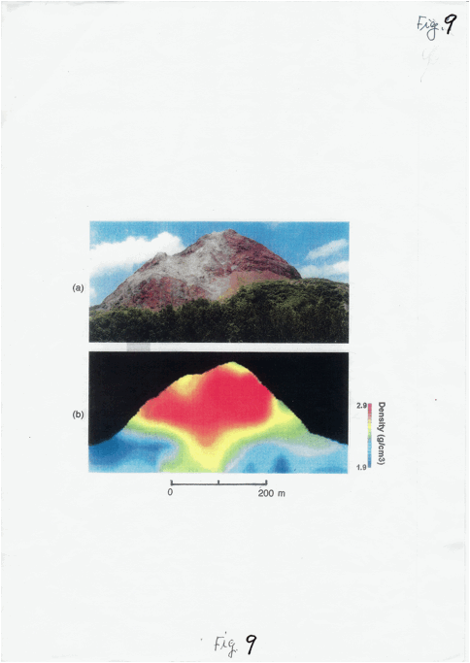
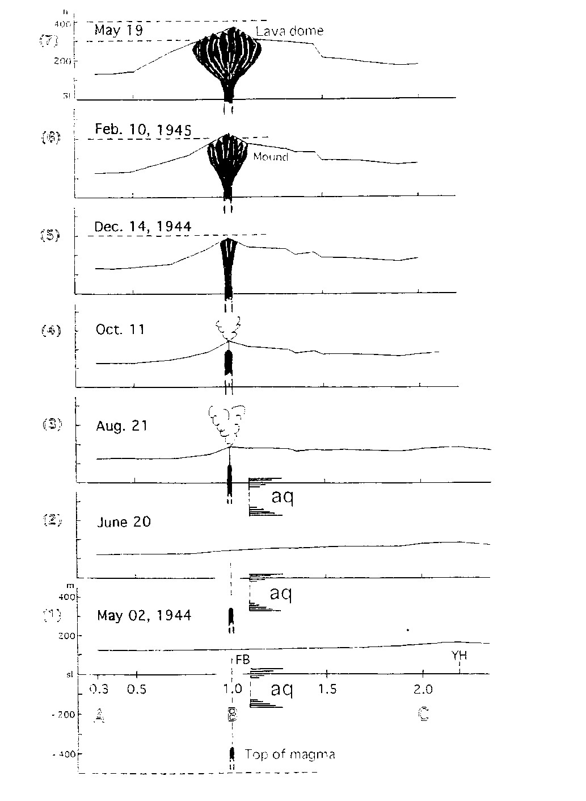
(C) SS-dome

Slide 14
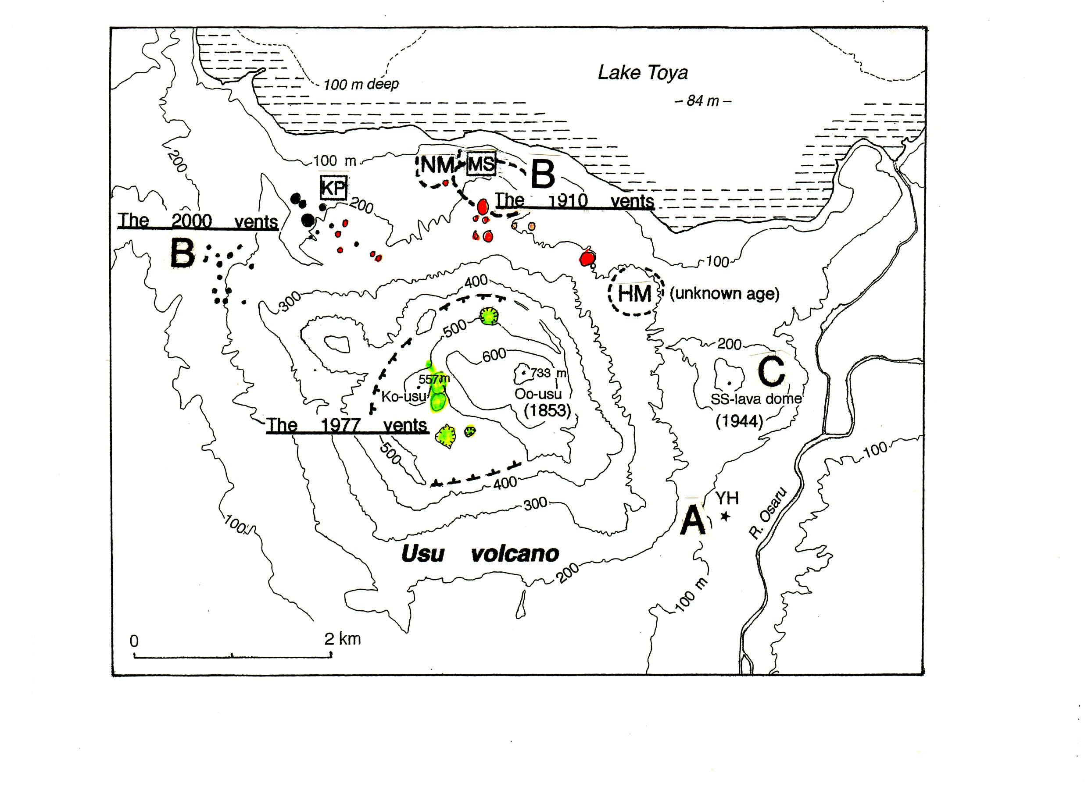
Three types of dome intrusion on Usu volcano

Slide 15
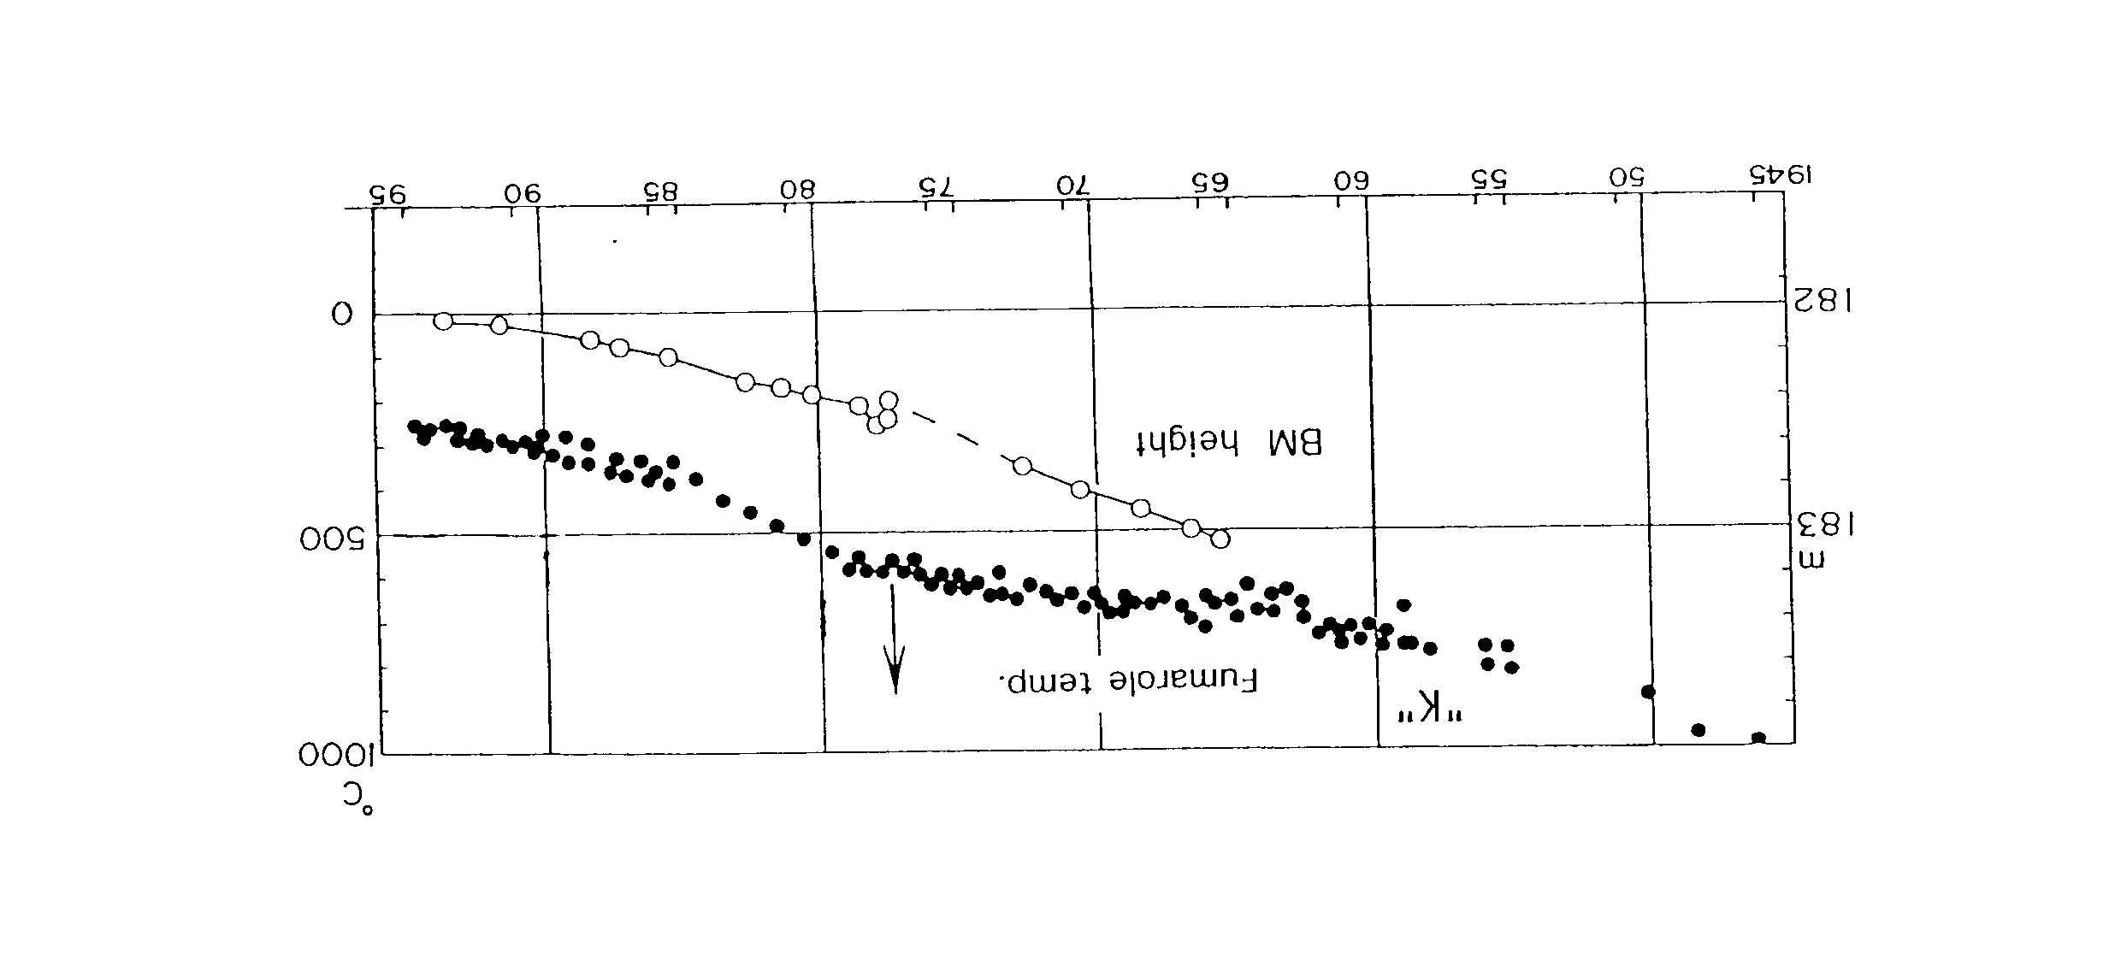
The 1944 lava dome (SS)
Secular changes of fumarole temp. and dme height

Slide 16
A definition of lava domes

Slide 17
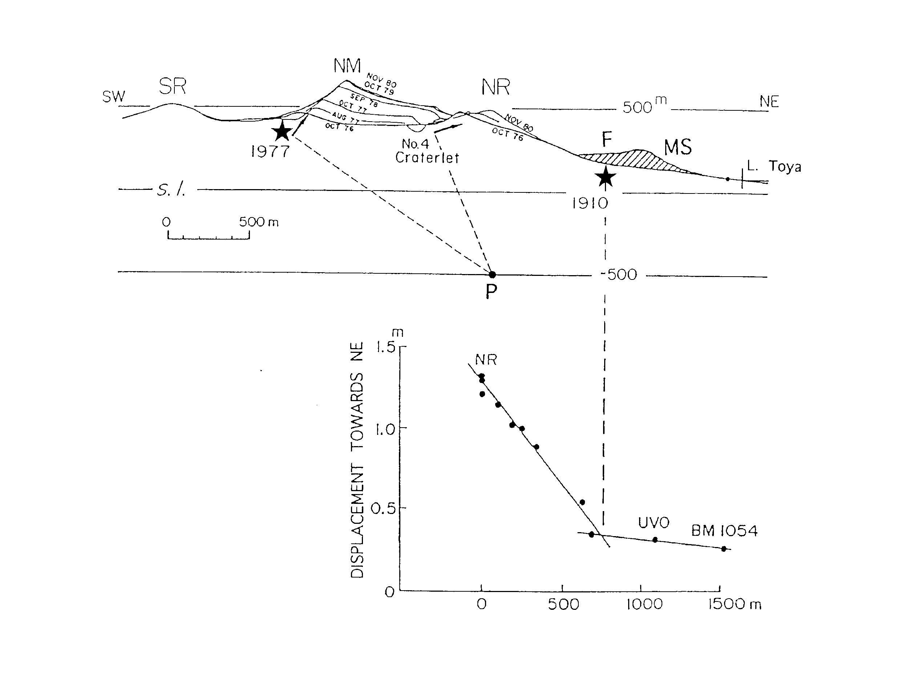
Tilt of the summit part (NM) in 1977

Slide 18
Thank you very much for your attention.

