Slide 1

Nuclear emulsions techniques
for muography
Cristiano Bozza¹, Lucia Consiglio², Nicola D'Ambrosio³,
Giovanni De Lellis⁴, Chiara De Sio², Seigo Miyamoto⁴,
Ryuichi Nishiyama⁴, Chiara Sirignano⁵, Simona Maria Stellacci¹,
Paolo Strolin², Hiroyuki Tanaka⁴, Valeri Tioukov²
University of Salerno and INFN¹
University of Napoli and INFN²
INFN / LNGS³,
Earthquake Research Institute of the University of Tokyo⁴
University of Padova and INFN⁵

Slide 2
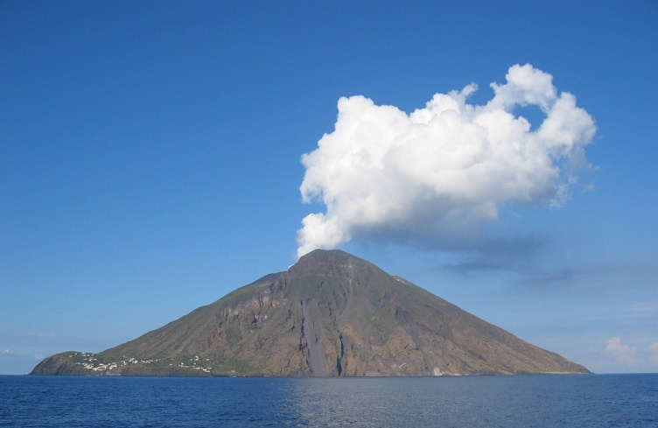
Nuclear emulsion detectors for muon radiography
Detectors are made of stacked emulsion films
μ
μ
e⁺e⁻
e⁺e⁻
e⁺e⁻
Emulsion has no time resolution, no trigger: all tracks are recorded
Emulsion films record hard tracks as well as soft tracks
3D information available for each track: momentum discrimination and/or particle id. possible!

Slide 3

Nuclear emulsion images
AgBr gel
Charged particles ionize Ag atoms (stochastic process), producing the latent image
Metallic Ag grows in filaments during development
1 μm
With green-white light the average λ is 600 nm: the filaments cannot be resolved because
of diffraction
“Grains” = clusters of filaments

Slide 4
Looking at emulsion films: basic optical setup
CMOS sensor
Objective lens
(or lens system)
Illuminated spot
Emulsion film
Plastic base
Condenser lens
Lamp (optionally w/ filters)
White, green or blue

Slide 5
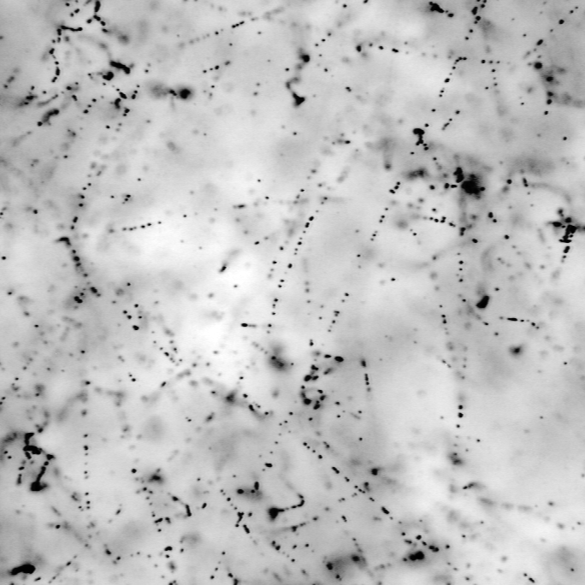
Nuclear emulsion images
Imaging by objective + camera: the spatial density of metallic Ag is folded with the PSF
(point-spread function), characterizing the optical setup
Ψ(x,y,z)
Out of focus
Focal
plane
Out of focus
Depth of field: ~3 μm
Typical grain size after development: 0.2÷1 μm
(0.5 μm in the case shown in this talk)
50 μm
Grains in emulsion image: high-energy tracks, electrons, fog (randomly developed grains,
not touched by any ionizing particle)

Slide 6
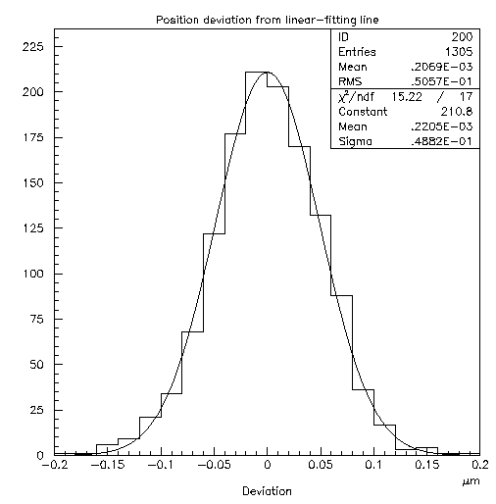
Nuclear emulsion images
3D tomography:
change focal plane
Alignment residuals of track grains: 50 nm in optical microscopy!
Good precision helps rejecting random alignments and thus keeps the signal/background ratio relatively high

Slide 7
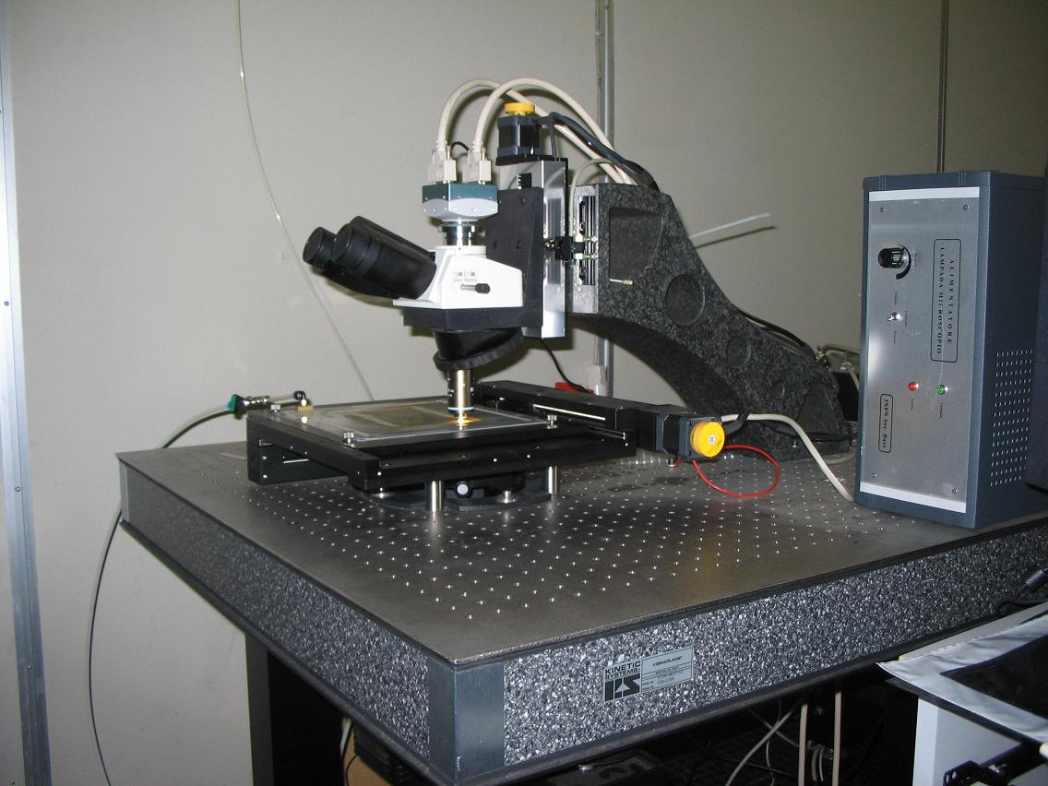
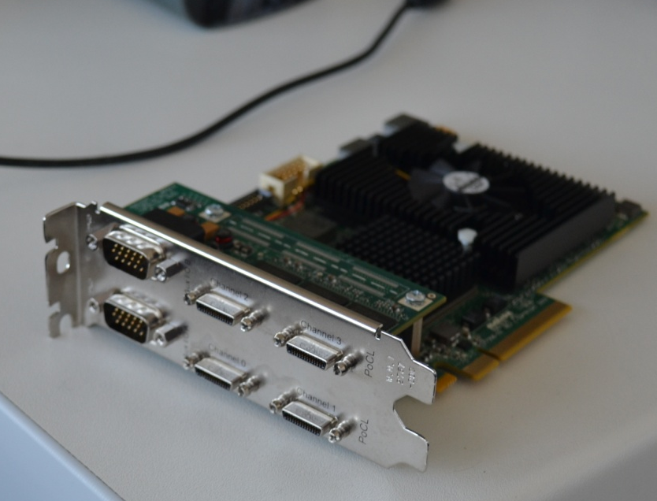
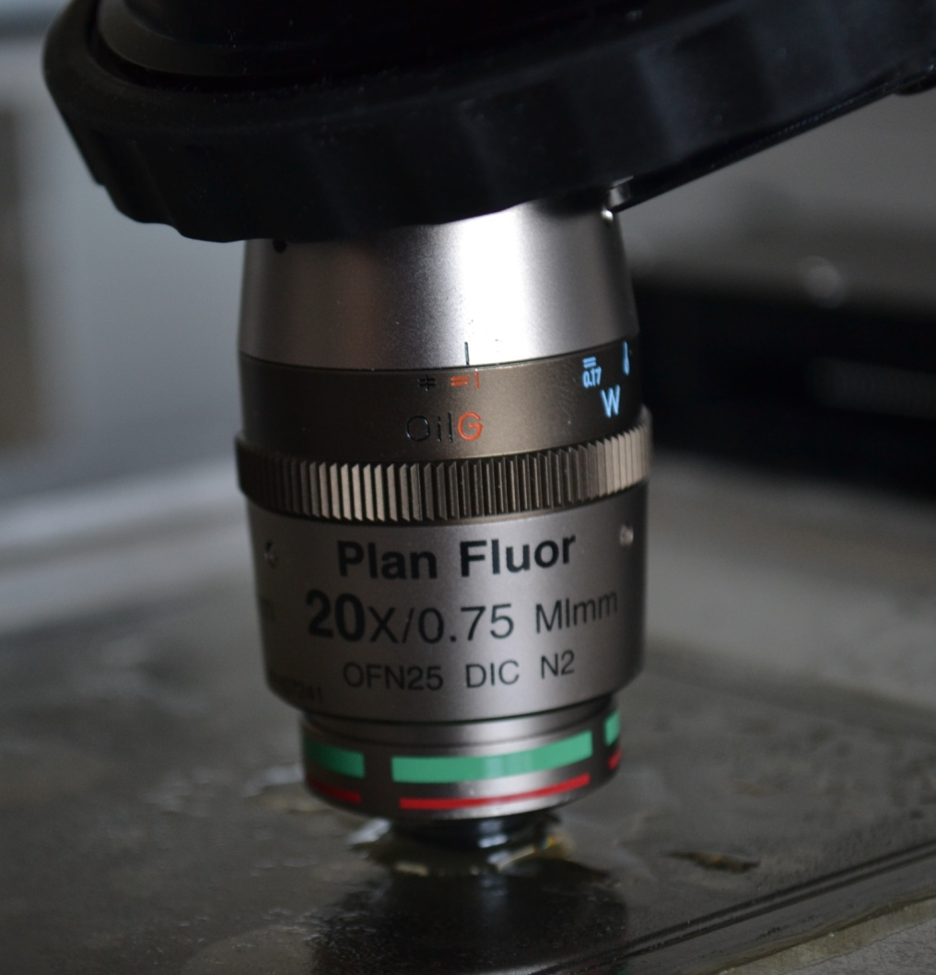
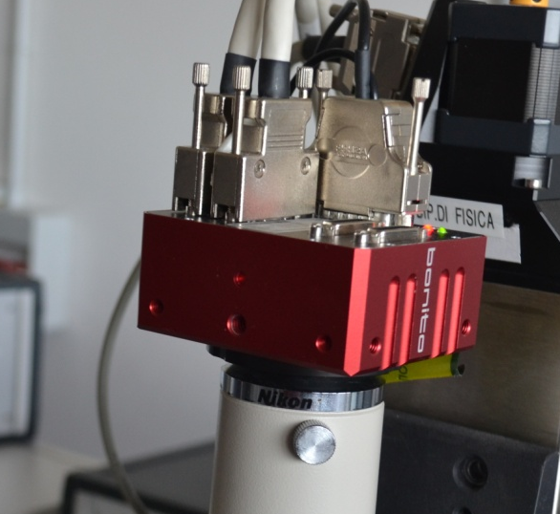
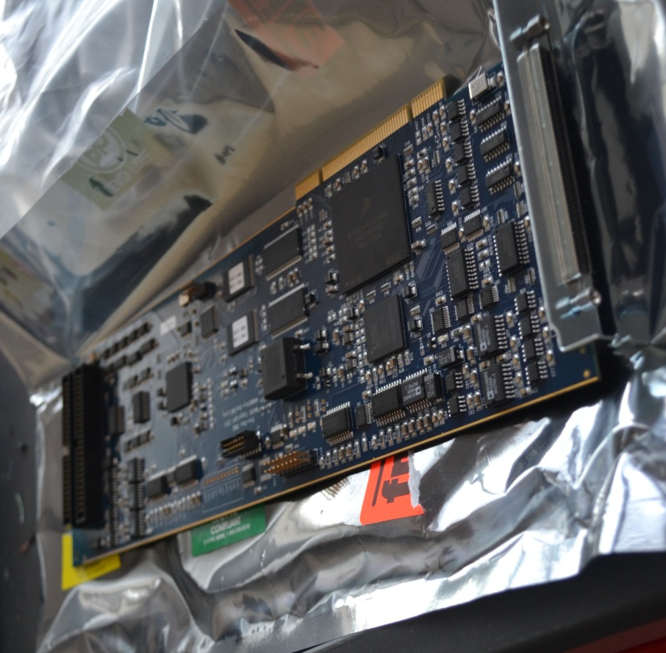
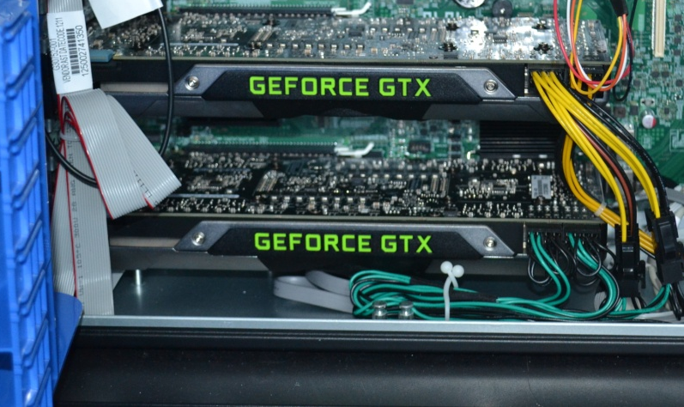
The European Scanning System (ESS)
The Quick Scanning System
Developed for OPERA, used in all European labs
Also installed at Tokyo ERI
Scanning speed: 20 cm²/h/side – 80 k€
Same mechanics, new hardware
Scanning speed: 40~90 cm²/h/side – 20 k€
Aiming at 180 cm²/h with new stage drive
Installed in Salerno, Tokyo ERI
Double Frame grabber
New optics (20×)
Z stage
0.05 μm nominal
precision
CMOS camera
1280×1024 pixel
256 gray levels
376 frames/sec
4 Mpixel camera, 400 fps
Emulsion Film
Image processing and tracking by GPU
XY stage
0.1 μm nominal
precision
Illumination system, objective (Oil 50× NA 0.85)
and optical tube
New motion control unit

Slide 8
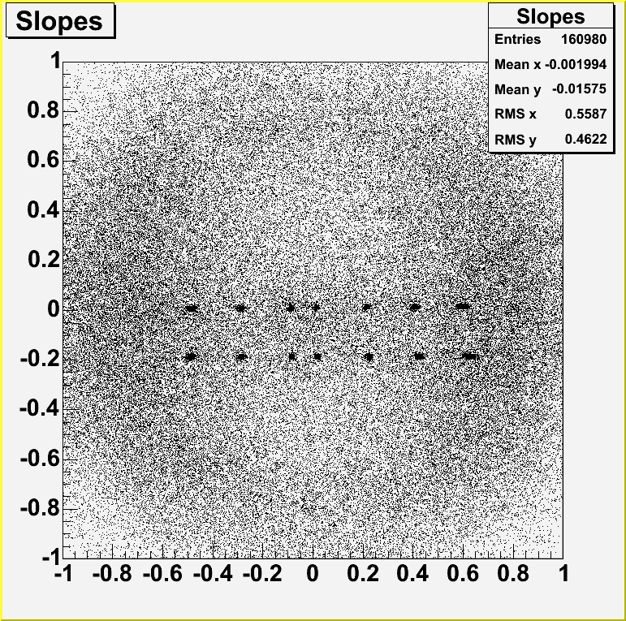
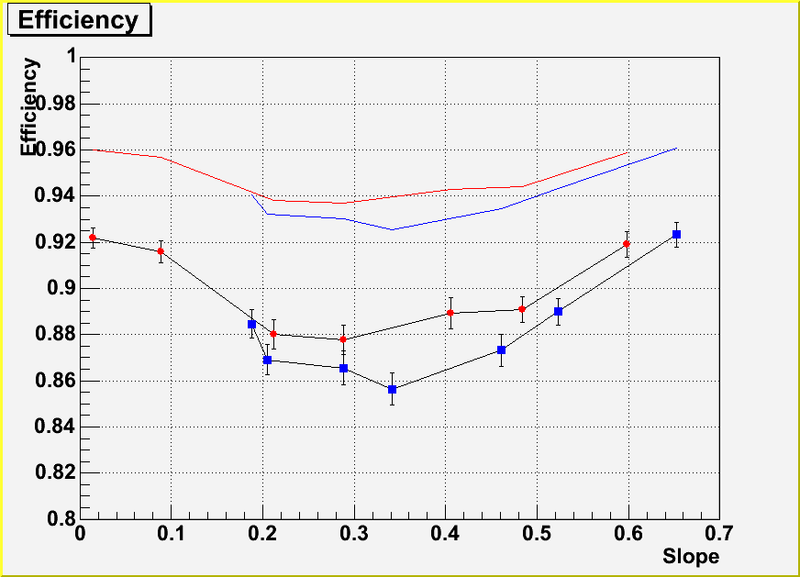
The ESS: current performances
Tests on 8 GeV/c pion beams, 45 µm thick emulsion films
Microtrack
Base-track
Sy = 0
Sy = -0.180
Notice: efficiency depends on emulsion quality!!!

Slide 9
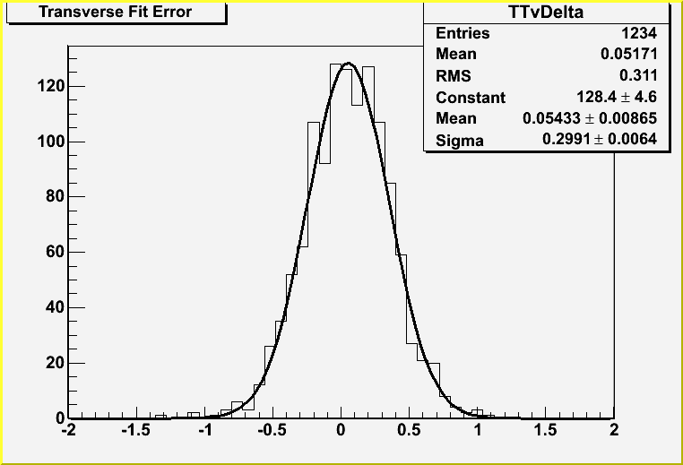
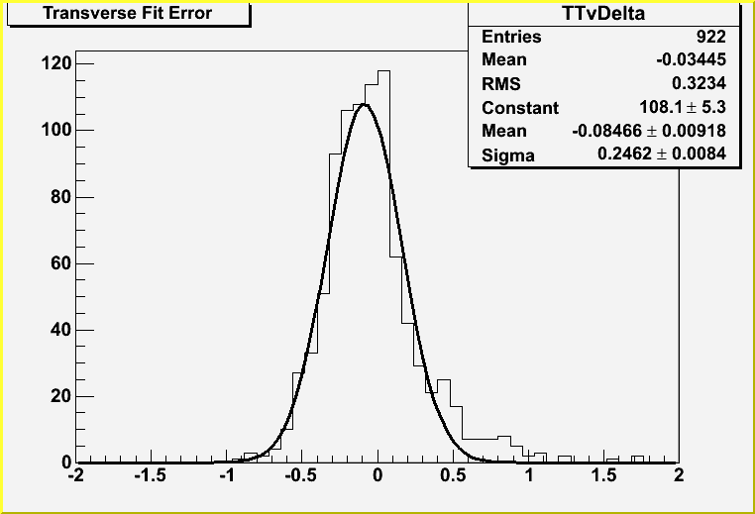
The ESS: current performances
Precision of film-to-film track connection
Tests on 8 GeV/c pion beams, 45 µm thick emulsion films
Sx = 0.025
Sy = 0
Sx = 0.600
Sy = -0.180
µm
µm

Slide 10
Scanning microscope at work (QSS)
Same mechanics, new hardware, continuous motion
Scanning speed: 40~90 cm²/h/side, aiming at 180 cm²/h with new stage drive
y
z
x
View #1
View #2
View #3
View #4
View #5
Z axis slant
(X and Y)
Magnification vs. Z
XY curvature
Corrections
needed
Z curvature
XY trapezium
Vibrations

Slide 11
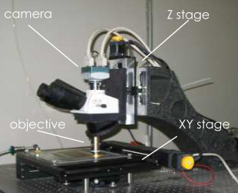
Scanning microscope and its backing data-processing system
ESS – 40 tracking cores/microscope
QSS – 18432 GPU cores/microscope
GTX 590
NVidia GTX 590/690 hosted in
microscope workstation
Temporary storage server
Ensures constant flow
Manages job allocation
Dynamic reconfiguration
Data protocol: networked file system
Control protocol: HTTP + SAWI
(Server Application with Web Interface)
Integrates web interface and
interprocess communication
RAMDisk
32 GB
GTX 690
GTX 690
GTX 690
GTX 690
GTX 690
GTX 690
Tracking servers
host 1 or 2 GTX 690 each
Final storage
Flexible platform: Tesla C2050, GTX780Ti,
TITAN, TITAN/BLACK also used

Slide 12
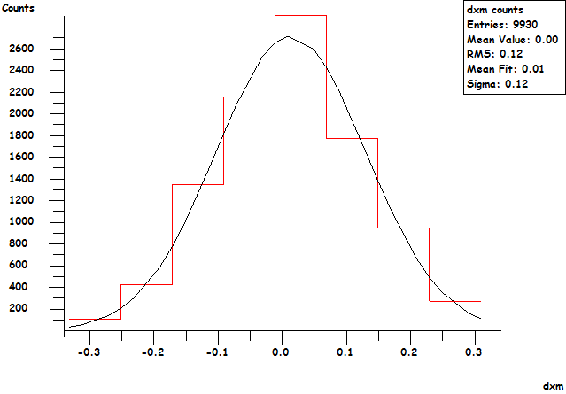
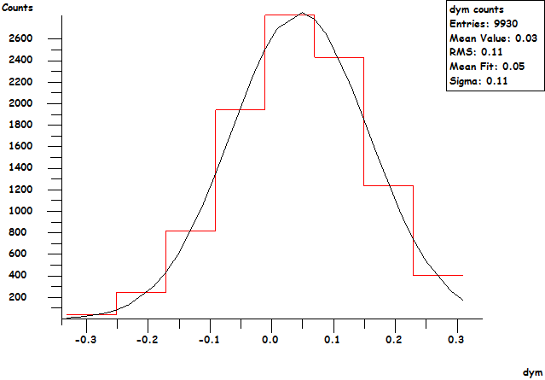
Data quality of QSS
Image-to-image alignment results
μm
μm
XY precision: 0.12 μm

Slide 13
The QSS: current performances
θ
Tests on pion beam, 32 µm thick emulsion films (originally 45 µm)
ϕ
θ(degrees)
Efficiency
PRELIMINARY
ϕ (degrees)
Angle(degrees)
Access to very wide angular regions with a single detector
Notice: efficiency depends on emulsion quality!!!
Computational limit of ESS (previous system)

Slide 14
Muon detectors made with nuclear emulsion films
Discard soft component of cosmic rays (mostly e⁺e⁻)
Stack several films and require good alignment (< 10 µm)
Interleave films with iron or lead absorber slabs to stop electrons and soft muons
Investigating bulk regions of volcanoes
  Low muon flux
  Large areas required to collect statistically significant sample
  Modular structure repeated to increase detector area
Iron

Slide 15
Muon detectors made with nuclear emulsion films
Data from emulsion exposed to cosmic rays include a soft component (soft muons + remnants of e.m. showers) – no time trigger!
Such tracks have high scattering (low momentum) and bremsstrahlung, but have more grains than minimum ionizing particle tracks
Apparently low efficiency: they cannot be easily followed from film to film in a stack using tight tolerances (∼20 mrad, ∼20 μm)
Film #1 (2 sides)
Film #2 (2 sides)
Film #3 (2 sides)
Applying tight cuts for base-tracks and to follow tracks from film to film reduces the efficiency, but actually filters out background of soft tracks, while only hard muons survive

Slide 16
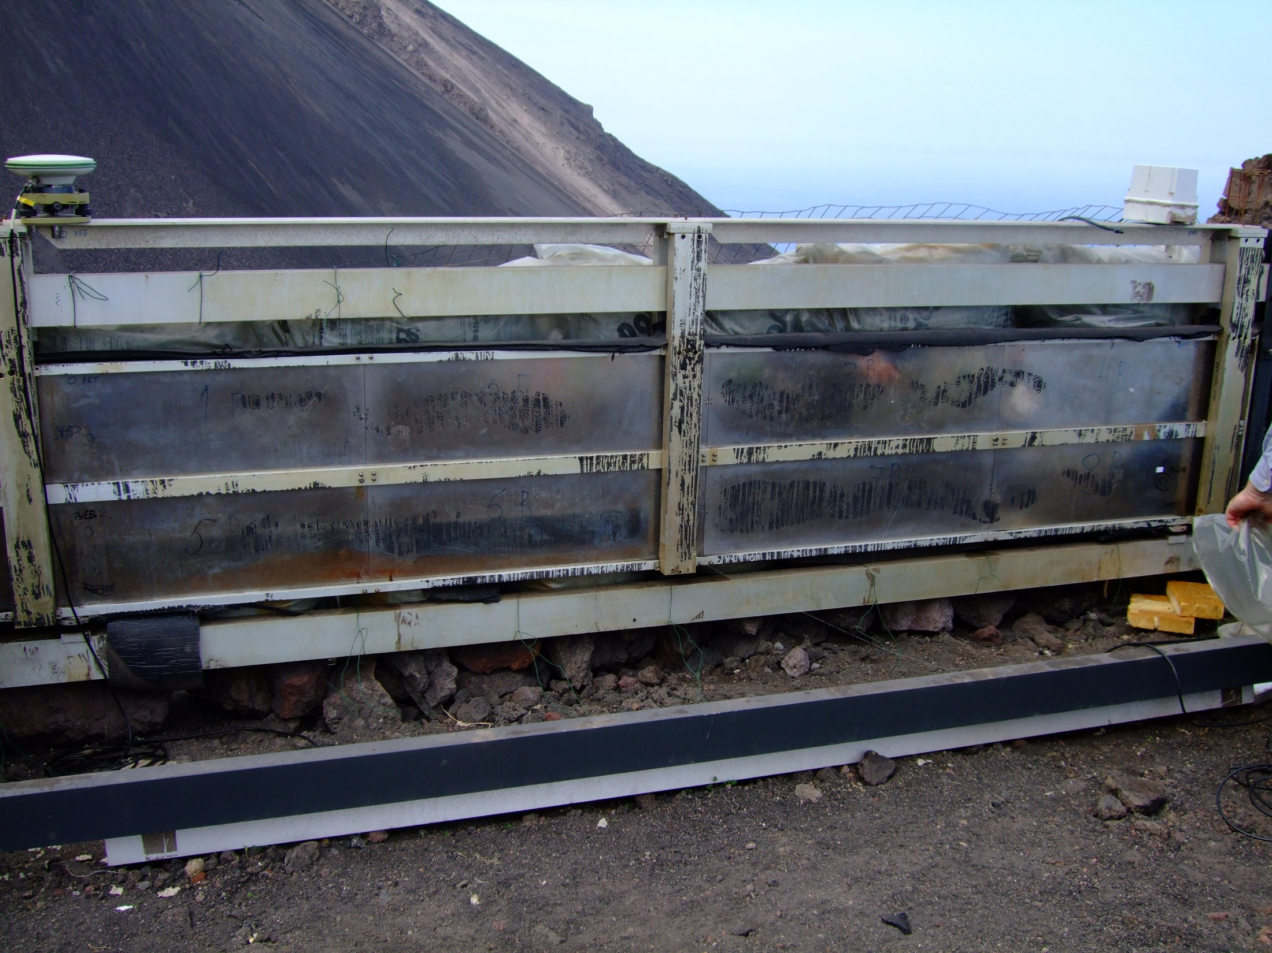

Muon detectors made with nuclear emulsion films
Stromboli: emulsion-based detector exposed 154 days
  22/10/2011 – 24/03/2012
10 modules of 10 «quadruplets» (1.2 m²)
Aluminum Frame
Elastic (rubber) layers
Metal plates
of 5 mm (inox)
Envelopes with films
glued to the inox plate

Slide 17
Muon detectors made of nuclear emulsion
Pattern matching allows track connection from film to film
Position projection residuals of the same track in consecutive films after all corrections, including tracks of all momenta (films exposed at Unzen)
σ=6 μm
μm
ΔY

Slide 18
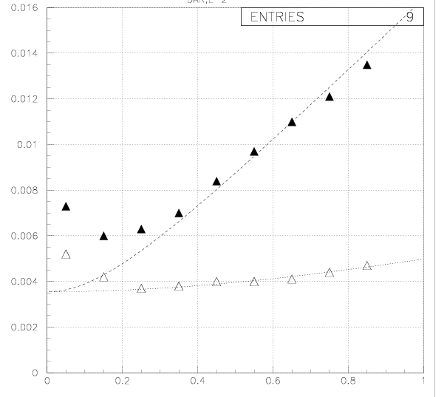
Muon detectors made of nuclear emulsion
Pattern matching allows track connection from film to film
Slope residuals of same track measured in consecutive films
(emulsion films exposed at Unzen)
Slope residuals
Longitudinal direction
Slope close to 0: background due to shadowing effect of grains
Most such tracks are fake or Compton electrons
Transverse direction
Slope

Slide 19
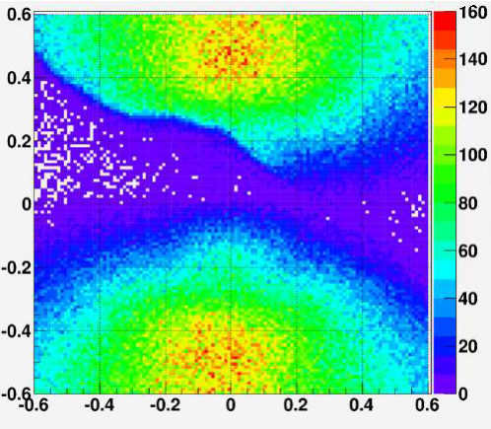
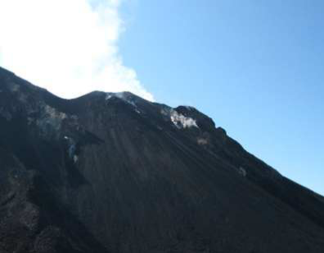
Muon detectors made of nuclear emulsion
Stack tracks at Stromboli (3 out of 4 films)
tan θ_{y}
Volcano profile and
track counts from
emulsion (Stromboli)
Flux (arbitrary units)
tan θ_{x}

Slide 20
Data processing for muon radiography
Post-processing steps consist of pattern matching to filter out instrumental fakes and soft tracks
Image acquisition
3 TB/film (120 cm²)
Microtracks
30 GB/film (120 cm²)
Next generation detectors
(10∼100 m²)
400∼4000 GB
Filtered microtracks (coincidence) 1.5 GB
Needs:
Fresh emulsion films
Faster automatic microscopes
Larger processing power
(Possibly) Larger storage
Stack tracks
400 MB / quadruplet
Full detector (1 m²)
40 GB

Slide 21
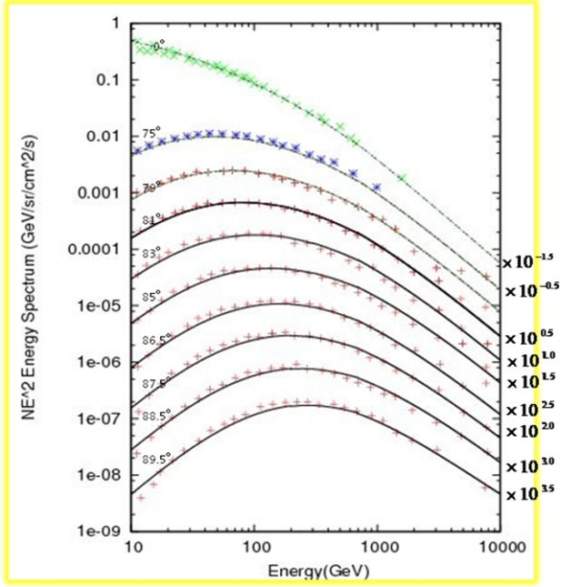
Simulation of muon data from nuclear emulsion
Average flux models used so far
High elevation and small rock thickness: OK
  many relatively soft muons
Low elevation and big rock thickness: large systematic errors (factor 10?)
  formulae extrapolated
  few hard muons
  statistical fluctuations
  need to model well the “knee” region in
  primary cosmic rays
Next step: use full simulation of muon production and propagation in atmosphere

Slide 22
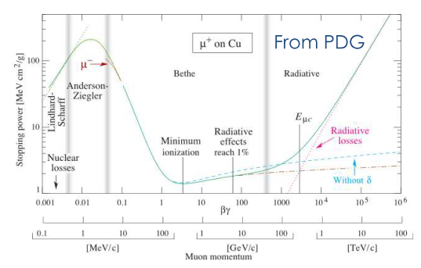
Simulation of muon data from nuclear emulsion
Continuous Slowing Down Approximation used so far
  OK for high flux, small rock thickness
  Statistical fluctuations matter for low flux, large rock thickness region
  Muon direction change neglected
  Bremsstrahlung and EM
  showers accompanying
  hard muons neglected
Next step: simulate passage of
muons through rock (GEANT4)
  Very heavy computation load!!!
Needs:
Larger computing power
Manpower effort to develop new software

Slide 23
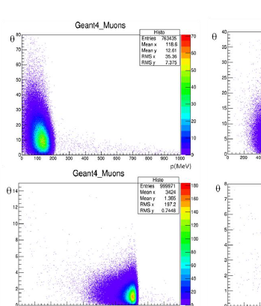
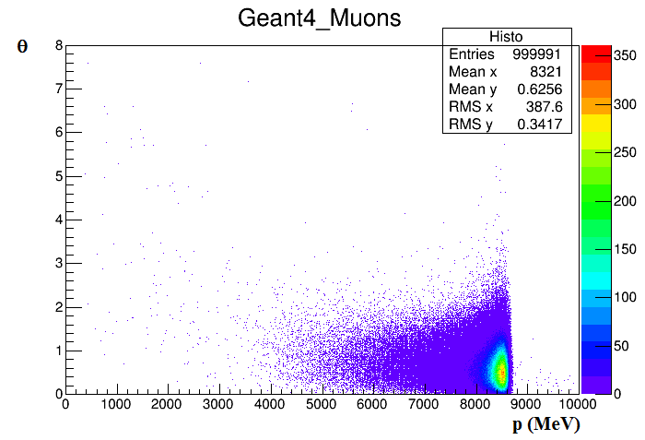
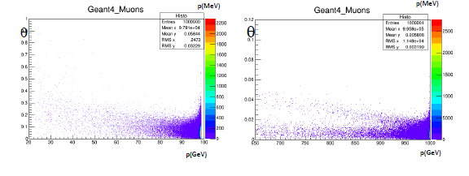
Simulation of muon data from nuclear emulsion
Detailed simulation by GEANT4 of muon processes in rock layers
Multiple scattering
Bremsstrahlung
Nuclear processes
Work out energy loss
and direction change
for sample energies
Build analytic
approximations
including correlations
Plug into absorption
map computation
software
1 GeV
10 GeV
100 GeV
10 GeV
5 GeV
1 TeV

Slide 24
Conclusions
Muography triggered speed-up of existing automatic microscope systems
Muography requires large computation power already at early stages in data acquisition
Emulsion data are capable of high angular precision
Critical: rejection of soft component of muon-induced showers
Dedicated simulation software developed to work out the absorption map from emulsion data
Improved simulation of cosmic rays needed to reach low elevation regions
In-progress: simulation of muon processes beyond the “CSDA” approximation to improve extraction of density maps from flux maps
Next generation of muographic exposure will need 10∼100× statistics, but thanks to new technologies cost increase will not scale linearly
Thank you for your attention!

