Slide 1
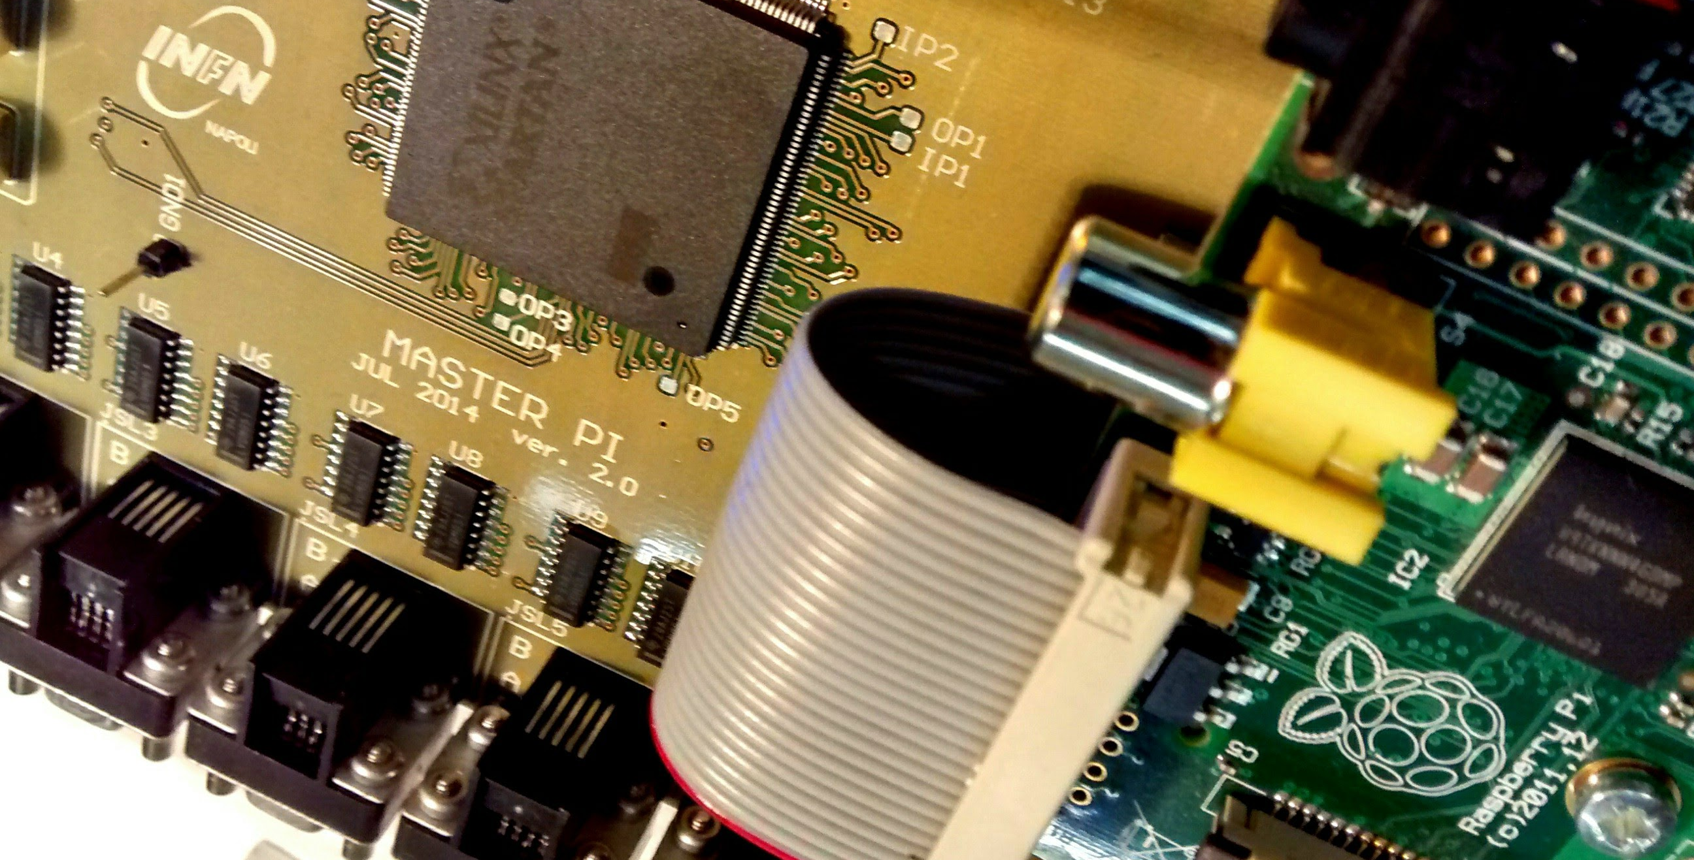
UNIVERSITA’ DEGLI STUDI DI NAPOLI
FEDERICO II
The MURAVES telescope Front-end Electronics and Data Acquisition
INTERNATIONAL WORKSHOP ON MUON &
GEO-RADIATION PHYSICS FOR EARTH STUDIES
Luigi Cimmino
November 12th, 2014 - Tokyo

Slide 2
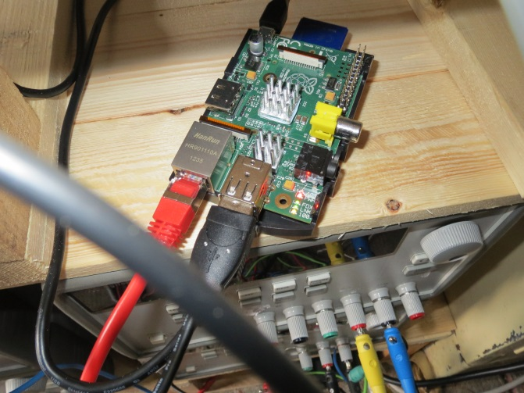
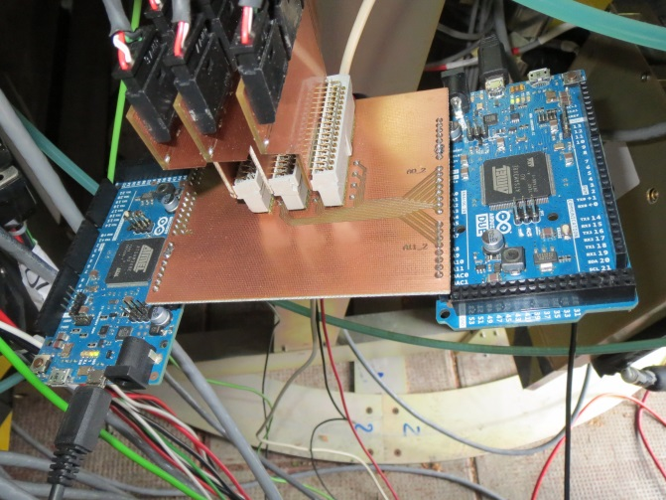
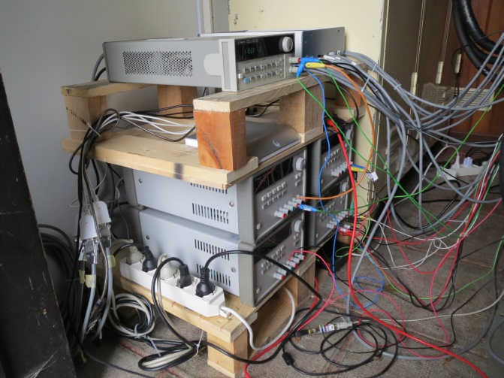
MUray Automatic Remote system
Improvement of remote control software (automatic mail delivery service in case of warnings and errors)
Realization of an automated system for the telescope operations
Test of Voltage Follower Data Acquisition without the chiller
1. The PC is a Raspberry Pi minicomputer
(few watts consumption)
2. SiPMs temperature is controlled using Arduino boards
(10 bits DAC – 0.15°C sensibility)
3. Power supplies are controlled remotely
(no handling required)

Slide 3
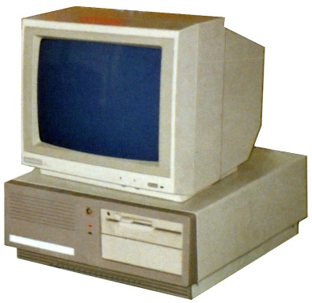
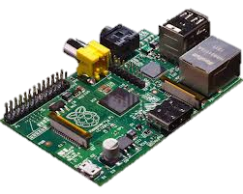
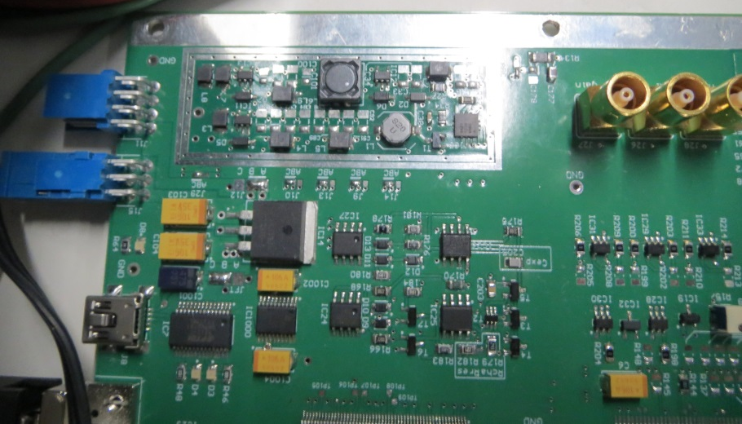
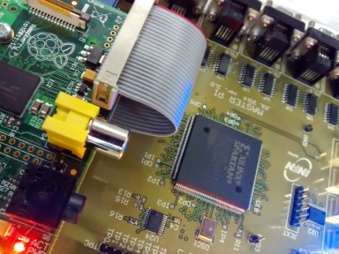
electronics Upgrade
PIC Board has been replaced by a pin-to-pin connection with the Raspberry Pi GPIO
Implementation of an interrupt based protocol
Low level management of the communication
Increase of the data transmission bandwidth
Reduction of the dead times
BEFORE
PC
AFTER
Raspberry PI
PIC
Micro
controller
Each slave board has an onboard power supply
MASTER Board

Slide 4
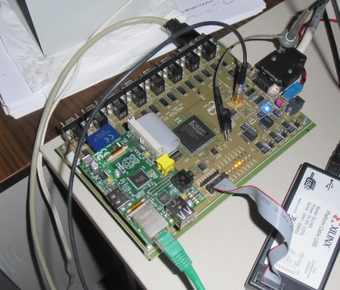
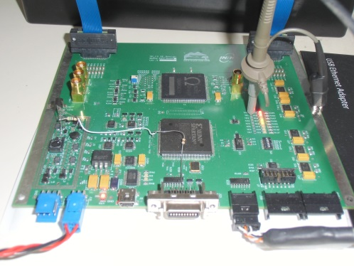
Front-End Electronics
muNet
Low power consumption Application-Specific Integrated Circuit EASIROC
Each slave board is programmed and read by the FPGA controller assembled on the master board
12 slave boards are controlled by a single master board
Data flows are managed by the low level protocol that links the telescope electronics to the PC through the GPIO port
A monitoring board reads each couple of PT1000 thermosensors mounted on the SiPMs board
Room conditions are constantly monitored with a thermo-hygrometer connected to the PC
Slow Control
Master Pi Board
…
Slave Board
Slave Board
Slave Board
…
32 x SiPMs
32 x SiPMs
…
32 x SiPMs

Slide 5
Data acquisition main features
Very low power consumption (Could be supplied by solar cells system)
Off-the-shelf technology (standard stores availability)
Open-source software (community support and code portability)
Modularity (the only problem is to have enough space)

Slide 6
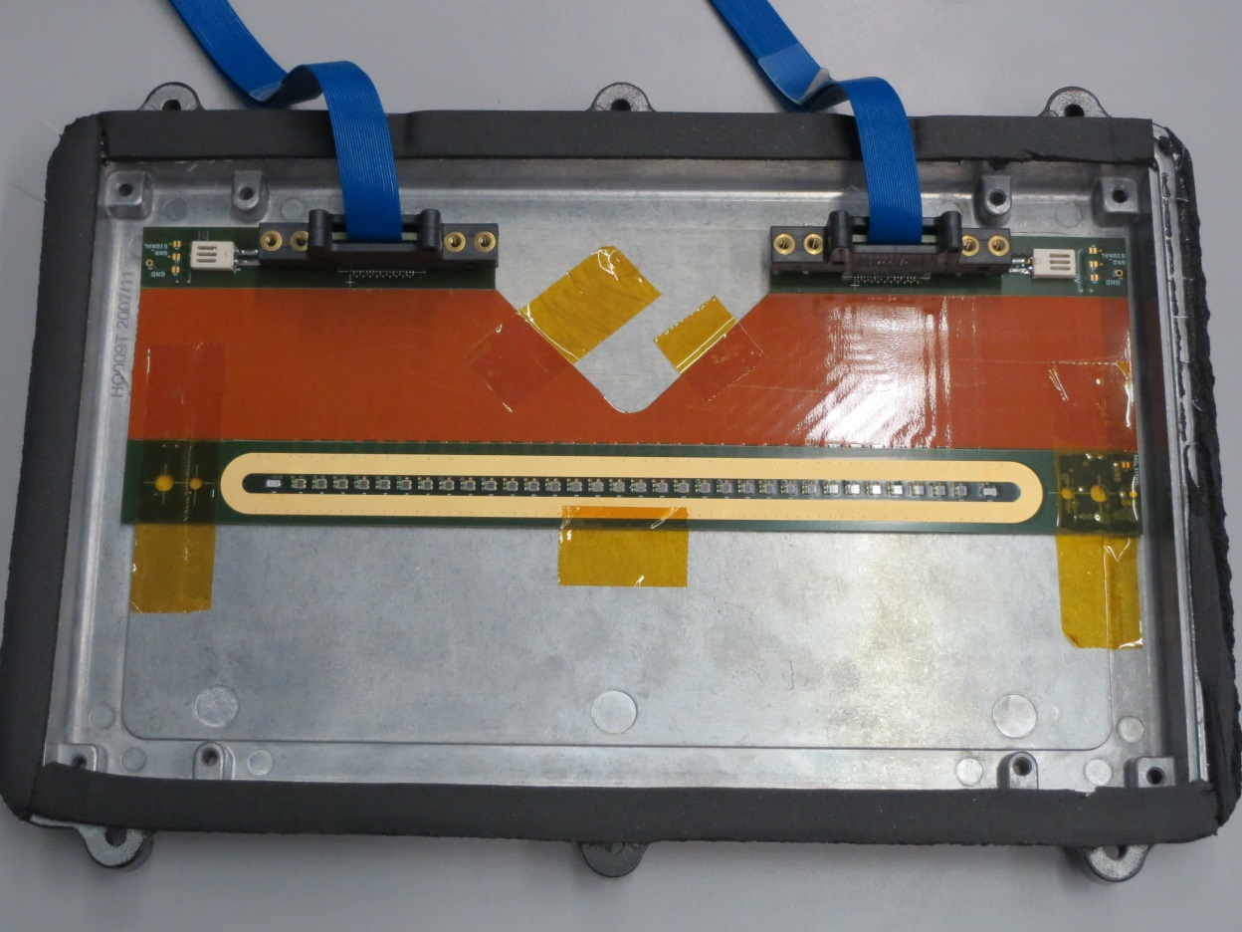
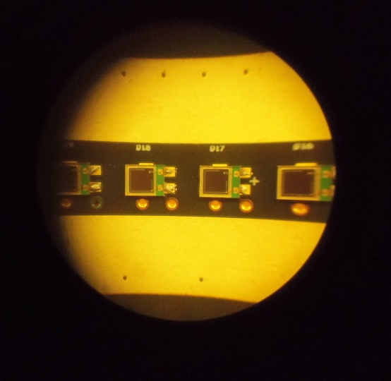
Hybrid equipment
Hygrometer
Pt1000 thermoelectric sensor
Pt1000 read by ADue Local Monitoring Board
Thermal plate on the back
New generation SiPMs

Slide 7
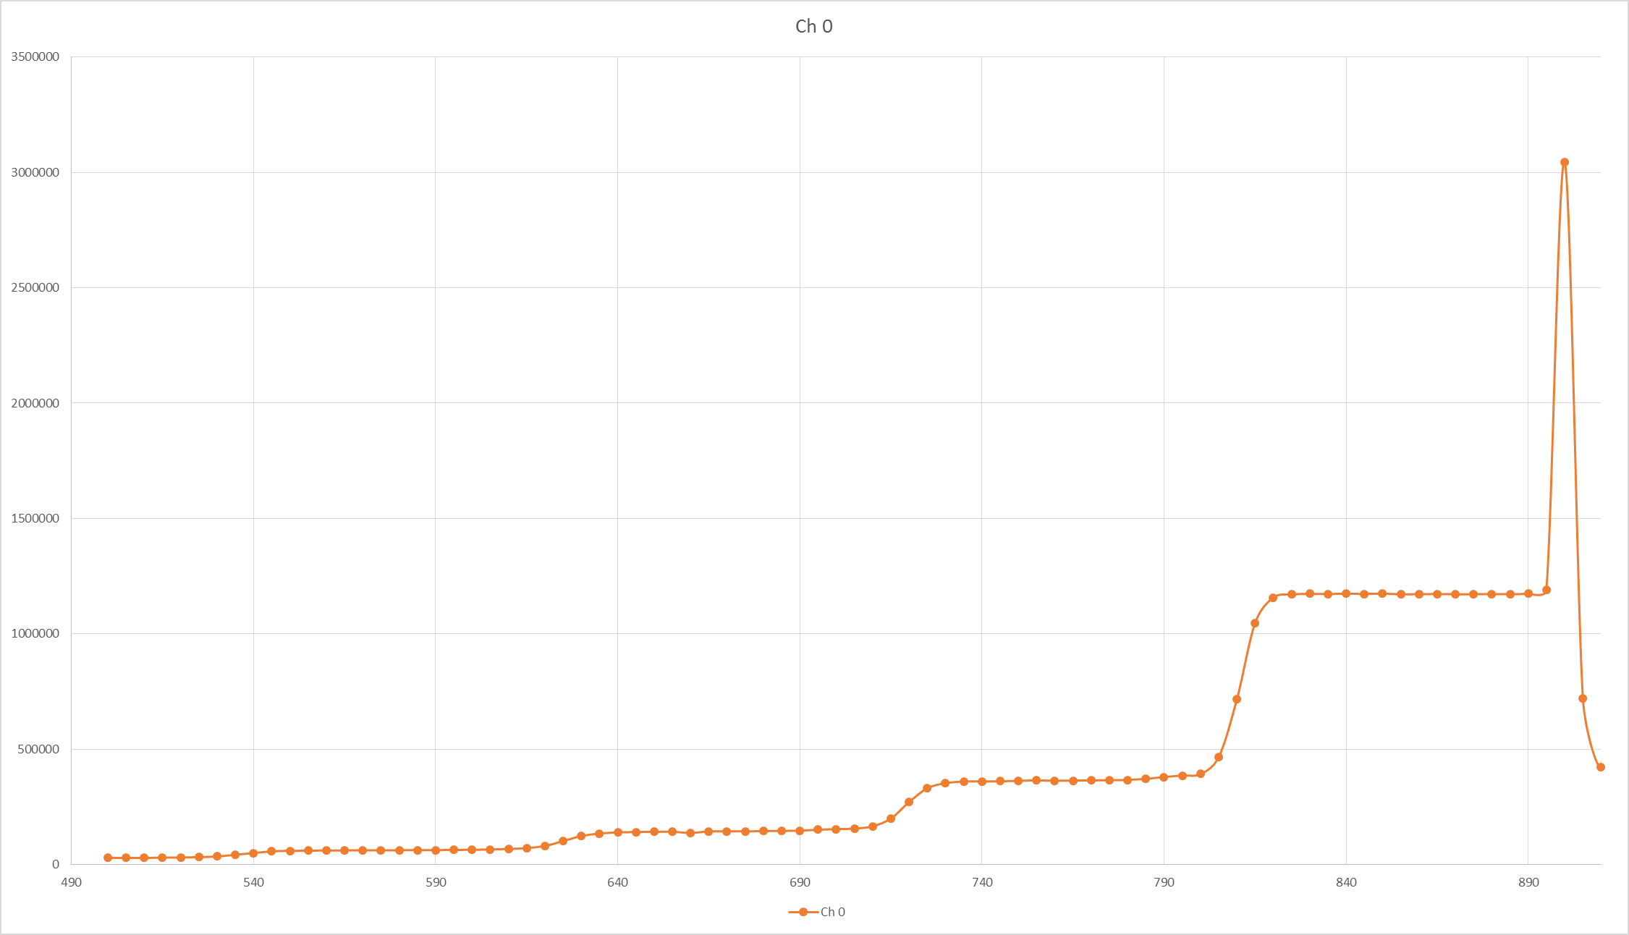
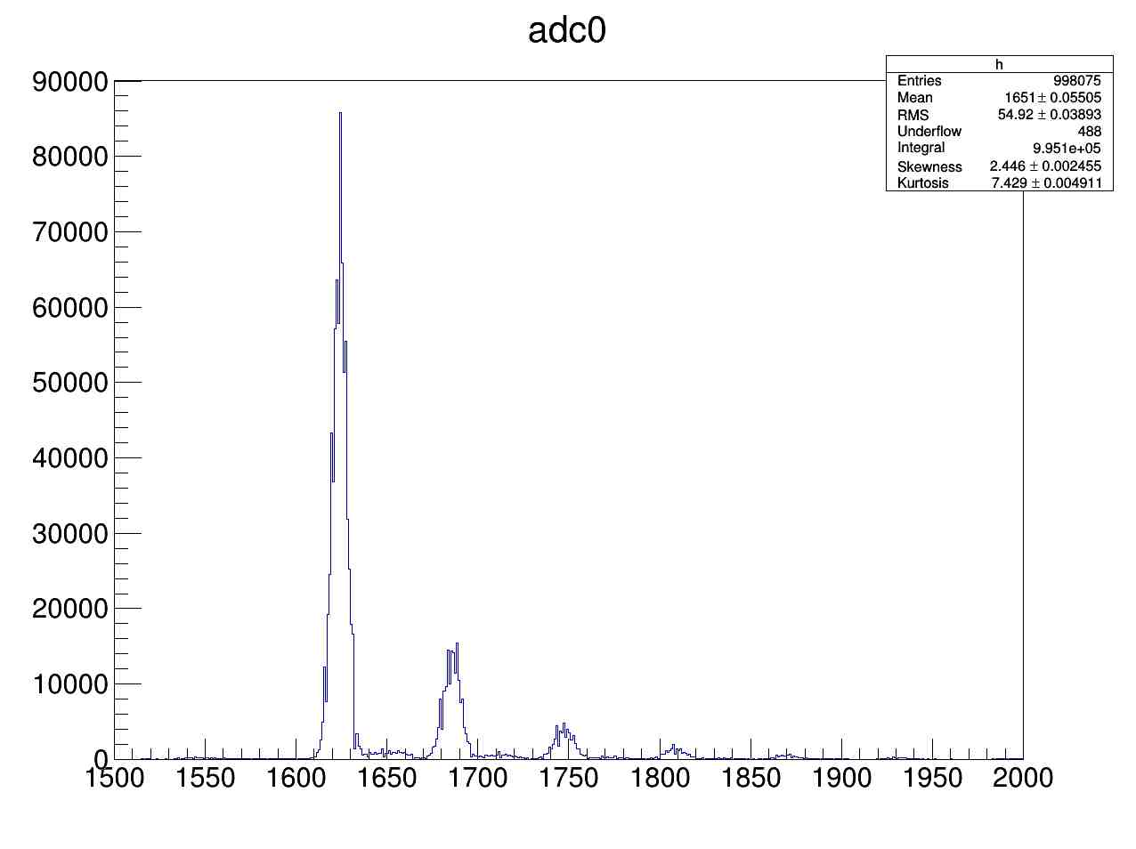
HAMAMATSU MPPC Response
Dark counts (0.1 Hz)
counts (a.u.)
ADC value (a.u.)

Slide 8
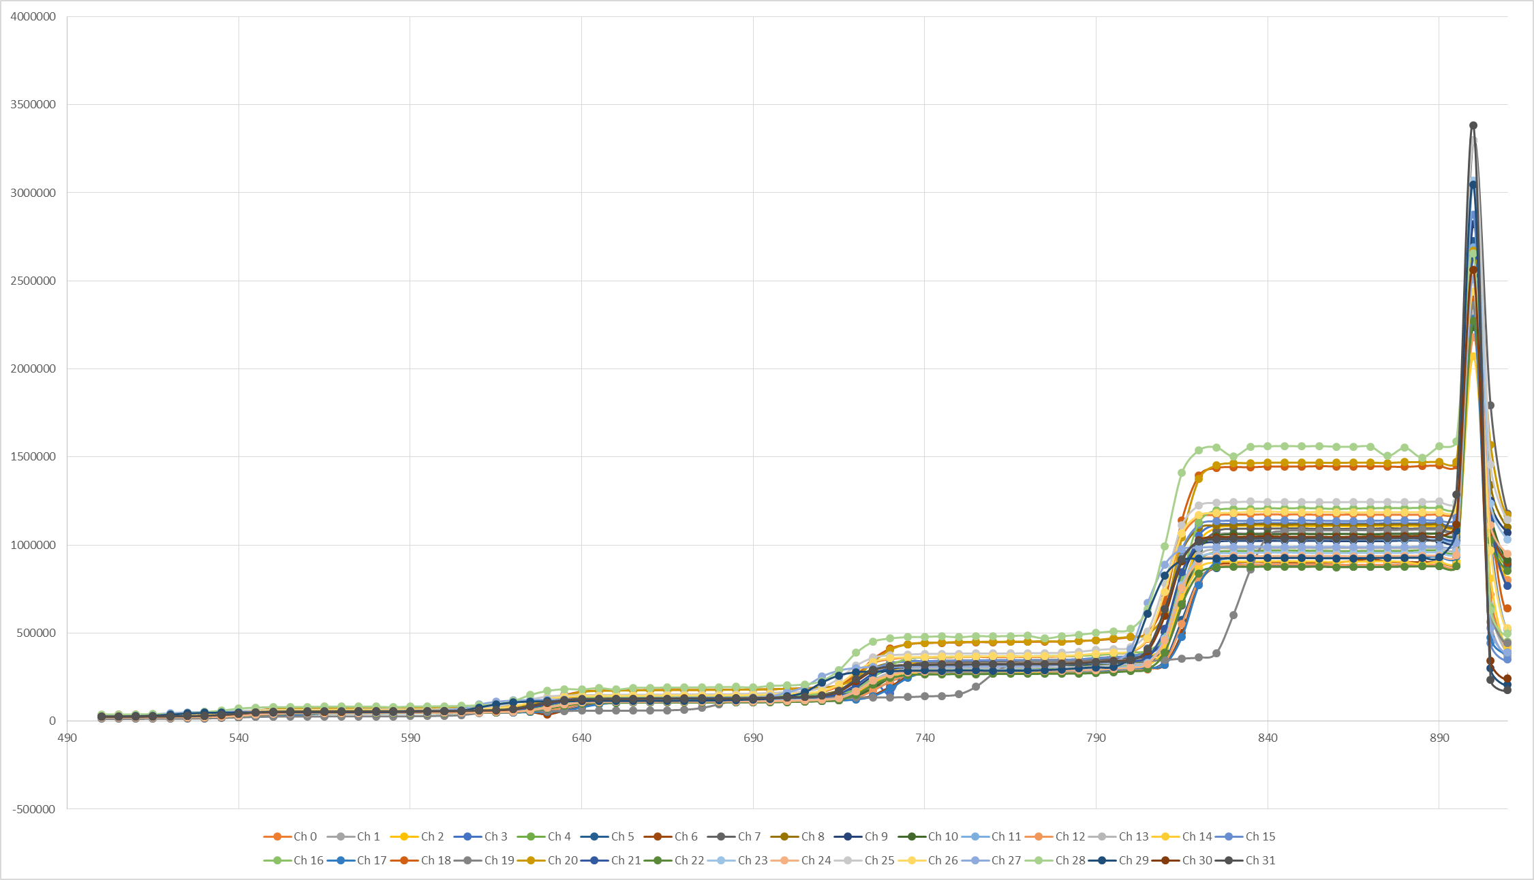
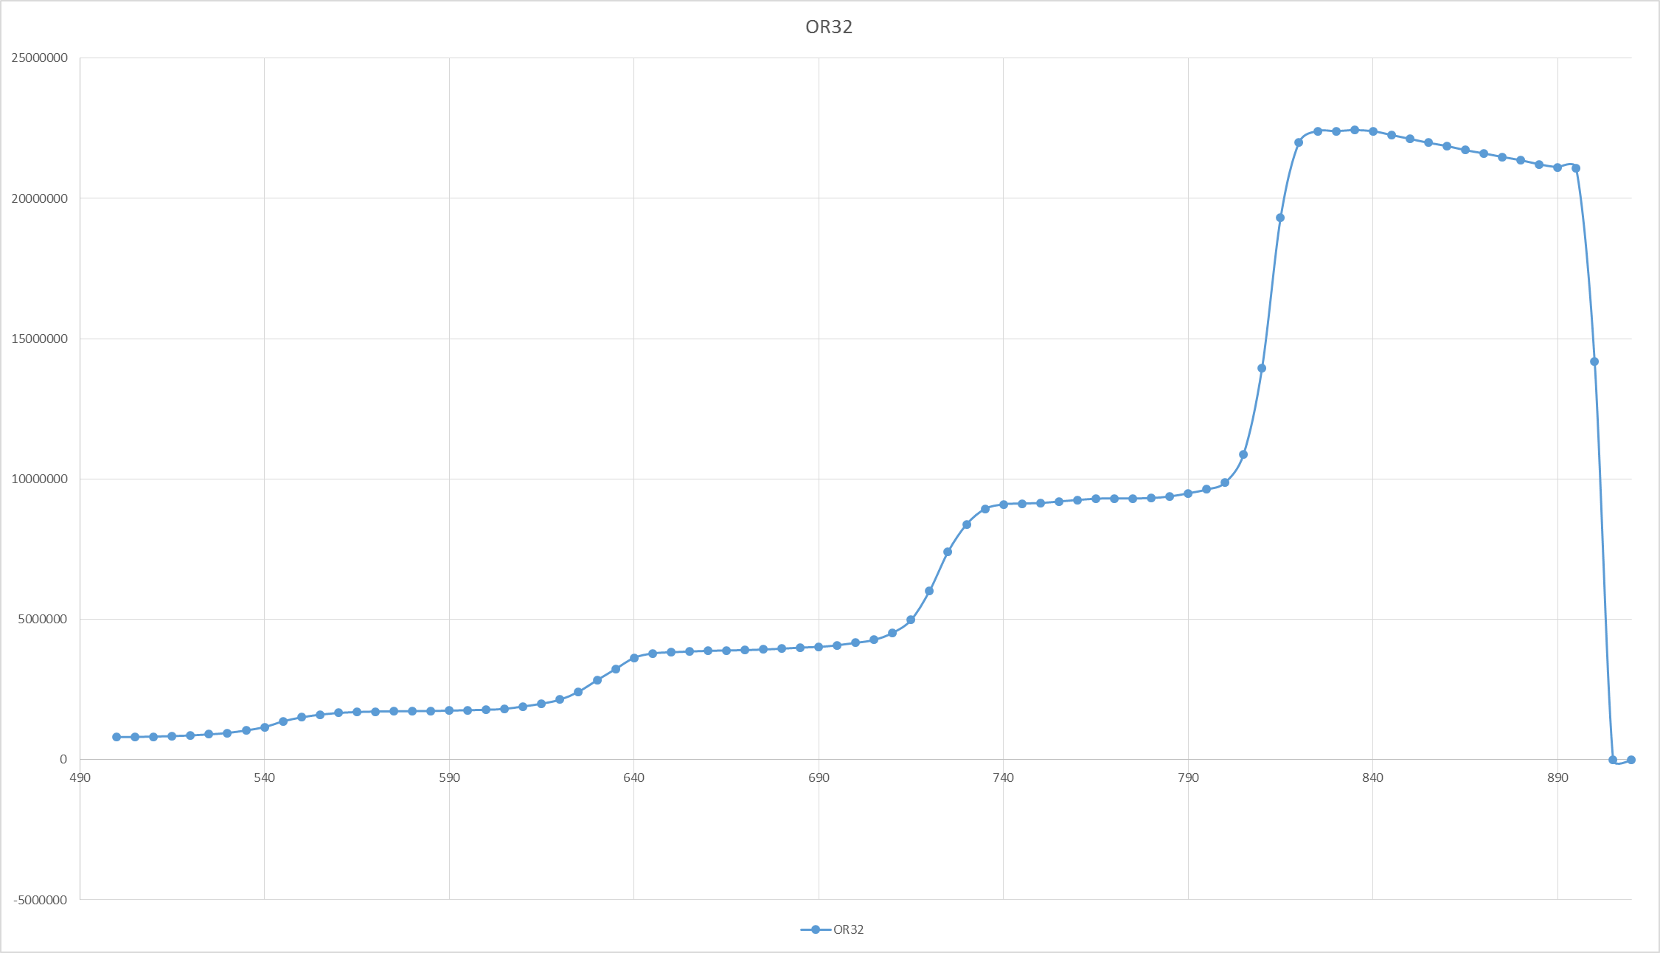
Sipms FIRST TRIALS
32 SiPMs show an homogeneous response
At room temperature the dark rate is very low (75 – 150 kHz) near the electronic noise threshold
Dark counts (0.1 Hz)
counts (a.u.)
counts (a.u.)

Slide 9
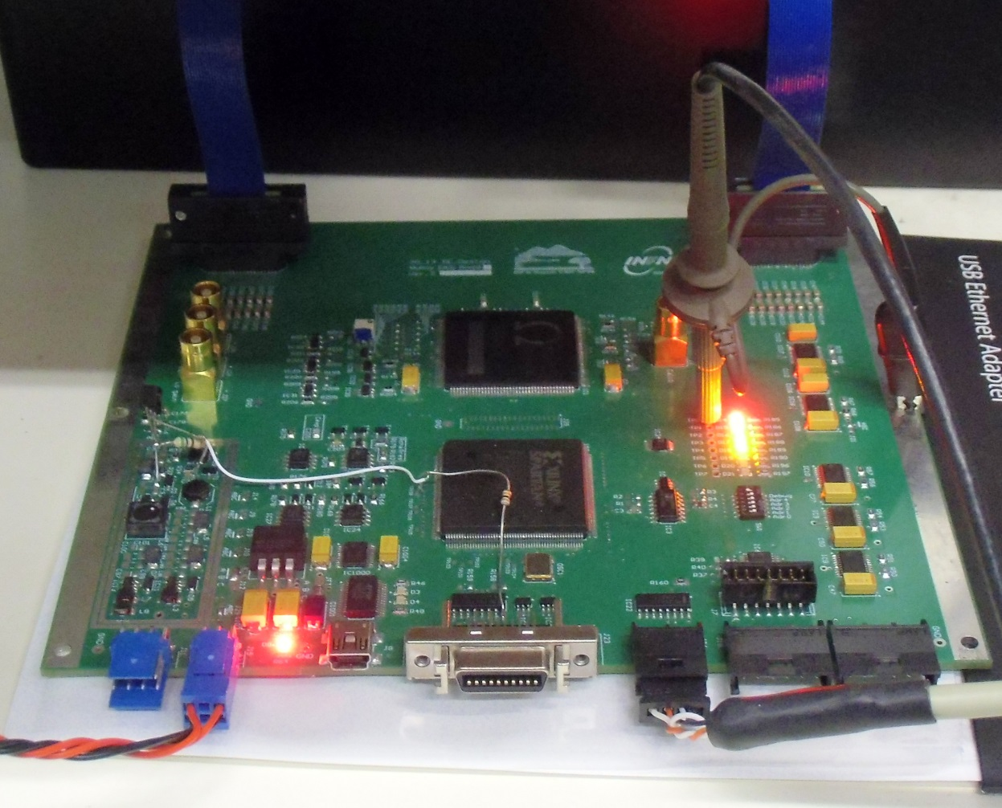
Slave Board
EASIROC (Extended Analogue SiPM Integrated Read Out Chip)
Digital operations implemented in the FPGA
32 digit counters for each channel
Switching regulators provide all voltages needed by the time expansion circuit
Linear regulators provide high voltage for SiPMs and EASIROC operations
Programmable potentiometers to set the Hold time and the Timeout
External Power Supply support
3W power consumption

Slide 10
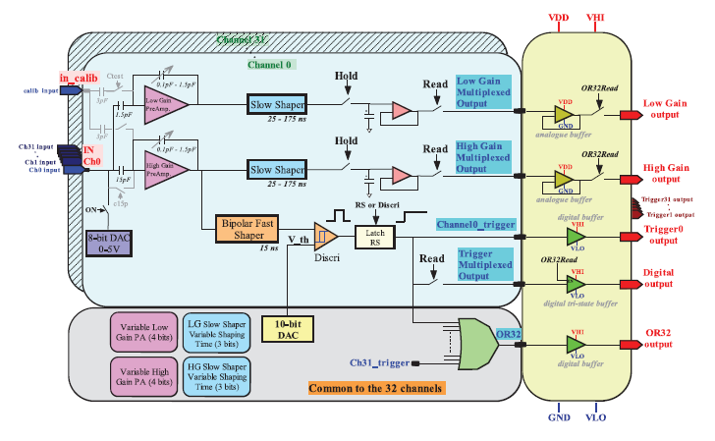
EASIROC SCHEMATIC
Sample and Hold sampler
32 independent triggers and an OR32 trigger
No digital part
Low and high gain output
Notes:
The sample and hold is a sampler used as interface between an analog signal, that varies very fast in time and an output device, often an ADC. This device holds the analog value constant for all the time required by the device to act on the signal.

Slide 11
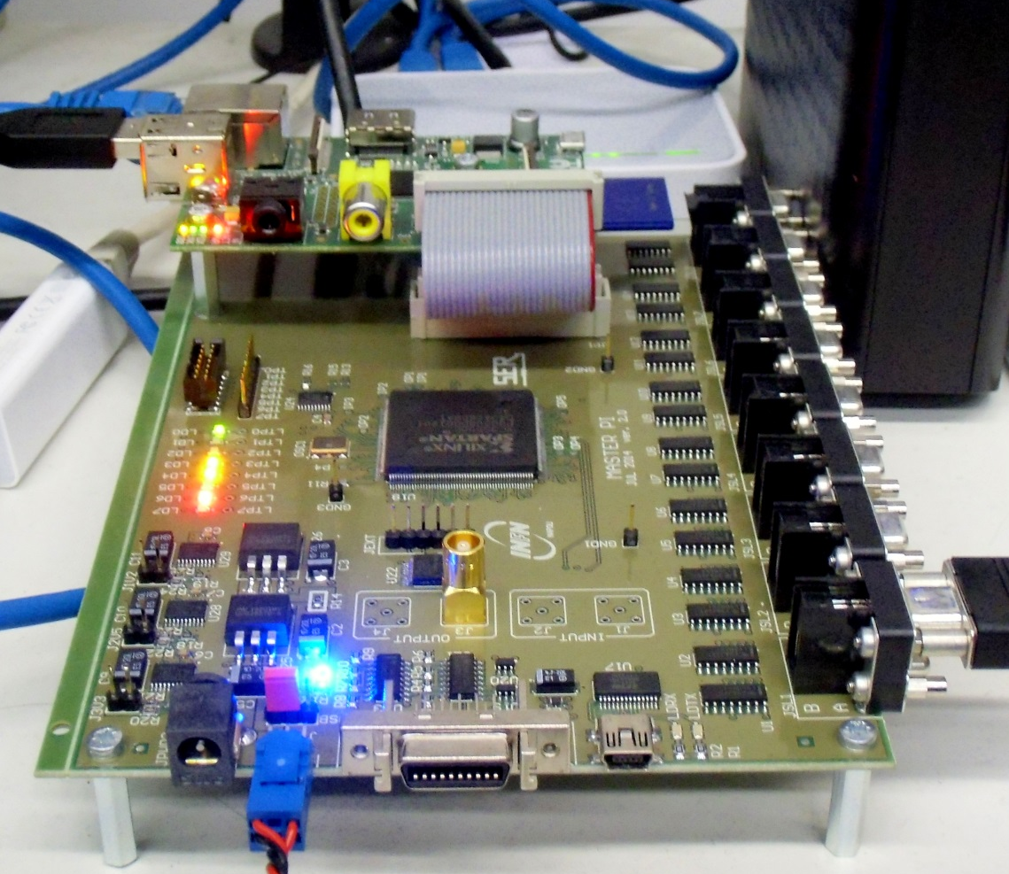
Master pi specifics
Each master now mounts a dedicated credit card size PC Raspberry Pi
32 trigger input
Settable trigger configuration
Connect up to 32 slaves
μNET FEATURES
DHCP Server
Apply settings to all connected Master Pi and read their data
Data storage
Watchdog functions
Internet link for remote functions
Slow Control

Slide 12
General schema
Environment
Sensors
Raw data storage
Raspberry Pi
( μNET )
Data
Setup Voltages
Read Voltages
Settings
Data Base (MySQL)
Power Supply
Master Pi

Slide 13
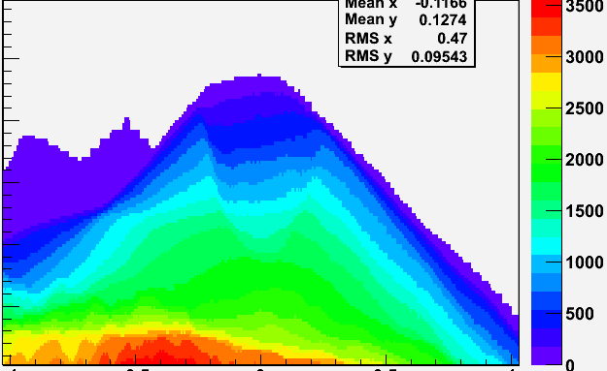
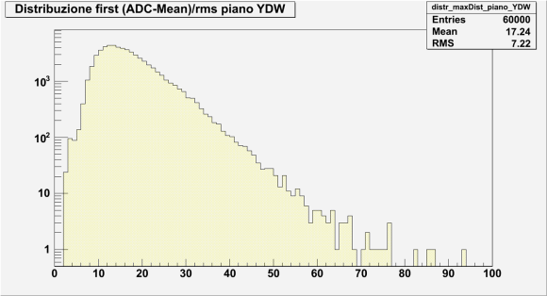
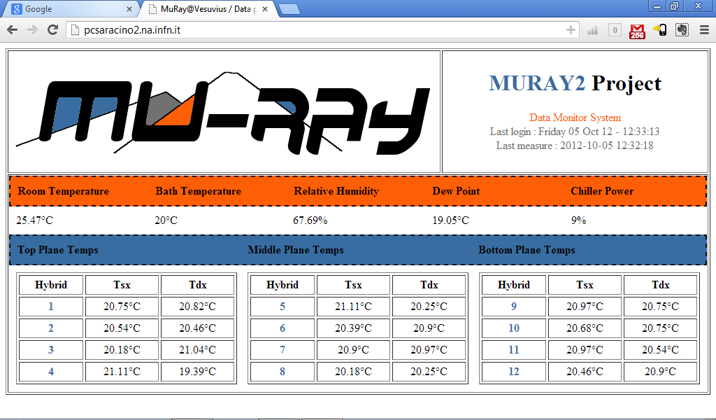
USE OF tHE Database and raw data
computer
Linux OS
DB
Data Analysis
Remote Alarm Website
Data Quality
ONLINE
OFFLINE

Slide 14
How TO measure the tof?
Muons cross the detector
A certain trigger logic is satisfied
Relative time are recorded
tX₁
tX₂
μ
tY₁
tY₂
TOP Plane
DOWN Plane

Slide 15
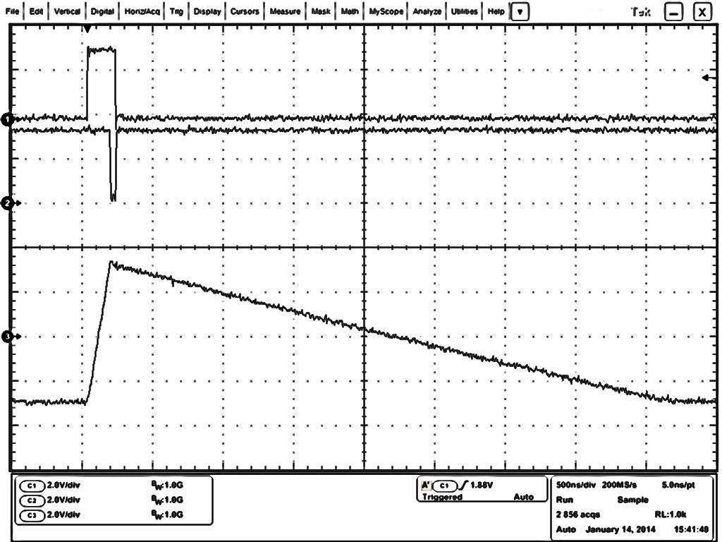
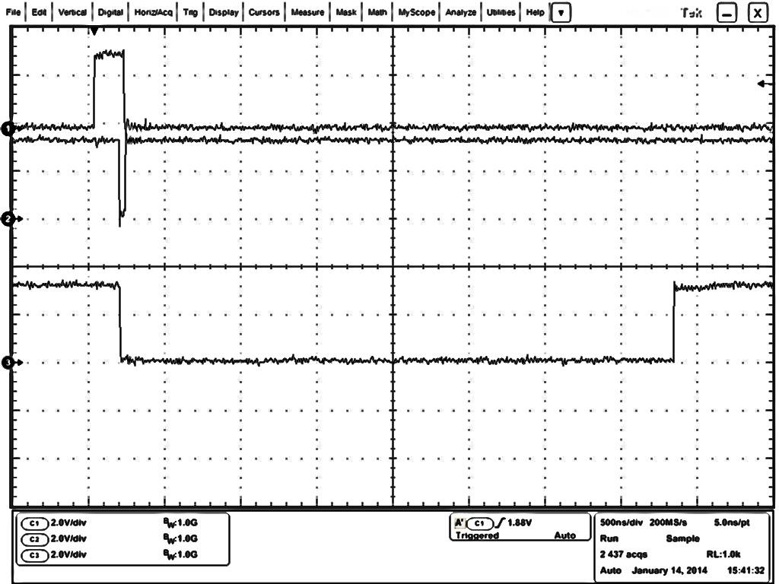
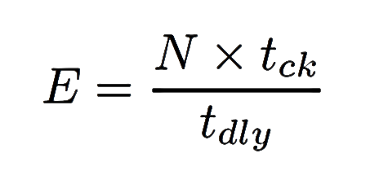
TIME Expansion
Local trigger
Local trigger
Stop
Stop
Charge
Enable window
Discharge
A local trigger is produce on the slave board and transmitted to the master when a particle hits the relative plane
Master board receives all local triggers and if they fulfill the trigger logic, it sends to all slaves a global trigger (stop)
We want to measure the time between every single local trigger and the stop signal
From the production of the local trigger to the stop signal a capacitor is charged on each slave boards

Slide 16
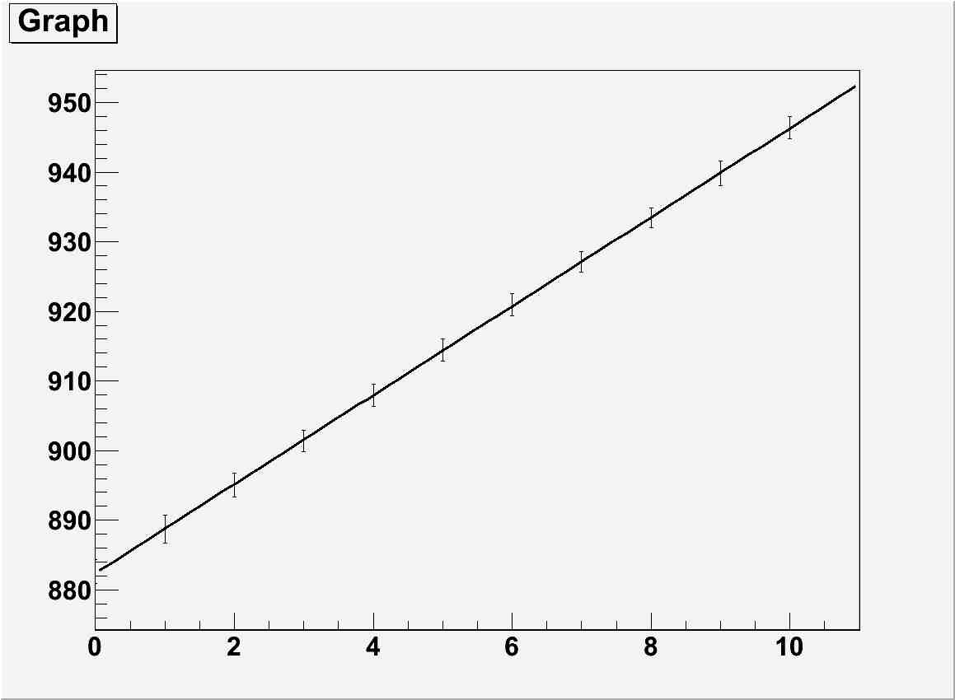
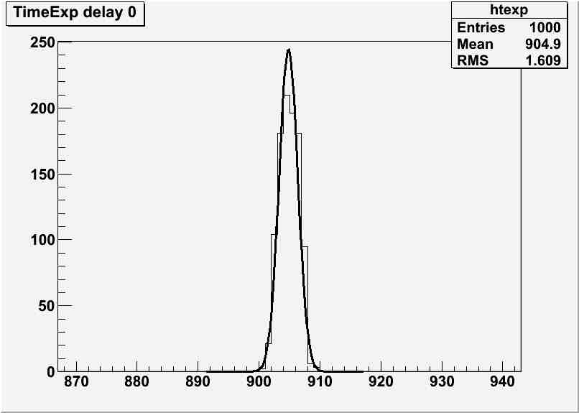
Experimental measure of the tof
Linear response
RMS indipendent from the delay
counts (a.u.)
delay (ns)
Measured TDC spread
counts (a.u.)
1.6 counts
250 ps

Slide 17
Conclusions
The construction of the MURAVES detector will start at the beginning of 2015
Tests and experiments to find best materials, sensors, computing and monitoring solutions lead to the development of the remotely controlled muon detector that constitutes the basic part of the MURAVES telescope
Its precise calibration and characterization will allow to set for best performance
Improvements and new features are in progress

Slide 18
Thanks
mail :: cimmino@na.infn.it

