Slide 1
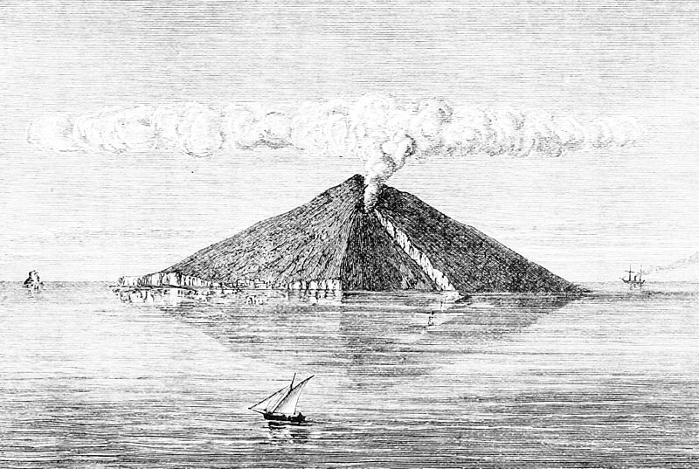
Muography with nuclear emulsions – Stromboli and other projects
Valeri Tioukov¹, Giovanni De Lellis¹, Paolo Strolin¹, Lucia Consiglio¹, Andrey Sheshukov¹, Massimo Orazi², Rosario Peluso², Cristiano Bozza³, Chiara De Sio³, Simona Maria Stellacci³, ChiaraSirignano⁴, Nicola D’Ambrosio⁵, Seigo Miyamoto⁶, Ryuichi Nishiyama⁶, Hiroyuki Tanaka⁶
¹University of Napoli / INFN, Italy, ²INGV - Napoli, Italy, ³University of Salerno / INFN, Italy, ⁴Universityof Padova / INFN, Italy, ⁵INFN - LNGS, Italy, 6University of Tokio, Japan

Slide 2
Emulsion laboratories in Italy
Main business is fundamental Particle Physics (neutrino experiments in particular)
1990 – 2002 CHORUS experiment
2002 – now OPERA project
Emulsion scanning laboratories in Italy (OPERA participants)
  Napoli, Salerno, Gran Sasso, Bari, Bologna, Padova
  About 30 scanning systems were constructed in Italy for OPERA scnning
Since 2011 – some laboratories are involved in Muography projects
  Napoli, Salerno, Gran Sasso

Slide 3
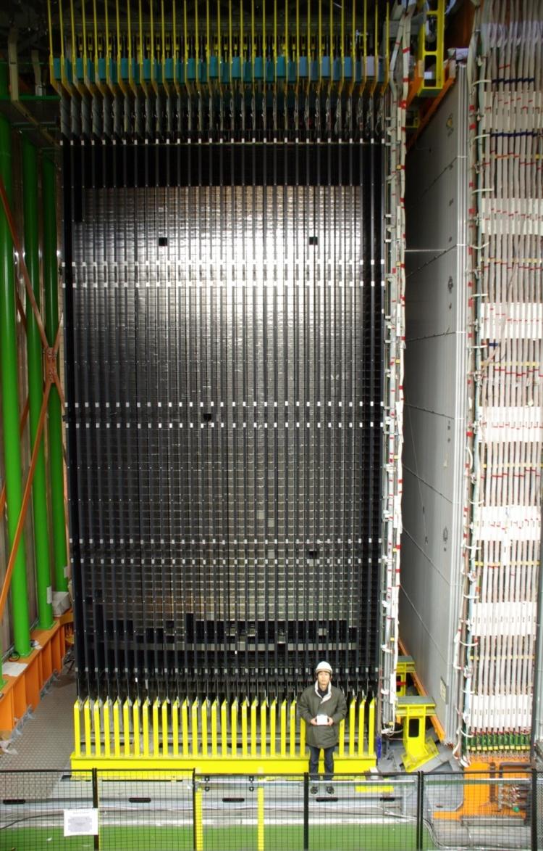
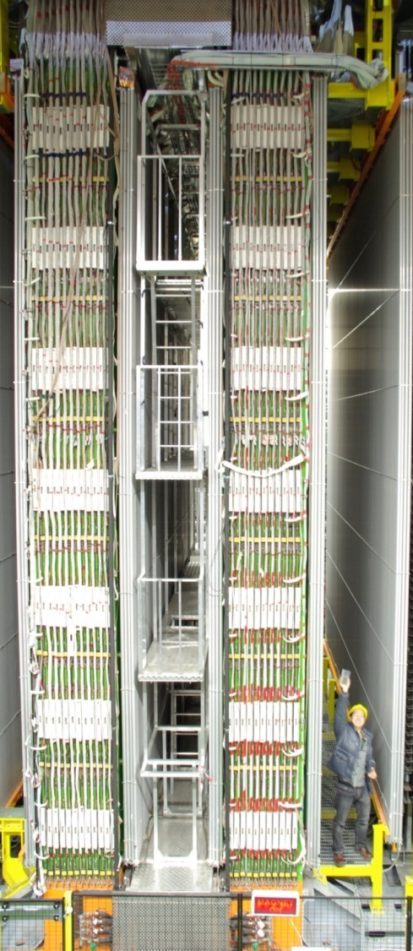
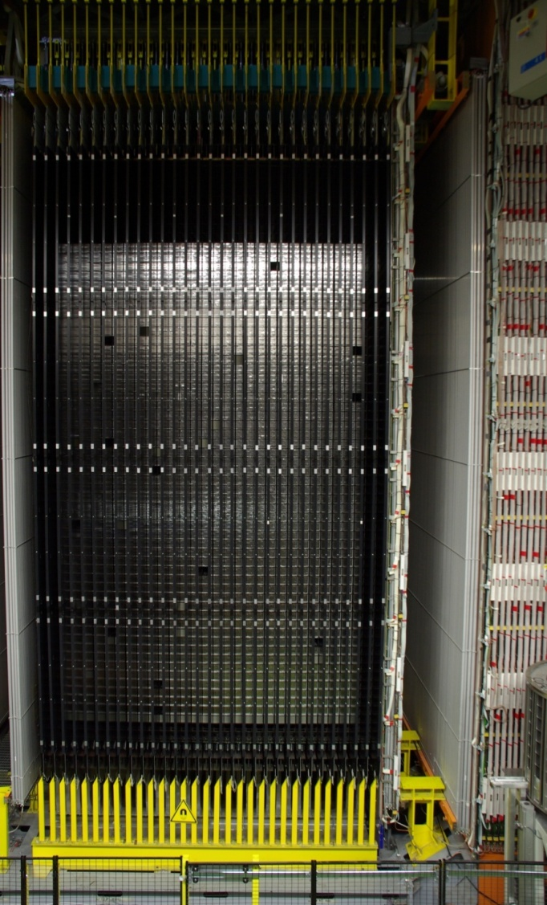
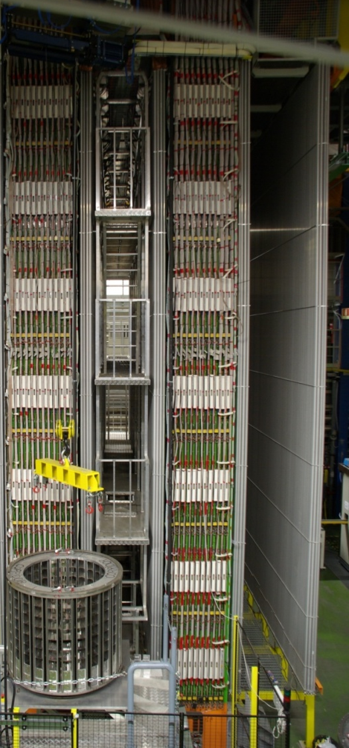
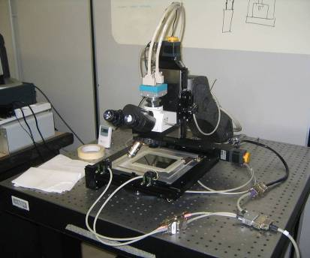
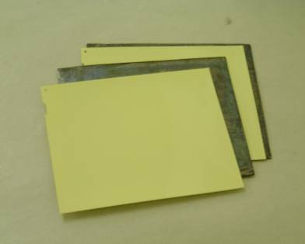
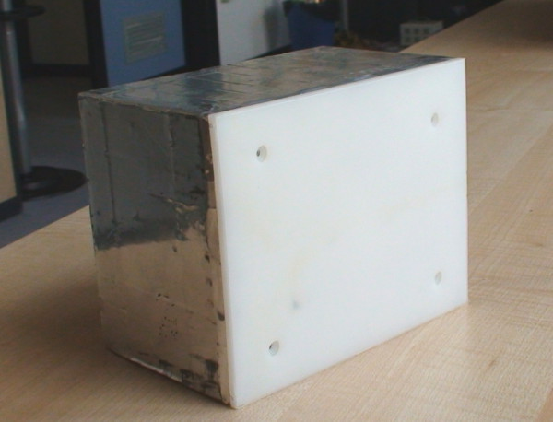
The OPERA detector: 8.9 mln films with the total emulsion sensitive surface of 200000 m²
neutrino
10x10x50 meters
apparatus
ECC “brick”
57 emulsion plates
56 lead plates
10x12x7 cm, 8 kg

Slide 4
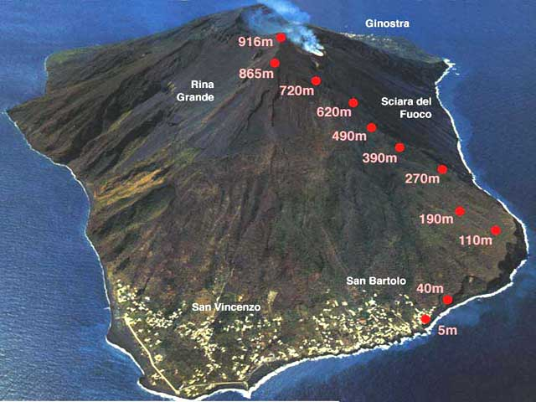
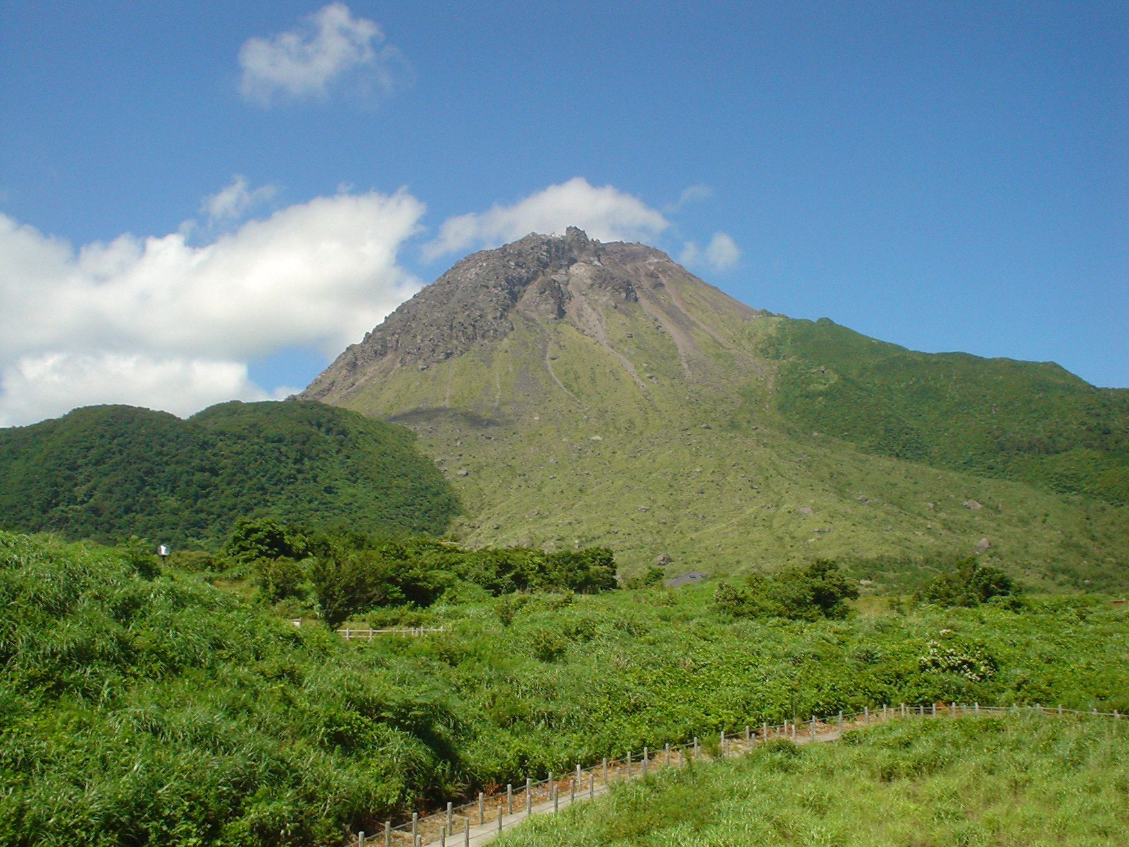
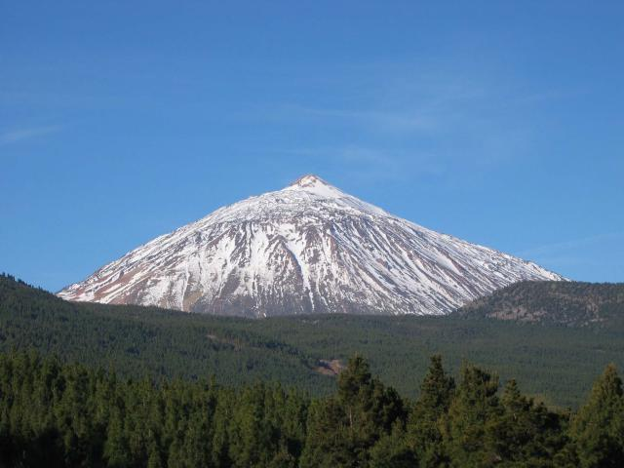
Stromboli
Muography emulsion projects with
contribution of Italian laboratories
Unzen – contributed to data scanning and analysis (2011)
Stromboli – Design, installation and data analysis (2012)
Teide – exposure is completed, scanning is started (2013)
La Palma – modules design, installation, analysis started (2014)
Unzen
Teide summit

Slide 5
The principle of muon radiography
It’s assumed that the muon flux and spectrum well known and nearly constant
Assumed the precise knowledge about the mountain shape
What we can obtain is the angular map of the average rock density using the muons absorption information
Detector should provide precise angle for each particle passed through
Telescope
Nearly horizontal
atmospheric muons cross the mountain
The method is limited to the upper part of the mountain above the detector
Low muons rate do not allow to have short exposure – months is a typical time scale
1 km of the rock thickness is an approximate upper limit for 1-few m² detectors with few months exposure
Emulsion is a good candidate!
11/18/2014
Valeri Tioukov, IAVCEI 2013
5

Slide 6
Motivations for the Stromboli exposure
Stromboli is one of the most known and most active volcanoes in the world
Great amount of monitoring equipment is installed on the volcano slopes, but the exact internal structure of the region below craters is not well understood yet
There is a possibility that the explosion source mechanism is representative of two cracks dipping ∼60◦ that are located approximately 220-260 m, beneath the active craters, probably representing parts of an echelon system of fissures
muon radiography can be an independent technique for investigating the internal structure of the cone and revealing the location and extent of the conduits that feed the continuous explosions
Region under “Sciara del Fuoco” is the one of our interest
Motivations for muon radiography of active volcanoes,
G. Macedonio and M. Martini, Earth Planets Space, 61, 1–5, 2009

Slide 7
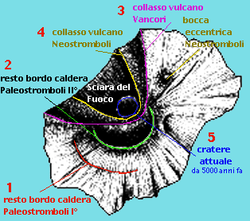
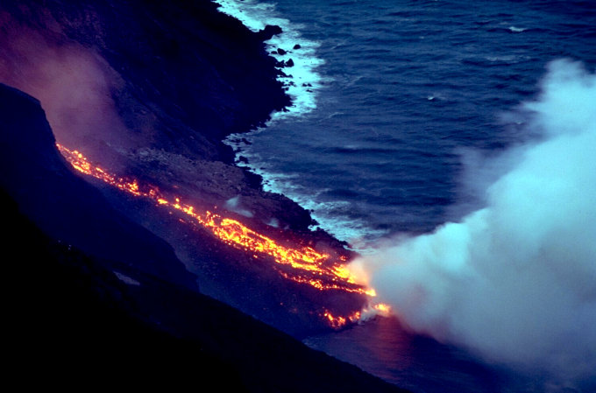
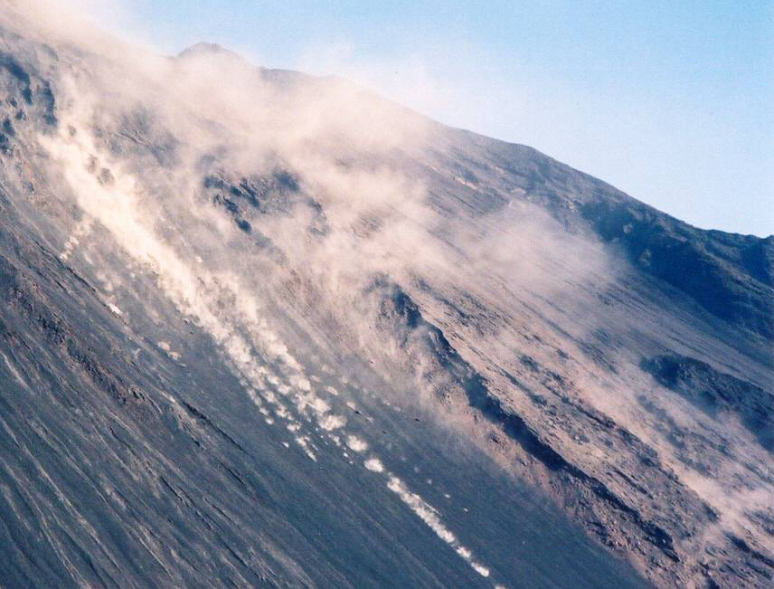

Slide 8
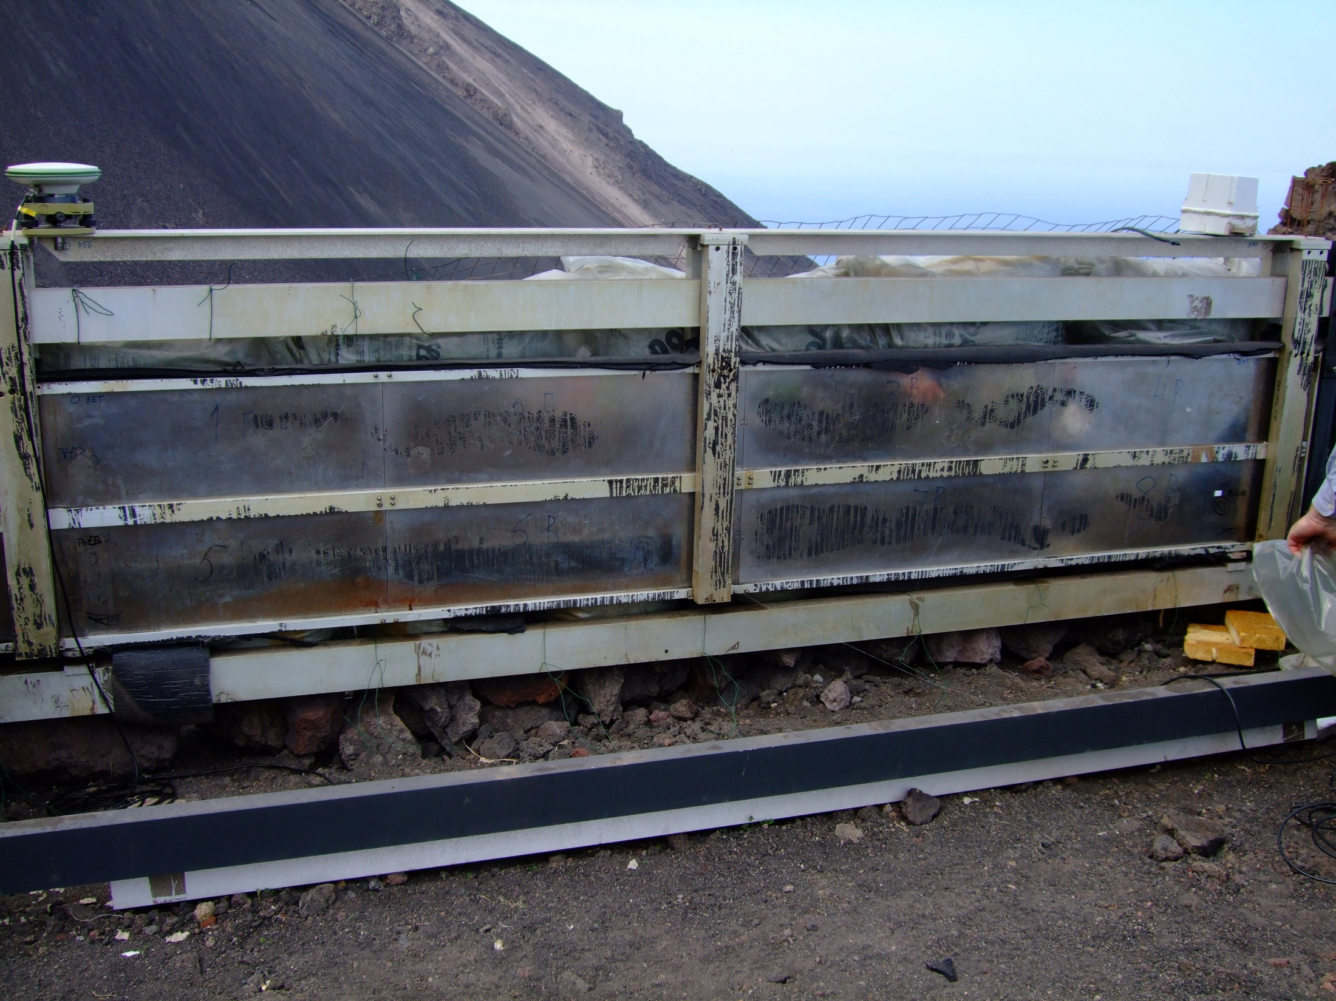
GPS
Movement sensor
3B
4B
1B
2B
8B
6B
7B
5B
The overall dimension is about 70 x 350 cm, 250 kg

Slide 9
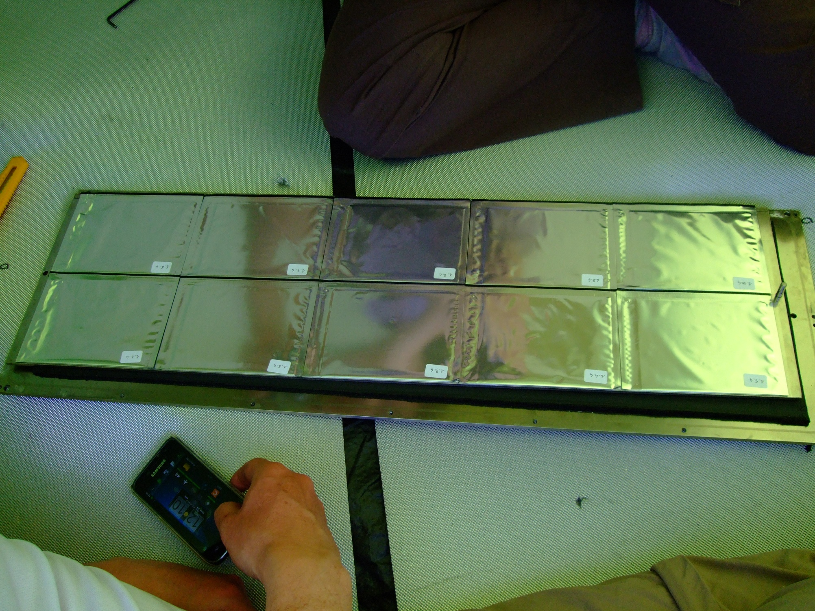
Emulsions extraction after 5 months exposure. The envelopes are in a good shape

Slide 10

Scheme of the internal module structure
One module with 10 emulsion “cells”
Each cell has 2 emulsions doublets attached
to both sides of the central metal plate.
Front view of the central plate (26 x 80 cm)
“Exploded view”
Aluminum Frame
Elastic (rubber) layers
Track is defined by 2-4 consecutive segments in 4 plates
x
x
x
The total weight of one module is of 26 kg
Total amount of emulsions/module: 40
The active surface covered is of 1200 cm2
The overall weight of 8 modules and the support frame is about 250 kg
Metal plates
of 5mm (inox)
Envelopes with emulsions
glued to the central
inox plate

Slide 11
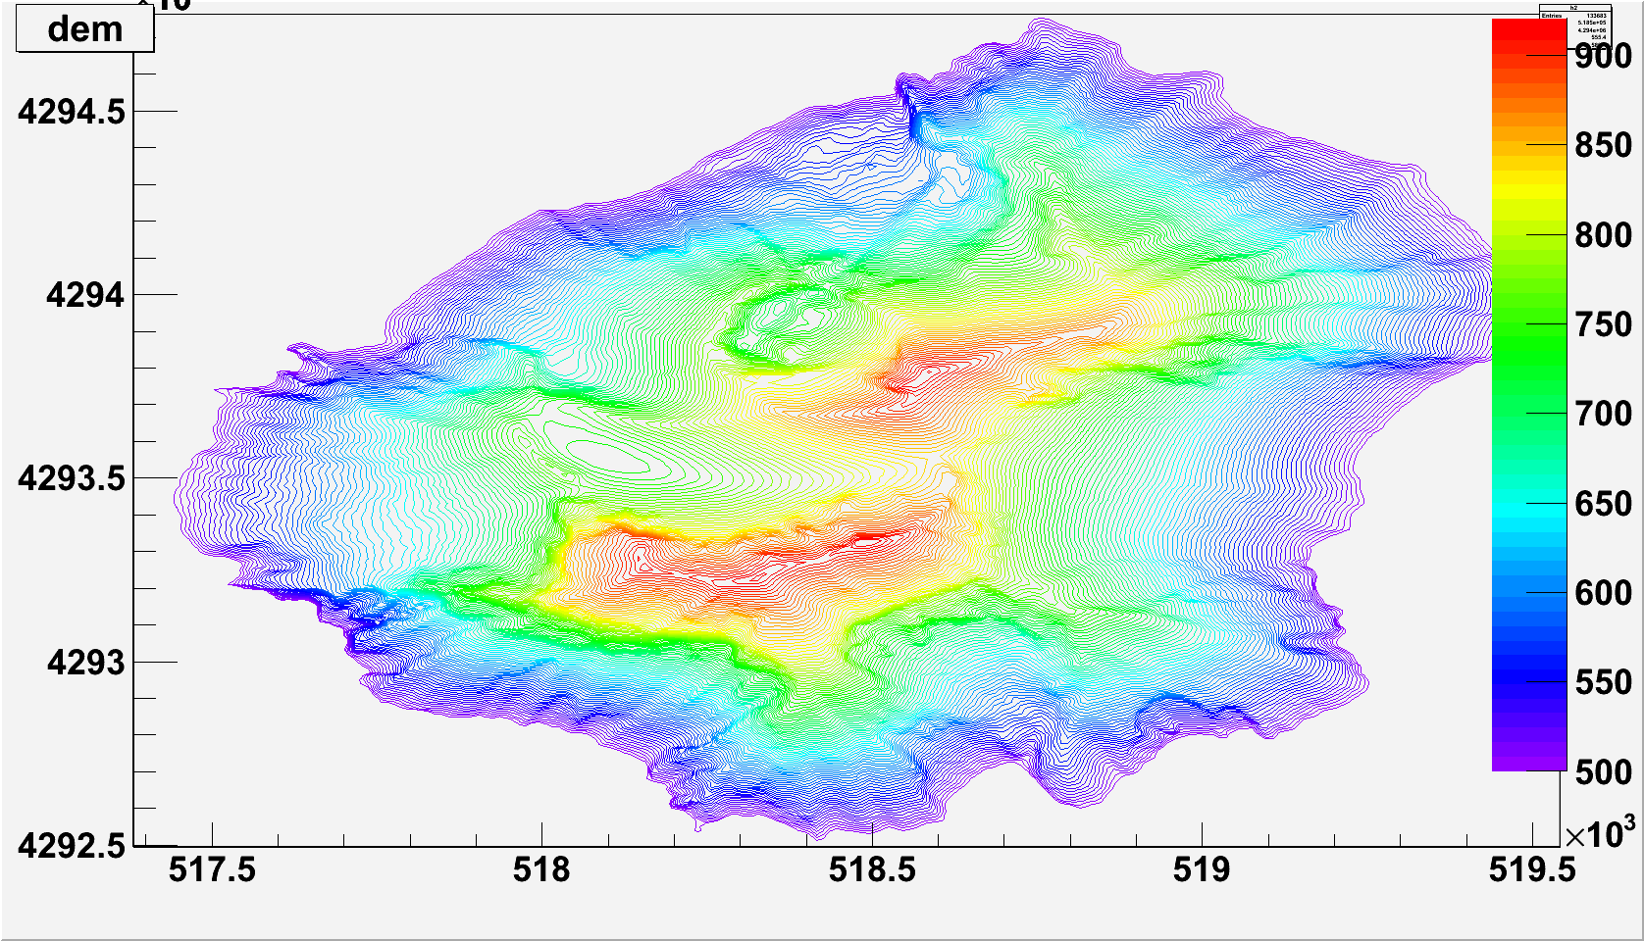
The data analysis assume the precise knowledge about the mountain shape
Detector position
Precise and up to date
Digital Elevations Map (DEM) Is important
Area of interest
Only the part of the island above
500m is displayed here

Slide 12
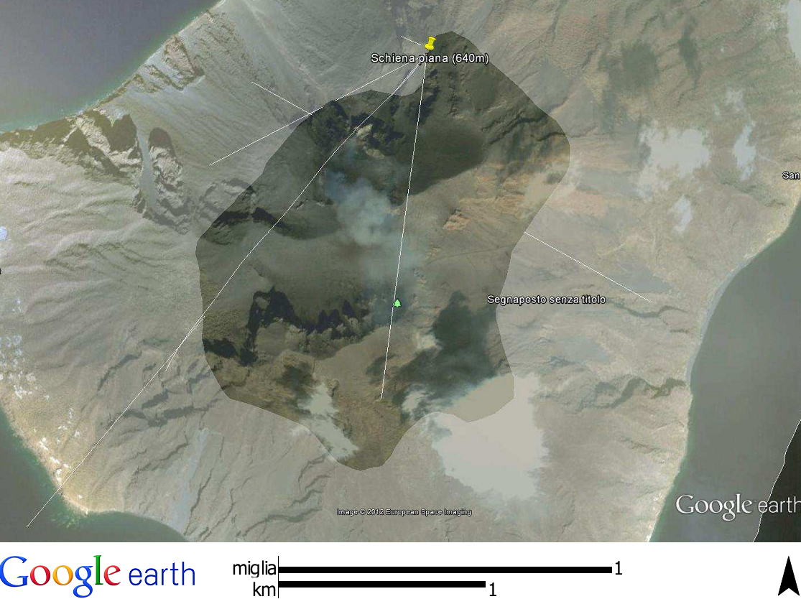
Above 500 m part of the island
Detector
Craters region

Slide 13
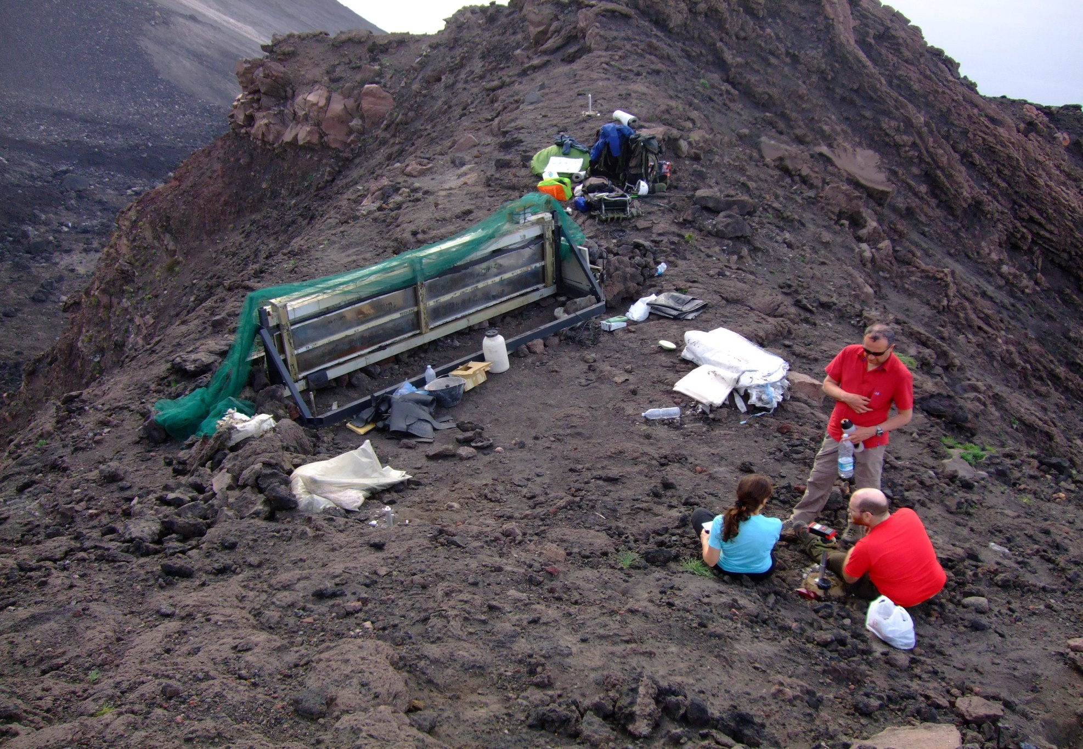
To keep memory about the module orientation 3 fixed vertices were installed and the distances measured with the laser distanziometer (+-2 mm accuracy)
GPS data were recorded on 2 detector and on 2 vertex points
1
3
2

Slide 14
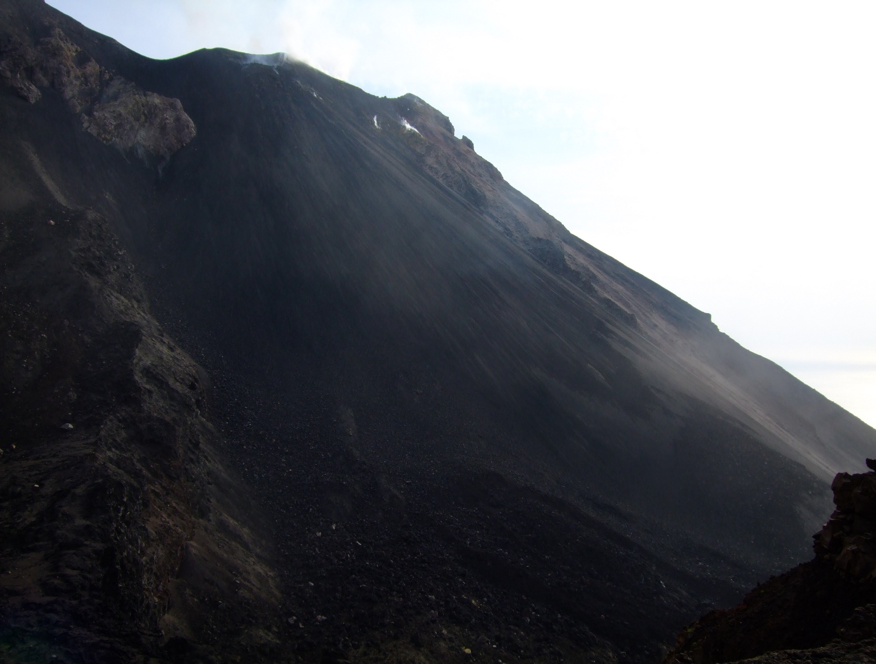
View from the detector position
(640m asl, about 600 m
linear distance to craters)
Craters region (750 m)
Sciara del fuoco

Slide 15
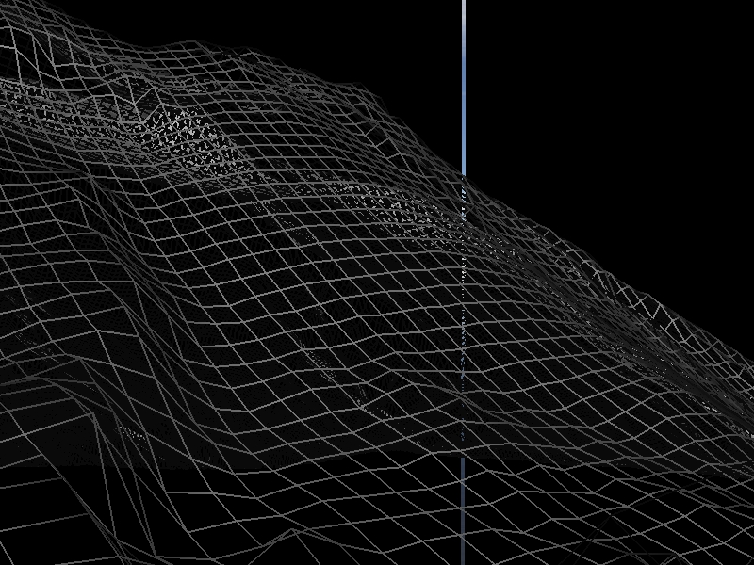
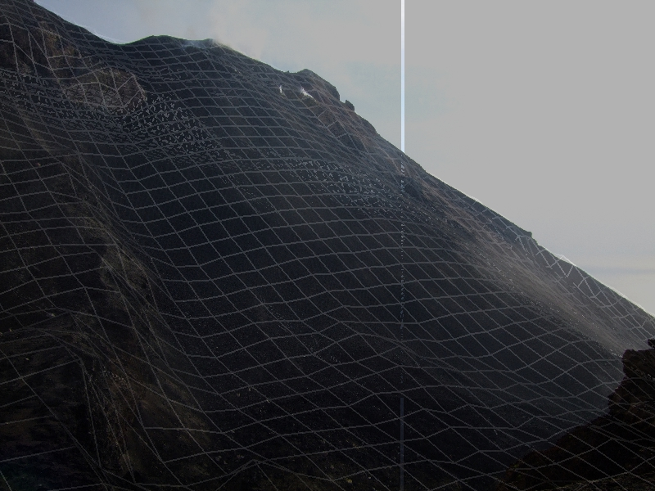
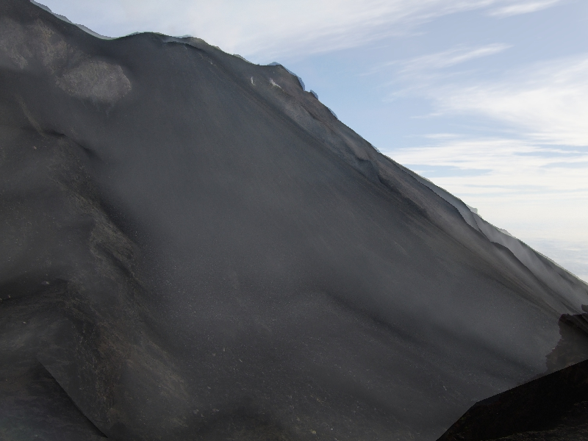
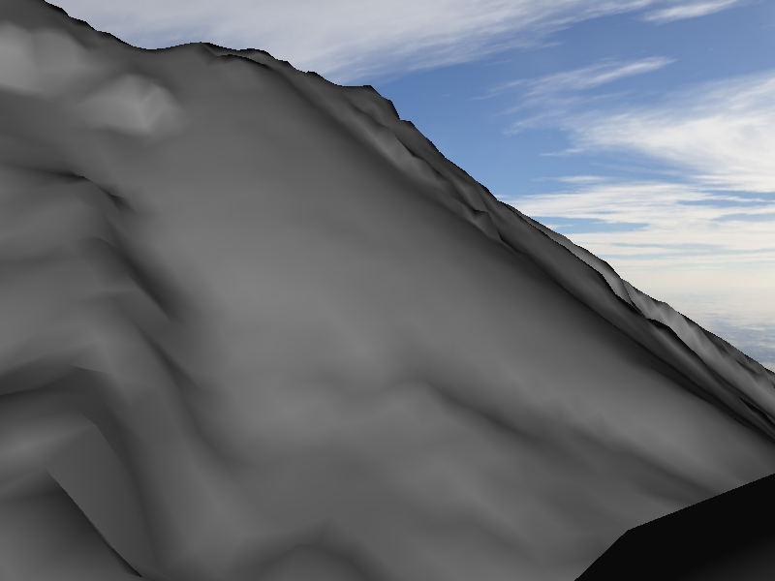
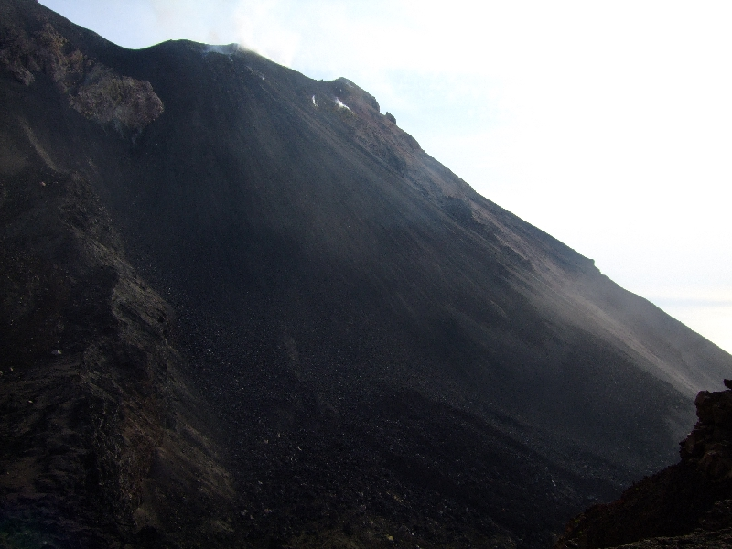
DEM – Photo comparison
Photographs of the mountain taken from the detector position compared to the shape of the DEM viewed from the same point
Precise images coincidence confirms the precision of the GPS coordinates

Slide 16
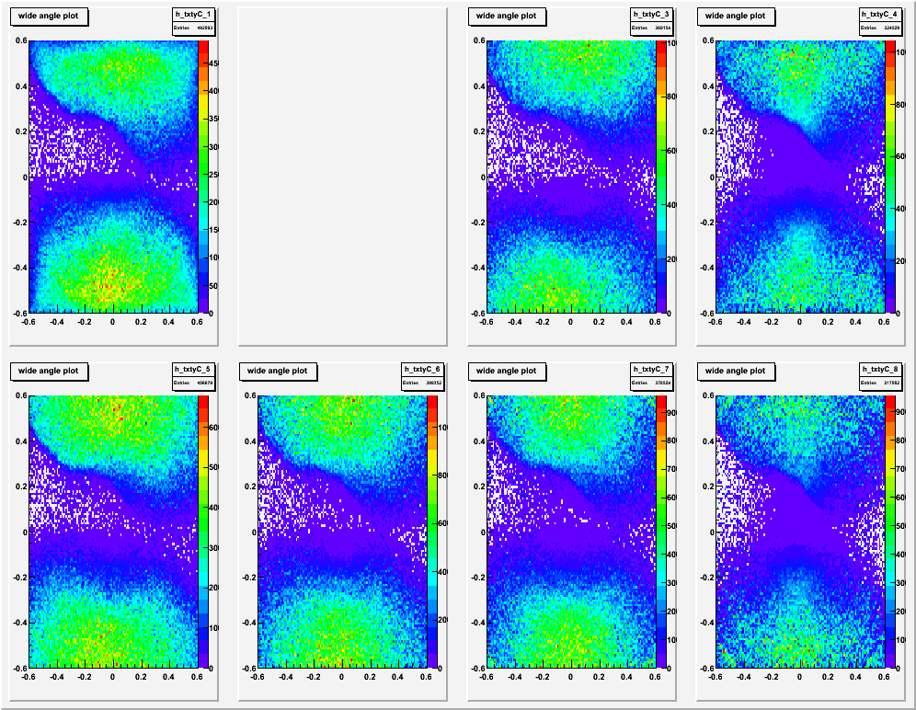
1 SA
2 SA
3 NA
4 TO
Data processing
8 modules were scanned and analyzed in 3 laboratories:
Napoli: 3,5,6,7
Salerno: 1 , 2(ny)
Tokyo: 4,8
The data are not perfectly uniform but in the region of interest have similar shape
Analyzed area is of 0.73 m²
Alignment problems
To be solved
5 NA
6 NA
7 NA
8 TO

Slide 17
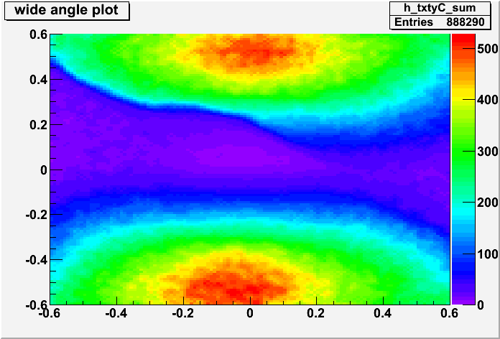
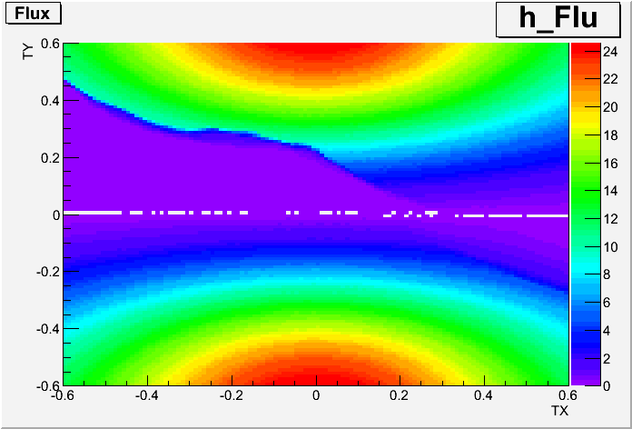
All data are superimposed after the module-dependent corrections
On the plots there are tracks slopes.
Positive ty correspond to the Mount direction
Negative ty correspond to the opposite direction – almost free Sky
BIN: 0.01x0.01
Data
Monte Carlo
Normalized to /day/m²

Slide 18
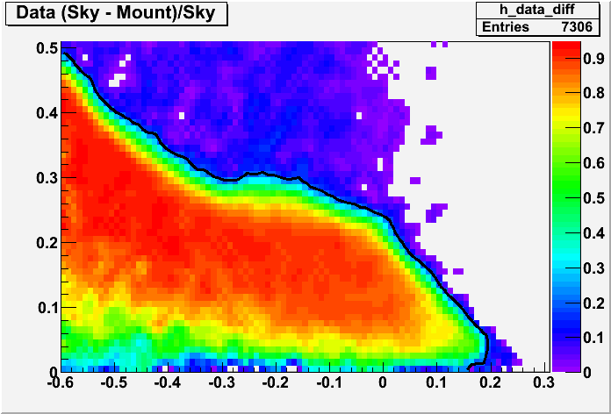
For precise definition of the mount shape by muons data the Mount (positive ty) was subtracted from the free Sky (negative ty) and normalized to Sky
Contour line taken at 0.2

Slide 19
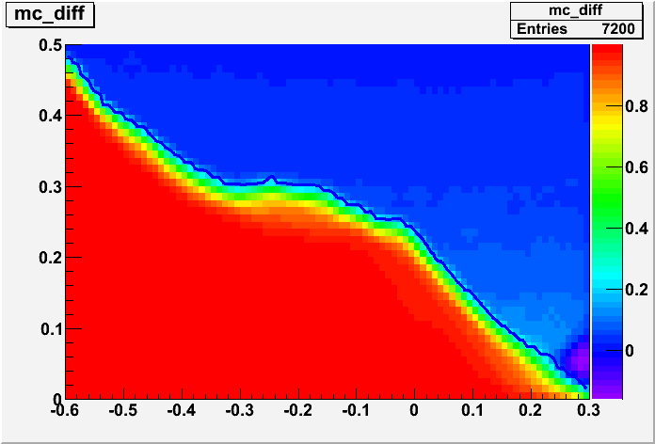
MC (Sky-Mount)/Sky
To cross-check the procedure,
the same was done for MC
Contour line taken at 0.2

Slide 20
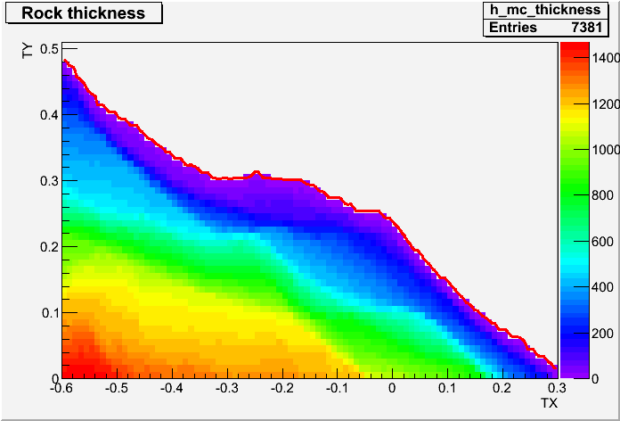
From DEM and detector position
Rock thickness on the path of muons travelling to the detector
DEM+MC viewer are used. Detector is positioned on the DEM using the coordinates taken from high precision GPS
measurements
Contour line taken at 1 m
of the muon path in the rock

Slide 21
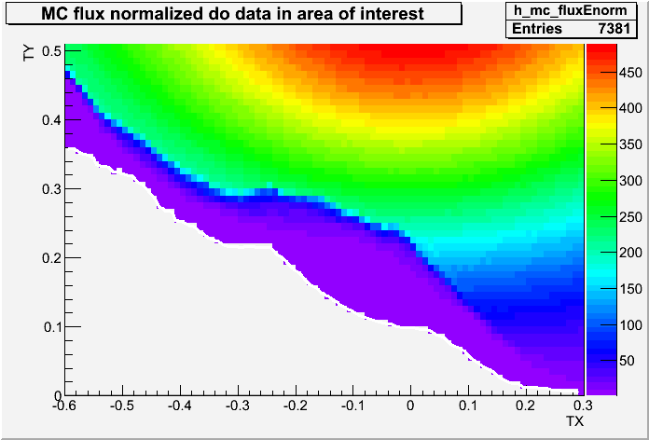
MC flux:
Due to normalization
problem we used data free Sky region close to mountain to normalize MC
Level of 1 muon/bin defines the theoretical measurement limit

Slide 22
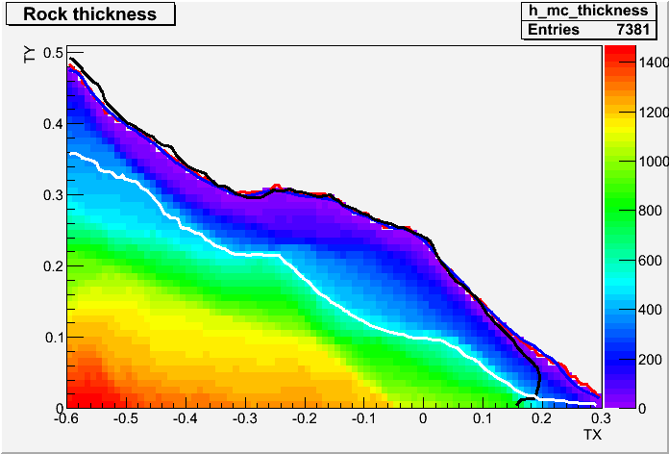
We may define 3 regions in the angular space:
mount edge from DEM&MC
mount edge obtained from MC flux
mount edge obtained from data flux
A
A
Free Sky
B
Sensitivity
region
B
Sensitivity limit (1 muon/bin)
C
C
Out of sensitivity
(thick rock, low flux)

Slide 23
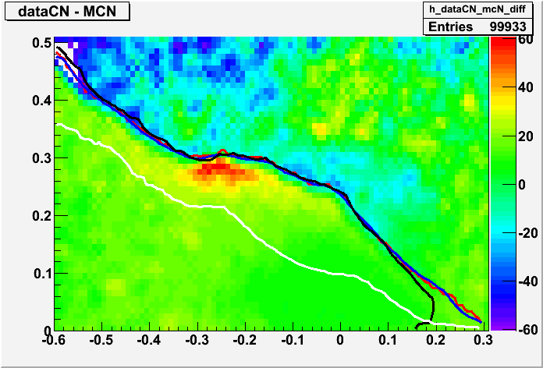
Data and normalized MC flux are subtracted
We observe significant muons excess in the craters region
A
B
C

Slide 24
Résumé for the Stromboli analysis
The scanning and data preprocessing are completed
Analysis is in a good shape, the improvements are expected in
  Absolute MC and/or data flux normalization
  Some fine tuning for the efficiency/purity corrections is still possible
Data interpretation from the geological point of view - to be done
General remark: data analysis becomes quite sophisticated due to the fact that we work with 9 years old emulsions which has high background and low efficiency. With new ones data purity and detection efficiency would be be much higher resulting in much higher precision in the flux measurement.

Slide 25
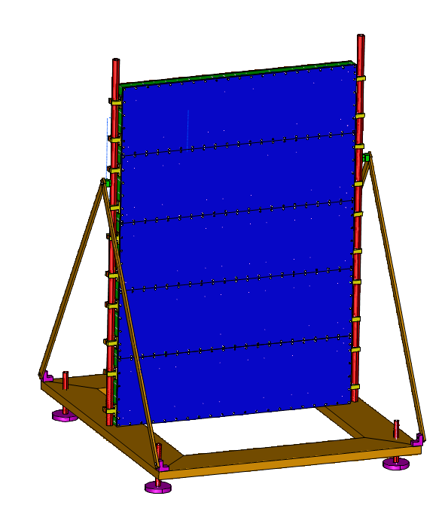
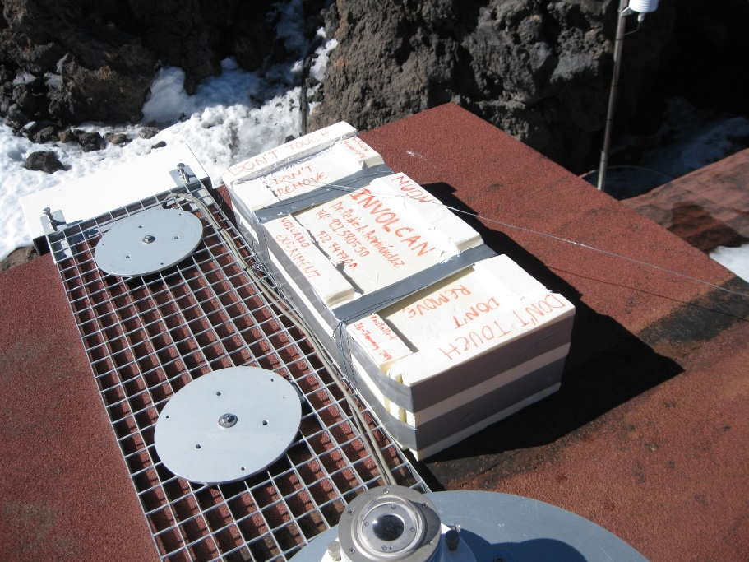
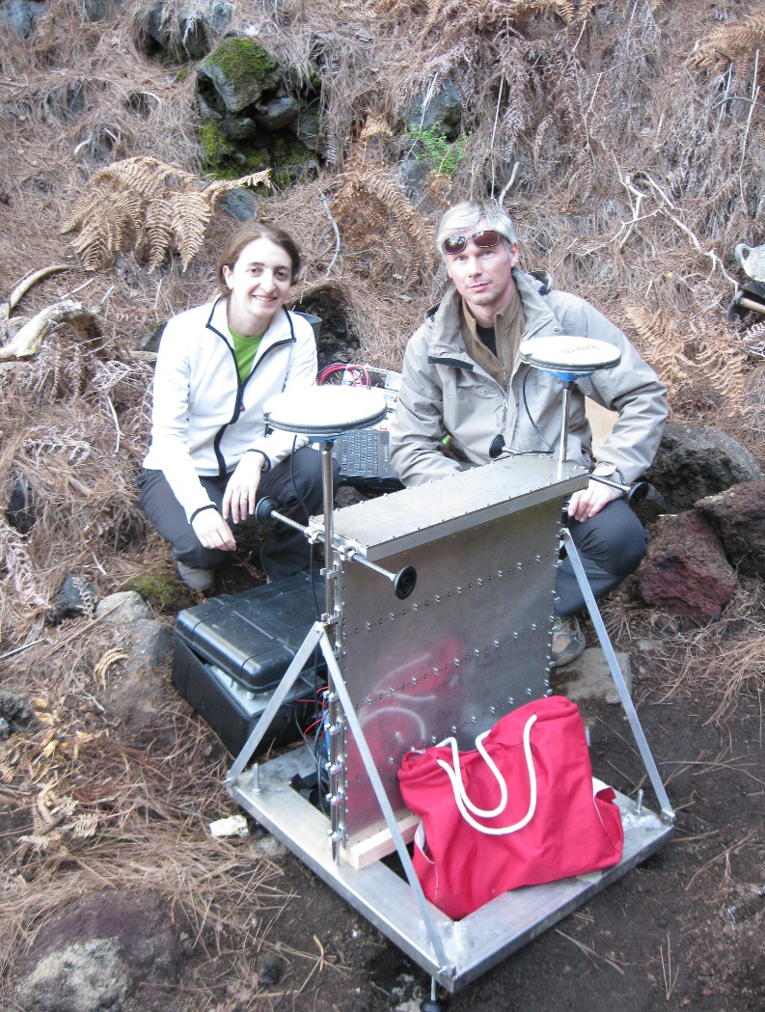
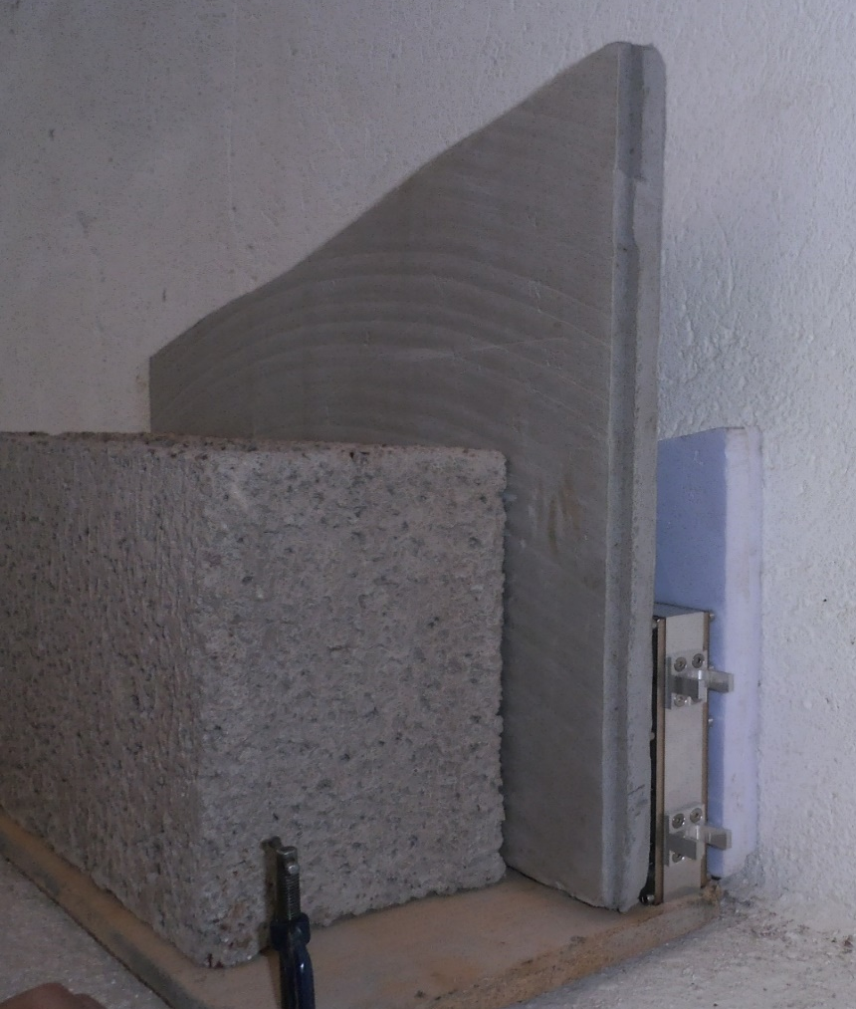
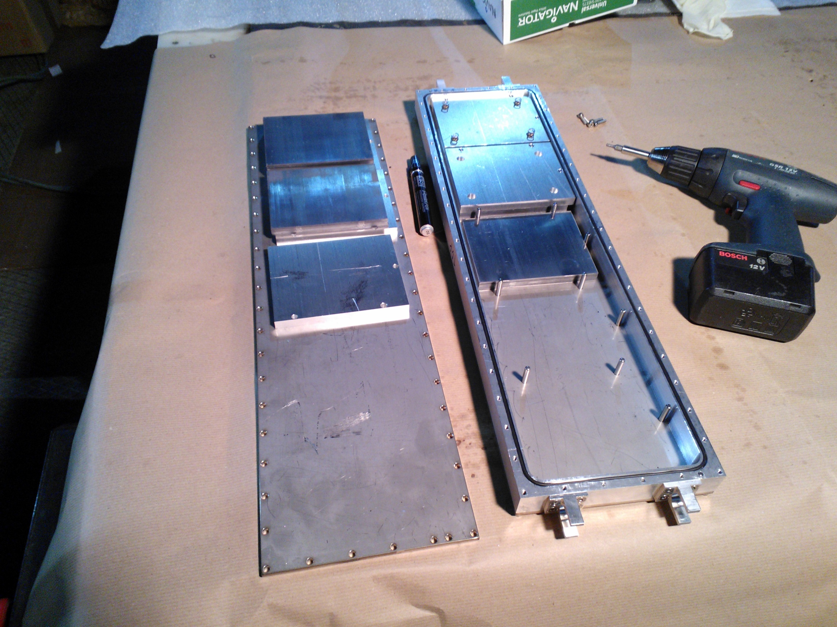
New compact ECC modules for muography were designed and constructed in INFN Napoli for Canary exposures. These modules were installed in 2014 on La Palma and on Teide mountain.
The modules are precise, robust, reusable and versatile
La Palma, CumbreVieja
Teide

Slide 26
Potential Italian contribution for future NET Muography projects
Emulsion scanning and analysis. We have huge experience and know how in this field
Mechanical design and installation of emulsion-based detectors – proved by Stromboli and La Palma exposures
Contribution to the data reconstruction analysis and simulation

Slide 27
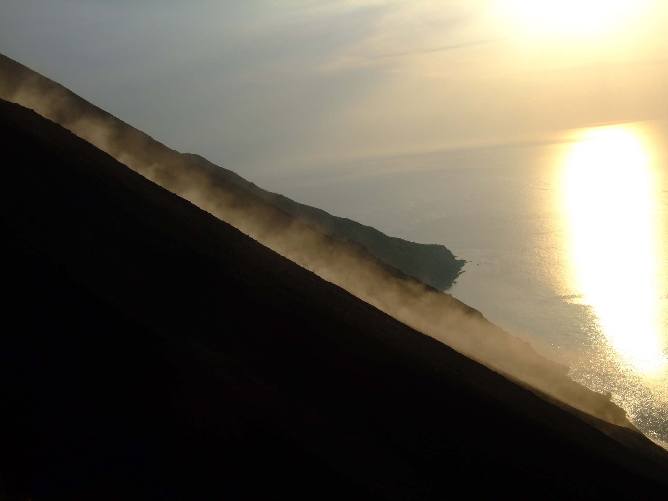
La Sciara del Fuoco al tramonto
Thank you for your attention!

Slide 28
Backup slides

Slide 29
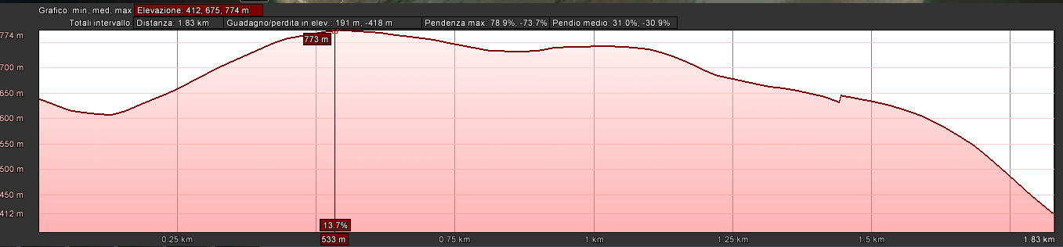
Example of the elevation profile
Tan =0.24
640 m
1.5 km
Stromboli has not so sharp cone - only a part of edifice can be
monitored with a middle-size muon telescope

Slide 30
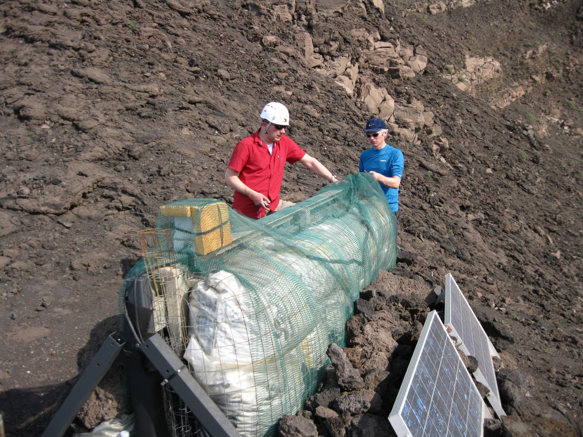
After 5 months of data taking we found the detector in a good shape well protected from sun heating and from moisture by rubber foam (armaflex) and by expanded clay

Slide 31
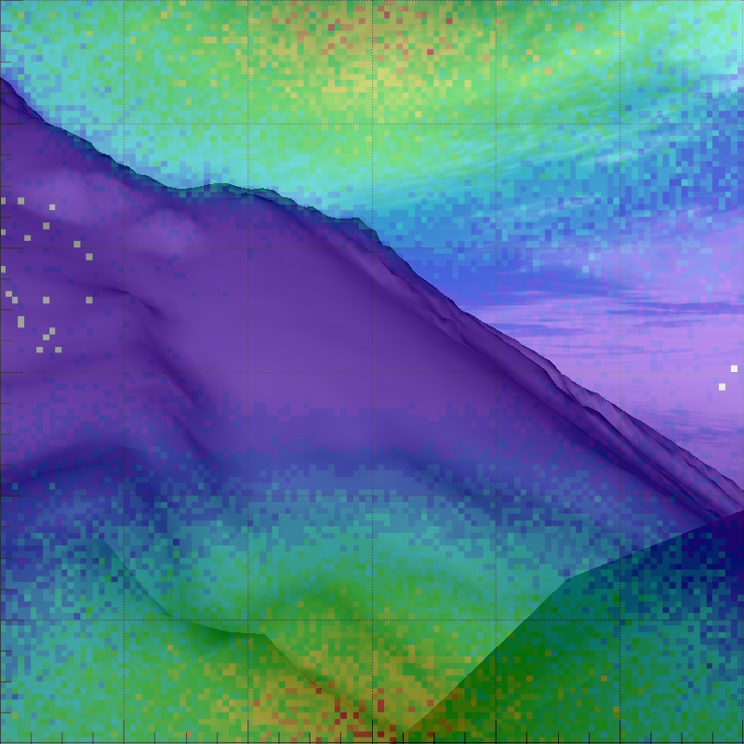
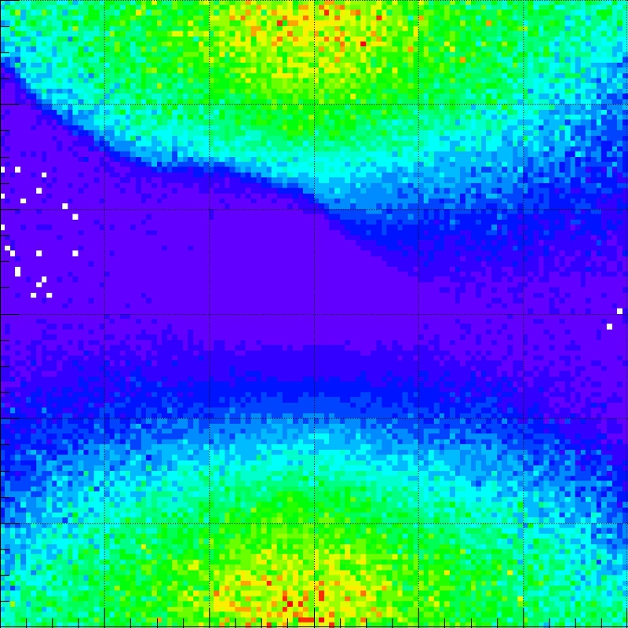
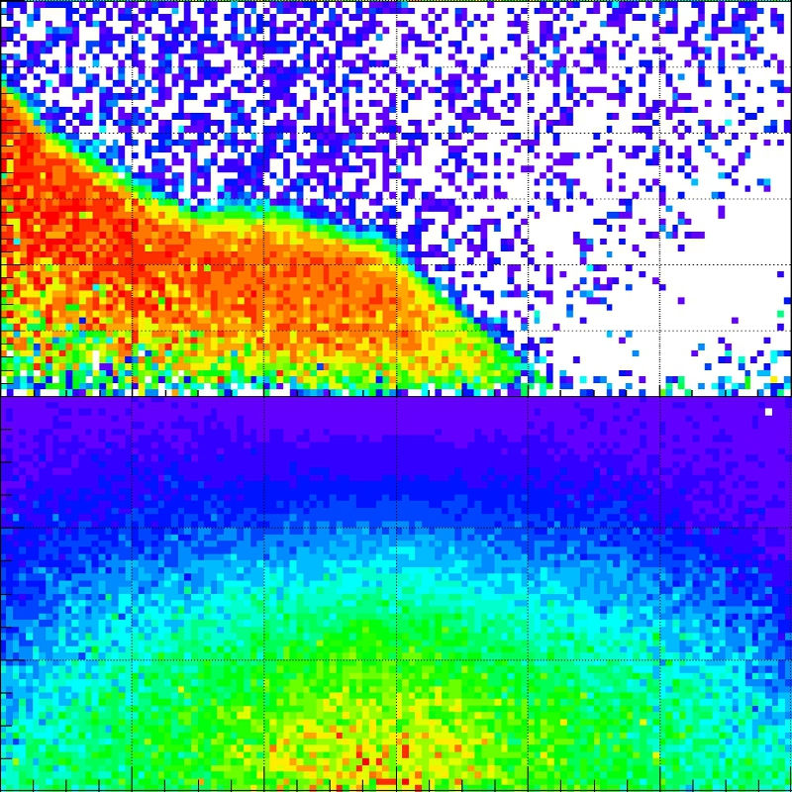
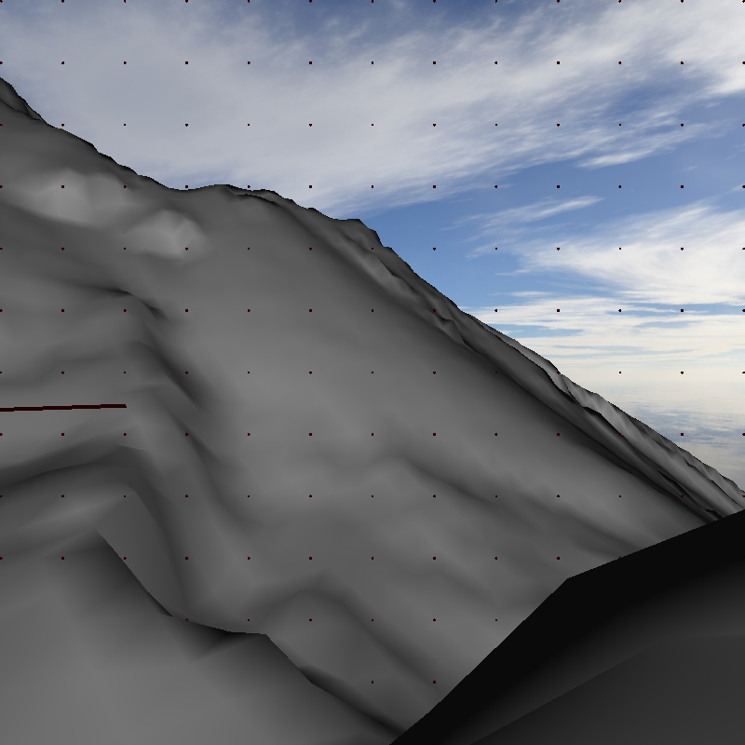
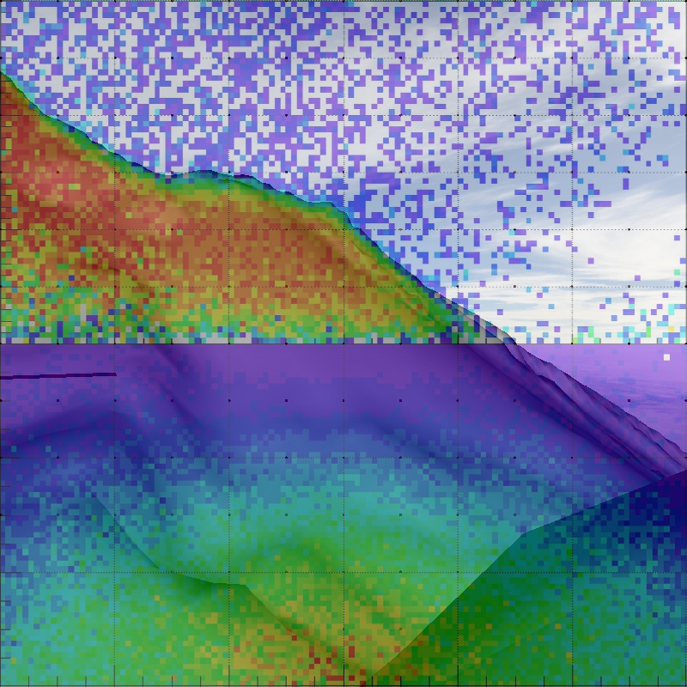
DEM – Data comparison
Dem view
Data tx-ty distribution
Dem-data superimposed
Data absorbed part
em-data absorbed superimposed

Slide 32
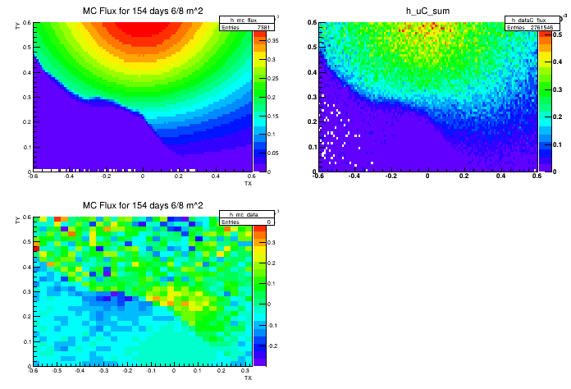
Data subtracted from MC
The first exercise of data-MC comparison on the incomplete statistics
We observe some data excess in a crater region in respect to MC, this can be a sign of lower density
It is difficult yet to judge about more fine effects
We plan to perform additional study to refine efficiency and background angular dependency corrections

Slide 33
Nuclear emulsions as a detector for muon radiography
Advantages
Perfect intrinsic angular resolution (better then 2 mrad)
Compact and easy to transport
No electricity required
Can be installed in a harsh environment
Modular, can be installed inside narrow locations
Disadvantages
No time information (can be solved in some cases)
Complicated and time-consuming data acquisition – required special scanning systems
accepted temperature range for long-term exposures is below 25 C
Single-use sensitive part
Able to provide new information complimentary to
other methods used for volcanoes survey

