Slide 1
Review on Modern Volcanology
Takeshi Nishimura
Department of Geophysics, Tohoku University
Understanding the Magma Activity beneath Volcanoes
Magma or volcanic fluids distributions
Magma locations and behavior
from geophysical observation
(seismic, GPS, tilt, strain meters, etc.)

Slide 2
Outline:
3D seismic velocity structure beneath volcanoes
Survey of magma reservoir/conduit
Dike intrusion
A case of failed eruption
Conduit process in shallow volcanic conduits
Bubbly magma/gas pocket

Slide 3
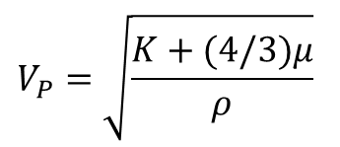
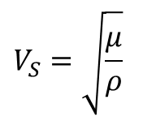
Survey of Magma by Seismic Tomography
From IRIS website
$$V_{P}=\sqrt{\frac{K+(4/3)μ}{ρ}}$$
P-wave velocity
S-wave velocity
K : Bulk Modulus
μ : Rigidity
ρ : Density
$$V_{S}=\sqrt{\frac{μ}{ρ}}$$

Slide 4
Seismic Tomography Image beneath North Eastern Japan
Grid Spacing
for tomography
H 12.5km
V 5-15 km
low V_{P}, low V_{S}, low V_{P}/V_{S}
Presence of H₂O
low V_{P}, low V_{S}, high V_{P}/V_{S}
Partial Molten Rocks
/ Magma Reservoir
Nakajima et al. (2001)

Slide 5
Seismic Tomography beneath Mt. Fuji
Deep Low Frequency Earthquakes (DLF), which are often inferred to be related to magma activity, are located at the region of:
low V_{P}, low V_{S}, low V_{P}/V_{S}
Supersaturated H₂O, CO₂
low V_{P}, low V_{S}, high V_{P}/V_{S}
Partial Molten Rocks
/ Magma Reservoir
Nakamichi et al. (2007)

Slide 6
Shallow Structure of Bandai Volcano
View of Mount Bandai from the north. Large crater formed by a sector collapse during the1888 Eruption
High-velocity zone is recognized beneath the summit.
No evidence on magma chamber & conduit at shallow depths.
These are common features of active volcanoes.
Yamawaki et al. (2004)

Slide 7
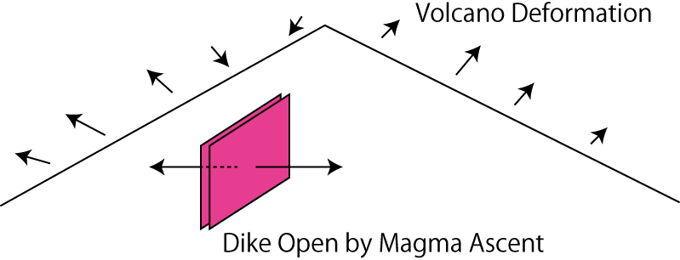
Magma Locations are Detected by Geodetic Measurements
GPS, Tilt meter, Strain meter
Spatial Distributions of Deformations enable us to estimate:
Locations of the pressure source
Shape of the pressure source (Dike, Spherical, etc.)
Strength of the pressure source (Volume Change)

Slide 8
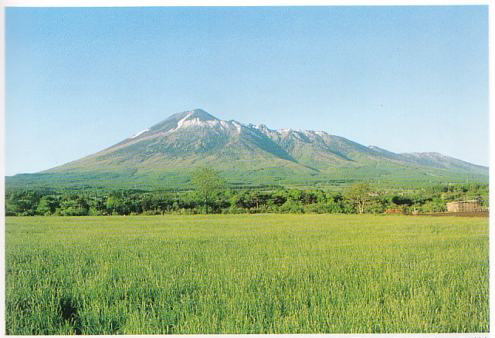
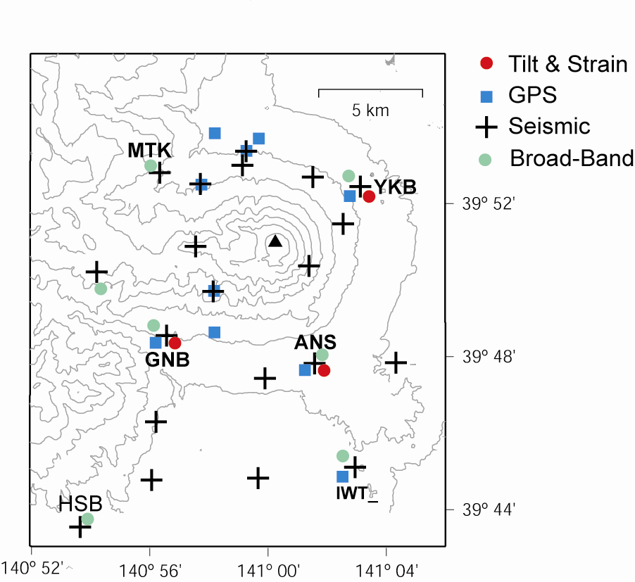
Failed Eruption: 1998 Activity of Iwate Volcano, Japan
Permanent stations
Borehole
tilt & strain
SP seismometer
>20 SP seismometers
6 STS-2 stations
3 tilt& strain meters
>10 GPS stations

Slide 9
Why the magma did not migrate upward but horizontally intrude?
Magma rises up due to buoyancy:
Magma can migrate up when the density of magma is less than that of the surrounding rocks

Slide 10
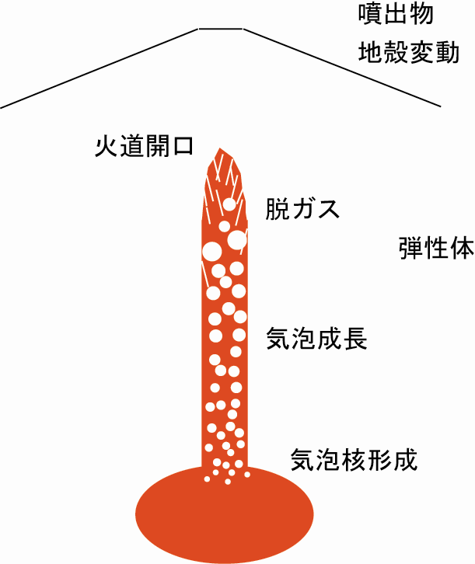
Schematic illustration of Magma Ascent in Shallow Depth
Views from
Theoretical considerations & Geological sample analyses
Deformation &Pylocrasts
Opening of Conduit
・Without Degassing
→ Explosive Eruption
（Plinian-type）
・With Degassing
→ Non-Explosive Eruption
（Lava Dome）
Degassing ,
Out gassing
Gas bubble growth
In Situ Observation of Volatile Behavior is Necessary, but
Plinian-type rarely occur.
Nucleation of gas bubbles

Slide 11
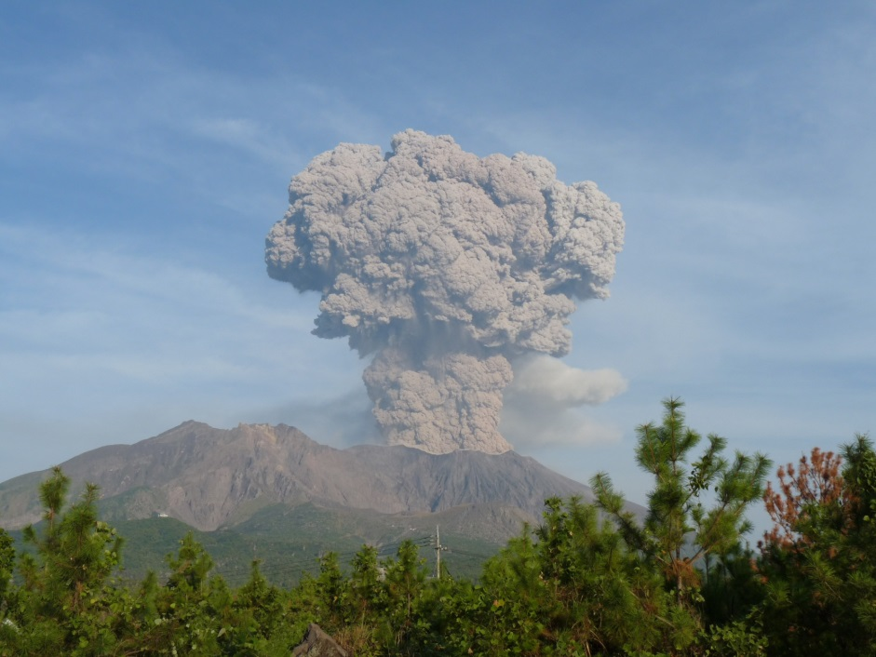
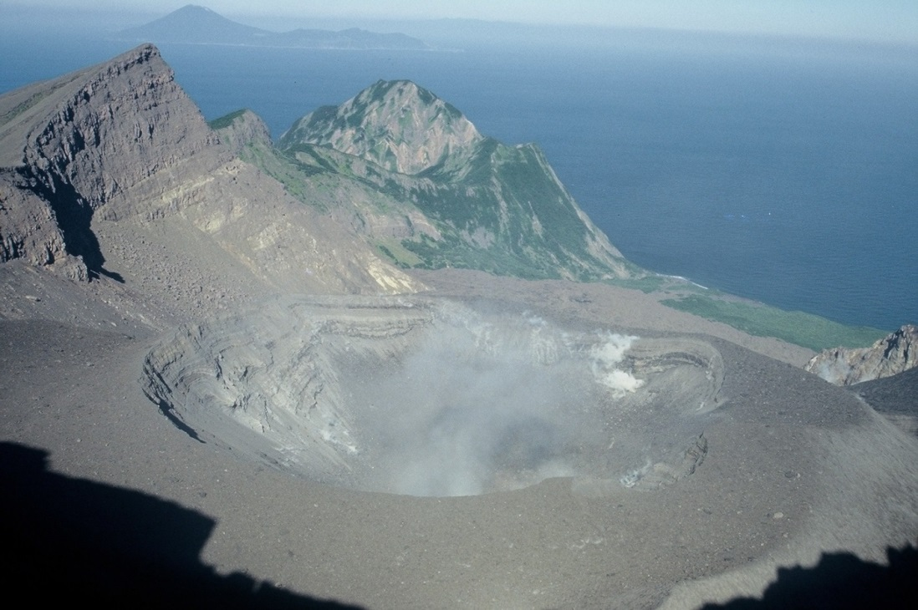
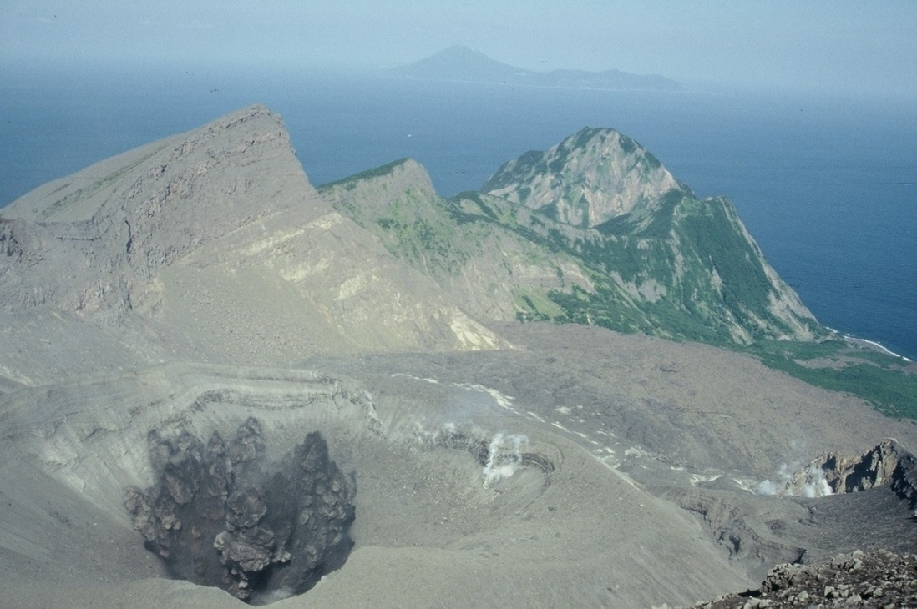
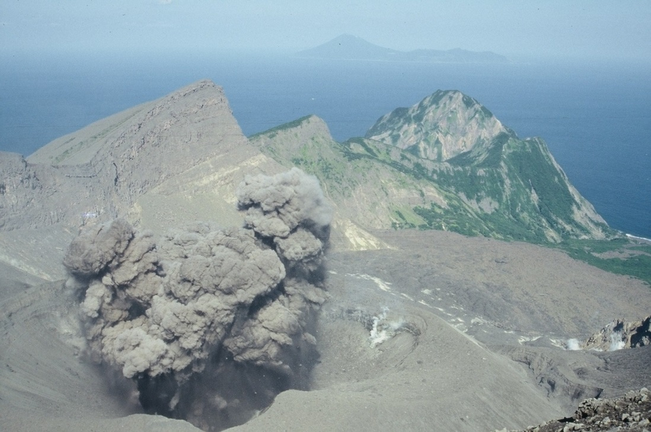
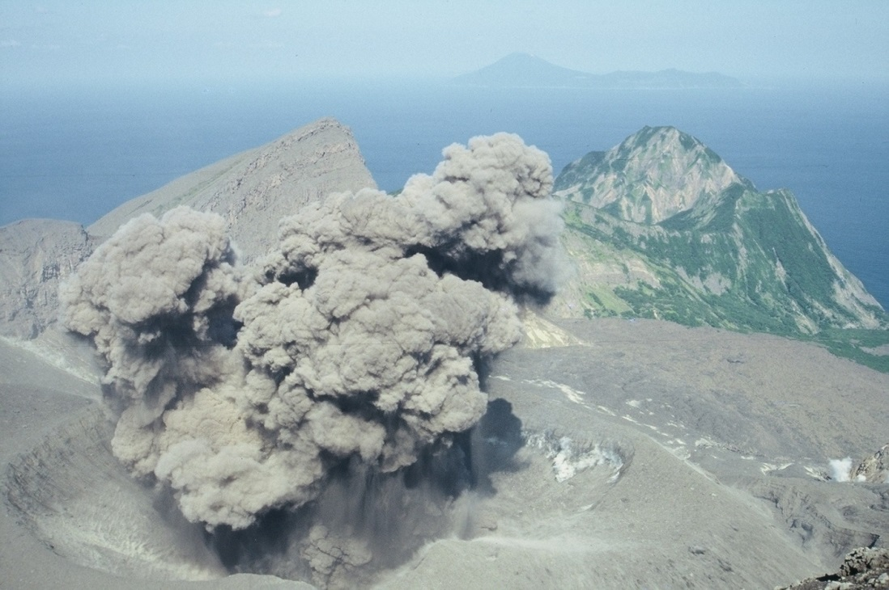
Vulcanian eruptions
Good observation targets to clarify the magma behavior
Short-duration
Repeatability
Small magnitude
Observations close to active vents
Sakurajima (photo by Dr. Yokoo)
Suwanose-jima

Slide 12
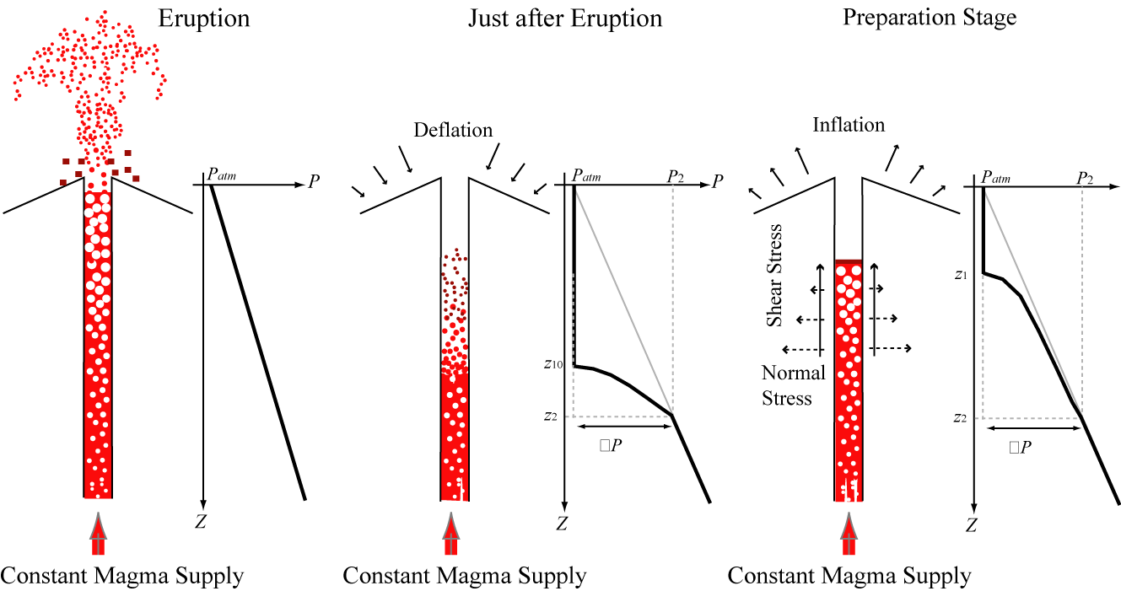
Repetitive Eruption from Open Conduit
ΔP
ΔP

Slide 13
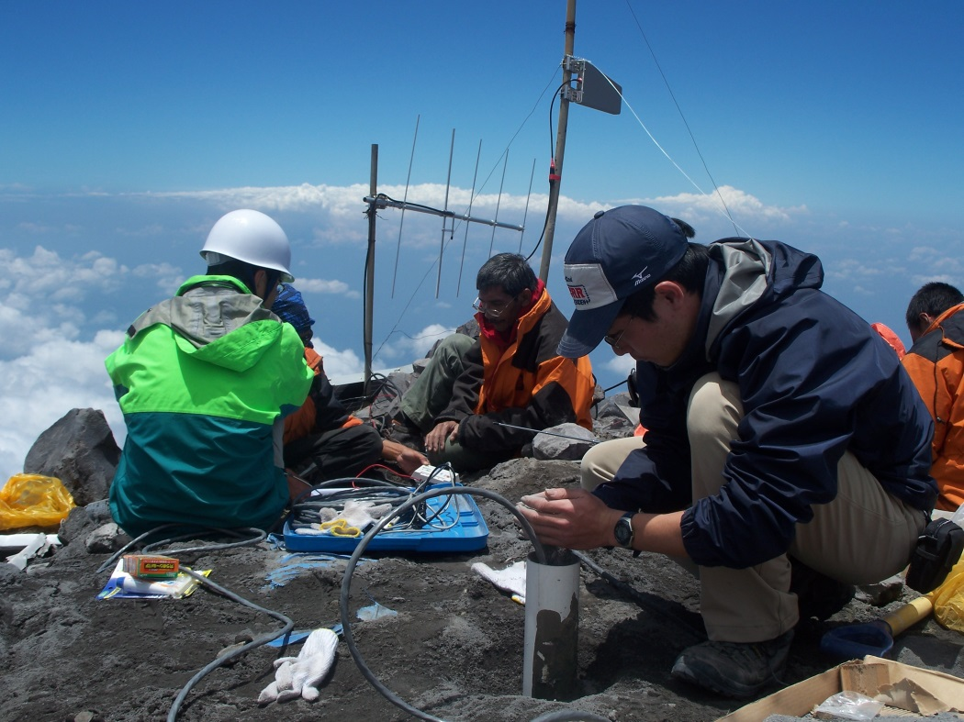
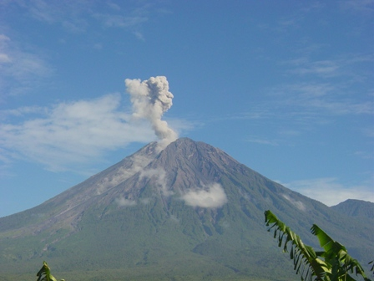
Tilt meter can detect a tiny uplift toward the active crater which are caused by pressurization of shallow conduit
Semeru volcano explodes every a few to tens of minutes
Tilt meter
Installation of tilt meter on the summit of Semeru volcano, Indonesia
Example of observation

Slide 14
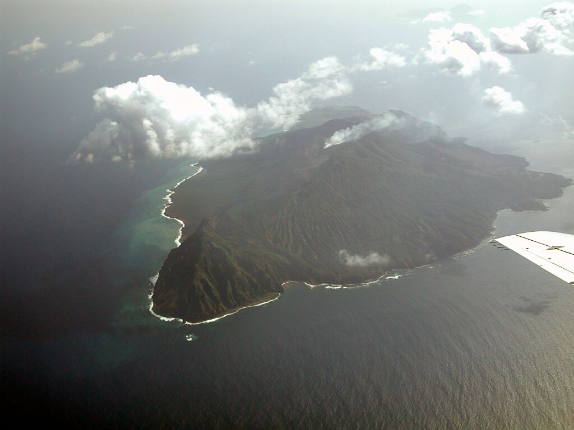
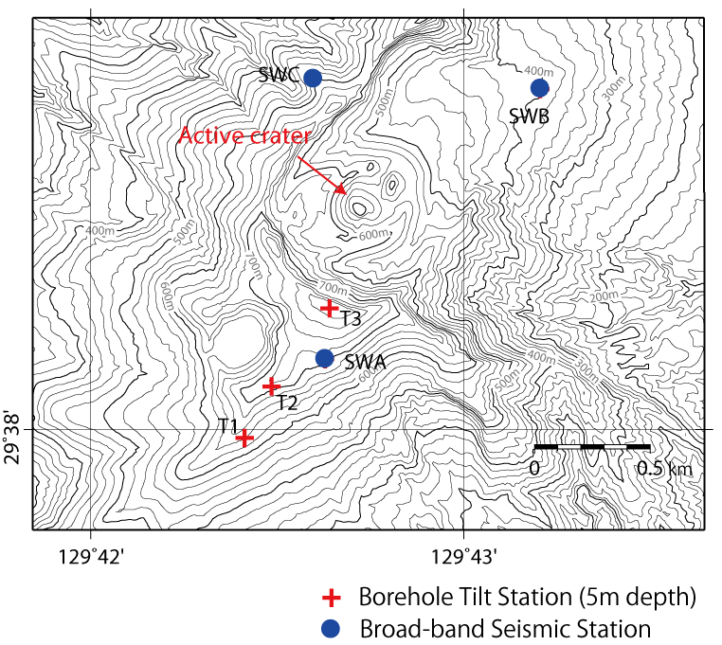
Seismic and Tilt Stations of Suwanosejima Volcano, Japanr
Active Crater
(after HP of Japan Coast Guard)
4 km and 8 km wide in EW and NS directions. 799m height

Slide 15
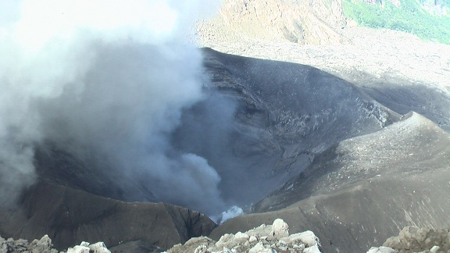
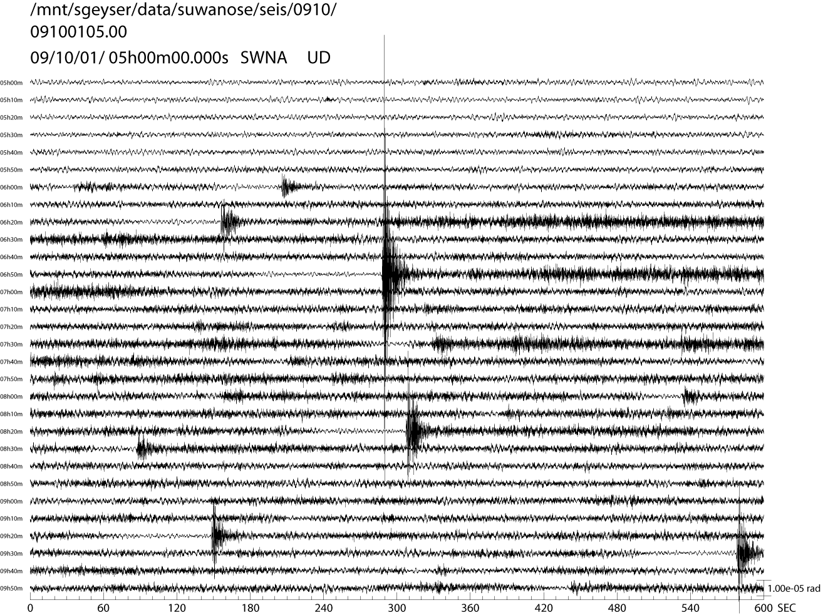
Monitor Seismograms
Ash emissions generate continuous tremor
Explosion Earthquake (EX)
Continuous Tremor
EX
EX
EX
EX

Slide 16
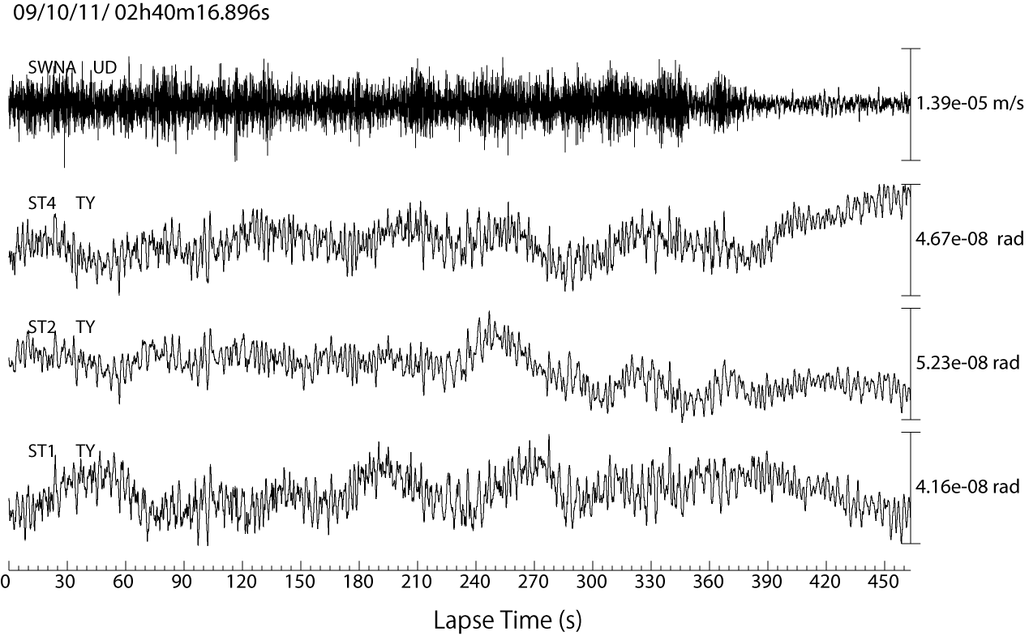
Seismic and Tilt Data Just Before Explosion
Explosion
Continuous Tremor associated with Ash Emissions
Seismic UD
Uplift toward the crater
Tilt 3 NS 350 m
Tilt 2 NS 700 m
Tilt 1 NS 1000m
Accumulation of ash/gas constantly supplied from deep conduit is inferred to be the origin of explosion

Slide 17
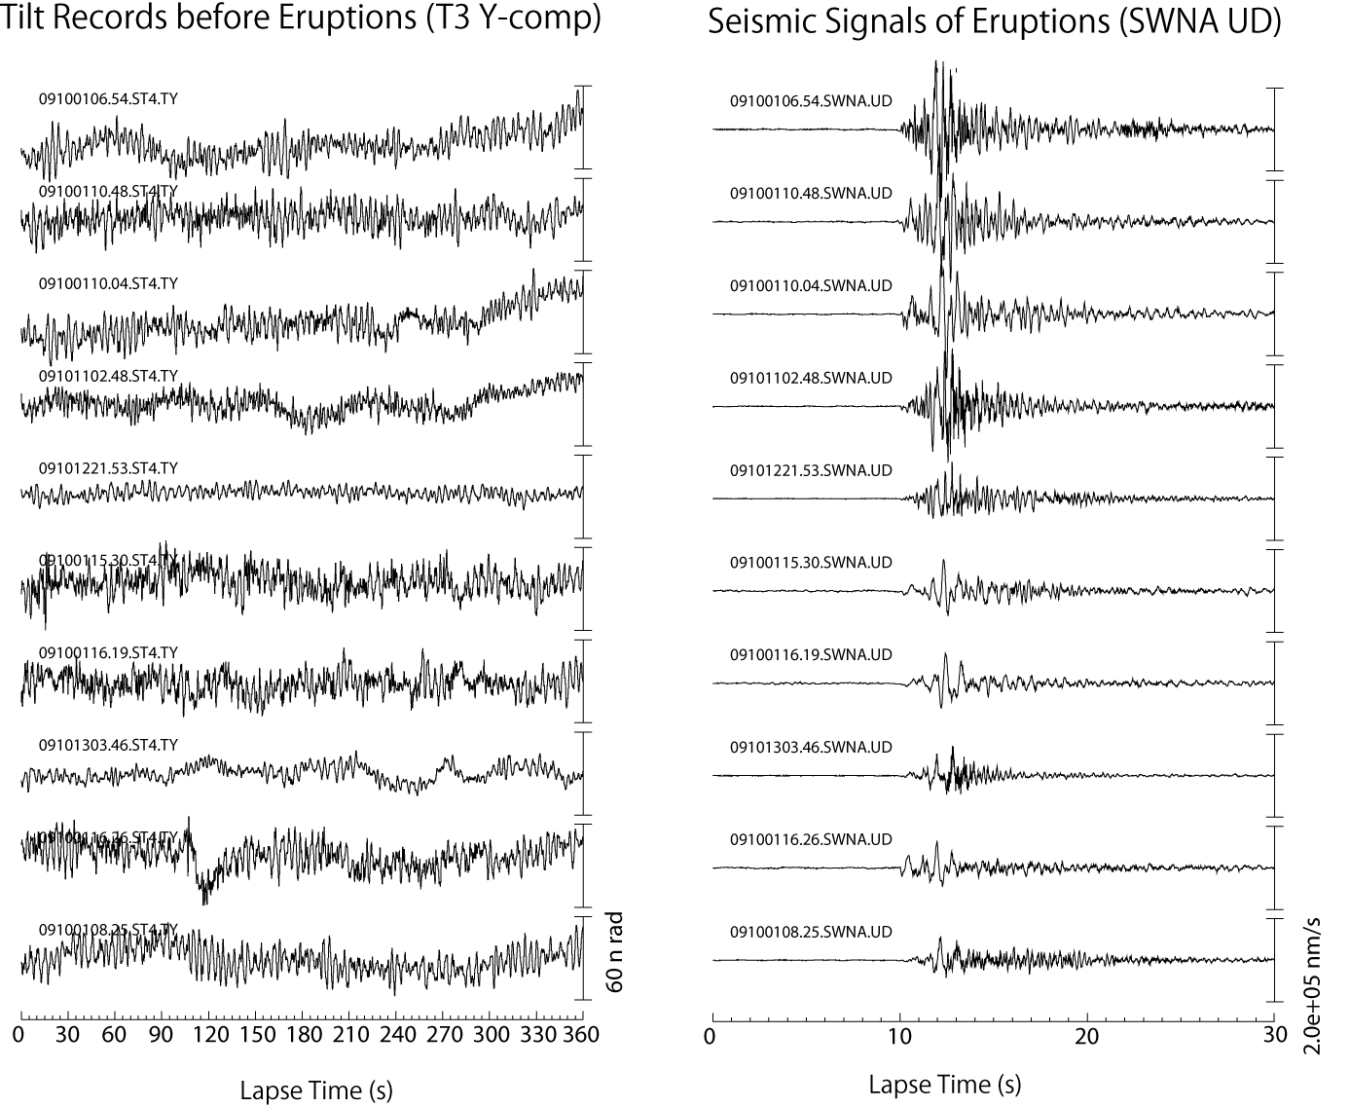
Uplift toward the crater
Time of Eruption

Slide 18
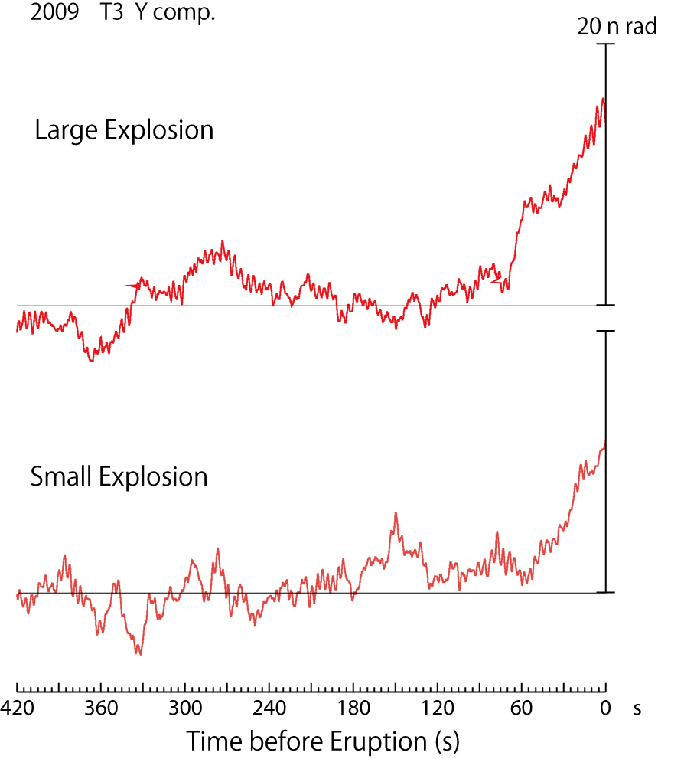
Comparison of Tilt Stacked for Seismic Amplitude
Average Amplitude of Explosion Earthquakes
184 μ m/s
Large Explosions accompany :
Large amplitude and
Long Duration of Inflation
49 μ m/s

Slide 19



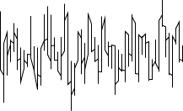
Possible Mechanism of Explosion at Suwanosejima
Gas flow is stopped by a plug formed at the top of conduit
Gas/Ash Flux
Volcano Inflation
Plug: Magma rheological changed due to cooling, degassing, crystallizing or stiffening
Pressure Build Up
Probably, low-density
Continuous tremor
Continuous tremor
Constant Gas/Ash Supply

Slide 20
Summary
Density structure is quite important to understand the magma processes.
Three dimensional heterogeneity of the density in volcanic edifices may control the magma ascent.
Recent geophysical measurements at active volcanoes suggest gas phase expansions in magma, which must be low-density, at shallow depths. But, not confirmed.
Shallow conduit shape is an important factor to understand the volcanic eruptions.

