Slide 1
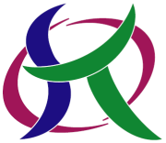
Muography at Kyushu University
MUOGRAPHERS 16 General Assembly
November 7, 2016 Delegation of the European Union to Japan
~ from Education to Application ~
Department of Advanced Energy Engineering Science
Kyushu University
Tadahiro Kin
Notes:
point of view from an engineer

Slide 2
Muography at Kyushu University
Contents
History of Muography Study
at Kyushu University
Prototype Muography Detector
(Current Status)
Summary and Future Tasks

Slide 3
Muography at Kyushu University
Contents
History of Muography Study
at Kyushu University
Prototype Muography Detector
(Current Status)
Summary and Future Tasks

Slide 4

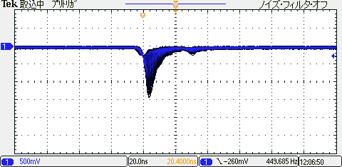
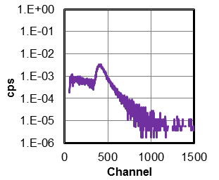
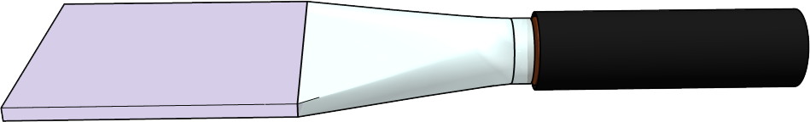
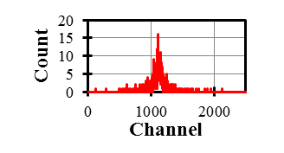
Muography at Kyushu University
History of Muography Study at Kyushu University
Cosmic-ray Muon Measurement
Available Everywhere on Earth
Many Education Institute Adopted for Education of…
Important Technique
in Radiation Metrology
Coincidence Detection
Time of Flight Method
Sufficient Intensity ~1 (μ/cm²/min)
MCA
PMT1
Signal
IN
Amplifier
Channel Divider
Almost 100%
Detection Efficiency
Quad CF Discri.
Coincidence
Logic Level Adapter
PMT2 Signal

Slide 5
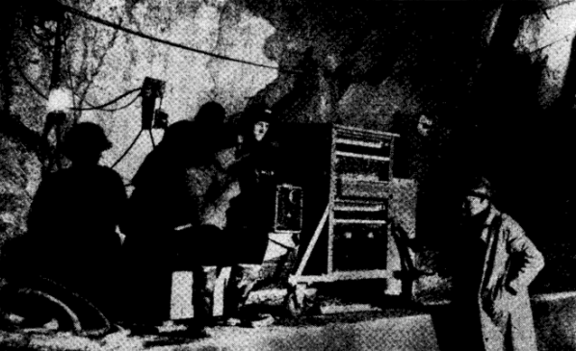
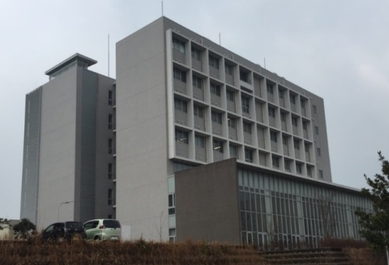
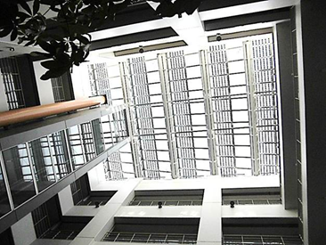
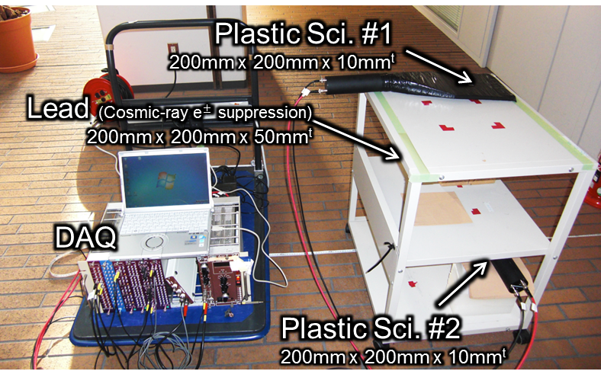
Muography at Kyushu University
History of Muography Study at Kyushu University
“One dimensional” Muography by Simple Detection System
George: Measurement of overburden thickness by cosmic-ray muon intensity (1955)
C-Cube, Kyushu Univ.
Open
Ceiling
Space
Room Area
Room Area
Measured Floor
Thin roof made of glass
The space is surrounded by rooms
15 points measured
(1m step)
Library
Coincidence Detection with two plastic scintillators
Cosmic-ray e± suppression
→ a few % of contamination
2 hours for each position
→ Statistical Error < 2%

Slide 6
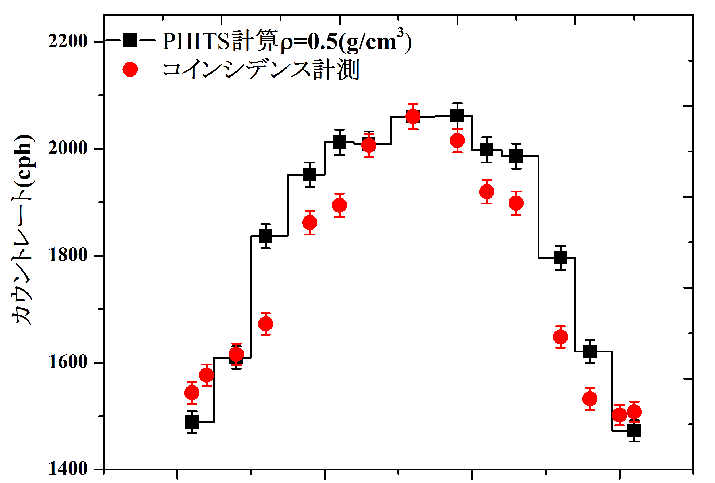
Muography at Kyushu University
History of Muography Study at Kyushu University
Results
Open
Ceiling
Space
Room Area
Room Area
Simulation by PHITS [1]
Measured Floor
Present
15 points measured
(1m step)
Library
PHITS^{[1]} simulation
→ Bulk density 0.5 g/cm³
(normal concrete building^{[2]})
→ EXPACS^{[3]}
Counting Rate (cph)
Center of Open Ceiling Space
The Experimental Attenuation Rate is very consistent with PHITS result.
-1.5
-1.0
-0.5
0.0
0.5
1.0
1.5
Distance from the Center (m)
[1] T. Sato, et al., J. Nucl. Sci. Technol. 50:9, 913-923 (2013)
[2] S. Minato, Appl. Radiat. Isot. 37, 941-946 (1986)
[3] http://phits.jaea.go.jp/expacs/index.html
Particle and Heavy Ion Transport code System
EXcel-based Program for calculating Atmospheric Cosmic-ray Spectrum

Slide 7

Muography at Kyushu University
History of Muography Study at Kyushu University
If the plastic scintillators had position sensitivity, we could obtain two dimensional image.
This is the starting point of our study!

Slide 8
Muography at Kyushu University
Contents
History of Muography Study
at Kyushu University
Prototype Muography Detector
(Current Status)
Summary and Future Tasks

Slide 9
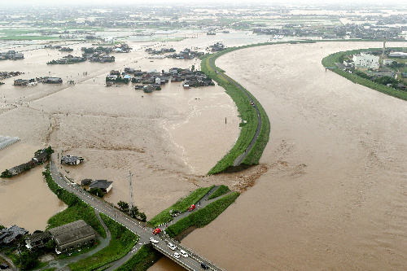
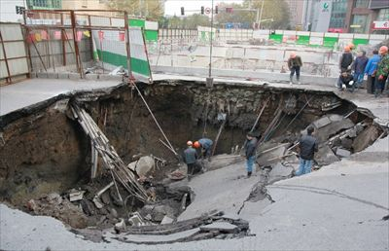
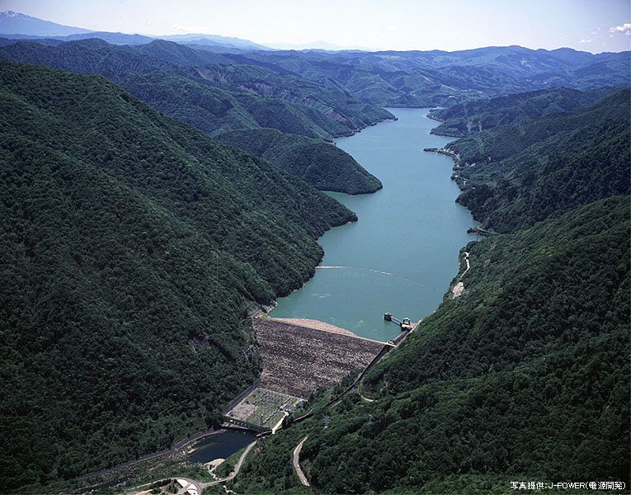
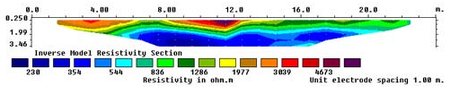
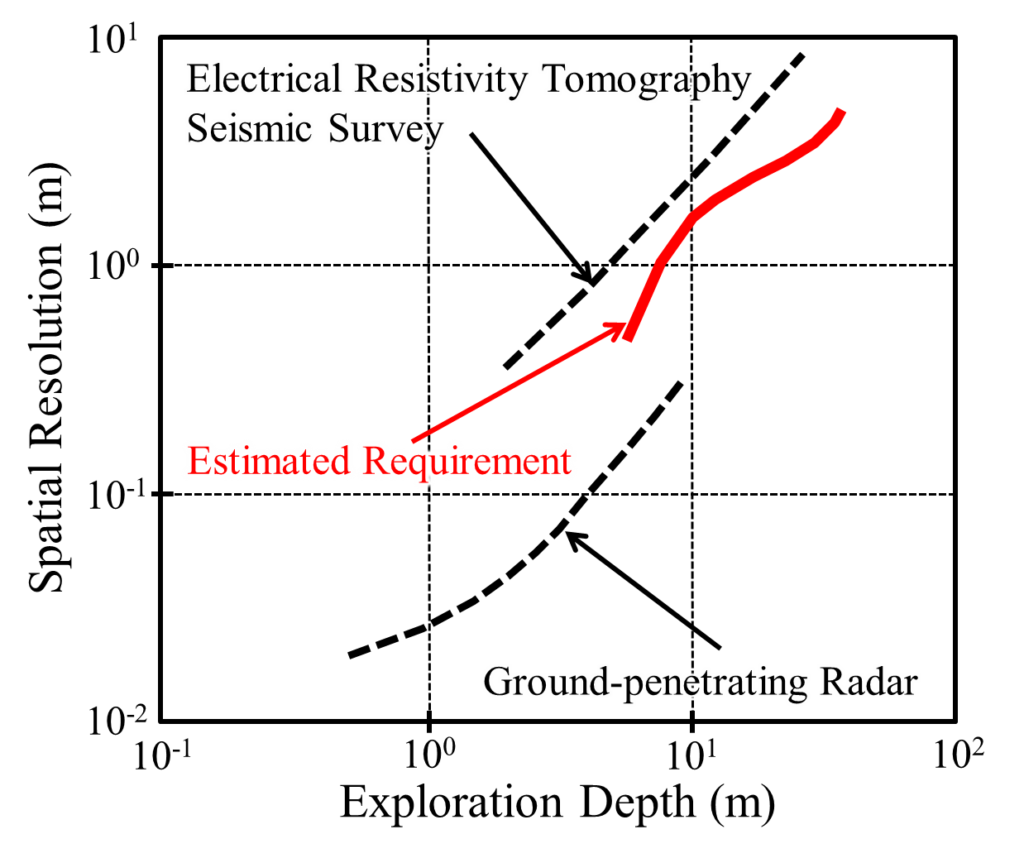
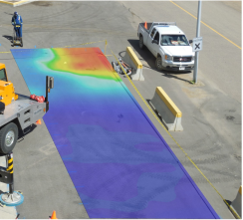
Muography at Kyushu University
“Present” Motivation
Disaster Defense, Operation & Maintenance
2012, Breached Levee
(Fukuoka, Japan)
2012, subsidence (China)
Miboro Dam (55 years old)
・Seismic Survey
・Electrical Resistivity Tomography
Deep region with rough resolution
Gap
・Ground-penetrating Radar
Shallow region with high resolution
Muography covers “the gap”
of existing exploration technique.

Slide 10
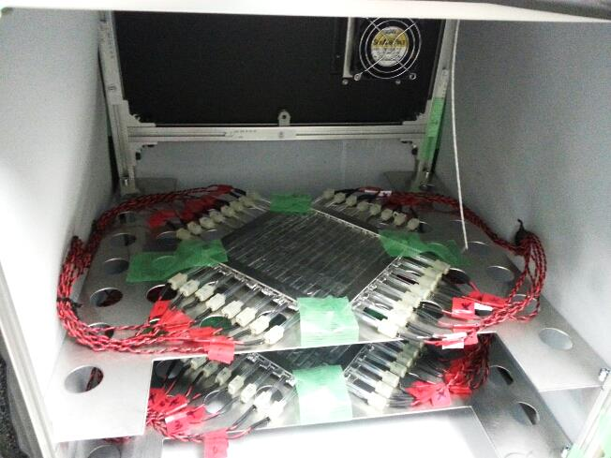
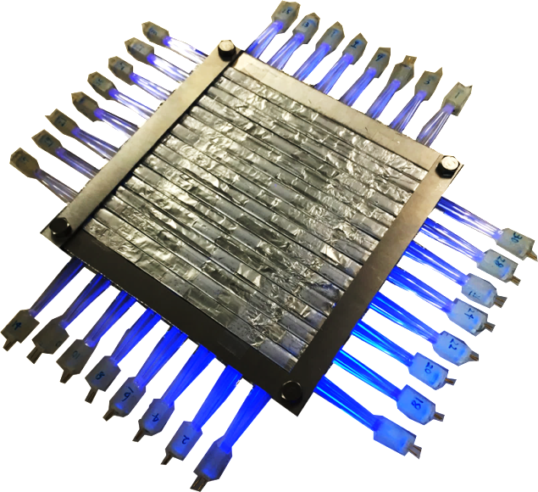
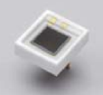
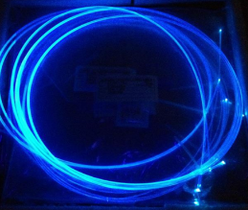
Muography at Kyushu University
Prototype Detector Development
Design of Prototype Muography Detector
muon
140 mm
32 MPPCs
Peltier Cooling & Heating Unit
mu-PSD 1
mu-PSD 2
140 mm
100 mm
PSF
mu-PSD
Plastic Scintillating Fiber (2mm x 2mm, SQ)
Multi Pixel Photon Counter (MPPC, SiPM)
Temperature Control System (ΔT ~0.3 ºC)
EASIROC Module[1] (64ch MPPC readout module)
Portable （450x450x450mm）
Resolution ~30msr
Cost: ~$18,000
[1] I. Nakamura, et al., Nucl. Inst. Meth. A, 787, 376-379 (2015)
Notes:
PSF \600k, Electronics \300k, MPPC \600k, Temperature Control System \200k, Other \100k -> \1,800k

Slide 11
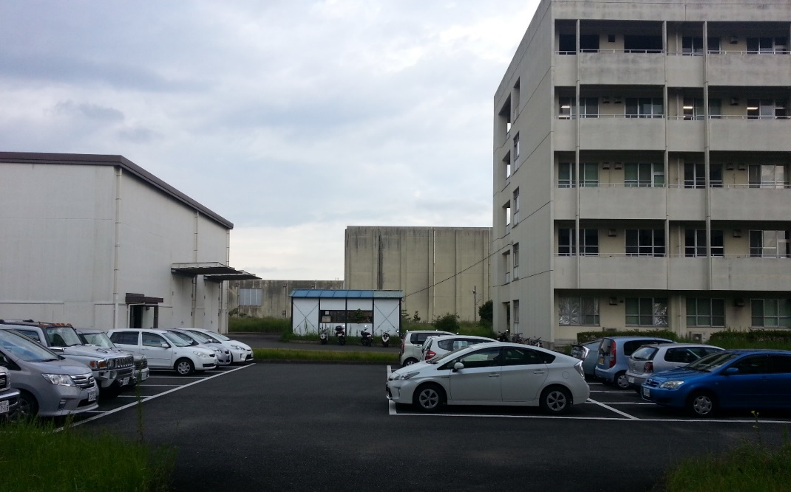
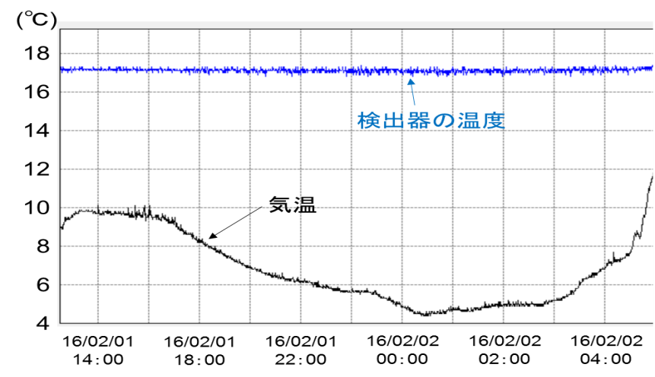
Muography at Kyushu University
Open-air Measurement
Detector Stability Test
Measurement of Counting Rate without Any Obstacle
0~40º Open Sky
40º
West
East
Location:
・ Chikusi, Kyushu Univ.
→ Altitude: 39.3m
・ No obstacle below 40 deg. Zenith Angle
・ Prefabricated Room: Thin Walls and Roof
Measurement Time：
・ Three Runs of 3, 4,and 3 days
→ Total: 235 hours
Detector Temperature： 17.0±0.3 ºC
Experimental Room
Detector
Room

Slide 12
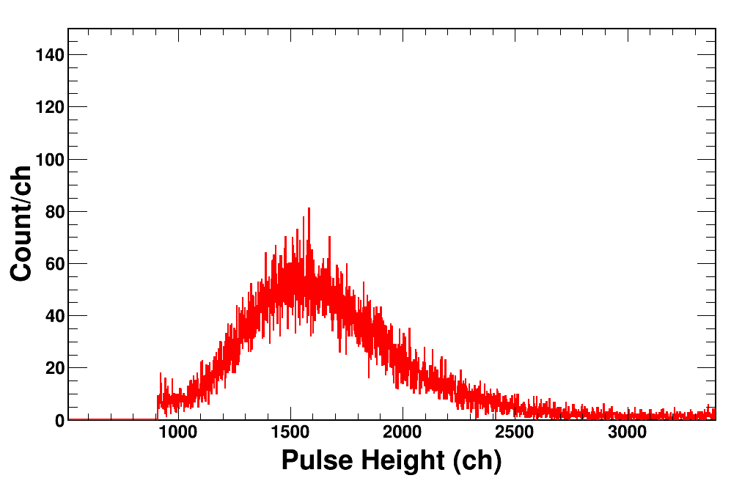
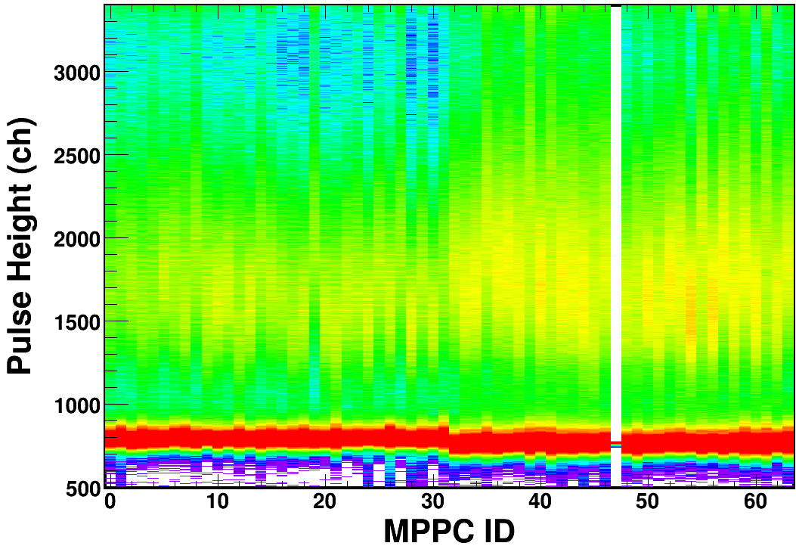
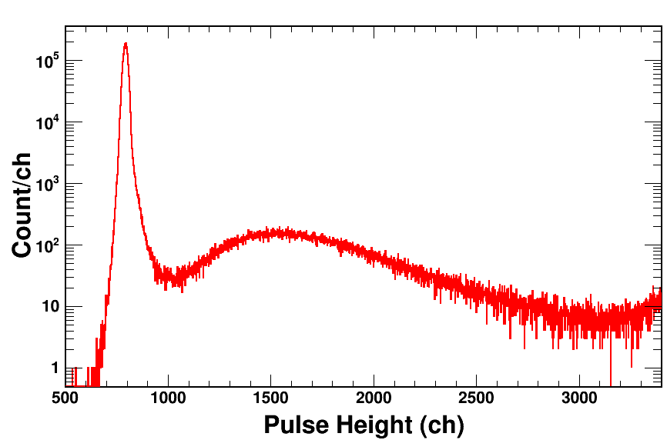
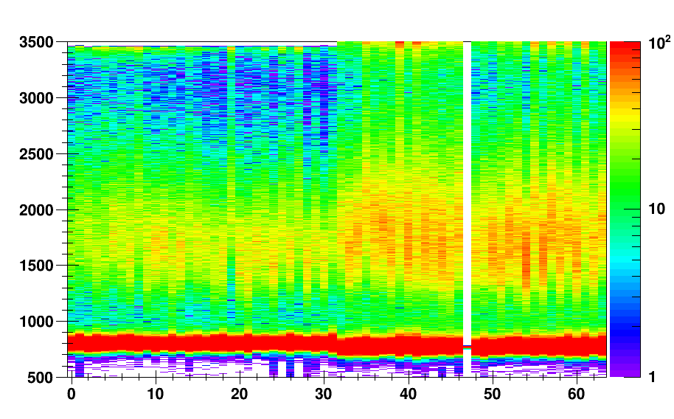
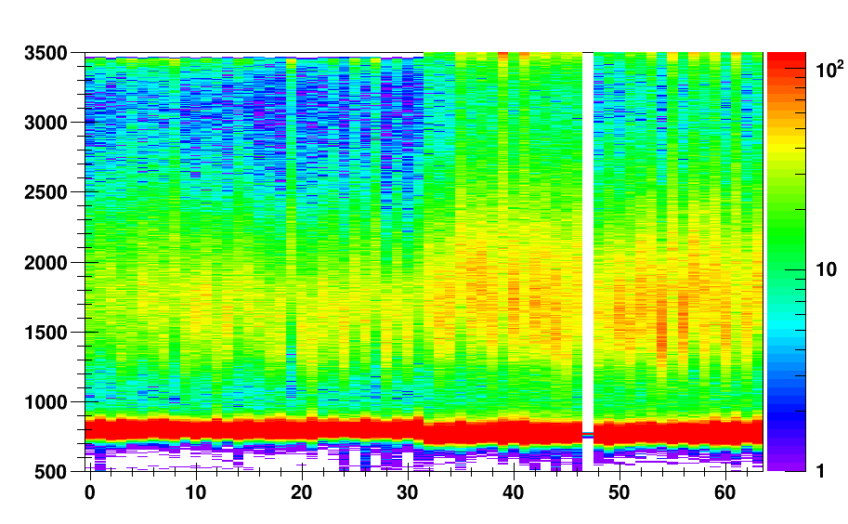
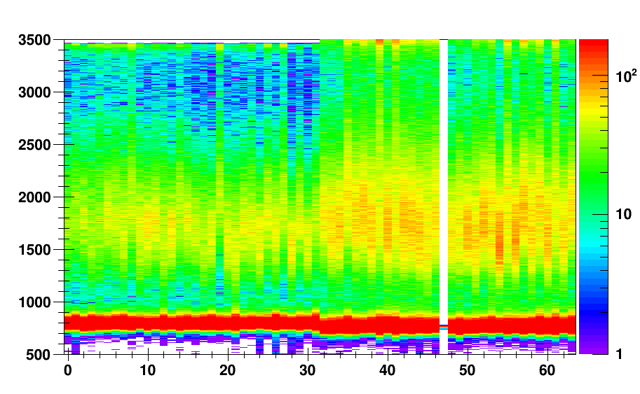
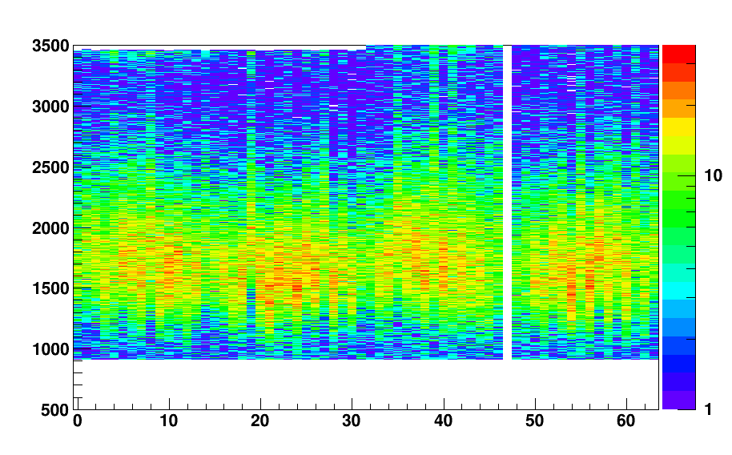
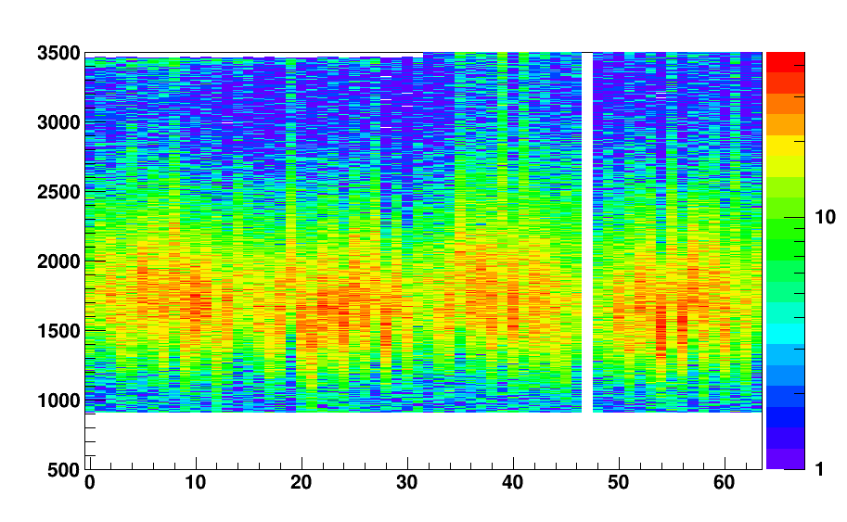
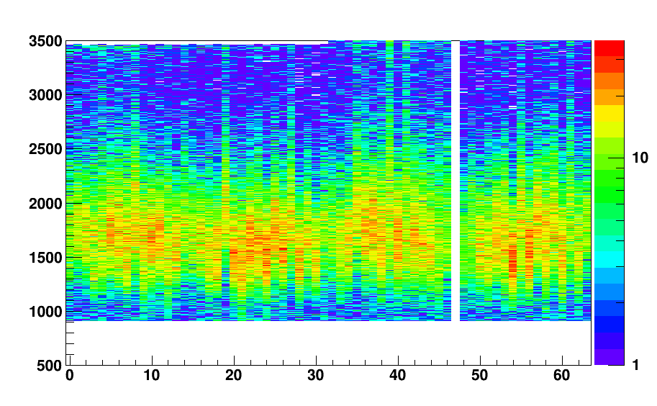
Muography at Kyushu University
Open-air Measurement
Pulse Height Distribution and its Fluctuation
Dark Count
Muon (Landau Dist.)
y-projection of MPPC#30
Preamp for this MPPC was broken.
Threshold = 900ch, 4-coincidence （x₁,x₂,y₁,y₂）
exp. #1 (3 days)
exp. #2 (4 days)
exp. #3 (3 days)
Pulse Height (ch)
The main component of muon events never fell below the threshold level
MPPC ID
MPPC ID
MPPC ID

Slide 13
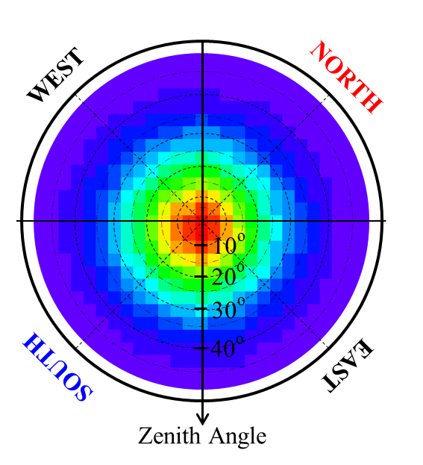
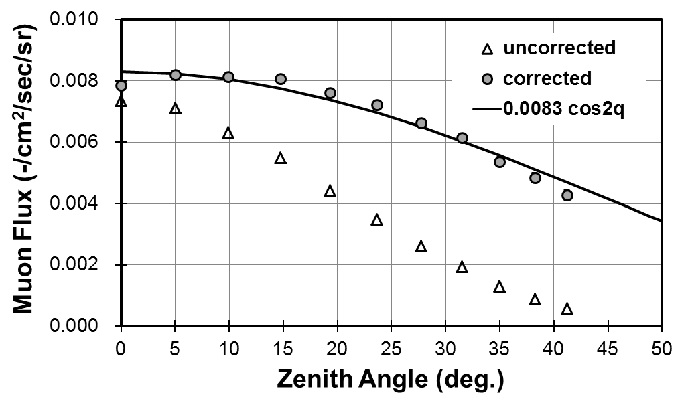
Muography at Kyushu University
Open-air Measurement
8.3x10⁻³ cos²θ
Acceptance Correction
Summary of the Results
Sufficient Stability for Long Term Measurement
Muon Flux was Successfully Measured
→ Consistent with well-known Cosine Square Distribution

Slide 14
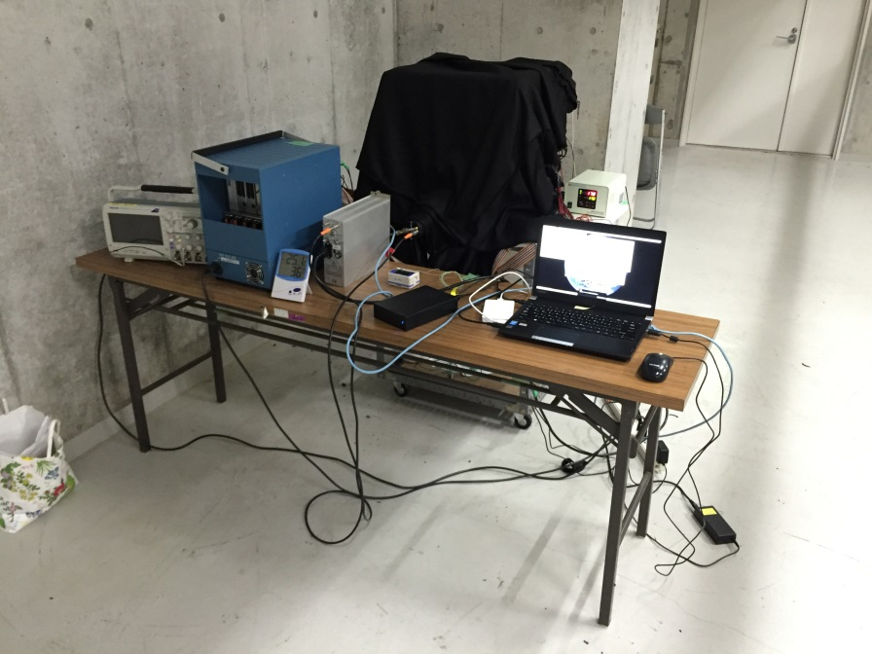
Muography at Kyushu University
Muography Test Measurement
C-Cube, Kyushu Univ.
Open
Ceiling
Space
Room Area
Room Area
Library
detector position
Basement
Location:
・ C-Cube, Chikusi, Kyushu Univ.
・ 3.5 meters below the ground
Measurement Time：
・ 390 hours (16 days)
Detector Temperature：
・ 17.0±0.3 ºC
Prototype Muography Detector

Slide 15
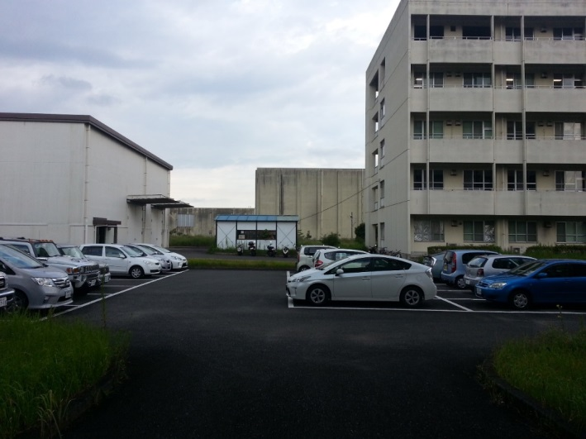
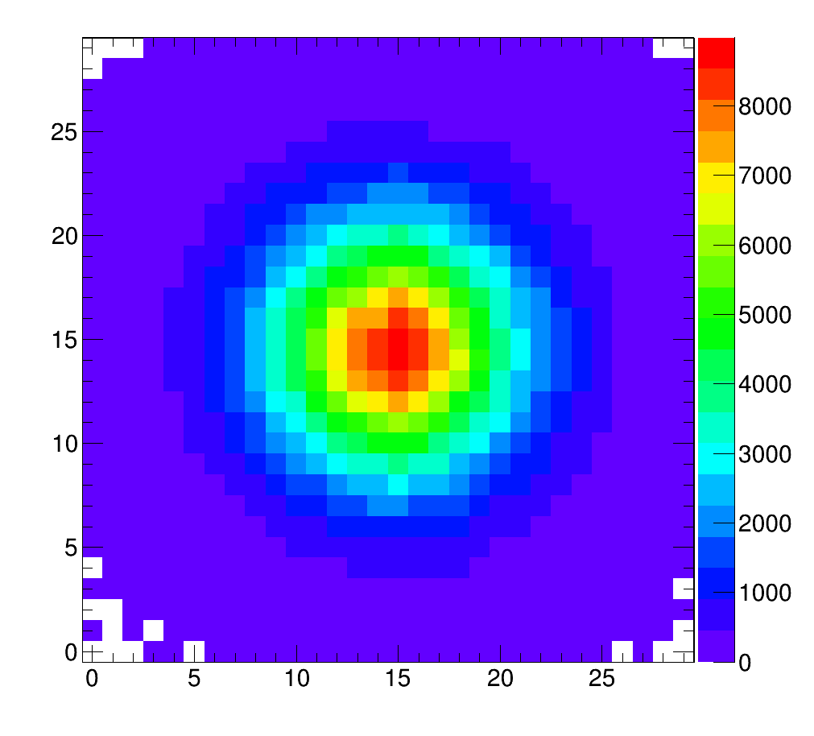
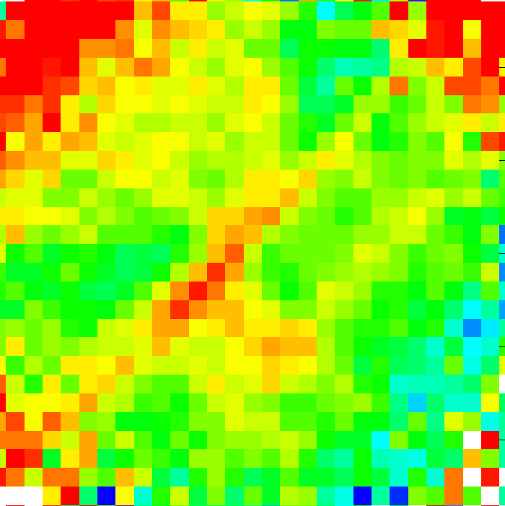
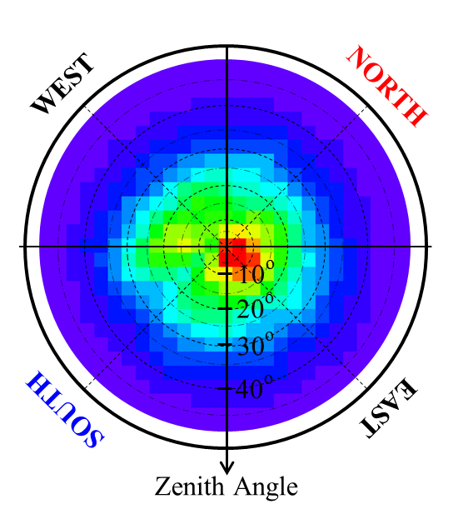
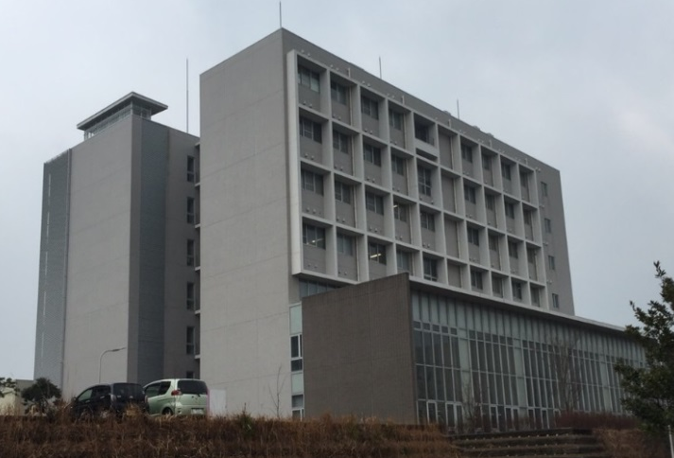
Muography at Kyushu University
Results and Discussion
0~40º Open Air
Attenuation Rate Map
40º
Attenuation Rate
West
East
Low
High
Experimental Room
WEST
NORTH
Open-air Measurement
Muon Intensity
Low
High
Muography Test Measurement
10º
C-Cube, Kyushu Univ.
20º
30º
40º
SOUTH
EAST
Detector was placed at 3.5m below Ground
Zenith Angle

Slide 16
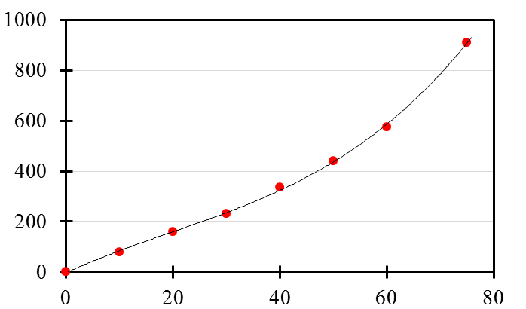
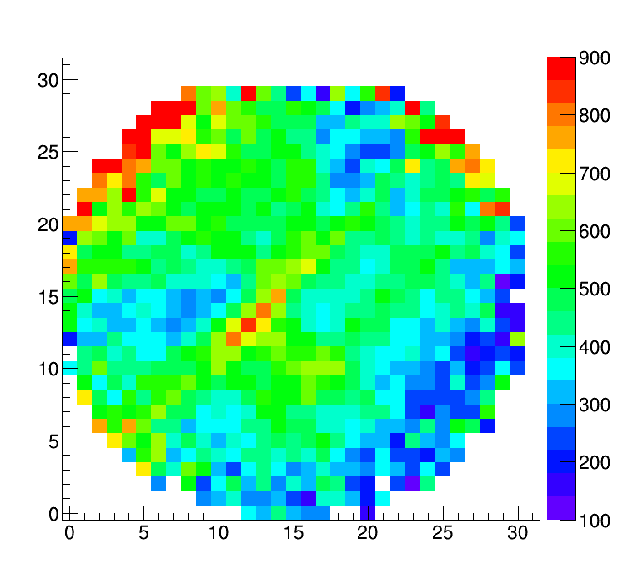
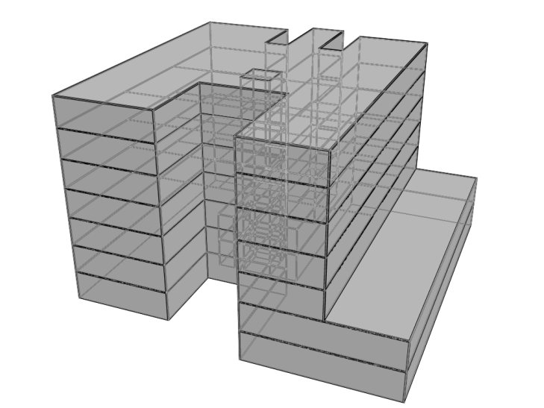
Muography at Kyushu University
Results and Discussion
Conversion from Attenuation Rate to Concrete Thickness
by PHITS
WEST
NORTH
Concrete Thickness (cm)
B
A
Concrete Thickness (cm)
10º
Attenuation Rate (%)
20º
A
30º
B
40º
SOUTH
EAST
Zenith Angle
Thickness read out from Drawing
A: 850～900 cm
B: 250～300 cm

Slide 17
Muography at Kyushu University
Contents
History of Muography Study
at Kyushu University
Prototype Muography Detector
(Current Status)
Summary and Future Tasks

Slide 18
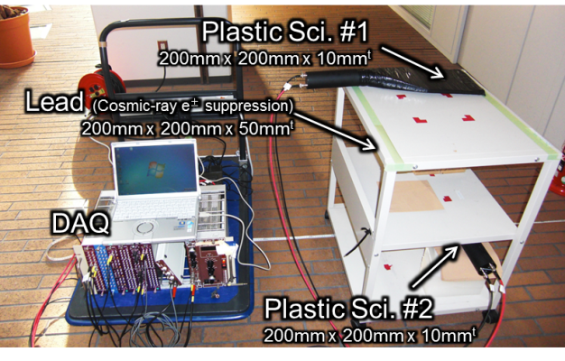
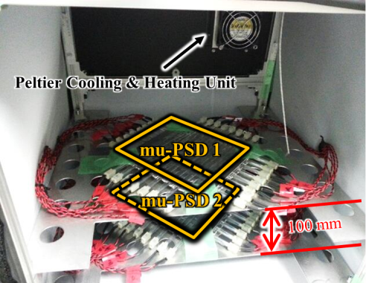
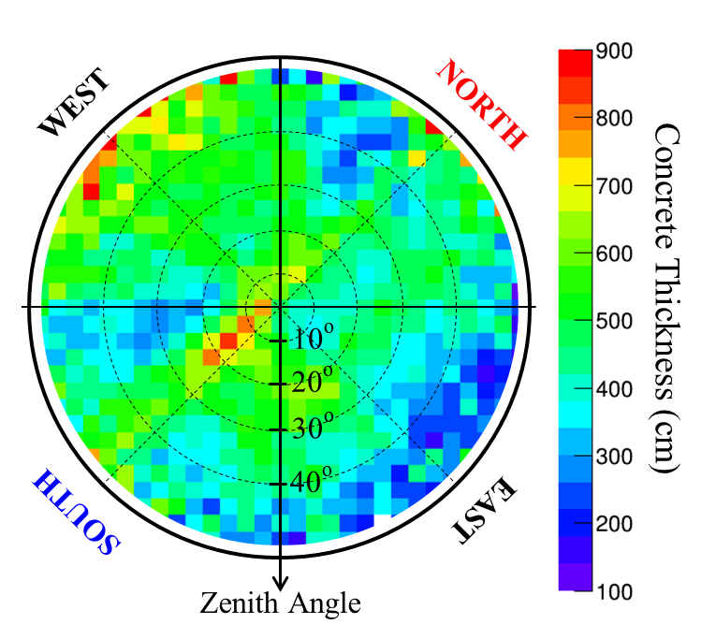
Muography at Kyushu University
Summary
Education of Radiation Metrology
One dimensional muography data was successfully obtained.
Prototype Detector Development
Stable operation is achieved.
Consistent with cos square distribution.
Test Measurement
Two dimensional muography image was successfully obtained.

Slide 19
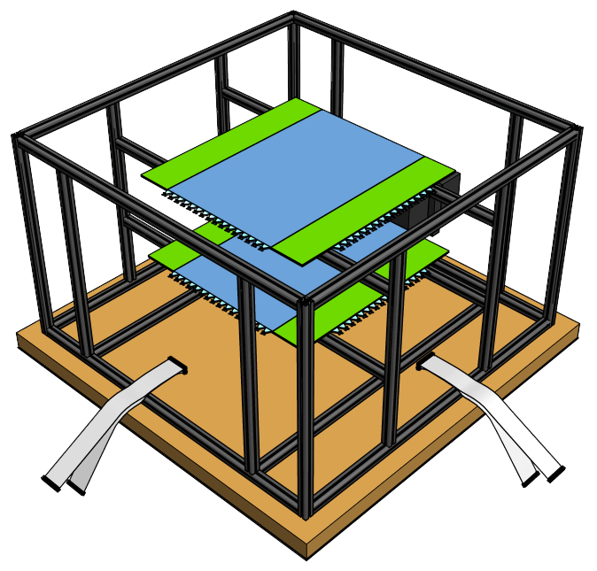
Muography at Kyushu University
Future Tasks
Constructing a New Detector for Practical Use
Maximum limit of “Portable” detector (?)
~800 mm
~800 mm
10 times larger detection area
Thicker and better heat insulator to decrease power consumption for temperature control
Increase number of MPPC for higher resolution
Prototype detector will be used for education of muography.

Slide 20

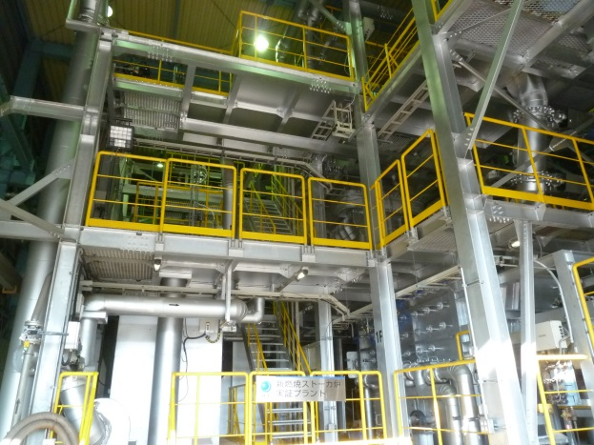
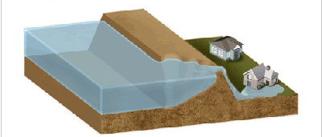
Muography at Kyushu University
Future Tasks
Measurement of Underground Structure
Cosmic-ray muon flux decreases to 25%
at 10m below the ground.
→ Meas. Time will be less than 4 days
The prototype detector: more than 1 month.
←Cavity
~10m
Tunnel, Underground pit, etc.
←The New Detector
Measurement of Artificial Structure
Furnace, Levee, Dam, and so on.
→ The first two will be measured
also by the prototype
Stoker Furnace
Development of Analysis Method using AI for Correction of Flux Daily Deviation.
atmospheric pressure, air temperature, solar activity, anisotropy of primary CR,…

Slide 21
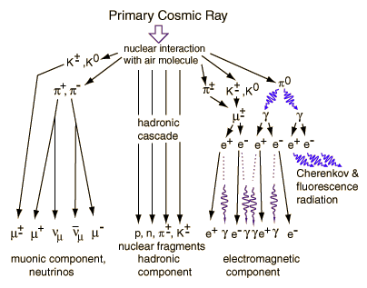
Coincidence Detection
Time of Flight Method
Cosmic-ray muon is available everywhere on earth.
Detection efficiency is almost 100 %.
Principle of important radiation technique can be adopted.

Slide 22
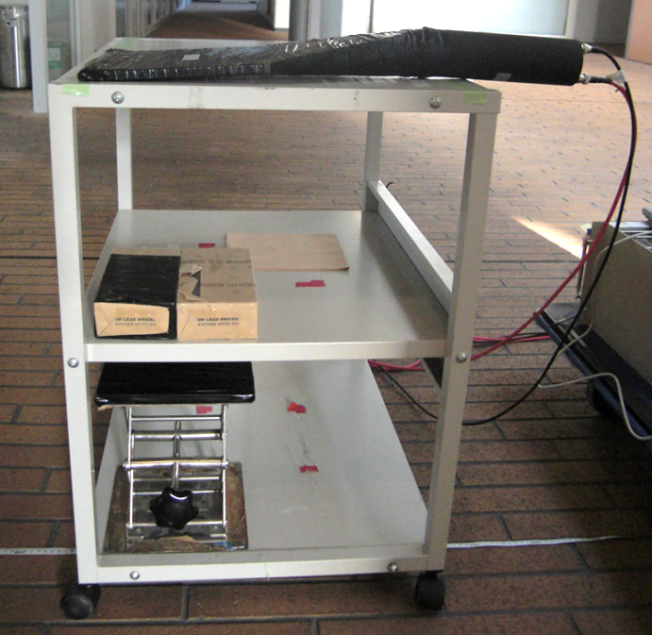

40cm
muon
Plastic Sci. #1
200mm x 200mm x 10mm^{t}
Lead (Cosmic-ray e± suppression)
200mm x 200mm x 50mm^{t}
DAQ
Plastic Scintillator
(200mm×200mm×10mm^{t})
Plastic Sci. #2
200mm x 200mm x 10mm^{t}

Slide 23
Plastic Scintillating Fiber (2mm x 2mm, SQ)
Multi Pixel Photon Counter (MPPC, SiPM)
Temperature Control System (ΔT ~0.2 ºC, <120W@T_{diff}=30 ºC)
EASIROC Module[1] (64ch MPPC readout module)
Portable （450x450x450mm）
Resolution >30msr
  Detector Requirement
Portability:
Low Power Consumption:
Spatial Resolution:

Slide 24
10¹
Electrical Resistivity Tomography
Seismic Survey
10⁰
Spatial Resolution (m)
Estimated Requirement
10⁻¹
Ground-penetrating Radar
10⁻²
10⁻¹
10⁰
10¹
10²
Exploration Depth (m)

Slide 25

90º
NORTH
EAST
135º
45º
φ
180º
0º
10º
20º
30º
40º
-135º
-45º
WEST
50º
SOUTH
θ

