Slide 1
Great Pyramid of Giza and the Aseismatic Structure: Potential of Muography
Michinori Ohshiro (Komazawa University, Japan)
Notes:
From ancient time until now, the Great Pyramid of Khufu of Giza has been considered as a great enigma. Many historians, archaeologists, architects, and scientists have challenged to solve the riddle. However, even fundamental questions such as “for what purpose it was built” or “how it was built” (big questions) still remain unsolved

Slide 2
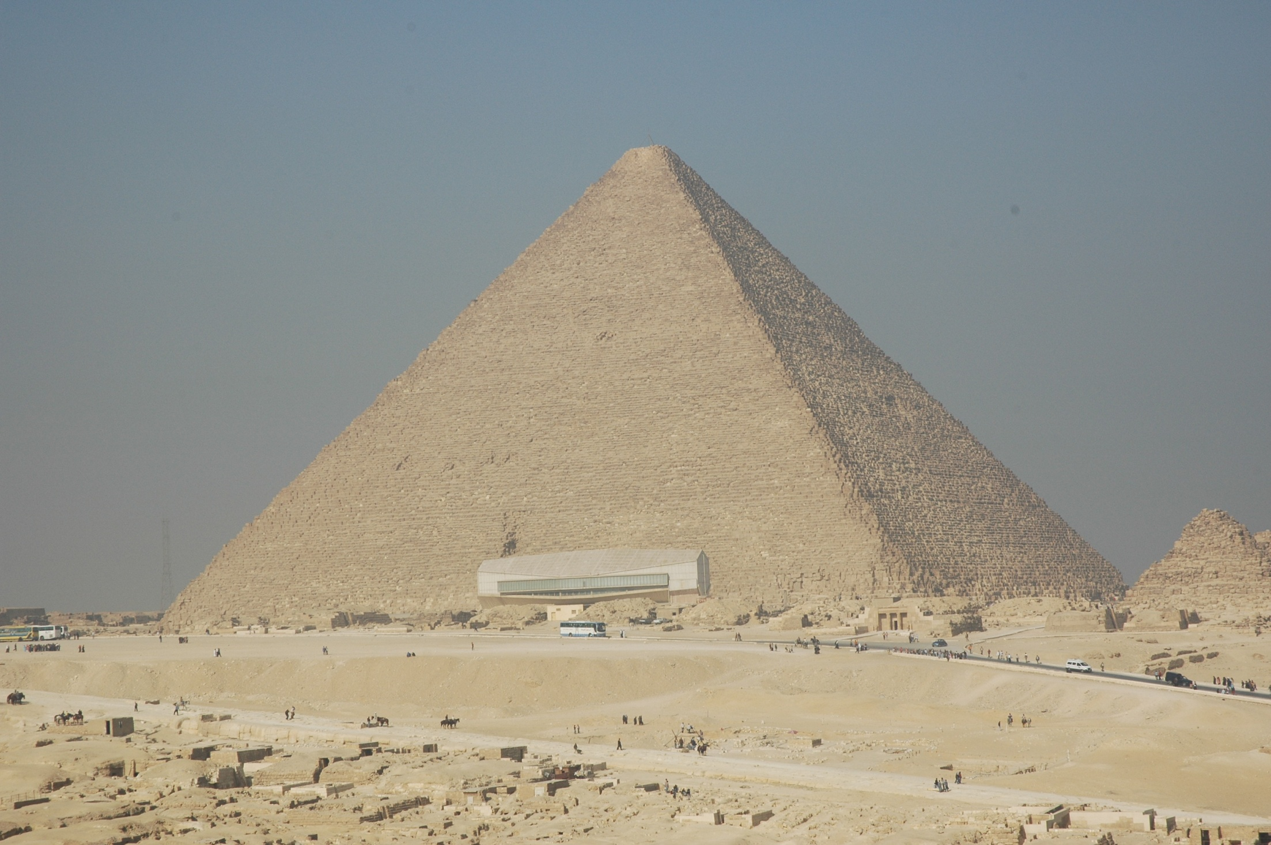
Pyramid of Khufu in Giza

Slide 3
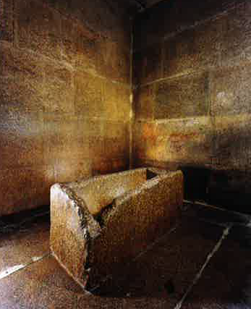
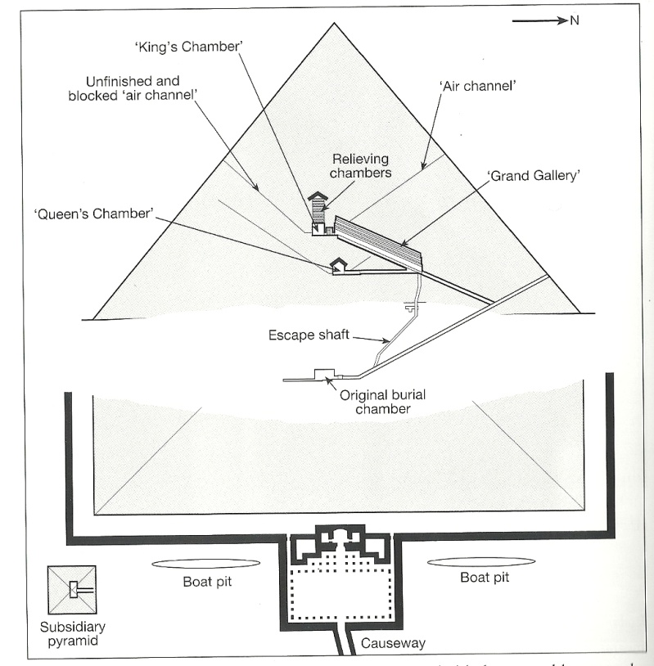
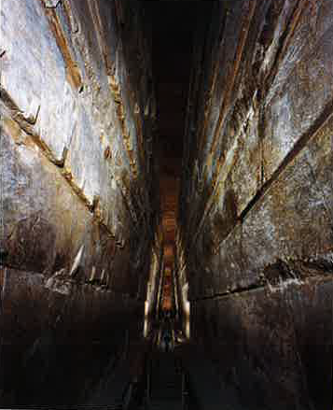
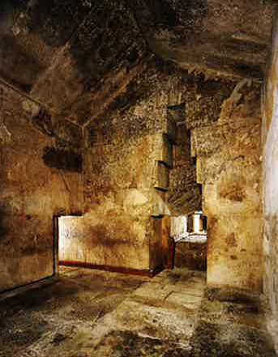

Slide 4
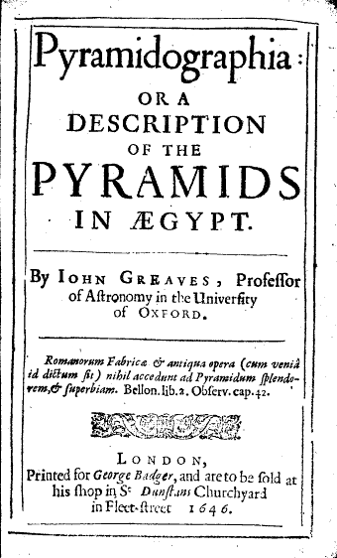
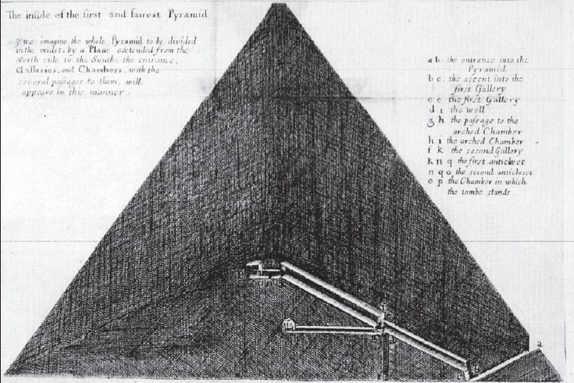

Slide 5
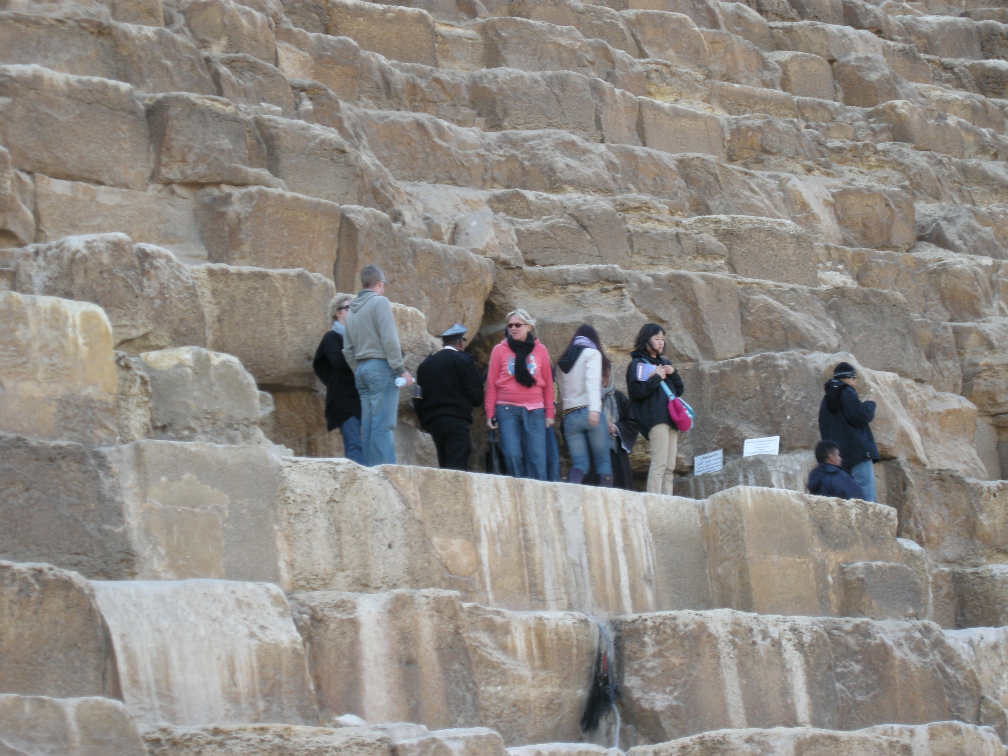

Slide 6
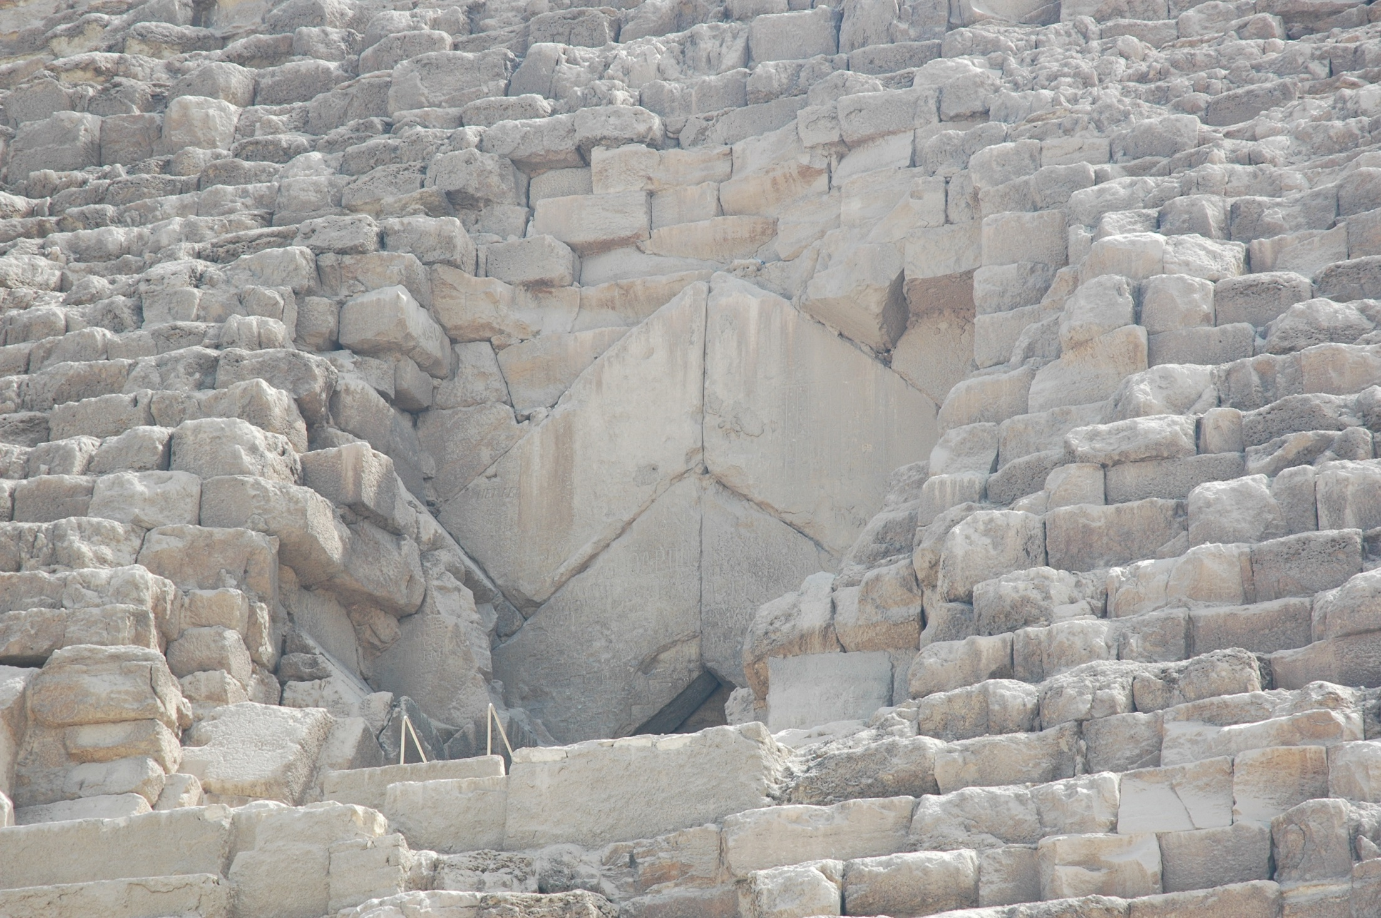

Slide 10
Notes:
However, more than 90% of inside of the Great Pyramid is unsure. No one has ever seen the inside. Maybe undiscovered chambers within the Great Pyramid remain in tact. It means that king’s mummy (maybe Khufu) and grave goods (maybe treasures) will be there even now. Many Egyptologists including historians, linguists and archaeologists have been tried to understand what is the Great Pyramid by reading Hieroglyphic documents on the reliefs and papyrus. Also many scientific approaches such as radar survey and the use of robots have often been applied to the Great Pyramid of Giza. But unfortunately these don’t have unveiled the mystery. So we are looking for new approaches to the Great Pyramid. So I give great attention to Muography because it is possible to reach nearer to revealing the Massive stone structure such as pyramids.

Slide 11
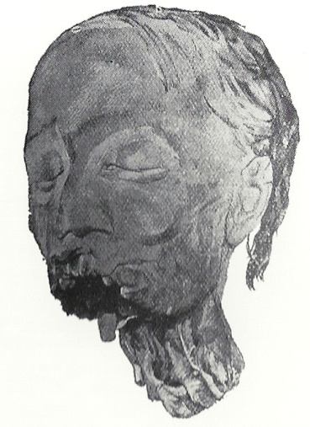
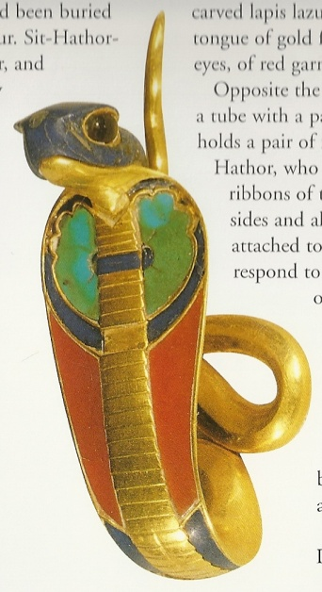
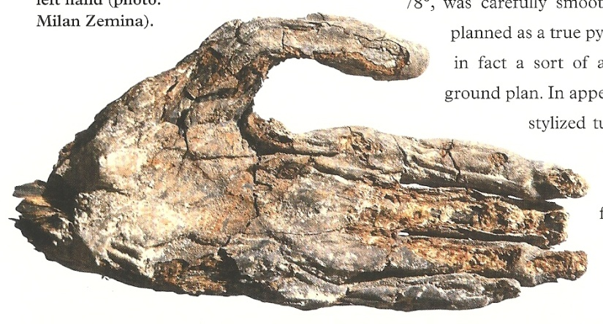
My final goal is not only to find the mummies and the treasures of pharaohs and undiscovered space, but also to unveil the secret of the Aseismic (earthquake-proof structures) structure of the Great Pyramid of Giza, Khufu.
Notes:
This is a head of mummy from pyramid. This is a hand of mummy from pyramid. This is a symbol of pharaoh, we call it Uraeus, made of gold with lapis lazuli, turquois and carnelian. This is definitely a symbol of the kingship. Everything is belongs to the Egyptian kings. The Great pyramid of Khufu may have something like this or more.
However, My final goal is not only to find the mummies and the treasures of pharaohs and undiscovered space, but also to unveil the secret of the Aseismic structure of the Great Pyramid of Giza.

Slide 12
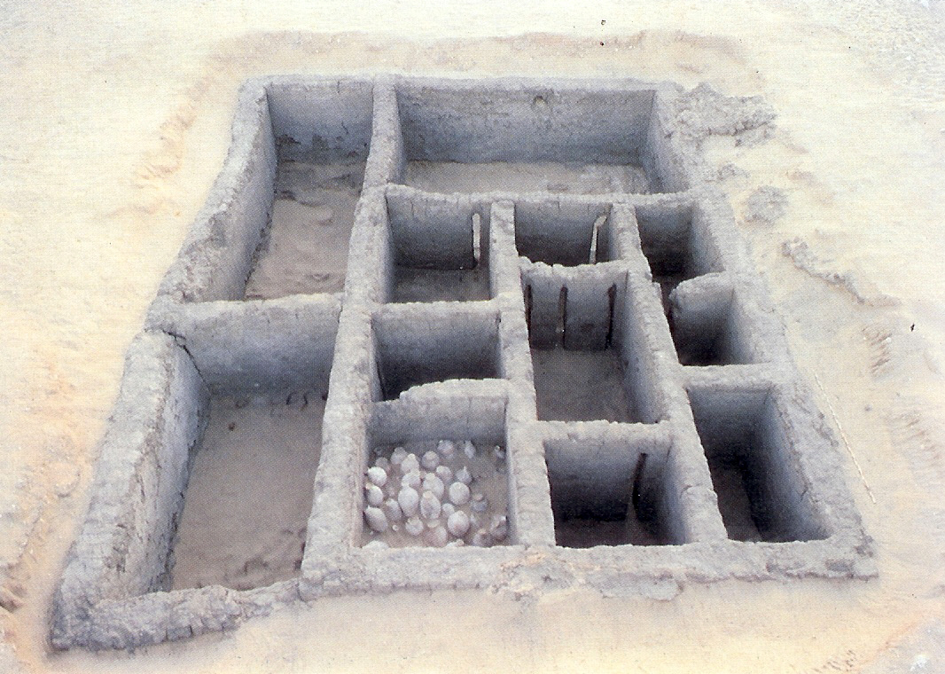
Simple graves: Early Egyptian kings’ tombs were comprised of brick-lined cuttings in the desert gravel. They had many store rooms for funerary goods and servant’s graves. Some of them had a stairway from the outside. The superstructure was completely destroyed today.

Slide 13
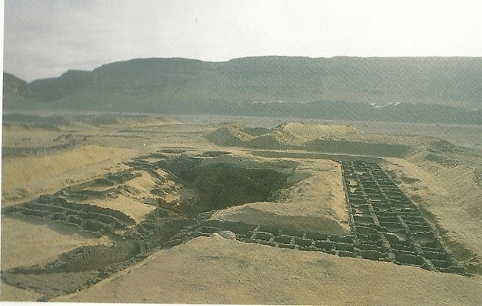
Tomb of King Den

Slide 14
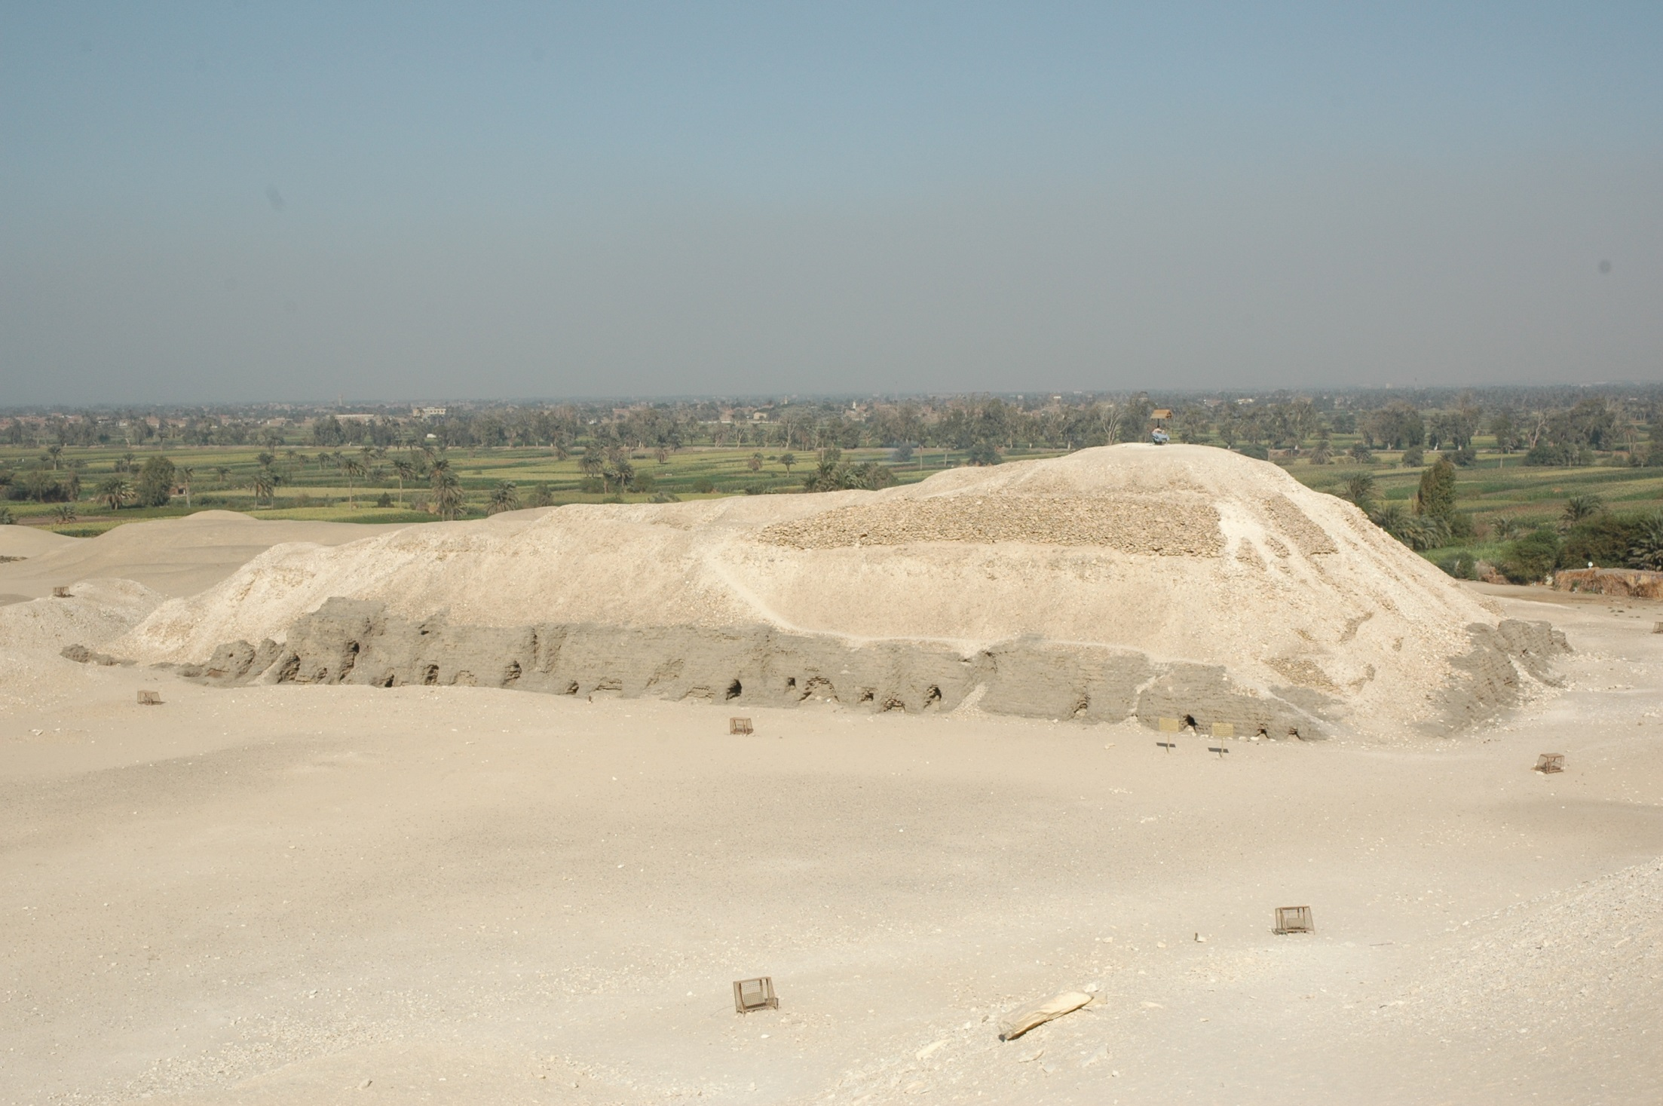
Mastabas: These had rectangular superstructures made of mud-bricks or stones. Some of them had elaborately decorated internal chambers. The burial chamber and store rooms were located below ground.
Notes:
Mastaba was the next step. The graves were getting bigger.

Slide 15
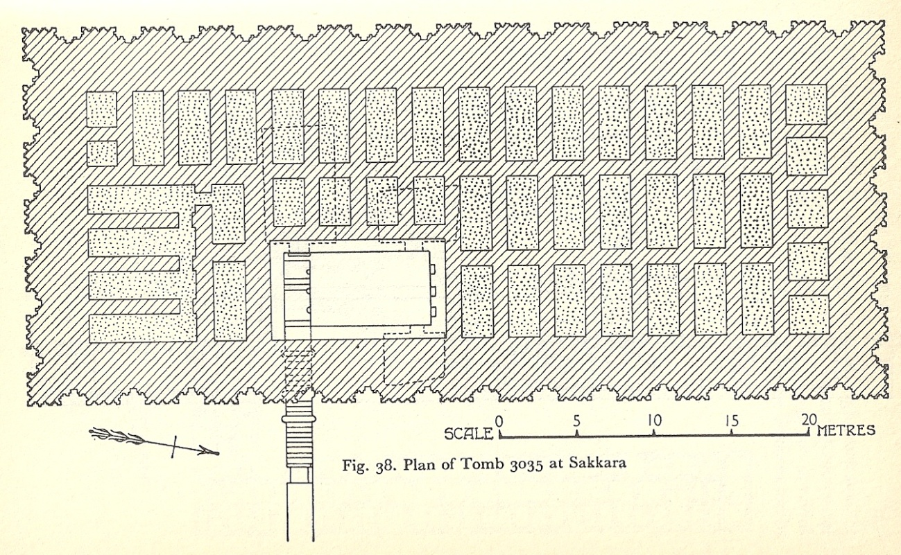
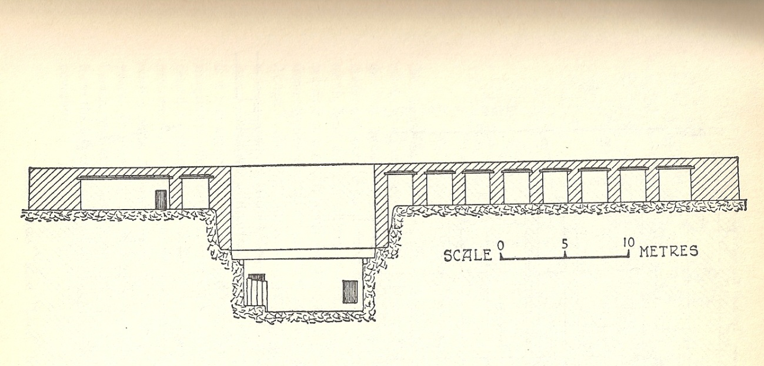
ground plan
cross-section drawing

Slide 16
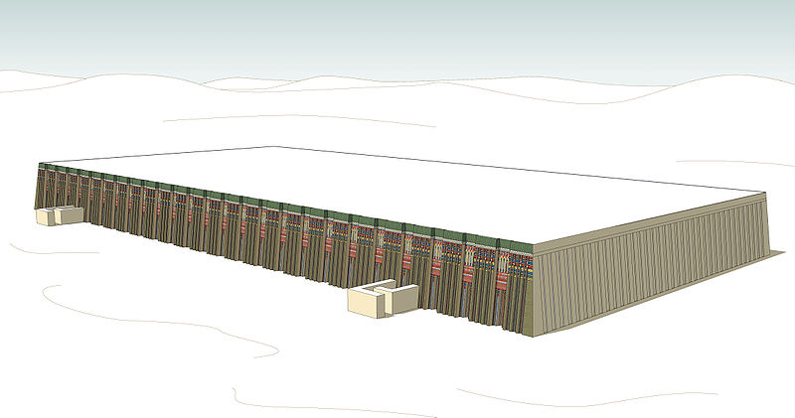
Notes:
Reconstruction of Mastaba.

Slide 17
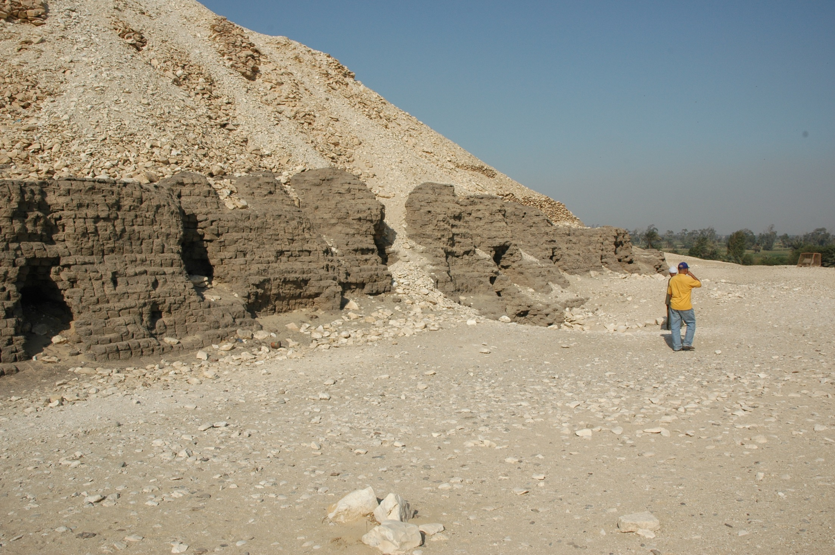

Slide 18
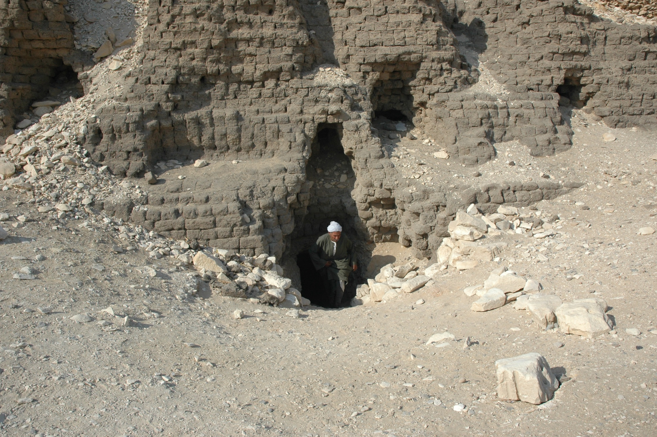
Notes:
I’ll show you the understructure of Mastaba.

Slide 19
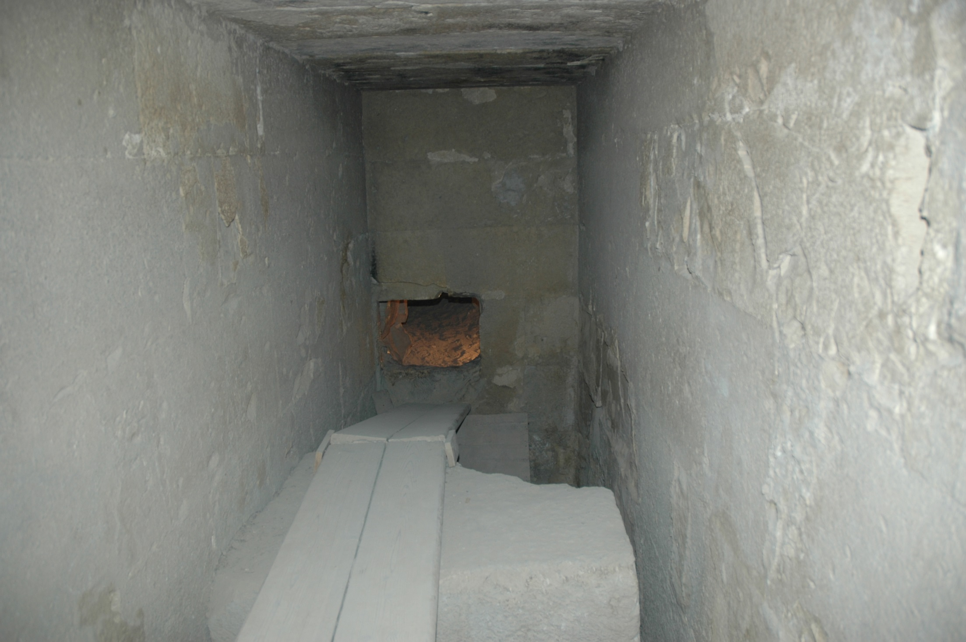

Slide 20
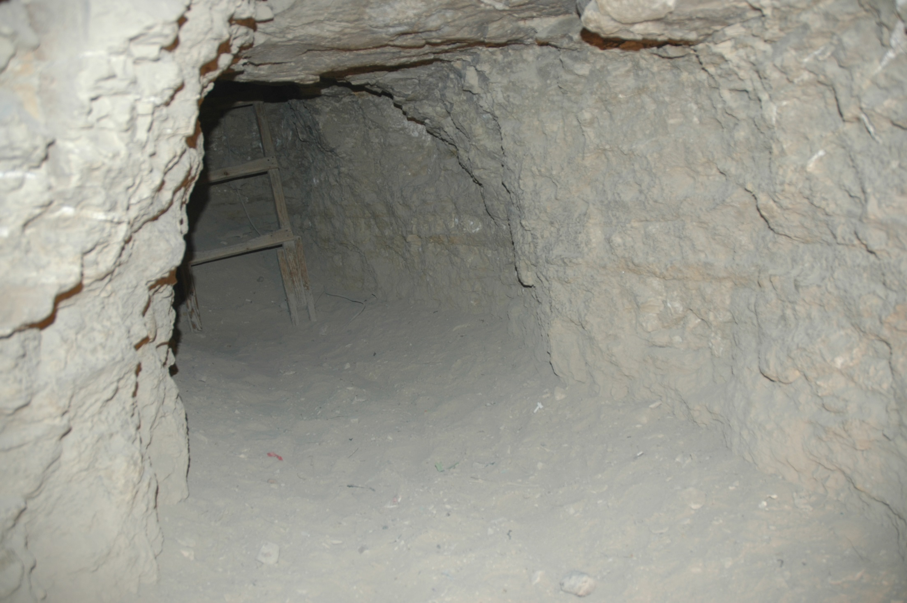

Slide 21
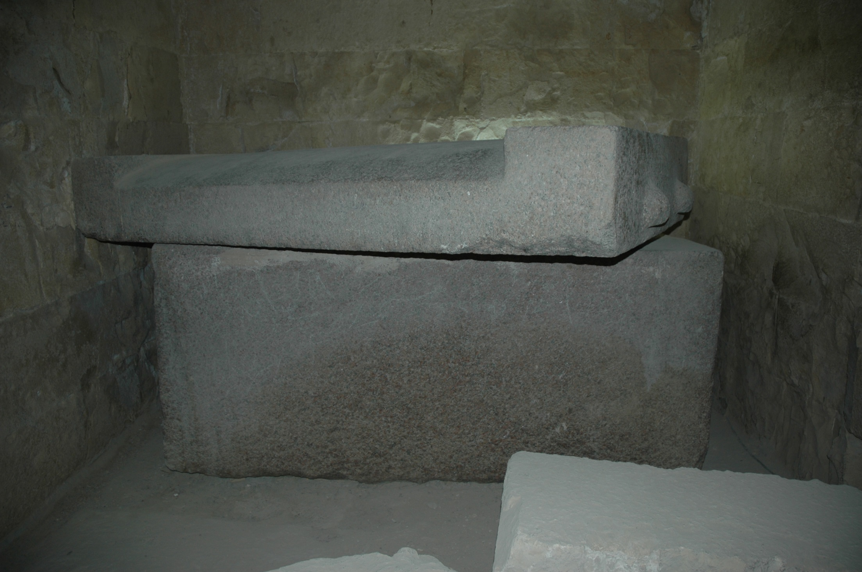
Notes:
sarcophagas

Slide 22
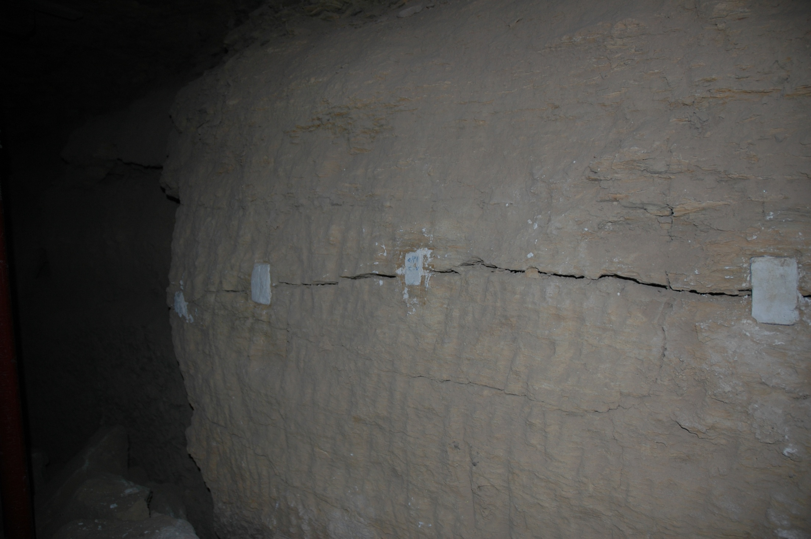

Slide 23
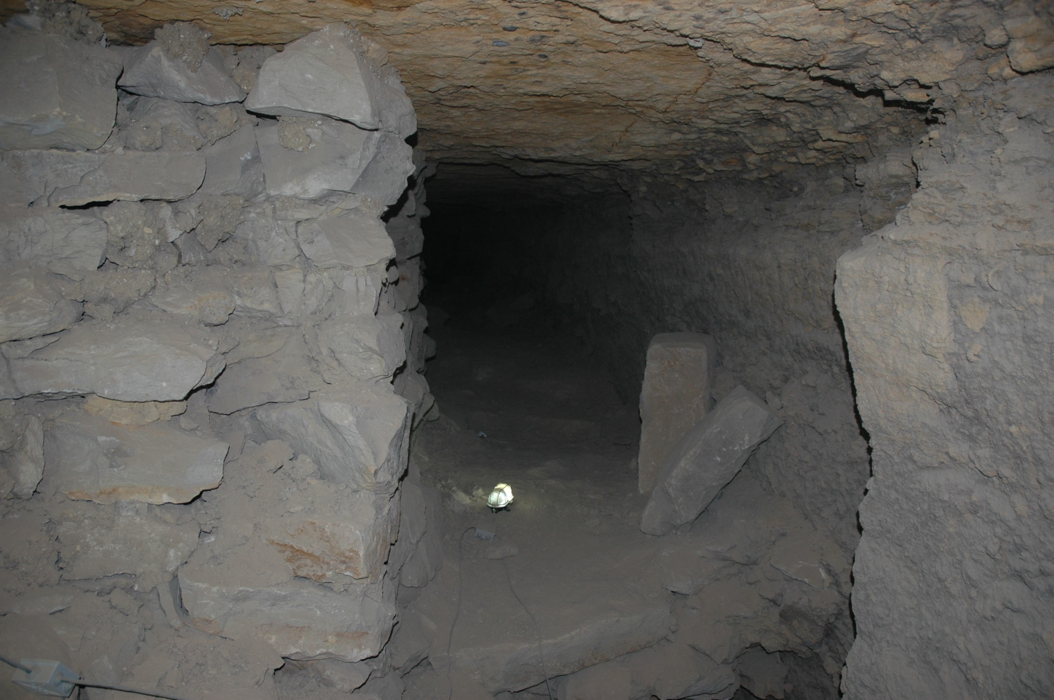

Slide 24
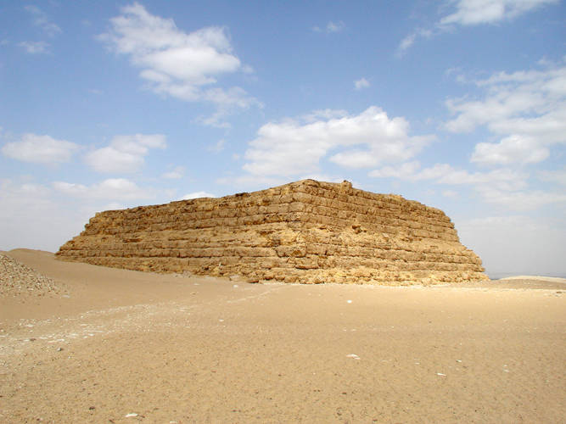
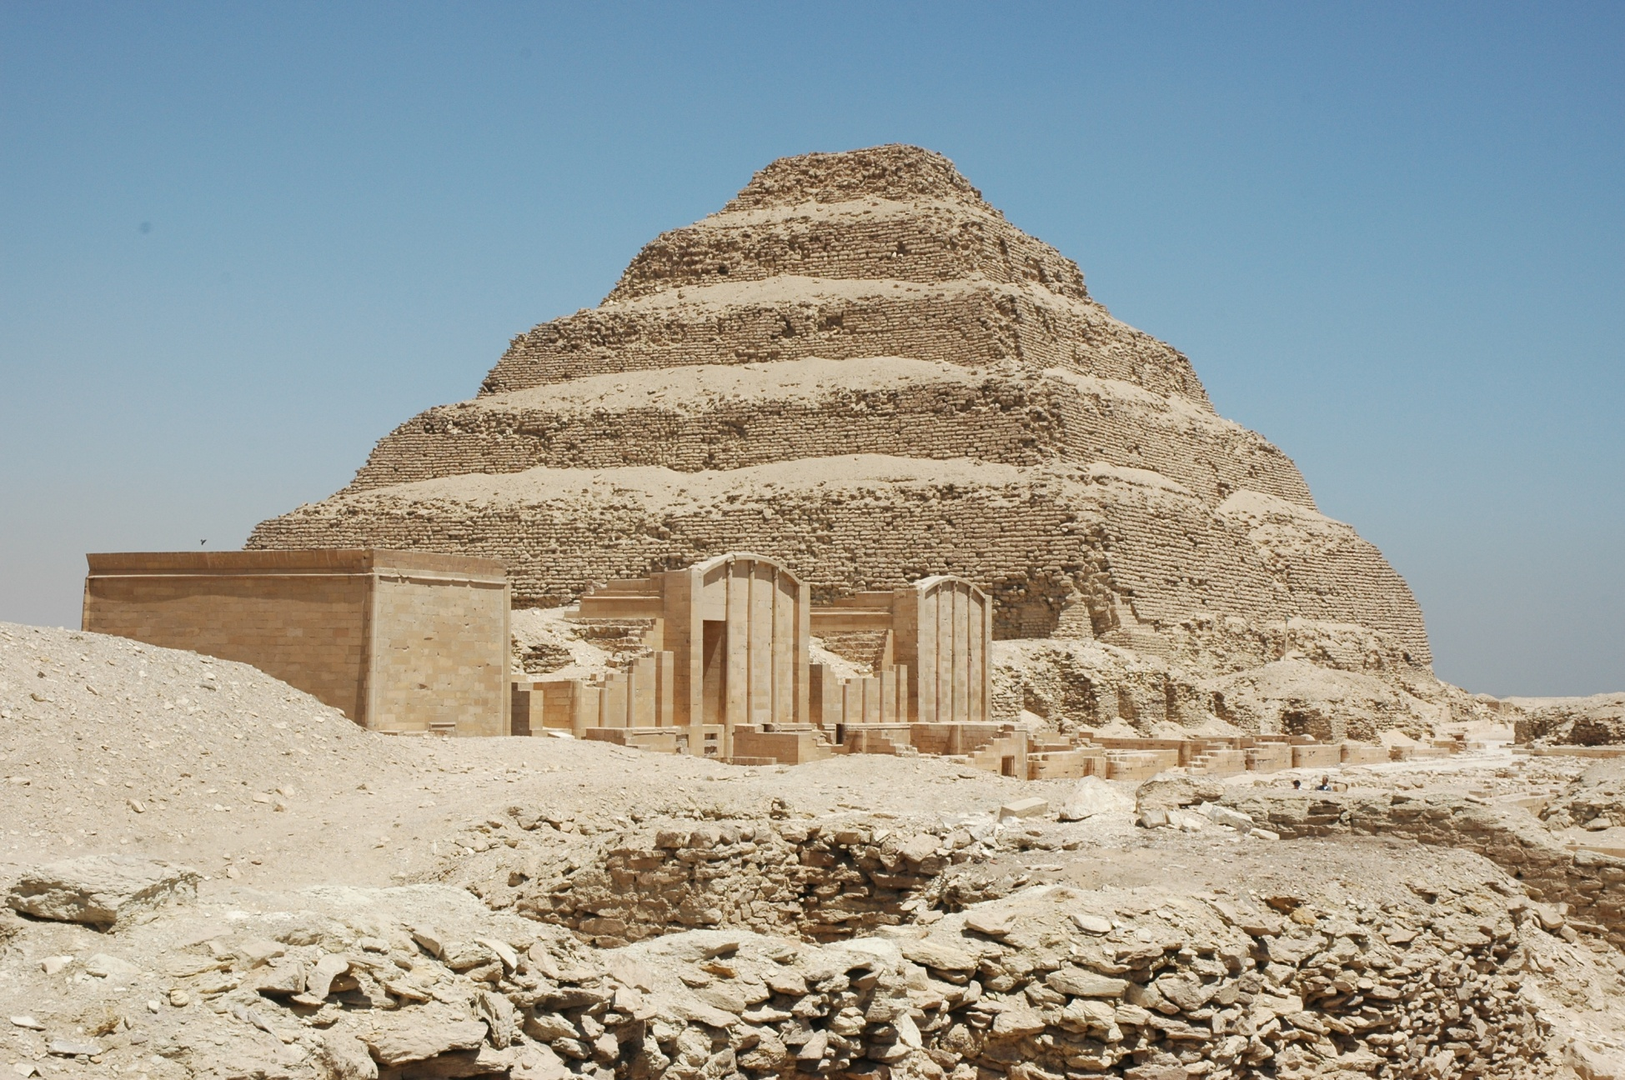
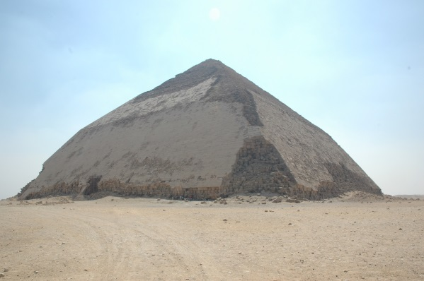
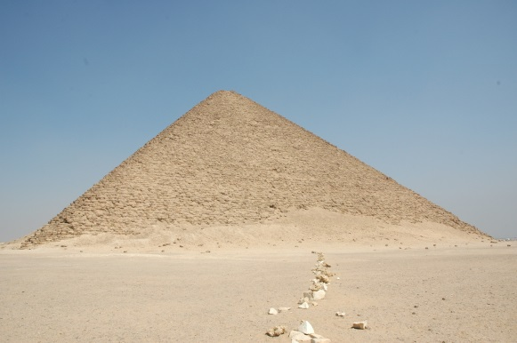
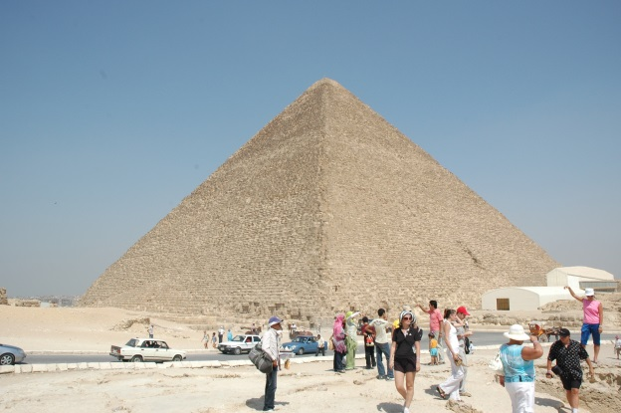
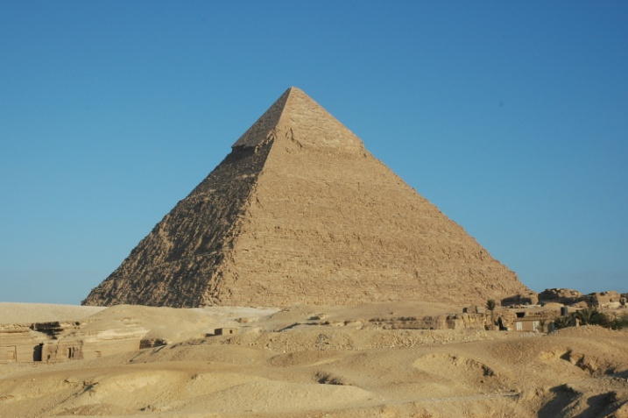
The Transition of the Superstructure of Pyramids
Mastaba
Step Pyramid in Saqqara
Bent Pyramid in Dahshur
True Pyramid (Red Pyramid) by Snefer in Dahshur
True Pyramid by Khufu in Giza
True Pyramid by Khafra in Giza
Notes:
This is the chart of the transition of the superstructure of pyramids. The king’s tombs made progress from Mastaba (trapezial shaped tomb) to true pyramid.
There is a truth that Step Pyramid in Saqqara, the Bent Pyramid in Dahshur and Red Pyramids in Dahshur, and Great Pyramids of Giza (Khufu and Khafra) have stood the test of time through major earthquakes. These pyramids are still standing now.

Slide 25

Pyramid of Khufu in Giza
If we have the opportunity to use muography to the above mentioned pyramids, we can put an end to speculation as to the evolution theory of the pyramid from the viewpoint of earthquake-proof structures and advancement of civilization.
Notes:
If we have the opportunity to use muography to the above mentioned pyramids, we can put an end to speculation as to the evolution theory of the pyramid from the viewpoint of Aseismic structure (earthquake-proof structures) and advancement of civilization.

Slide 26
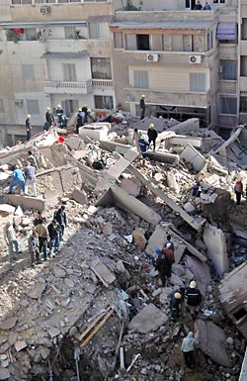
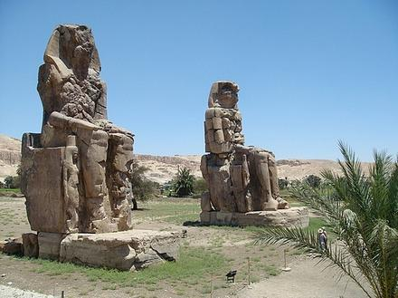
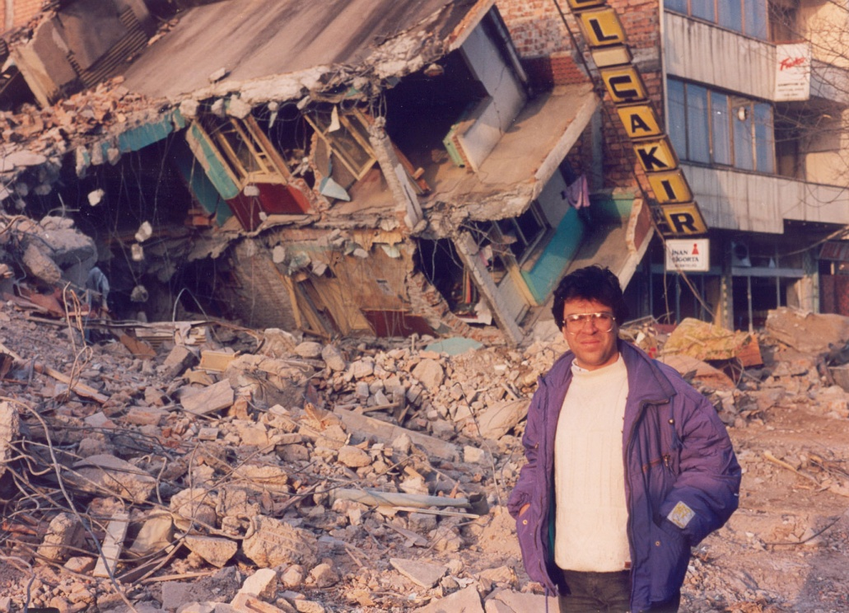
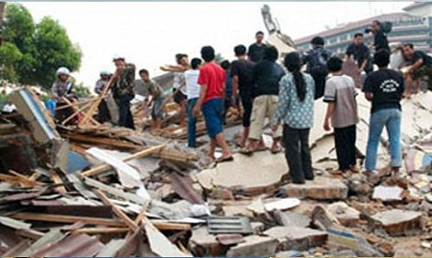
Luxor in Egypt
Cairo in Egypt
Notes:
Major or Mega earthquakes in Egypt are know to have collapsed great stone statues and shrines in Thebes (Luxor) and the capital city Alexandria during ancient time, and also Cairo in 1992.
Now it’s important to know the secret of the Aseismic structure. Especially it would be of great value to countries prone to massive earthquakes such as Japan and Italy.

Slide 27
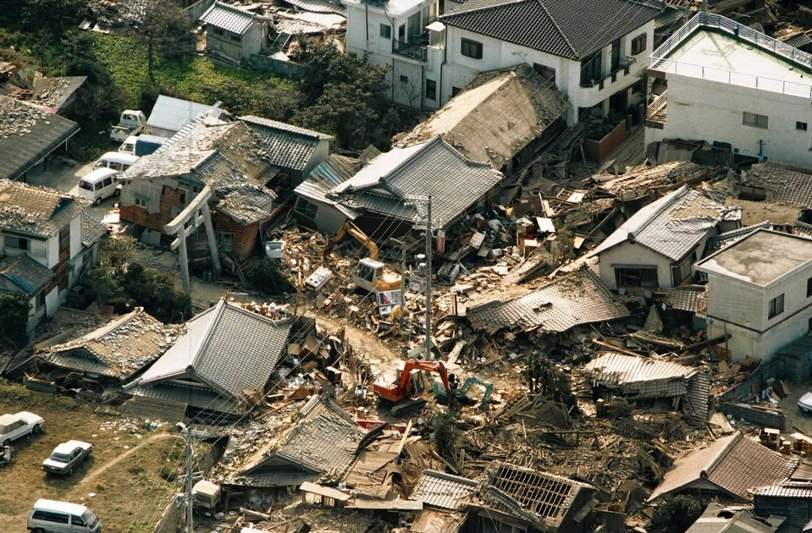
Kobe in 1995
Notes:
Earthquake in Kobe.

Slide 28
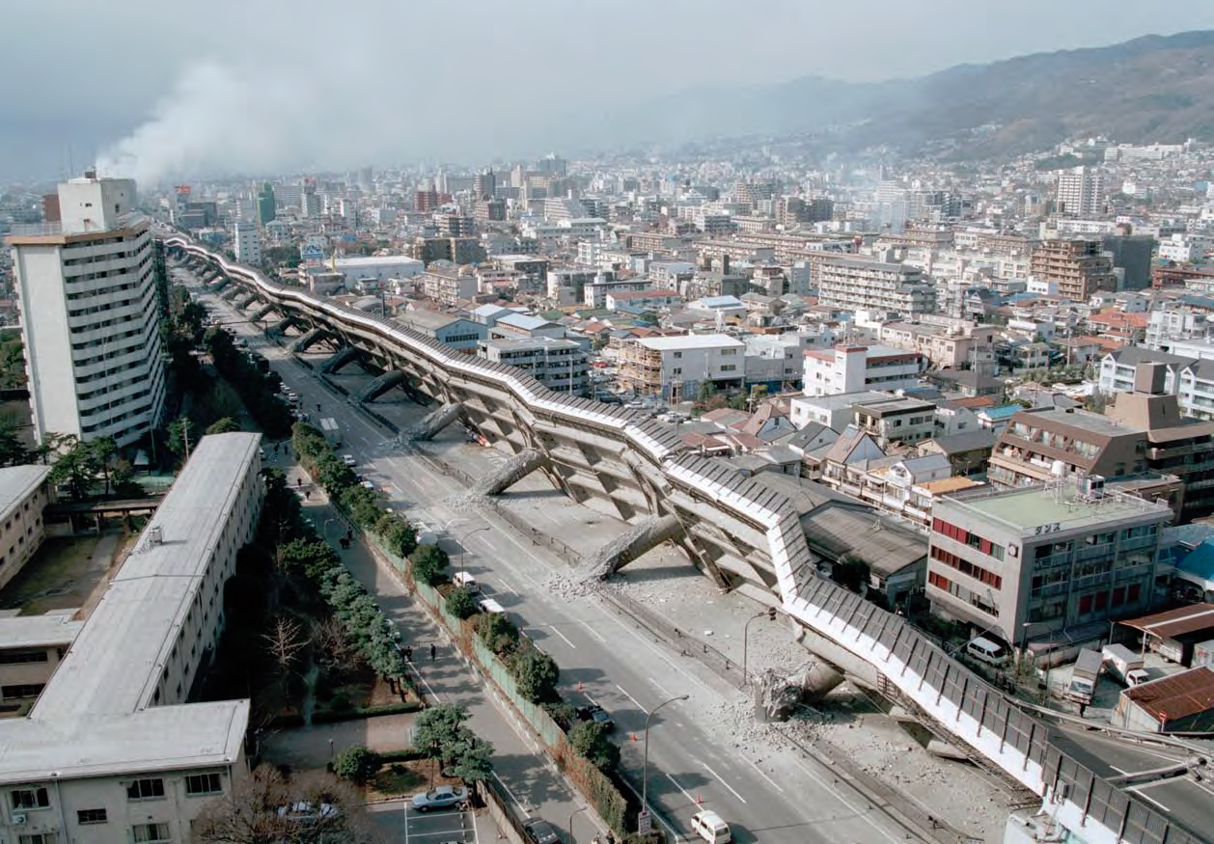
Kobe in 1995
Notes:
To know the structure of pyramids is to save our life in my opinion.
Unexpectedly, the only way to acquire such information (that is more precious than golden treasures), left by the ancient Egyptians, is muography (which enables a detailed perspective of the great megalith structure).
Muography is the state-of-the-art, non-destructive technique for unveiling the human-history and structural mysteries of pyramids.

Slide 29
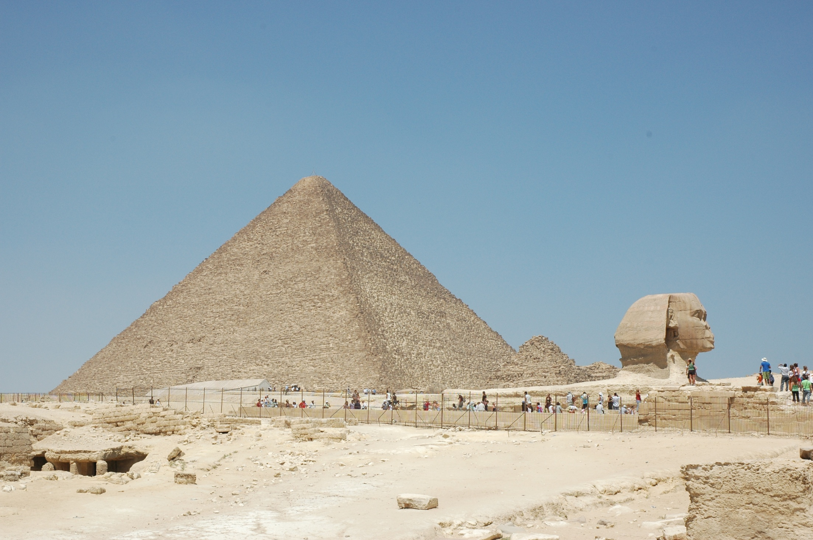
What could be revealed by muography to the Great Pyramid by Khufu now?
Notes:
So what could be revealed by muography now? In particular, what can we know the structure?

Slide 30
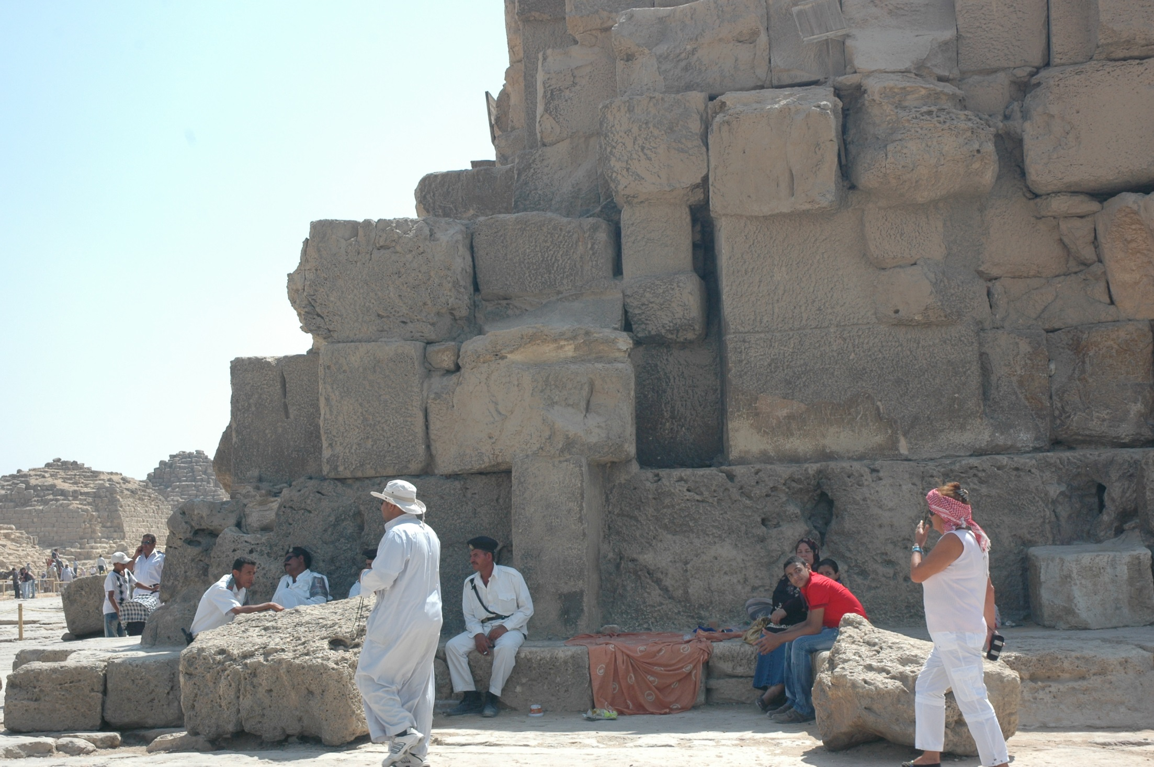
If it can be made clear where two different kinds of stones (lime stone and granite) were used, we can have the information ①how much volume of stones were used for the pyramids and ②how did it build. So we can take possession of previously-unattainable new information in the study of Aseismic (earthquake-proof structures) of pyramids.
Notes:
You can see the different size of stones. And it is known that Ancient Egyptians used different kinds of stones, lime stone and granite to the pyramids.
It means that if it can be made clear where two different kinds of stones were used, we can have the information ①how much volume of stones were used for the pyramids and ②how did it build. So we can take possession of previously-unattainable new information in the study of Aseismic (earthquake-proof structures) of pyramids.

Slide 31
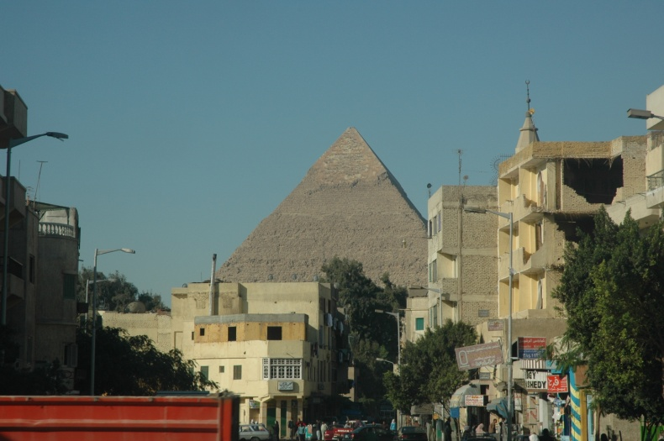
Pyramid of King Khafre (Second Great Pyramid of Giza)
①How much stones were used for the pyramid of Khufu? (Hiroyuki K. M. Tanaka and Michinori Ohshiro, Muographic data analysis method for medium-sized rock overburden inspections, Geosci. Instrum. Method. Data Syst., 5, 427–435, 2016 www.geosci-instrum-method-data-syst.net/5/427/2016/ doi:10.5194/gi-5-427-2016)
＊This article made clear that it was 30% less heavy than has long been accepted. Also it suggested that there is a possibility that it could change part of the established theory, such as how long it took to build it.
Notes:
Prof. Hiroyuki Tanaka and I already have published an article about this problem (Number ①) using the muographic data of another great pyramid of Giza (king Khafra) collected by Louis Alvarez in 1968.
This article made clear that it is 30% less heavy than has long been accepted. Also it suggested that there is a possibility that it could change part of the established theory, such as how long it took to build it.

Slide 32
Pyramid of Khafre: The height is 143m and the angle is around 53 degrees (Khufu: The height is 146m and the angle is around 52 degrees).
Hiroyuki K. M. Tanaka and Michinori Ohshiro, Muographic data analysis method for medium-sized rock overburden inspections, Geosci. Instrum. Method. Data Syst., 5, 427–435, 2016 www.geosci-instrum-method-data-syst.net/5/427/2016/ doi:10.5194/gi-5-427-2016)
Notes:
The size of pyramids of Khufu and Khafre are not so different. So this article is very useful for the pyramid studies, especially Khufu.

Slide 33
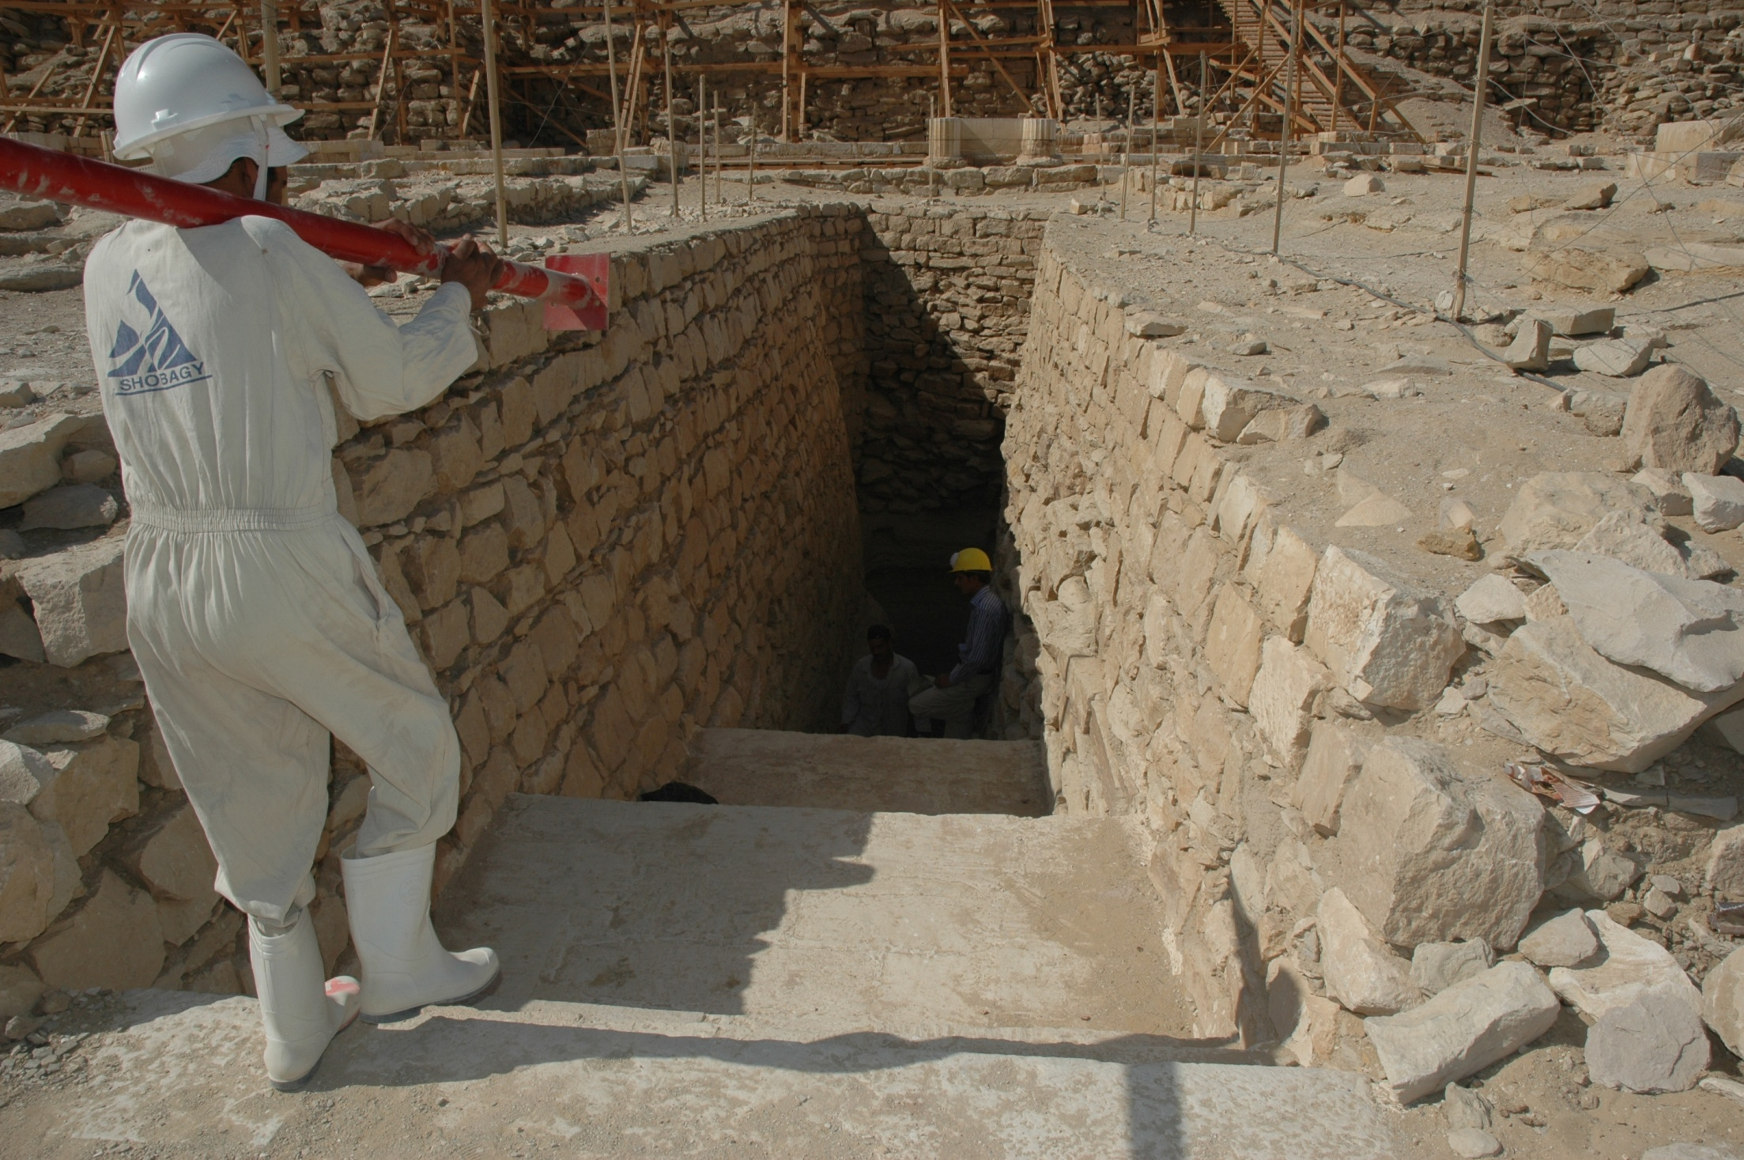
②How was the pyramid of Khufu built?
Notes:
Second question is how was the pyramid of Khufu built?

Slide 34
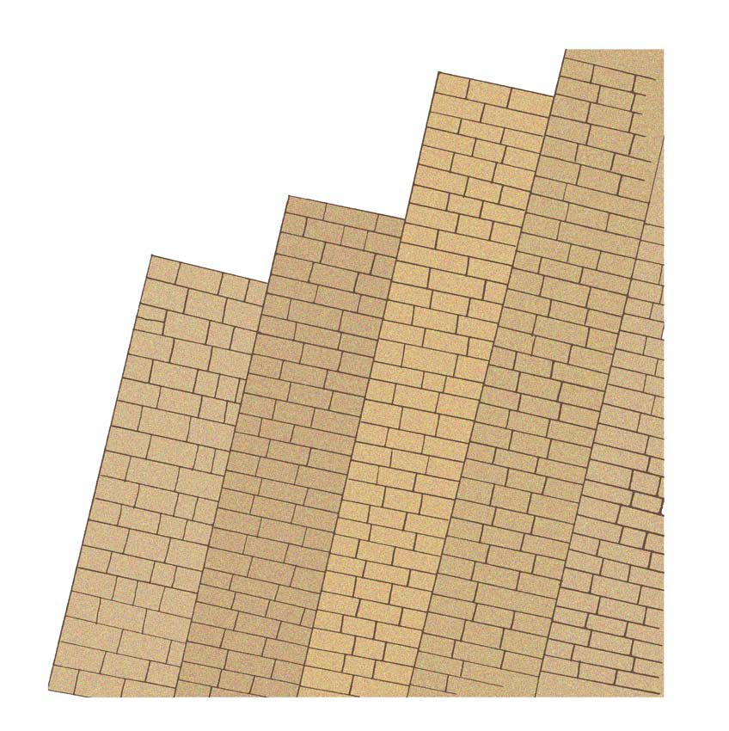
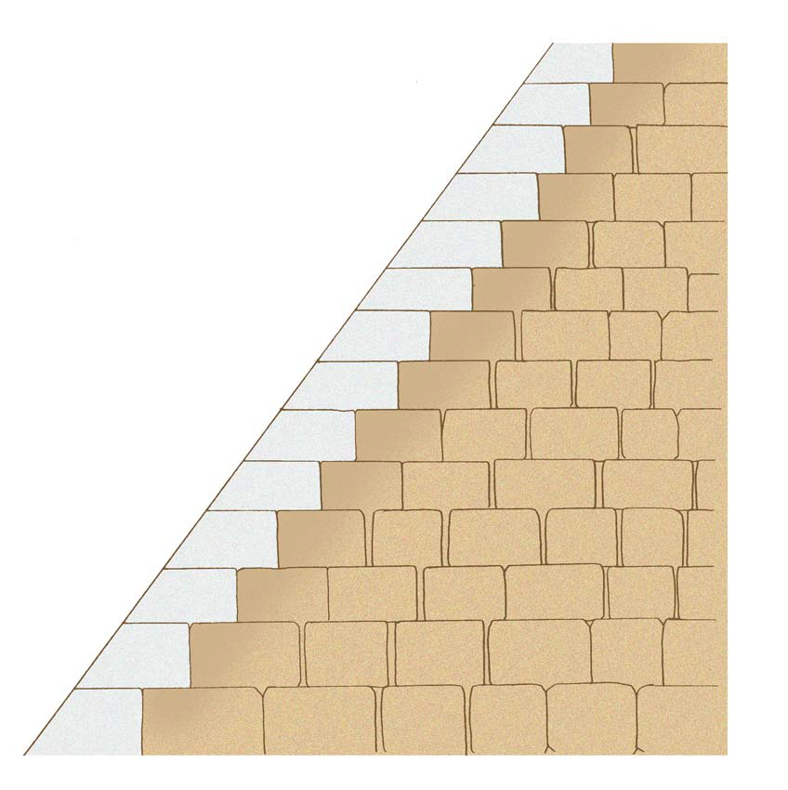
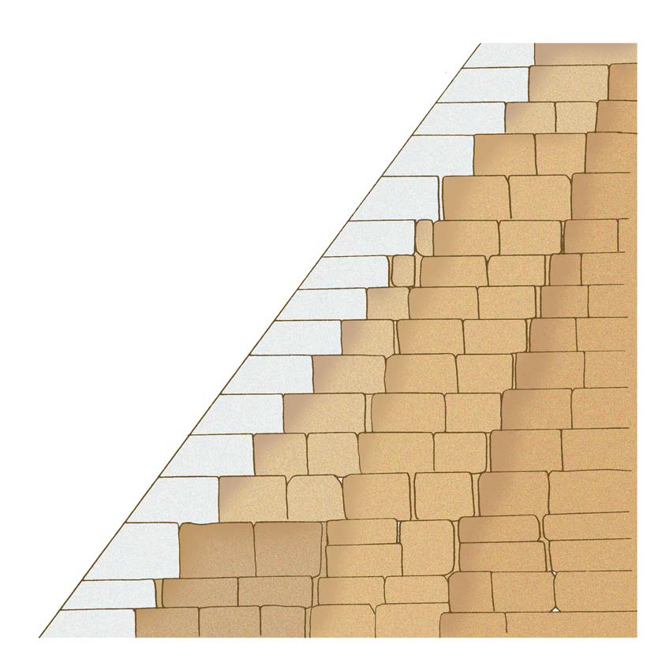
①Piling stone obliquely to the centre in layers
②piling stone horizontally to the top
③=①＋②
Notes:
Basically three types of masonry used in construction of the Pyramids are currently known. ①Piling stone obliquely to the centre in layers
②piling stone horizontally to the top
③=①＋② (combine ① and ②)

Slide 35
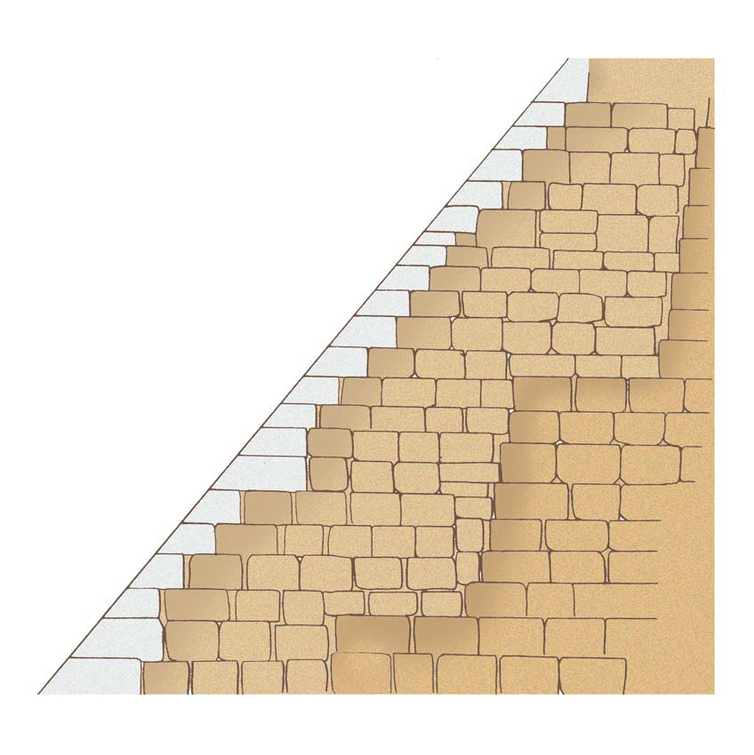
Notes:
Moreover some hypotheses have been proposed concerning the masonry of the pyramids, such as Great Pyramid of Khufu.
This is one of them. Firstly the foundation and core were composed of stone or sun-dried bricks like the step pyramid. Then stones piled on top. It means that the pyramid has a core made of bricks.

Slide 36
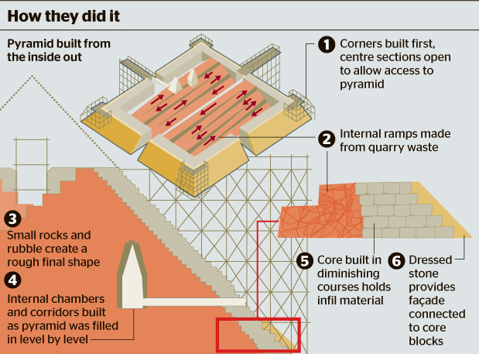
Peter James assumed that there are internal ramps made from Quarry waste
Core made of stone bricks
Surface (dressed stones)
Notes:
This is the theory by Peter James (Welsh engineer). He assumed that there are internal ramps made from quarry waste. Stuffed waste in the space.

Slide 37
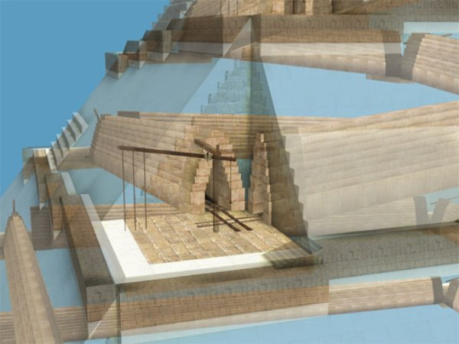
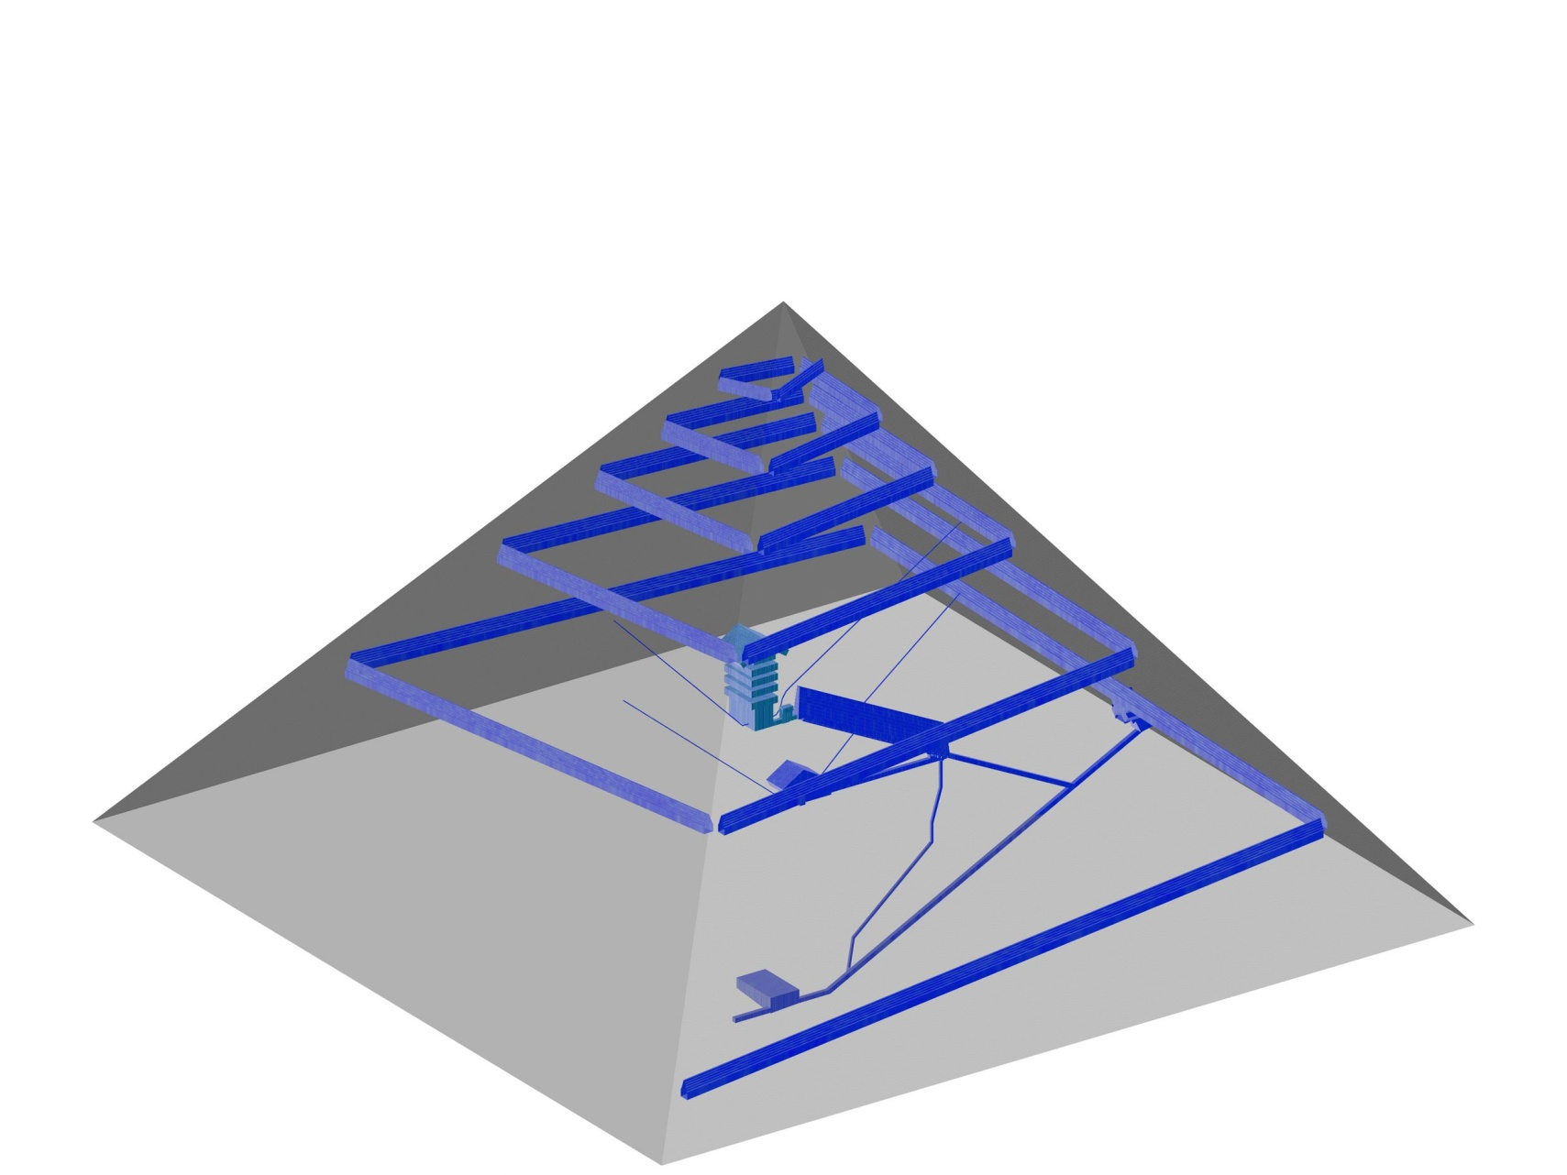
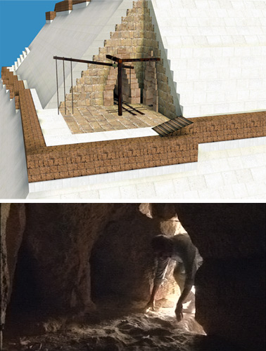
Jean-Pierre Houdin are claimed to have used a spiral slope to carry stone inside of the pyramids.
Notes:
Also Jean-Pierre Houdin are claimed to have used a spiral slope to carry stone inside of the pyramids.
Each hypothesized method lacks detail and demonstration, while ignoring the aseismic structure and construction period of the Great Pyramid of Khufu.

Slide 38
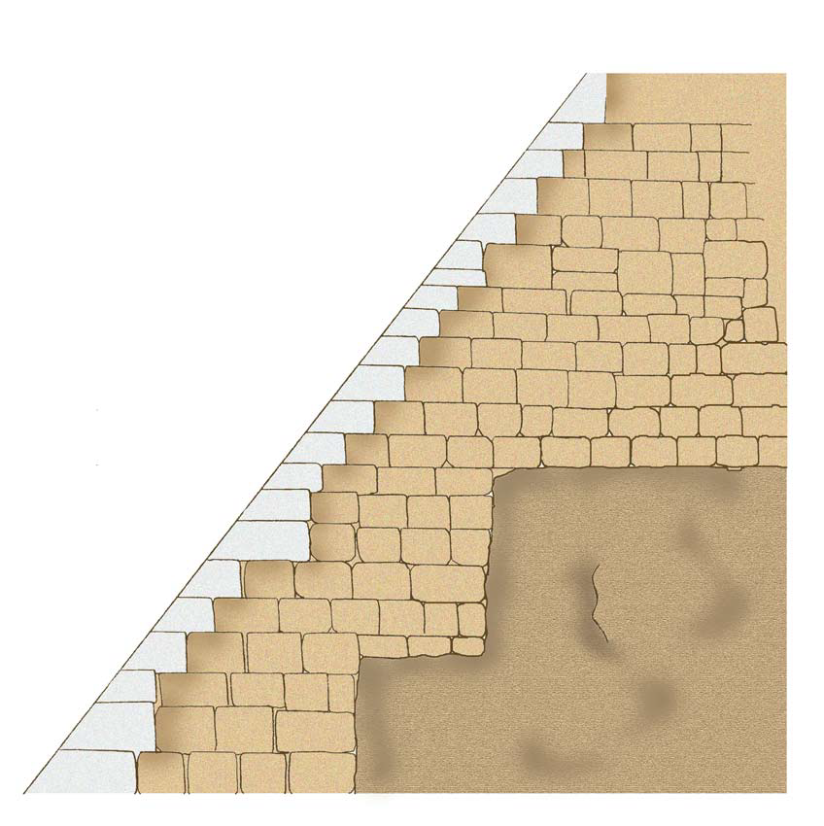
I hypothesize that there is an extensive natural rock originally at the foundation (for example 20% to 30% of the volume of the pyramid). The natural rock was sculpted and adjusted into the terraced or trapezoid core.
Notes:
So I hypothesize that there is an extensive natural rock originally at the foundation (for example 20% to 30% of the volume of the pyramid). The natural rock was sculpted and adjusted into the terraced or trapezoid core like this. It looks like very stable.

Slide 39

Notes:
This is an image. Men at work there. Some workers are conveying stone bricks and sculpting the core rock. I think that they were not slaves but professional because they need skill and special technique.

Slide 40
I propose that the proportion is much larger than previously thought. I consider this because of the earthquake proof structure of the Great Pyramid of Khufu. If extensive solid rock was present at the foundation, then the quakeproof Pyramids of Giza can be understand, and both the construction period, estimated to be 20 years or more and the work load earlier estimated to near a hundred thousand people supposed by Herodotus, would be drastically reduced.
Notes:
There has been the idea of using natural base rock. However, (here) I propose that the proportion is much larger than previously thought. I consider this because of the earthquake proof structure of the Great Pyramid of Khufu (and maybe Khafra as well). If extensive solid rock was present at the foundation, then the quakeproof Pyramids of Giza can be understand, and both the construction period, estimated to be 20 years or more and the work load earlier estimated to near a hundred thousand people supposed by Herodotus, would be drastically reduced. This is also the matter of Egyptology and history. This is my business.

Slide 41

①How much volume of stones were used for the pyramids?
②How was the pyramid of Khufu built?
③Which stone (lime stone and granite) is used for which part?
④Are there any hidden space (rooms) inside?
Notes:
I introduced some hypotheses and proposed my idea but very little is known about pyramids including the masonry used in their construction. This is the present situation.
However, through muography, due to the difference in density between the two kinds of stone (lime stone and granite), the following questions will be answered.
①How much volume of stones were used for the pyramids?
②How was the pyramid of Khufu built?
③Which stone is used for which part?
And ④Are there any hidden space (rooms) inside?

Slide 42




Summary
We can obtain brand-new information about the inner structure of pyramids through muography. Such information will be invaluable to Japan and other earthquake-prone countries.
Muography is not only a technique to solve the mystery of pyramids, but also to protect human beings from natural disasters including mega earthquake. Muography has great potential to help mankind.
Notes:
In summary, we can obtain brand-new information about the inner structure of pyramids through muography. Such information will be invaluable to Japan and other regions of the world prone to natural disasters including mega earthquake.
Muography is not only a technique to solve the mystery of pyramids, but also to protect human beings from natural disasters including mega earthquake. Muography has great potential to help mankind.

Slide 43

Great Pyramid of Giza and the Aseismatic Structure: Potential of Muography
Michinori Ohshiro (Komazawa University, Japan)
FIN

